Slide 1
Azure AD, B2C, B2B and Libraries
Rory Braybrook
Microsoft Identity Architect
Microsoft MVP (Enterprise Mobility)
Twitter: @rbrayb
LinkedIn: https://www.linkedin.com/in/rory-braybrook-6050a521/
Blog: https://medium.com/the-new-control-plane

Slide 2

















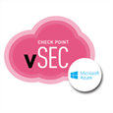

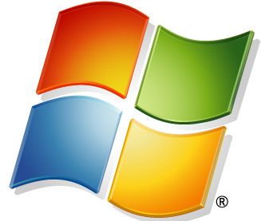




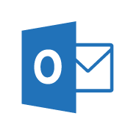
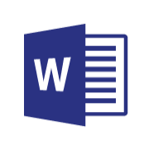
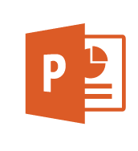
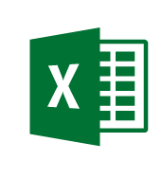
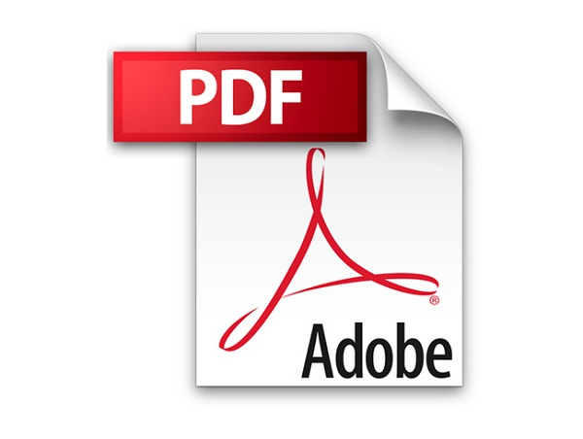





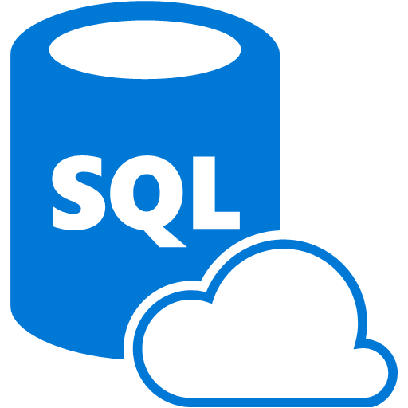
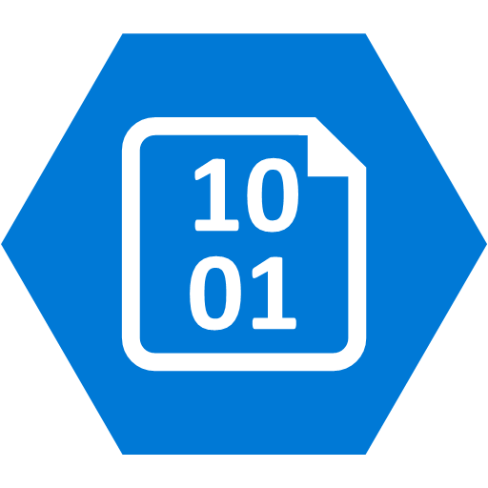
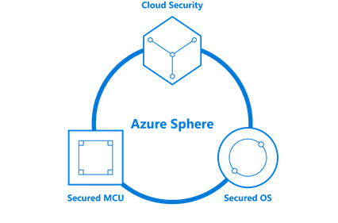


Security Operations Center (SOC)
Cybersecurity Reference Architecture
April 2019 – https://aka.ms/MCRA | Video Recording | Strategies
Software as a Service
Microsoft Threat Experts
Incident Response, Recovery, & CyberOps Services
Office 365
Security Information and Event Management (SIEM)
Analytics/Automation
Secure Score
Azure Sentinel – Cloud Native SIEM and SOAR (Preview)
Vuln Mgmt
Cloud App
Security
Azure
Security Center
Microsoft Defender
Office 365
Azure
This is interactive!
Present Slide
Hover for Description
Click for more information
Roadmaps and Guidance
Securing Privileged Access
Office 365 Security
Rapid Cyberattacks (Wannacrypt/Petya)
Customer Lockbox
Advanced Threat Protection (ATP)
Dynamics 365
MSSP
Identity & Access
Graph Security API – 3rd Party Integration
Information Protection
Azure Active Directory
Alert & Log Integration
Conditional Access – Identity Perimeter Management
Clients
Hybrid Cloud Infrastructure
Cloud App Security
Azure AD Identity Protection
Leaked cred protection
Behavioral Analytics
Unmanaged &
Mobile Devices
On Premises Datacenter(s)
3rd party IaaS
Microsoft Azure
Azure Information Protection (AIP)
Discover
Classify
Protect
Monitor
Azure Security Center – Cross Platform Visibility, Protection, and Threat Detection
Configuration Hygiene
Just in Time VM Access
Azure AD PIM
NGFW
Azure Firewall
Security Appliances
Adaptive App Control
Classification Labels
Multi-Factor Authentication
Intune MDM/MAM
Managed Clients
Extranet
Edge DLP
Azure Policy
Hold Your Own Key (HYOK)
Azure AD B2B
SSL Proxy
Azure Key Vault
AIP Scanner
Azure AD B2C
IPS/IDS
Hello for Business
Express Route
Azure WAF
System Center Configuration Manager
Windows Server 2019 Security
Window 10 + Just Enough Admin, Hyper-V Containers, Nano server, and more…
Azure Antimalware
Office 365
Data Loss Protection
Data Governance
eDiscovery
MIM PAM
Microsoft Defender ATP
Application & Network Security Groups
Azure ATP
Shielded VMs
VMs
Intranet Servers
Backup & Site Recovery
Azure Stack
Azure SQL
Threat Detection
Active Directory
Secure Score
Threat Analytics
Privileged Access Workstations (PAWs)
Disk & Storage Encryption
SQL Encryption & Data Masking
ESAE Admin Forest
Windows 10 Enterprise Security
IoT and Operational Technology
Included with Azure (VMs/etc.)
Premium Security Feature
Confidential Computing
Azure SQL Info Protection
Network protection
Credential protection
Exploit protection
Reputation analysis
Full Disk Encryption
Attack surface reduction
App control
Isolation
Antivirus
Behavior monitoring
DDoS attack Mitigation+Monitor
Windows 10 IoT
Azure Sphere
IoT Security Maturity Model
Microsoft Defender ATP
Endpoint DLP
Azure IoT Security
IoT Security Architecture
Compliance Manager
S Mode
Security Development Lifecycle (SDL)
Trust Center
Intelligent Security Graph
Notes:
BUILD SLIDE VERSION (Animated Build sequence that takes ~25 clicks)
Key Takeaway: This is the Microsoft Cybersecurity Reference Architecture (https://aka.ms/MCRA) which describes Microsoft’s cybersecurity capabilities and how they integrate with existing security architectures and capabilities.
The latest version of this diagram, associated presentation video (on v1 version currently), and the complementary cybersecurity reference strategies can be found at the links at the top. Links to key guidance are also included for important and complex initiatives like securing privileged access, Office 365, and protecting against attack like Petya/Wannacrypt.
This diagram is interactive, you can hover over any of the capabilities for a quick description and then click on it for more documentation on the capability.
CLICK 1
Most enterprise organizations have Windows and Linux servers (and often applications containers) to protect. Most have also established a basic core set of security capabilities at the network edge / egress points to protect extranet and intranet resources.
CLICK 2
We also commonly find that enterprises also have a range of client devices to support and protect ranging from corporate issued PCs to Bring Your Own Device (BYOD) personally owned mobile devices.
CLICK 3
Many enterprise organizations have established an operational security capability that includes vulnerability management and incident management, which is typically provided by an on-premises Security Information Event Management (SIEM) capability or a Managed Security Services Provider (MSSP).
CLICK 4
Many have also deployed endpoint Data Loss Prevention (DLP) capability to help with information protection needs.
CLICK 5
Most larger organizations have Active Directory as a primary enterprise directory (frequently as part of an identity system that includes other capabilities for identity lifecycle management, credential vaulting, and other needs)
CLICK 6
Most enterprises estates include Software as a Service (SaaS) like Office 365 and other popular services. Some of these are sanctioned and configured by corporate IT, but others are “Shadow IT” adopted by business units and individual user without the knowledge or endorsement of corporate IT.
CLICK 7
Many organizations also operate traditional Industrial Control Systems (ICS) including Supervisory Control and Data Acquisition (SCADA) technology. Many are also operating or planning to adopt Internet of Things (IoT) technology for both internal systems and customer product offerings.
CLICK 8
Additionally, the scope of enterprise infrastructure has grown into a hybrid state that incorporates Infrastructure as a Service (IaaS) and Platform as a Service (PaaS) from Microsoft Azure as well as other IaaS providers.
Pausing for a moment, this leaves most enterprises with a “hybrid of everything” estate to manage and secure, which is quite challenging given the steadily increasing volume and sophistication of cybersecurity threat actors.
CLICK 9
The foundation of Microsoft’s cloud services and products starts with our investments in security and compliance, many of which have been made available to our customers in some form:
Trust Center – Microsoft offers the most comprehensive set of compliance offerings of any cloud service provider. We transparently provide information on how we meet or exceed those standards in our trust center.
Compliance Manager - We built a capability to help you manage your compliance requirements (based heavily on what we learned while managing compliance of our cloud services such as an extensive mapping of controls across standards)
Security Development Lifecycle - We have also published documentation from our industry leading security development lifecycle openly to help you with securing your applications. This has recently evolved into a Secure DevOps toolkit for Azure - https://azsk.azurewebsites.net/
Intelligence Security Graph – Through the course of supporting, operating, and securing our cloud services and Windows PCs, Microsoft has accumulated a massive set of first party threat intelligence (processes about 6.5 trillion signals per day) that we use to protect our cloud services, IT environment, and customers. Many of the products in this architecture have integrated intelligence and analytics from the security graph directly into threat detection and alert enrichment capabilities.
CLICK 10
Familiar security capabilities from popular vendors are available in the Azure Marketplace to enable customers to extend on premises controls to the cloud. Additionally, Microsoft has built Azure Firewall, a native “Firewall as a Service” capability in Azure that includes several advanced technologies and greatly simplifies firewall deployment and management.
CLICK 11
Microsoft has invested into Azure Security Center (ASC) to enable you to
Protect servers and workloads
Detect and correct common misconfiguration issues such as
VMs exposed directly to the internet
Missing Web Application Firewalls (WAFs) for web applications
Out of date patches and antimalware signatures
…and many others
Leverage cutting edge capabilities in Azure like machine learning to suggest firewall rules and application whitelists (to allow/block which files can run on servers)
CLICK 12
Microsoft has also invested heavily in other Azure security capabilities such as Distributed Denial of Service (DDoS) mitigations, key management, ransomware-resistant backup archives, confidential computing capabilities to protect data while its being processed, and many more.
CLICK 13
Microsoft has also continued to invest into on-premises security capabilities for Windows Server (including Shielded VMs) and Azure Stack (which provides the ability to run Azure services in your on-premises datacenter)
CLICK 14
Microsoft has also focused heavily on device security with
System Center Configuration Manager and Intune MDM/MAM for cross platform security and management across Windows, Linux, Mac, iOS, and Android
Windows 10 Enterprise Security - An extensive set of platform capabilities to protect against ever-evolving attacks
Windows Defender ATP – Advanced endpoint detection and response (EDR) capabilities to rapidly detect and recover from attacks as well as management, monitoring, and security planning capabilities to keep devices healthy and secure.
CLICK 15
Based on lessons learned from credential theft and similar attacks, Microsoft has invested in securing privilege access including privileged access management, advanced credential/identity attack detection and privileged access workstation (PAW) architectures. Our PAW investments includes
Publishing Guidance – We have published detailed installation instructions for customers to build their own PAWs
Platform Security – We protect our IT Environment and cloud services with a full admin workstation program (internally called Secure Access Workstations or SAWs)
CLICK 16
Because of how critical identity is to security, Microsoft has invested heavily in security capabilities to protect and manage cloud and on-premises identities spanning multi-factor authentication, biometrics, hardware protection of credentials (via TPM and virtualization based security), applying threat intelligence + machine learning to authentication attempts, and more.
CLICK 17
Identity is also critical for protecting data and operational availability as it’s frequently the only control type available across modern IoT/mobile/etc. devices and cloud services. Organizations should focus on build an identity security perimeter to consolidate management of authentication and access controls and enforce consistency. Microsoft has invested into Conditional Access to enable simple (and powerful) visibility and policy control of this new perimeter.
CLICK 18
Microsoft has invested across our tools to enable integration with your existing Security Information and Event Management (SIEM) solution.
CLICK 19
Microsoft has built Advanced Threat Protection (ATP) technology to provide deep context on key technical elements of the modern estate (Endpoint, Identity, Email, and more) to rapidly detect and remediate threats across them. Microsoft also offers professional services to help you investigate incidents in your environment as well as to hunt for potential existing threats. This will enable you to transform your SOC using the massive set of Microsoft threat intelligence in the intelligent security graph (bottom right of slide) and integrate these with your existing capabilities using the Graph Security API.
CLICK 20
Microsoft also built Azure Sentinel, a cloud native SIEM and SOAR capability, into Azure to help you with breadth of visibility to collect security data from across your enterprise estate including Microsoft, AWS, other clouds, and on premises assets. Azure Sentinel uses machine learning to reduce alert fatigue (up to 90% in private preview) and native cloud capabilities (like automation) to simplify your data collection, SIEM maintenance, and incident investigation + remediation.
CLICK 21
Microsoft has built several Office 365 security capabilities to enhance your security planning (Secure Score), add additional explicit approval steps before Microsoft support can access your data for support issues (Customer Lockbox), and data protection technologies built into the platform.
CLICK 22
Azure Information Protection – Protects information at the file itself so the encryption and policy control can follow files wherever they go (Cloud, Devices, USB drives, etc.).
CLICK 23
Cloud App Security is a Microsoft Cloud Application Security Broker (CASB) offering that provides a wide array of security capabilities for SaaS including Shadow IT Risk management, Policy Monitoring and Enforcement, Information Protection, and incident detection/response/recovery.
CLICK 24
Additionally, Microsoft has invested in advanced security capabilities for data in SQL to protect against common threats and simplify information protection management and policy.
CLICK 25
Microsoft is also investing heavily into OT and IoT security to help manage and secure existing (brownfield) platforms, provide secure (greenfield) platforms, and help manufacturers quickly determine what level of security they need and enable them to rapidly and easily achieve that.
CLICK 26
We understand this is a lot of capabilities to plan for, so we have built several prescriptive roadmaps to help organizations quickly mitigate risk from critical and complex cybersecurity challenges.
Feedback
We are always trying to improve everything we do at Microsoft and we need your feedback to do it! You can contact the primary author (Mark Simos) directly on LinkedIn (https://aka.ms/markslist) with any feedback on how to improve it or how you use it, how it helps you, or any other thoughts you have.

Slide 3
The pieces of the puzzle
Azure AD
Azure AD B2B
Azure AD B2C
Identity Platform
Identity.Web
MSAL

Slide 4
Azure AD
Basis of M365
Domain joined
Access to SaaS products
Users managed by organisation
Woolworth’s employees

Slide 5
Azure AD B2B
Guest users
Domain joined but in other tenant
Microsoft account / Social
Federation via SAML or WS-Fed
Access to SaaS
Users managed externally
Other companies that do business with Woolworths

Slide 6
Azure AD B2C
Random email address
Non-domain joined
Social / Federation via SAML or OpenID Connect
No access to SaaS
Users self manage
Scales to hundreds of millions of users
Woolworth’s customers

Slide 7
Azure AD B2B demo
Invite guest user

Slide 8
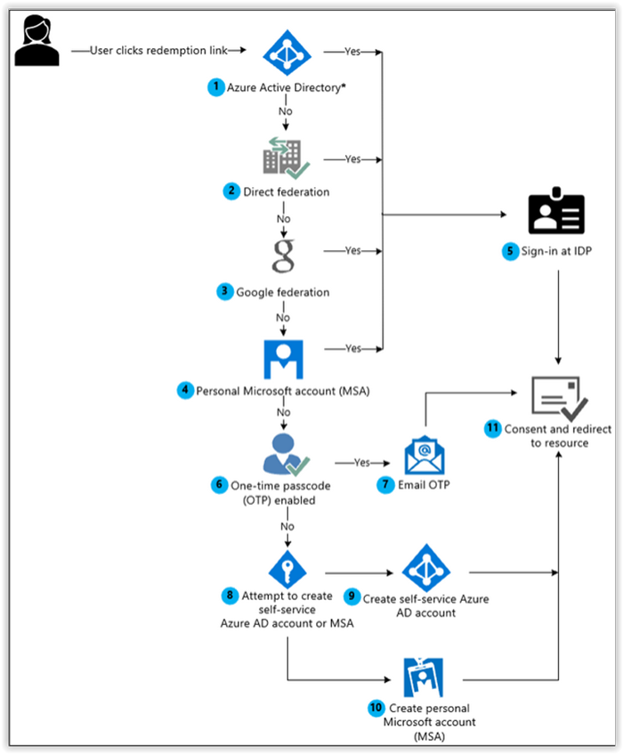
Invite guest user
flow

Slide 9
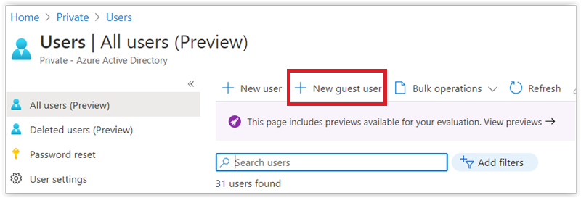
Invite guest user

Slide 10
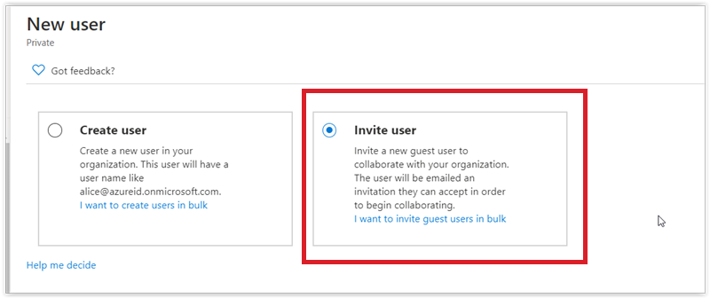
Invite guest user

Slide 11
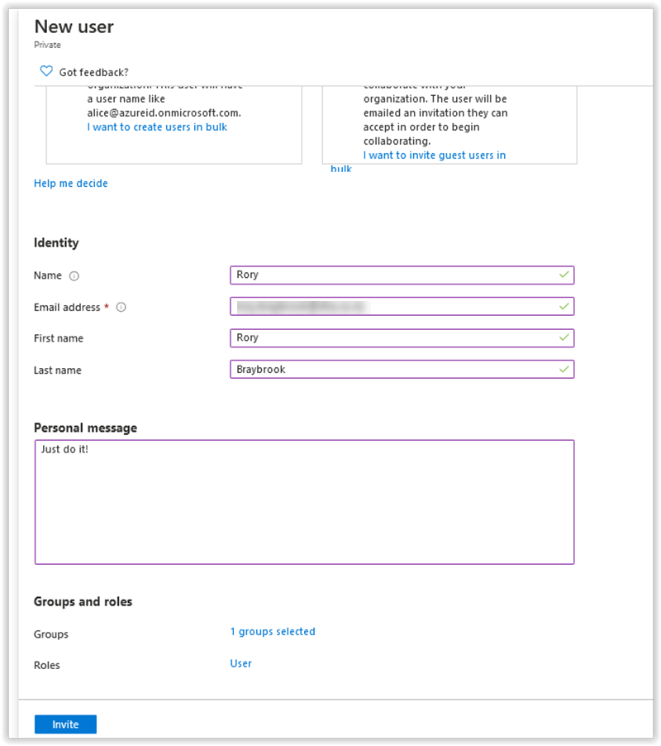
Invite guest user

Slide 12
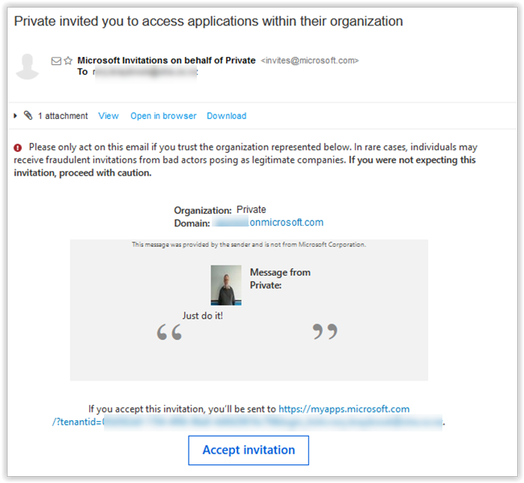
Invite guest user

Slide 13
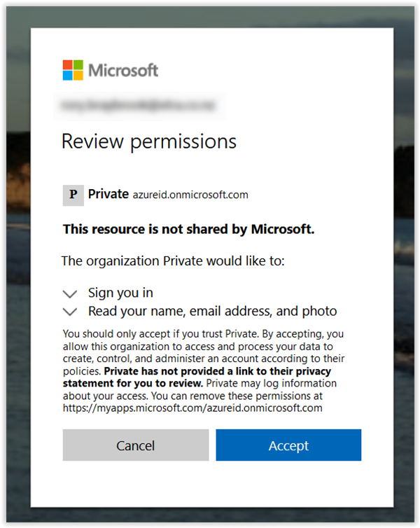
Invite guest user

Slide 14
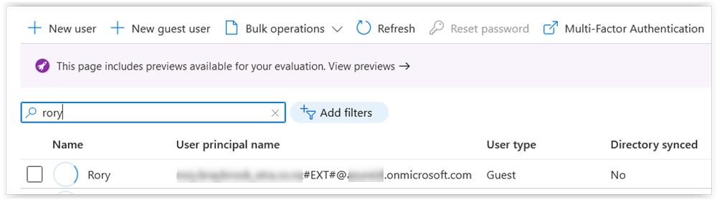
Invite guest user

Slide 15
Azure AD B2X demo
External Identity

Slide 16
Azure AD B2C demo

Slide 17
The Microsoft Identity Platform

Slide 18
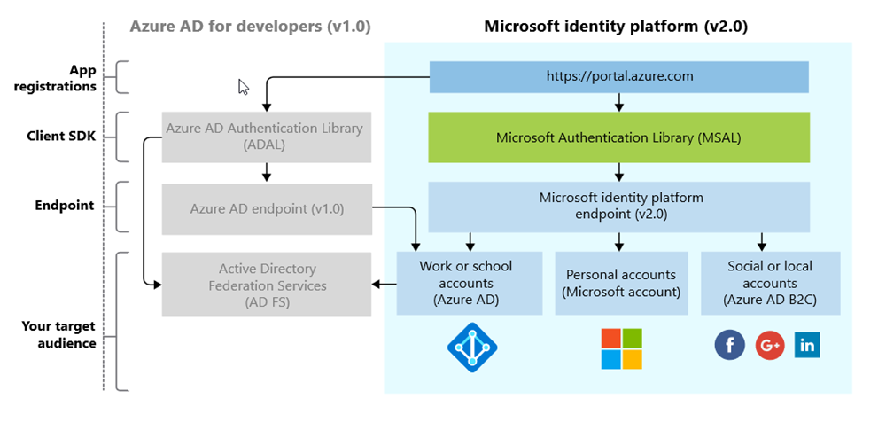
The Platform (not the Product!)

Slide 19
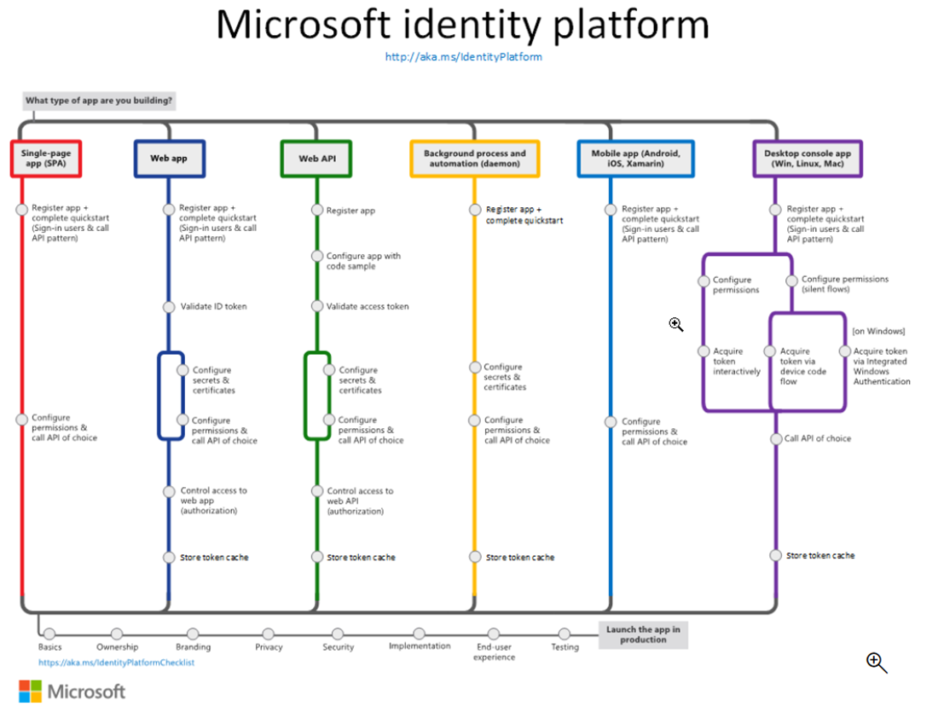

Slide 20
Microsoft Identity Platform demo

Slide 21
Microsoft.Identity.Web

Slide 22
What is it?
Microsoft Identity Web is a library which contains a set of reusable classes used in conjunction with ASP.NET Core for integrating with the Microsoft identity platform (formerly Azure AD v2.0 endpoint) and AAD B2C
This library is for specific usage with:
Web applications, which sign in users and, optionally, call web APIs
Protected web APIs, which optionally call protected downstream web APIs

Slide 23
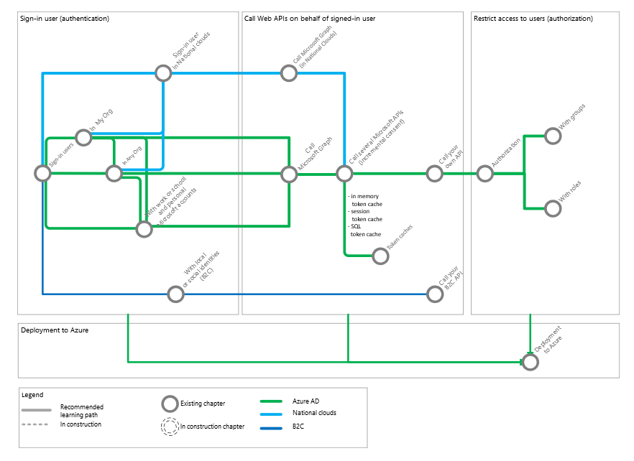
The “subway”

Slide 24
Command line commands
dotnet new mvc2 --framework net5.0
--auth SingleOrg
--domain tenant.onmicrosoft.com
--client-id bb2…07e
--tenant-id 00d…c79
--callback-path /signin-oidc
dotnet build
dotnet run -f net5.0

Slide 25
Microsoft.Identity.Web Demo

Slide 26
References
https://medium.com/the-new-control-plane
https://docs.microsoft.com/en-us/azure/active-directory/external-identities/redemption-experience
https://aka.ms/msidplatform
https://azure.microsoft.com/en-us/services/active-directory/external-identities/
https://github.com/AzureAD/microsoft-identity-web
https://github.com/Azure-Samples/active-directory-aspnetcore-webapp-openidconnect-v2
https://www.microsoft.com/security/blog/2018/06/06/cybersecurity-reference-architecture-security-for-a-hybrid-enterprise/

Slide 27


