Slide 1
Integrating Azure AD B2C with THE Microsoft Identity libraries
Rory Braybrook
Microsoft Identity Architect
Microsoft MVP (Enterprise Mobility/Security)

Slide 2
Azure AD B2C
Random email address / username
Non-domain joined
Social / Federation via SAML or OpenID Connect
No access to SaaS
Users' self manage – edit profile & password reset
Scales to hundreds of millions of users
Woolworth’s customers

Slide 3
A lap around Azure AD B2C user flows
Signup / sign in
Profile edit
Password reset
MFA
Conditional access
Let’s look at B2C user flows (not custom policies)

Slide 4
Microsoft Identity Platform
(MSAL)

Slide 5
MSAL
No need to directly use the OAuth libraries or code against the protocol in your application
Acquires tokens on behalf of a user or on behalf of an application (when applicable to the platform)
Maintains a token cache and refreshes tokens for you when they are close to expiring. You don't need to handle token expiration on your own.
Helps you specify which audience you want your application to sign in (your org, several orgs, work, and school, MSA, social etc.)

Slide 6
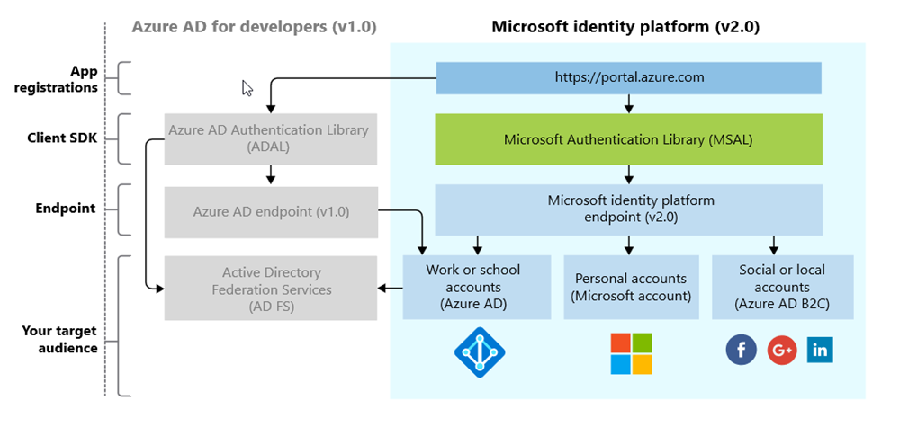
The Platform (not the Product!)

Slide 7
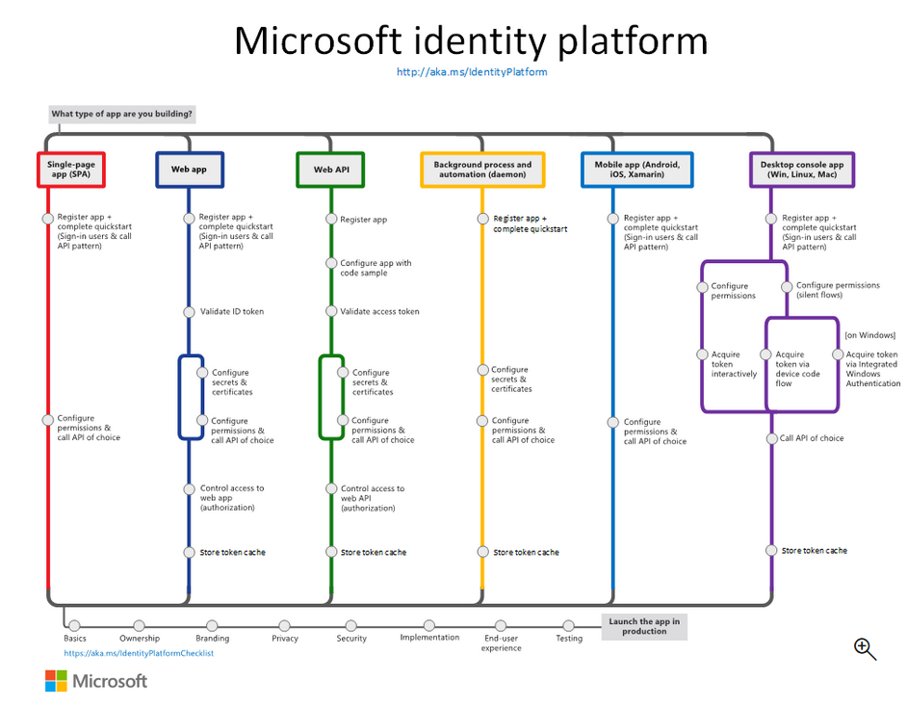

Slide 8
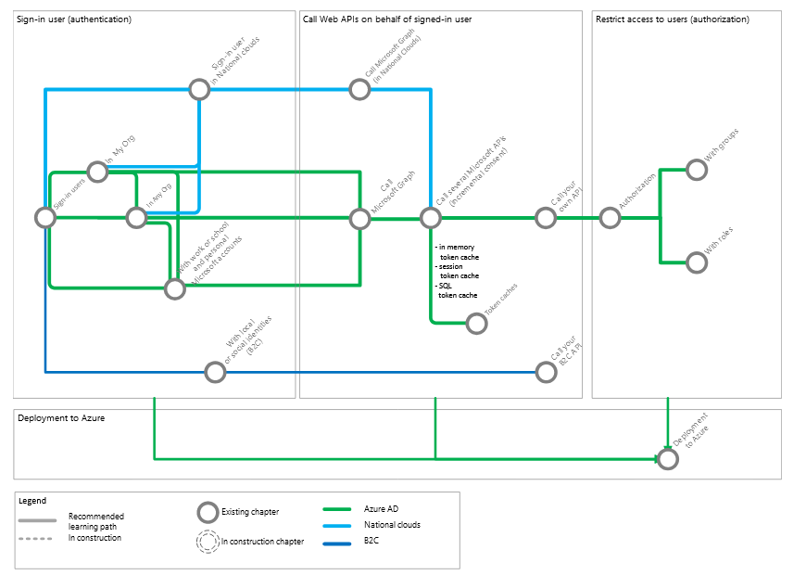
Microsoft Identity Platform “subway”

Slide 9
Microsoft Identity Platform demo
Code samples

Slide 10
Microsoft.Identity.Web
Code samples

Slide 11
What is it?
Microsoft Identity Web is a library that contains a set of reusable classes used in conjunction with ASP.NET Core for integrating with the Microsoft identity platform (formerly Azure AD v2.0 endpoint) and AAD B2C. Has Wiki.
This library is for specific usage with:
Web applications, which sign in users and, optionally, call web APIs
Protected web APIs, which optionally call protected downstream web APIs

Slide 12
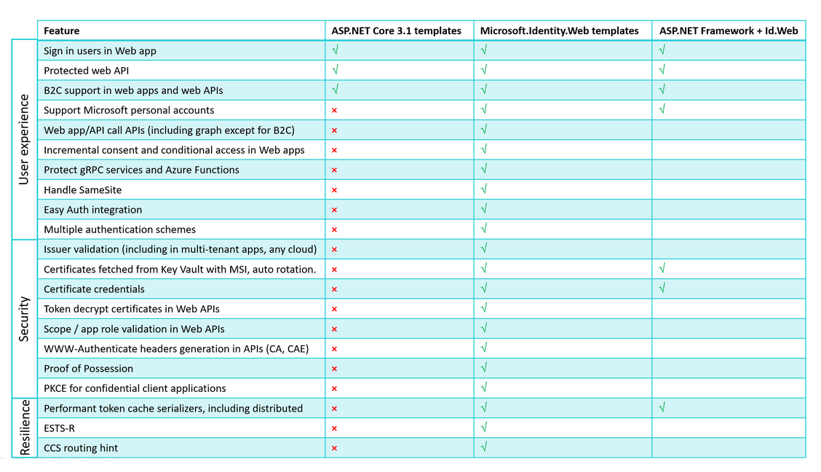
Templates

Slide 13
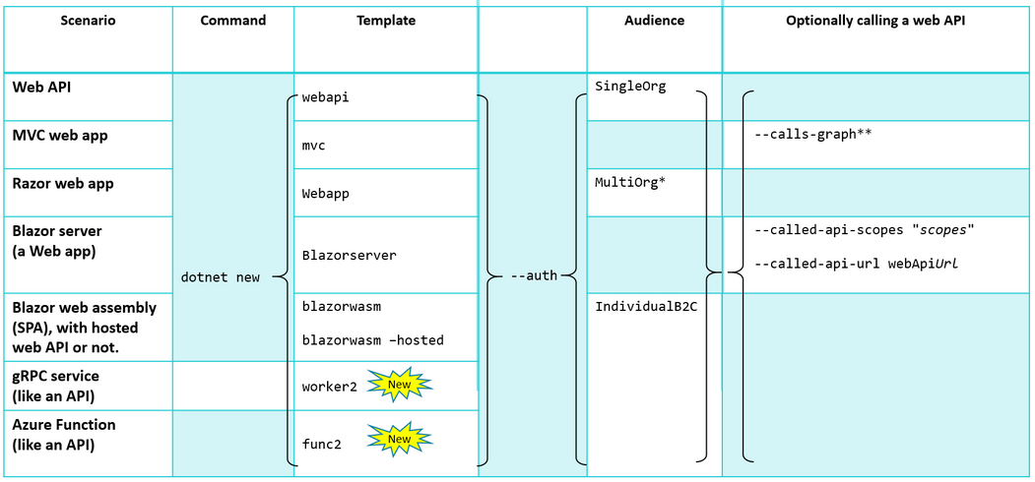
Templates

Slide 14
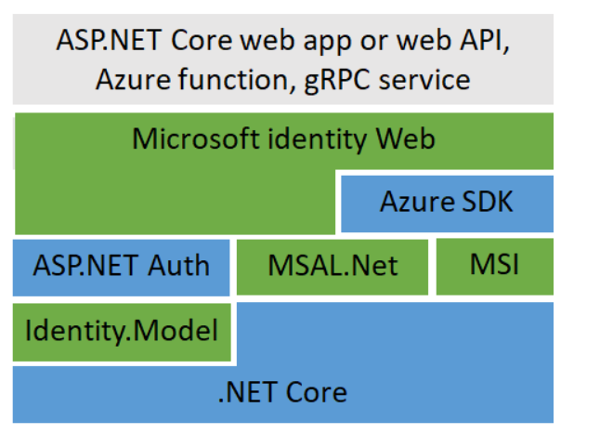
Architecture

Slide 15
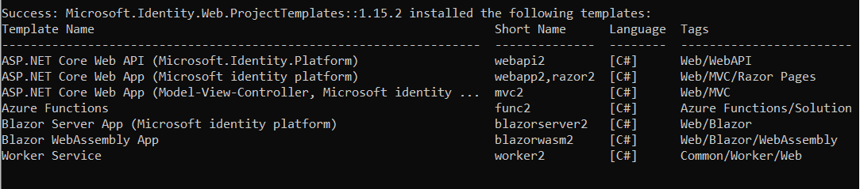
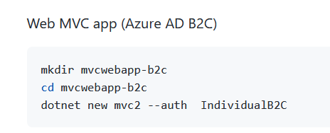
Command line commands
dotnet new -i Microsoft.Identity.Web.ProjectTemplates::1.15.2

Slide 16
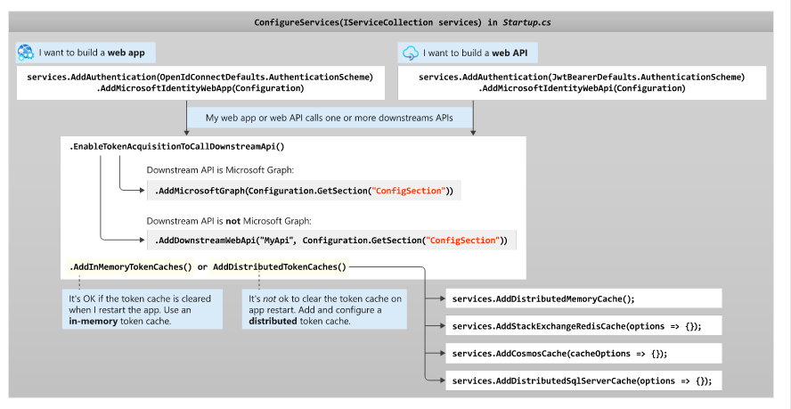
Architecture

Slide 17
Microsoft.Identity.Web Demo

Slide 18
Personal
Twitter: @rbrayb
stackoverflow: rbrayb
LinkedIn: https://www.linkedin.com/in/rory-braybrook-6050a521/
Blog: https://medium.com/the-new-control-plane
Combined blog: https://authory.com/rorybraybrook

Slide 19
References
https://docs.microsoft.com/en-us/azure/active-directory/develop/
https://docs.microsoft.com/en-us/azure/active-directory/develop/sample-v2-code
https://docs.microsoft.com/en-us/azure/active-directory-b2c/integrate-with-app-code-samples
https://github.com/AzureAD/microsoft-identity-web/wiki
https://github.com/AzureAD/microsoft-identity-web
https://github.com/Azure-Samples/active-directory-aspnetcore-webapp-openidconnect-v2

Slide 20


