Slide 1
AMA about Azure AD B2C
Rory Braybrook
Microsoft Identity Architect
Microsoft MVP (Enterprise Mobility)
@rbrayb
https://authory.com/RoryBraybrook

Slide 2
Notes
Experiment!
Mute yourself
Use “hands up” in Teams – will be asked to come off mute
Or ask questions in the chat
Slides will be uploaded to UG with links

Slide 3
What is B2C?
Azure AD – Corporate, domain joined, company employees
Azure AD B2B – Company partners, mainly corporate
Azure AD B2C – Company customers, not domain joined
Flows - SUSI, profile edit, password reset
Policies – built-in and custom

Slide 4
Question?
We have an application
It needs to be secure
B2C is an option
How do we start?
How do we add MFA, password reset etc.

Slide 5
B2C approach
Two options:
MSAL libraries
Microsoft.Identity.Web

Slide 6
Identity.Web dotnet new
Blazor Server App (Microsoft identity platf... blazorserver2
Blazor Server App blazorserver
Blazor WebAssembly App blazorwasm2
Blazor WebAssembly App blazorwasm
ASP.NET Core Empty web
ASP.NET Core Web App (Model-View-Controller... mvc2
ASP.NET Core Web App (Model-View-Controller) mvc
ASP.NET Core Web App (Microsoft identity pl... webapp2
ASP.NET Core Web App webapp
ASP.NET Core with Angular angular
ASP.NET Core with React.js react
ASP.NET Core with React.js and Redux reactredux
Razor Class Library razorclasslib

Slide 7
Auth
-au|--auth The type of authentication to use
None - No authentication
Individual - Individual authentication
IndividualB2C - Individual authentication with Azure AD B2C
SingleOrg - Organizational authentication for a single tenant
MultiOrg - Organizational authentication for multiple tenants
Windows - Windows authentication
Default: None

Slide 8


Slide 9
Custom policies

Slide 10
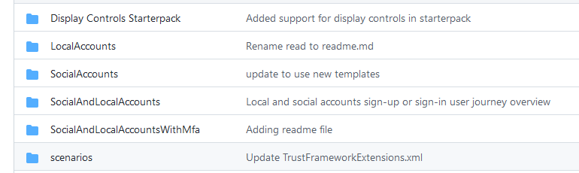
Custom policy starter pack

Slide 11
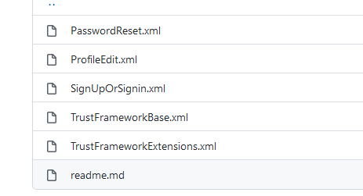
Custom policy starter pack contents

Slide 12
Custom policies
A) MFA with either Phone (Call/SMS) or Email verification
B) Username based journey
C) Sign In With Authenticator

Slide 13
References
Starter pack - https://github.com/Azure-Samples/active-directory-b2c-custom-policy-starterpack
CIAM custom policies - https://github.com/azure-ad-b2c/samples
All the CIAM policies - https://medium.com/the-new-control-plane/everything-you-wanted-to-know-about-azure-ad-b2c-custom-policy-samples-but-were-afraid-to-ask-96fa561f1e4d
B2C MSAL samples - https://docs.microsoft.com/en-us/azure/active-directory-b2c/integrate-with-app-code-samples
MSAL ASP.NET B2C project - https://docs.microsoft.com/en-us/azure/active-directory-b2c/configure-authentication-sample-web-app?tabs=visual-studio
Microsoft.Identity.Web - https://github.com/AzureAD/microsoft-identity-web/wiki
Useful B2C utility - https://b2ciefsetupapp.azurewebsites.net/

Slide 14
References - samples
https://github.com/azure-ad-b2c/samples/tree/master/policies/mfa-email-or-phone
https://github.com/azure-ad-b2c/samples/tree/master/policies/username-signup-or-signin
https://github.com/azure-ad-b2c/samples/tree/master/policies/sign-in-with-authenticator

