Slide 1
A Journey Across Entra External ID (CIAM) and Entra Verifiable Credentials
Rory Braybrook
Identity Architect and Consultant
Microsoft MVP – Security
Blog: https://authory.com/RoryBraybrook

Slide 2
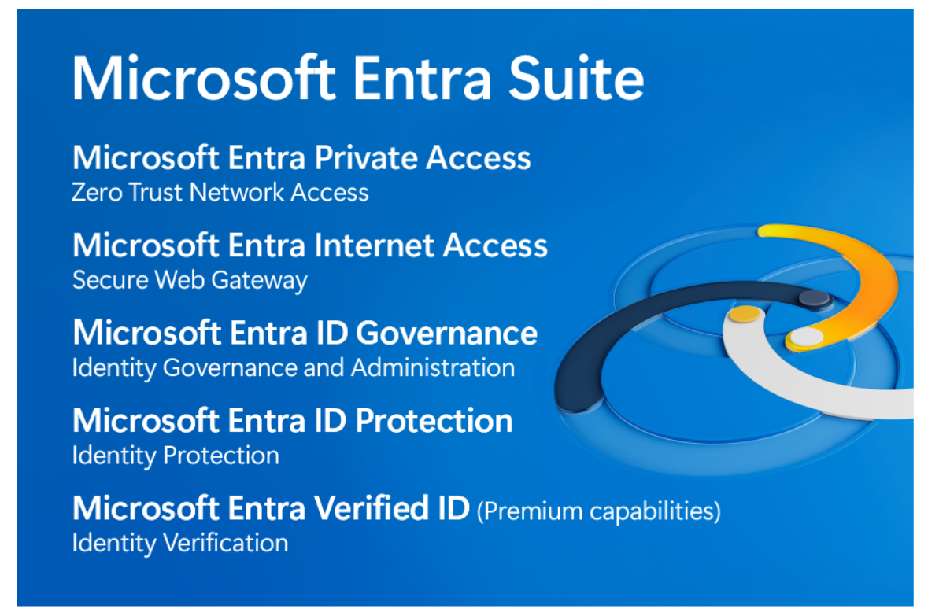

Slide 3
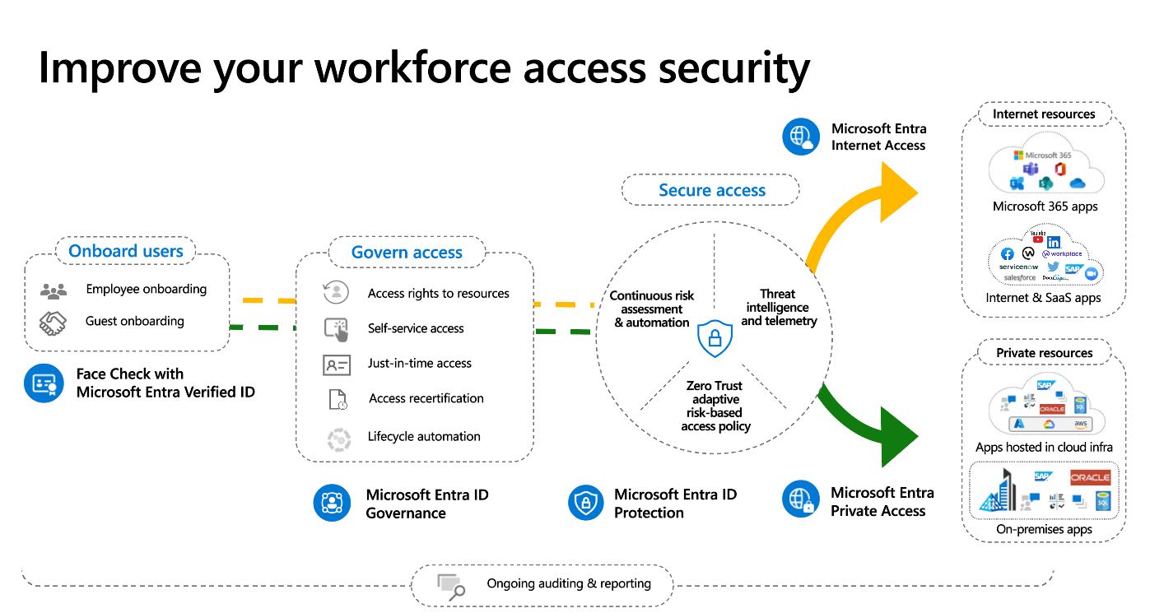

Slide 4
Azure ad b2c
Fully supported until 2030
From May 2025, new users will not be able to create B2C tenants
Working on migration plans to CIAM
Working on custom policy “plans” for CIAM

Slide 5
CIAM
Groups an integral part
Native API for authentication
User flow linked to the application, so no longer need to send policy name in the request
Will be able to “hook” API to events
“Proper” guest accounts

Slide 6
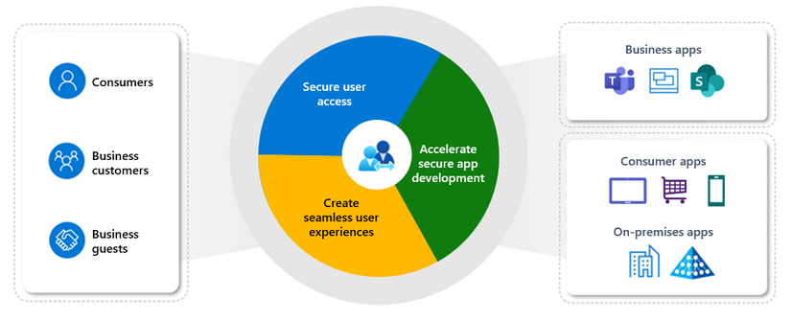
CIAM overview

Slide 7
CIAM Portal
Demo
Configuration flow

Slide 8
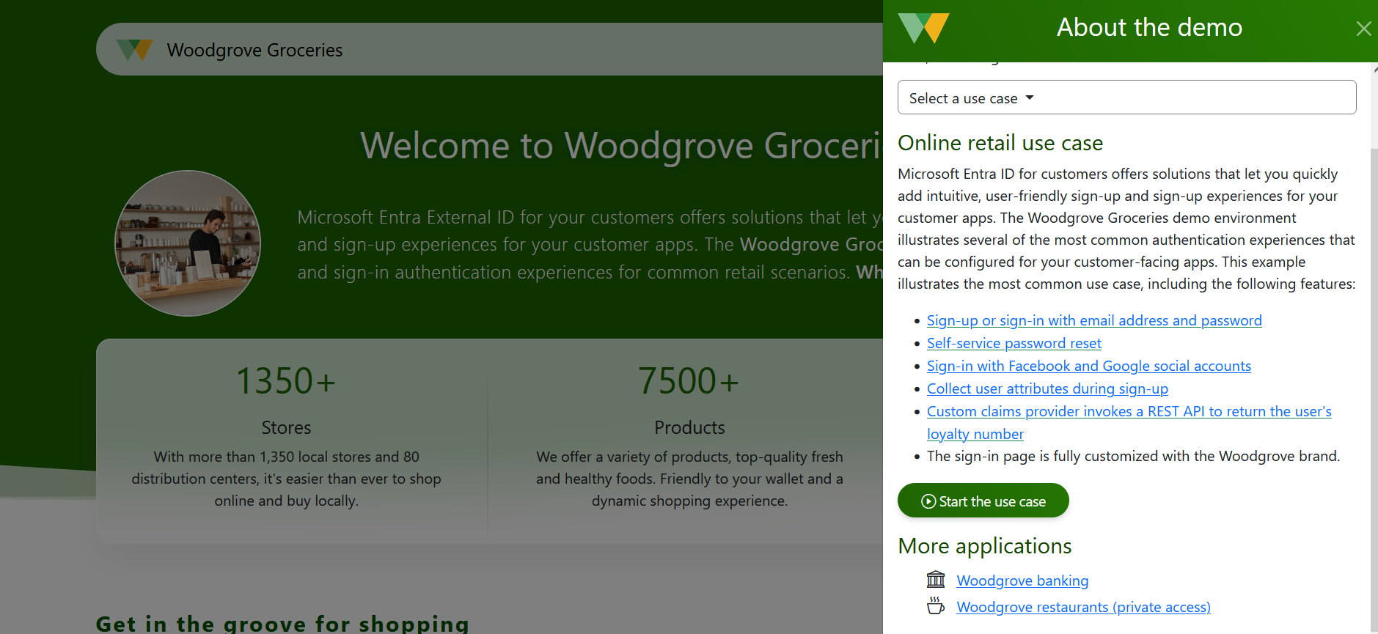
Sample CIAM Application

Slide 9
Entra Verified ID
Verified ID - own your own Identity
Ashley Madison !!!

Slide 10
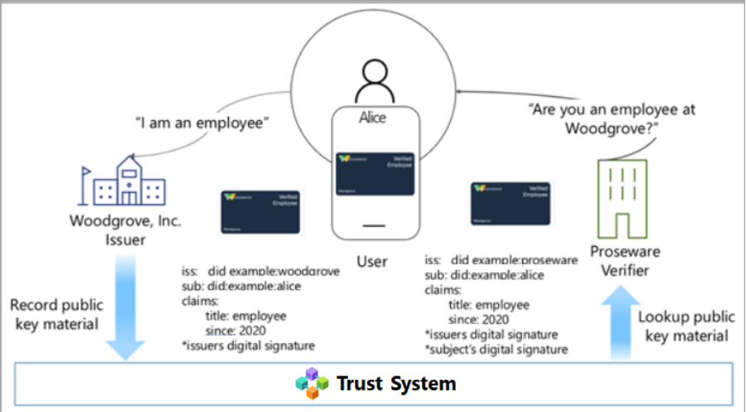
VC sample scenario

Slide 11
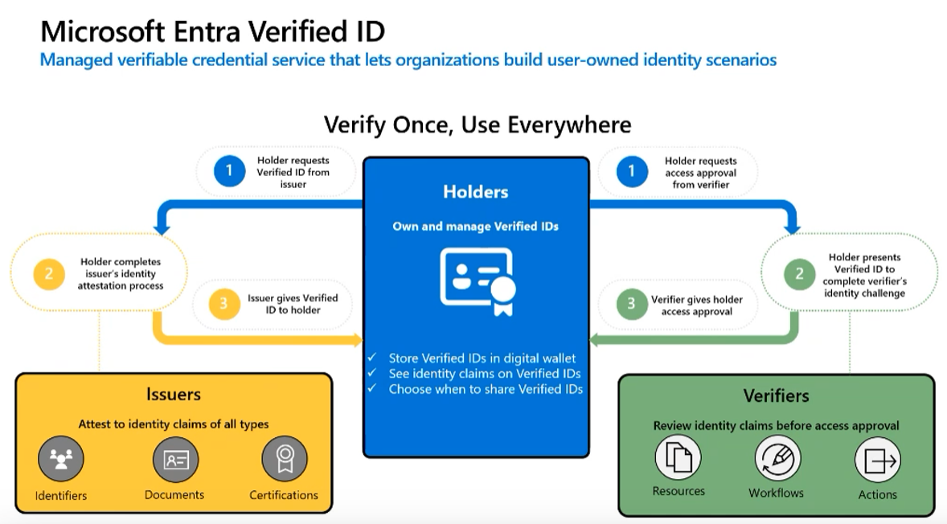
VC flow

Slide 12
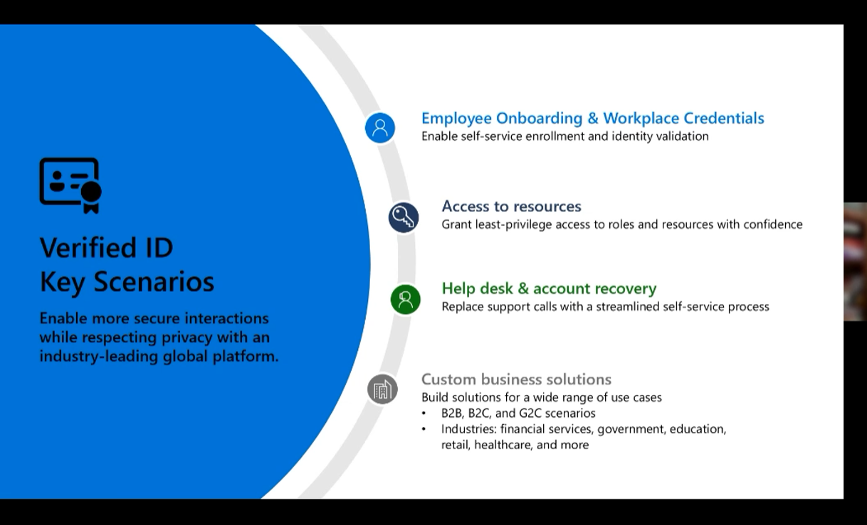
VC use cases

Slide 13
VC Portal
Demo

Slide 14
VC Onboarding Flow
Demo

Slide 15
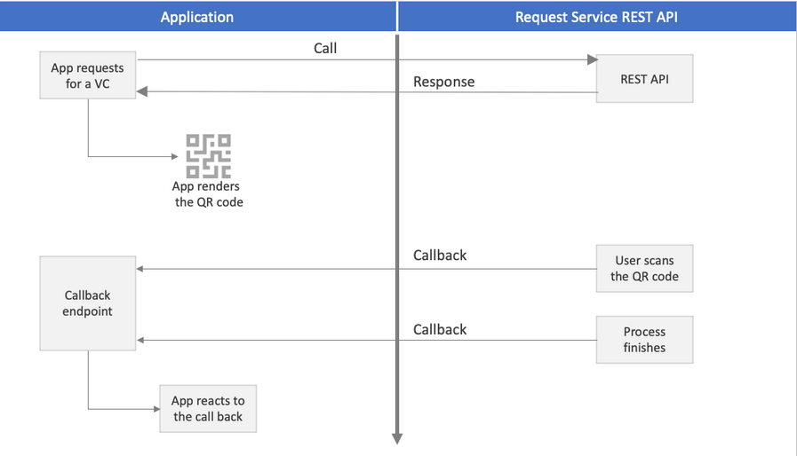
VC REST API Flow

Slide 16
VC Postman
Demo
Issue / Present

Slide 17
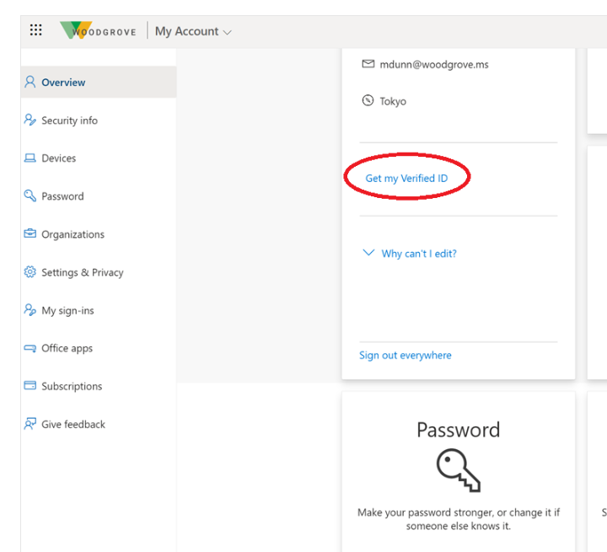
VC MyAccount page

Slide 18
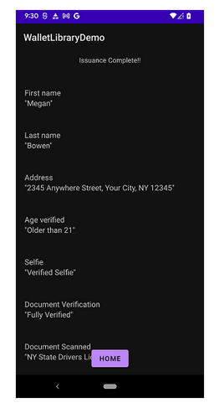
VC Wallet SDK

Slide 19
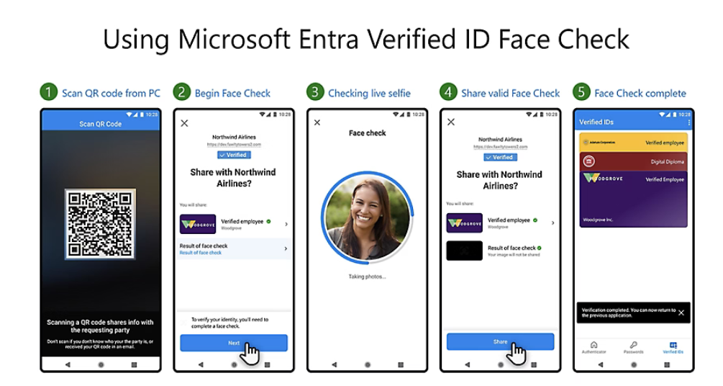
VC Face Check

Slide 20
VC Face Check
Help Desk Demo

Slide 21
References
https://woodgrovedemo.com/
https://developer.microsoft.com/en-us/identity/customers
https://woodgroveemployee.azurewebsites.net/landing
https://learn.microsoft.com/en-us/azure/active-directory/verifiable-credentials/
https://learn.microsoft.com/en-us/azure/active-directory/verifiable-credentials/get-started-request-api
https://medium.com/the-new-control-plane/entra-links-i-use-4cfedfde151c
https://rbrayb.github.io/Presentations/

