Slide 1
Build, Entra ID and Entra External ID
Rory Braybrook – Security MVP (I&AM)

Slide 2
Build sessions
Inside AI Security with Mark Russinovich
Jailbreak – Molotov cocktails
Demystify cloud-native development with .NET Aspire
Damien Edwards and David Fowler
Technology stack designed for cloud-native development Orchestration, Components, Tooling and more
Scott and Mark learn AI
Zoomit – SysInternals

Slide 3
Build sessions
Building a copilot: Azure AI Studio or Copilot Studio
"Highly Technical Talk" with Hanselman and Toub
Zero slides, just code. The internals of .NET, finding performance issues and fixing them live on stage
What’s new in GitHub Copilot and Visual Studio
Tips and tricks, special integrations, and other recent enhancements
GitHub Copilot in Github.com
Next generation AI for developers with the Microsoft Cloud
Scott Guthrie – dev. keynote

Slide 4
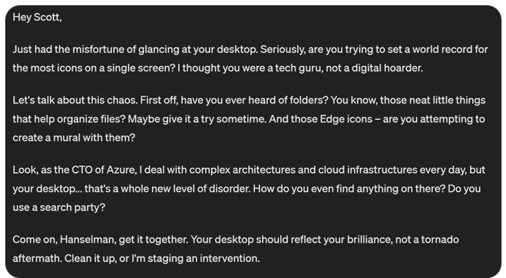

Slide 5
Identity
Public preview: External authentication methods in Microsoft Entra ID
Public preview: Expanding passkey support in Microsoft Entra ID
We’re adding support for device-bound passkeys in the Microsoft Authenticator app on iOS and Android
Azure AD Graph API retirement
Starting June 30th
Deprecation of Azure AD PowerShell and MSOnline PowerShell modules from March 30th
Use Microsoft Graph PowerShell SDK

Slide 6
Identity
General Availability of Microsoft Entra External ID
Public preview of Native Authentication for Microsoft Entra External ID
Microsoft Copilot for Security is generally available

Slide 7
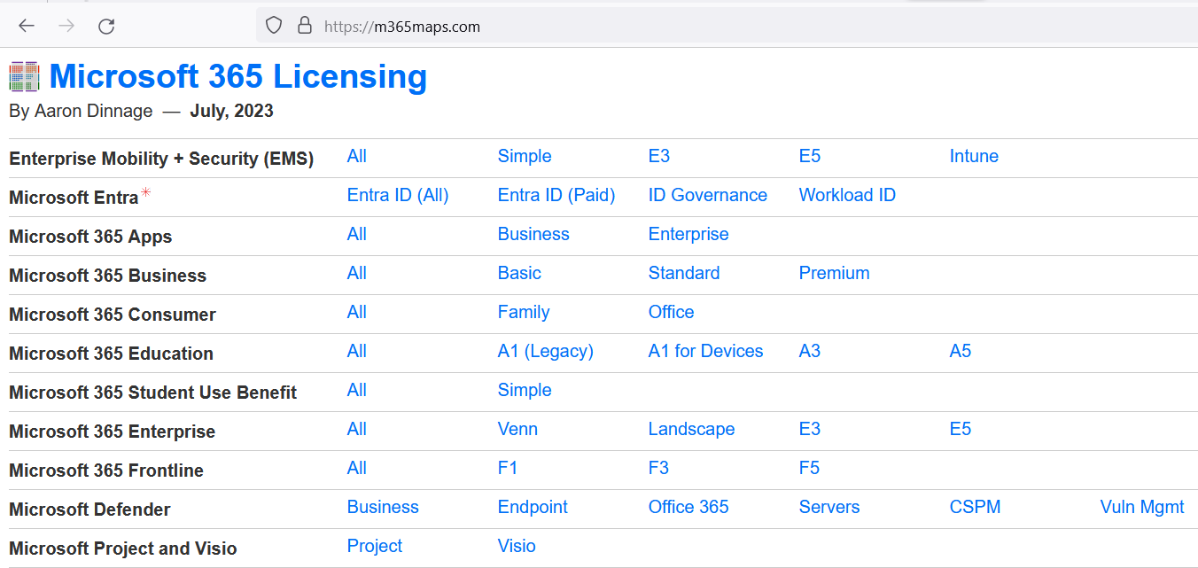
M365maps.com

