Slide 1
The halting problem A journey through Alan Turing's seminal paper

Slide 2
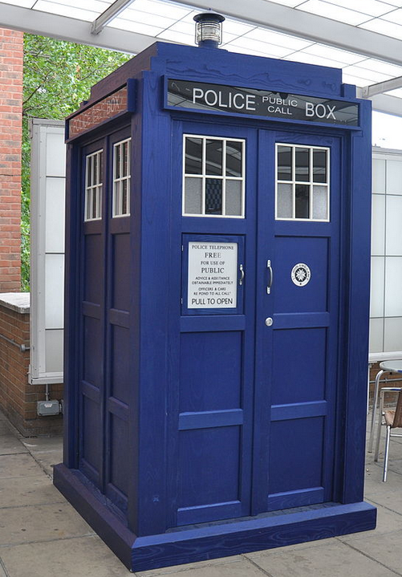
Time travel back to 1936
The IV Olympic Winter Games opened in Germany
The Coronation of King George VI and Queen Elizabeth
New Zealand conducted a census: the population was approximately 1,573,812, with 50.7% male and 49.3% female
The Australian rugby team toured NZ. The All Blacks won both test matches and regained the Bledisloe Cup

Slide 3
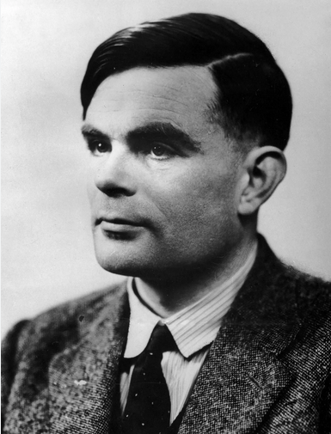
Alan Turing
Alan Turing entered the University of Cambridge to study mathematics in 1931.
After graduating in 1934, he was elected to a fellowship at King’s College in recognition of his research in probability theory.
In 1936, his seminal paper “On Computable Numbers, with an Application to the Entscheidungsproblem” was accepted for publication

Slide 4

Computer

Slide 5
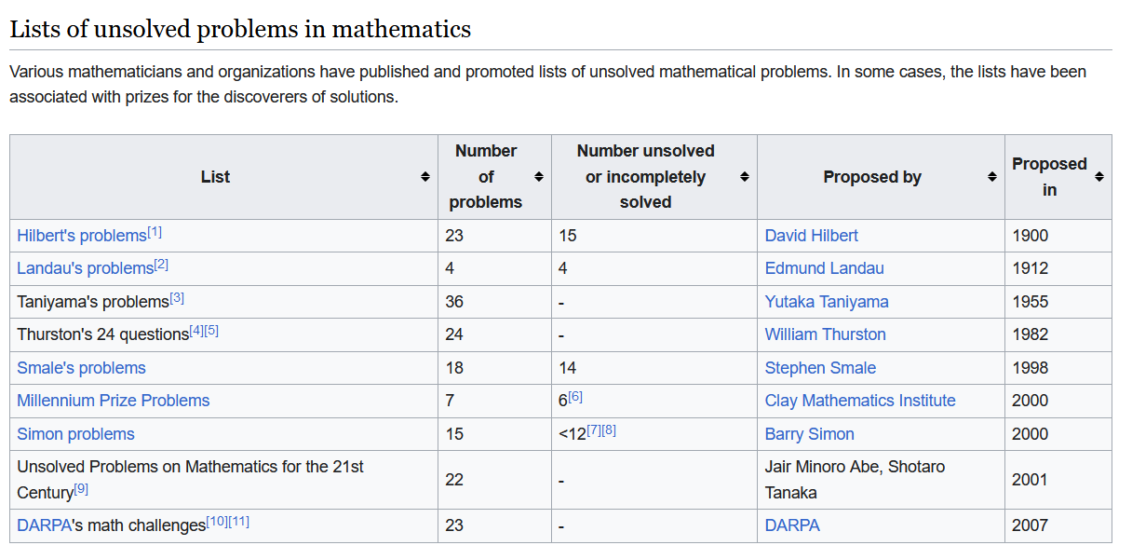
Maths problems yet to be solved

Slide 6
Axioms
An axiom is a fundamental statement or proposition that is accepted as true without requiring proof.
e.g. two sets are equal if and only if they have the same elements
Axioms are considered self-evident or universally accepted, forming the foundation upon which other truths and theorems are built.

Slide 7
Entscheidungsproblem
Hilbert's axiomatic foundations of mathematics (circa 1900):
Axioms should be consistent – there are no statements that could be proven to be both true and false
Axioms should be complete – every statement should be able to be proved or disproved from the axioms

Slide 8
Entscheidungsproblem
The Entscheidungsproblem – there should be a decision procedure that can tell us if a statement can be proved from the axioms
By decision procedure, he meant a clear computational process, i.e., an algorithm that would start with the axioms and a potential conclusion and tell us if the axioms could prove the conclusion.
Hilbert was certain that such an algorithm existed.
The Entscheidungsproblem (decision problem) was the problem of finding the algorithm.

Slide 9
Entscheidungsproblem
Decision procedure ~ algorithm
Can an algorithm decide if another algorithm will stop?
Turing’s insight was to define algorithms in terms of theoretical machines.
Can a Turing machine decide if another Turing machine will stop?
This is the topic of Turing’s paper

Slide 10
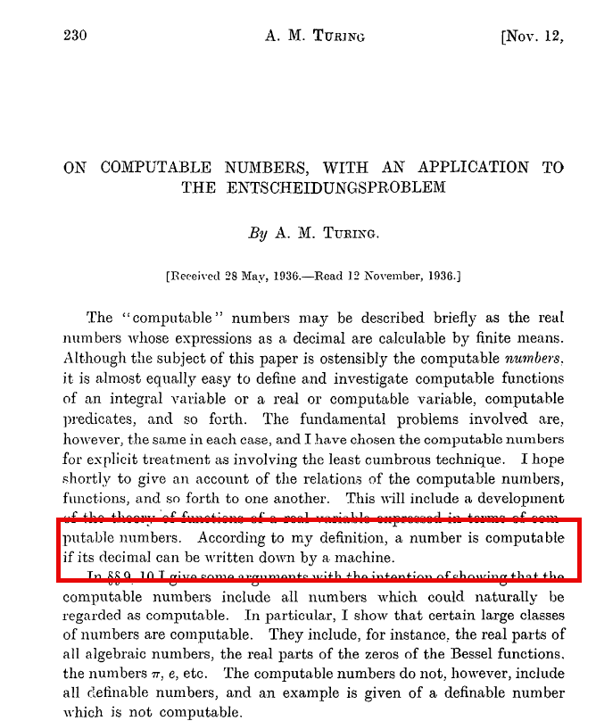
On computable numbers
A computable number [is] one for which there is a Turing machine which, given n on its initial tape, terminates with the nth digit of that number [encoded on its tape].
36 pages 372 pages

Slide 11
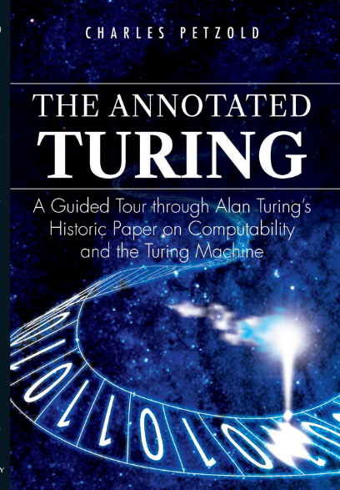
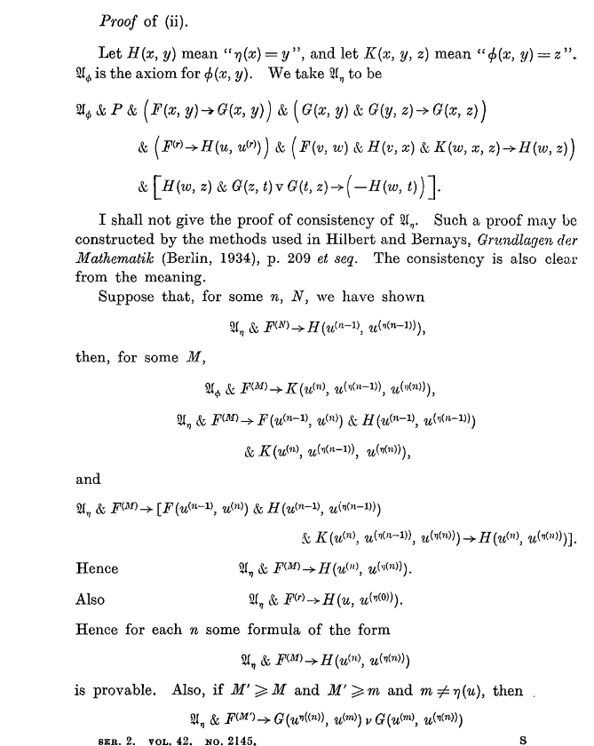
On computable numbers
36 pages 372 pages

Slide 12
Diagrammatic representation of FSM
head
…
@
0
0
1
¹
#
. . .
Finite control
Read/write input tape

Slide 13
Finite state machine
A finite state machine – processes the input and halts at the end.
The input string is accepted if it halts in an accept state.
It‘s rejected if it halts in a non-accept state.
The string is finite, read from left to right, no write

Slide 14
Finite state machine
They have only a finite number of states.
The number may be large, but it is still finite.
The only way they can remember something is to go to a new state.

Slide 15
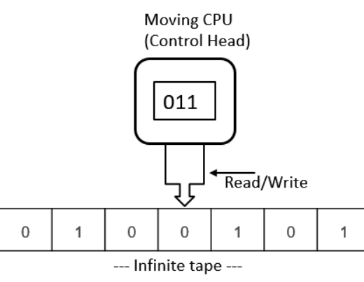
Diagrammatic representation of a TM

Slide 16
Turing machine
Turing machine – we can read/write and move the tape in either direction.
The Turing machine has infinite tape, reads in both directions and can write.
It halts in either an accept or reject state even if the input is not complete.
But it can loop, possibly forever, in which case it diverges.

Slide 17
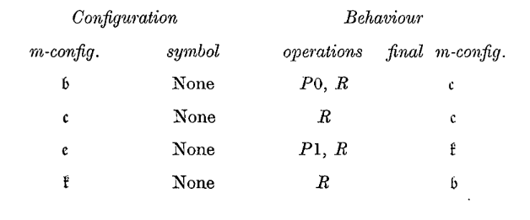
Turing machine

Slide 18
Turing machine
State | Scanned square | Operation | Next state
A | Blank | P0,R | B
B | Blank | R | C
C | Blank | P1,R | D
D | Blank | R | A

Slide 19
Turing machine
FSM – can check if there are equal numbers of `(` and `)` but can‘t check if they are balanced
TM -
1 | ( | ( | ) | )
2 | ( | ( | X | )
3 | ( | X | X | )
4 | ( | X | X | X
5 | X | X | X | X

Slide 20
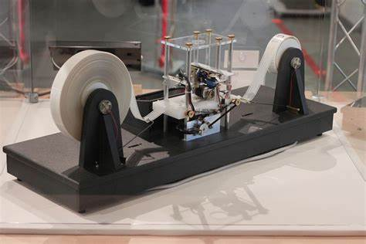
A physical Turing machine
Turing Machines and Tooling, Part I by Unknown Author is licensed under CC BY-SA

Slide 21
A simple machine
0
B
1
A

Slide 22
Encoding – strings that end with 01
1
1
0
0
0
1
2
3
1

Slide 23
Encoding
1111 = Start / end
111 = End of category ~period
11 = Change of sub category ~ semicolon
1 ~ comma
Number of states
Accepting states number
Encoding of states – input → state
1111
000 111 No. of states
000 111 Accepting state
State 1 0010 11
0 input goto state 2, 1 input goto state 1
State 2 001000 11
0 input goto state 2, 1 input goto state 3
State 3 0010
0 input goto state 2, 1 input goto state 1
1111
Encoding:
1111000111000111001011001001100101111

Slide 24
Universal Turing machine
For a machine M and an input I we can write it as (M,I) where M is the encoding of a Turing Machine and I is the input
Turing called this the M configuration.

Slide 25
Universal Turing machine
M1(M1,I1)
M2(M2,I2)
M3(M3,I3)
Where the tape contains M1(M,I), M2(M,I), M3(M,I) etc.
If it can be run by a Turing machine, it can be run by a universal Turing machine.

Slide 26
Universal Turing machine
Model of a modern computer:
CPU
Some form of sequential input – move left and right
Input contains both code and data – stored program computer
Can be “programmed” so is multi-purpose
M1(M,I)
M2(M,I)
M3(M,I)

Slide 27
Reductio ad absurdum
Reductio ad absurdum is a method of argumentation that involves refuting a proposition by demonstrating an absurd outcome if the proposition is assumed true.
This method involves extending the implications of an argument to a stage of absurdity, thereby disproving the validity or common sense of the argument itself
Essentially, proof by contradiction.

Slide 28
The barber paradox
The Scenario:
Imagine a small village with a single barber.
The barber is defined as the person who shaves all those, and only those, who do not shave themselves.
The Question:
Now, consider the following questions:
Does the barber shave himself?
Does the barber even exist?

Slide 29
The barber paradox
Analysis:
If the barber shaves himself, then he must be part of the group of people he shaves (those who do not shave themselves).
But this contradicts the definition of the barber, as he should only shave those who do not shave themselves.
Conversely, if the barber does not shave himself, then he fits the criteria for being shaved by the specified barber.
In this case, he must shave himself as the barber.
Either way, we encounter a logical inconsistency.
Resolution:
The paradox reveals that no such barber can exist in reality.
The problem arises from the self-referential nature of the barber

Slide 30
The halting problem – input (M) into M
What happens if we feed M(M,I) into itself i.e. M(M,M)?
Recall the encoding of a machine that accepts strings ending in 01:
1111000111000111001011001001100101111
So this machine M(M,M) will reject the input.

Slide 31
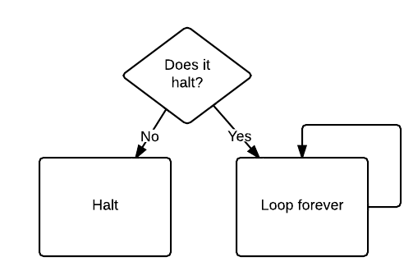
The halting problem (1)

Slide 32
The halting problem
What happens if we feed this program to itself?
If it doesn't halt, then it halts.
If it does halt, then it doesn't halt.
So, does it halt or not?

Slide 33
The halting problem (1)
We showed a machine rejecting its own encoding.
Is there a general machine MNA which will tell us which machines do not accept their encoding?
Assume MNA exists.
Either MNA accepts (MNA), or it rejects it.
If MNA accepts (MNA), then it is a machine that accepts its encoding, but by definition, it doesn’t
If MNA does not accept (MNA) then it is a machine that does not accept its encoding, but by definition, MNA accepts encodings of machines that do not accept their encodings
MNA can’t exist

Slide 34
The halting problem (2)
ATM = {[M,w] | M is a TM and M accepts w}.
PROOF: We assume that ATM is decidable and obtain a contradiction.
Suppose that H is a decider for ATM.
On input, where M is a TM and w is a string, H halts and accepts if M accepts w.
Furthermore, H halts and rejects if M fails to accept w.
In other words, we assume that H is a TM, where
H([M,w]) = {accept if M accepts w}
= {reject if M does not accept w.}

Slide 35
The halting problem
Now we construct a new Turing machine D with H as a subroutine.
This new TM calls H to determine what M does when the input to M is its own description .
Once D has determined this information, it does the opposite.
That is, it rejects if M accepts and accepts if M rejects.
The following is a description of D.
D = "On input [M], where M is a TM:
1. Run H on input [M, [M]].
2. Output the opposite of what H outputs; that is, if H accepts, reject and if H rejects, accept."

Slide 36
The halting problem
D([M]) = { accept if M does not accept [M]
= { reject if M accepts [M]
What happens when we run D with its own description as input?
In that case, we get:
D([D]) = {accept if D does not accept [D]
= {reject if D accepts [D]
If D(D) halts, Halt(D,D) told us that D(D) would run forever.
If D(D) runs forever, Halt(D,D) told us that D(D) would halt.
The problem arises from the self-referential nature of D[M]

Slide 37
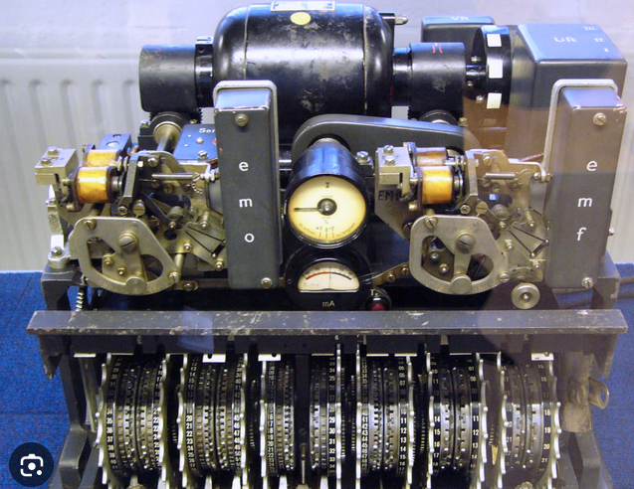
And then – Lorenz teletype

Slide 38
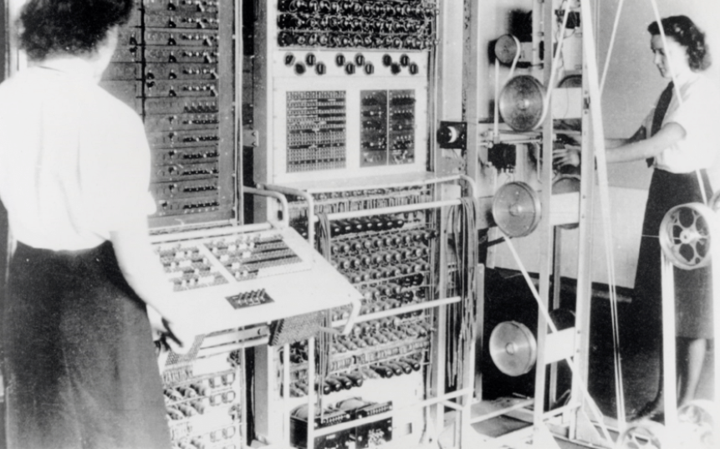
And then – Colossus Mark II
Colossus is regarded as the world's first programmable, electronic, digital computer, although it was programmed by switches and plugs and not by a stored program.
But … official secrets act!!!

Slide 39
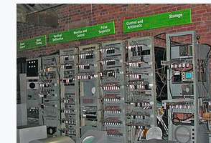
And then – Manchester baby
The Manchester Baby, was the first electronic stored-program computer. It was built at the University of Manchester and ran its first program on 21 June 1948.

Slide 40
Turing’s legacy
The universal Turing machine - now recognised as the foundation of computer science
It started the study of the theory of computation.
Everything that can be computed on a computer can be computed by the universal Turing machine.
There are limits to machine computation.
This machine is a mathematical model of the modern computers we all use today.
He solved a mathematics problem by including engineering principles

Slide 41
Turing’s legacy
He introduced the stored program – where the program and data were in the same memory space
He realized that software could be used to simulate hardware e.g. arithmetic – RISC
His insights into algorithm design and algorithmic complexity remain fundamental in computer science education

Slide 42
Alan Turing
The Turing Award is an annual prize given by the Association for Computing Machinery for contributions of lasting and major technical importance to computer science.
It is generally recognized as the highest distinction in computer science and is often referred to as the "Nobel Prize of Computing".

Slide 43
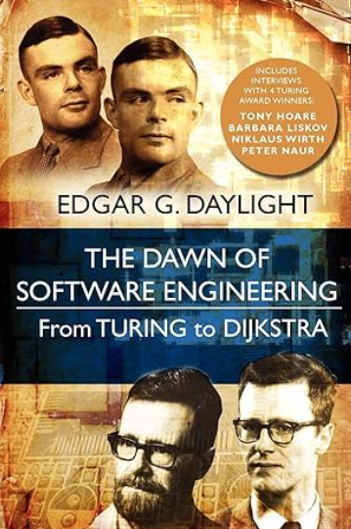
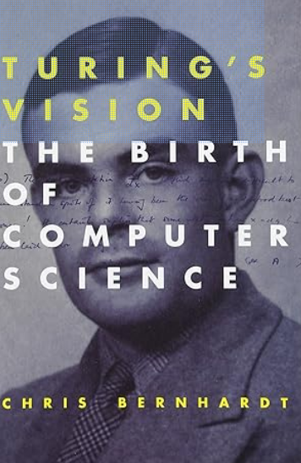
References
Wikipedia / Brilliant

Slide 44
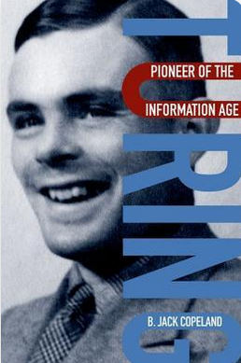
References

Slide 45
References
Good animated video of the halting problem:
https://www.youtube.com/watch?v=92WHN-pAFCs
Turing’s proof of the undecidability of the Halting problem explained in terms of mobile phone applications
https://thorehusfeldt.com/2012/06/25/the-freeze-app-does-not-exist/
Slides:
https://rbrayb.github.io/Presentations/

