Slide 1
Identity and Windows Azure
Rory Braybrook
AZR209

Slide 3
AAD allows you to move your I&AM to the cloud and manage access to both cloud and on-premise resources

Slide 4
Overview
AAD
ACS
Graph
API
ADAL
SSO

Slide 5
AAD ≠
AD
in cloud
ADD ≠ AD in Azure VM
AD AAD

Slide 6
AD
AD Domain Services
AD Lightweight Directory Services
AD Federation Services
AD Certificate Services
AD Rights Management Services
Corporate environment
Kerberos, LDAP, DNS
AAD
Azure Active Directory
Azure Access Control Service
AD RMS (Preview)
Cloud
REST, SAML-P, WS-Federation, OAuth, Graph API

Slide 7
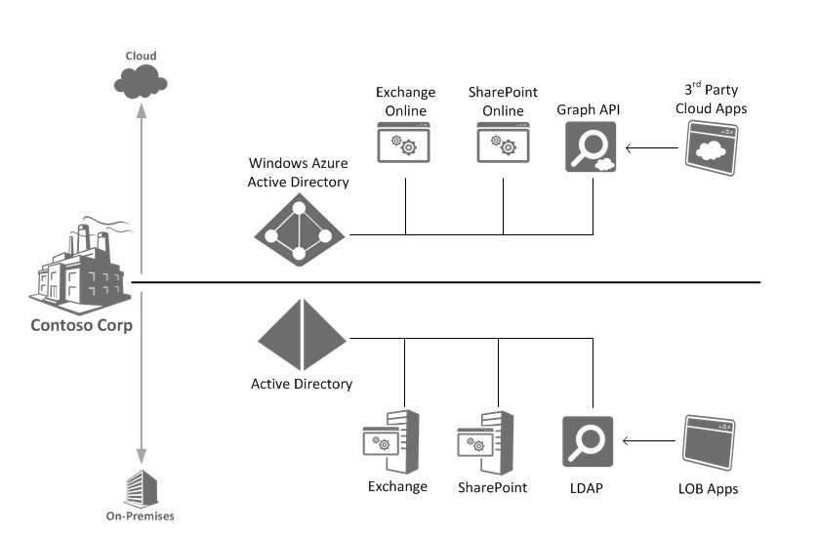
http://blogs.technet.com/b/in_the_cloud/archive/2013/08/09/what-s-new-in-2012-r2-identity-management-for-hybrid-it.aspx

Slide 8
AAD – one size fits all
Large companies
Projection of
on-premise AD
Small companies
Main repository

Slide 9
Concepts
Claims-based application
Security Token Service
Identity Provider
Service Provider
Windows Identity Foundation
Federation

Slide 10
AAD
Office 365
SharePoint Online
Exchange Online
Lync Online

Slide 11
Users
Attributes
AAD
targets
Authentication

Slide 12
Printers
AAD
doesn’t support
Management
of devices
Group policy

Slide 13

AAD supports SaaS
Google
docs
Sales
force
Dropbox
GitHub
Skype
Yammer
And many others …
Skydrive
Box

Slide 14
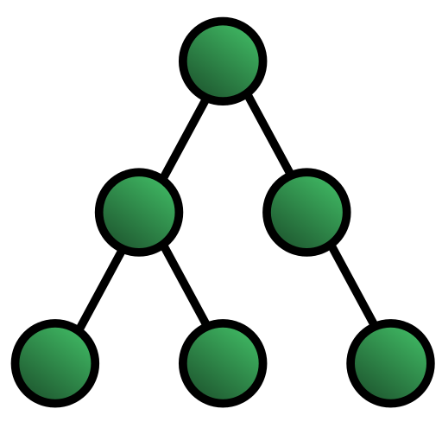


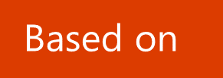
AD is hierarchical
Based on
Use
C# API

Slide 15

ADD is not hierarchical
Based on
Graph Theory
Use
Graph API based on REST

Slide 16
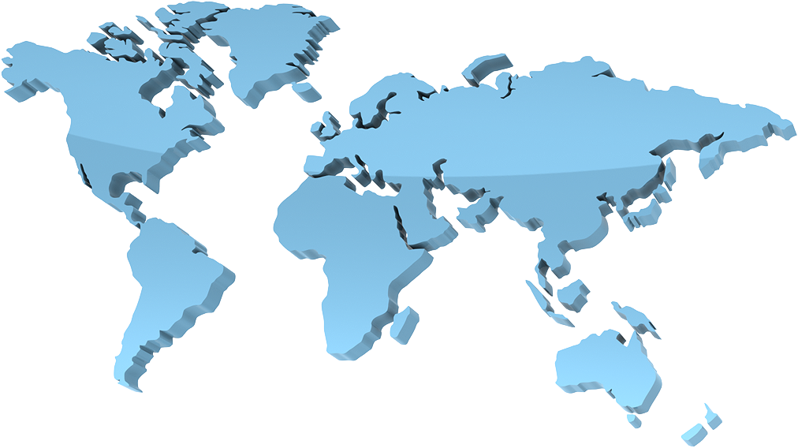
Management
Customer
Microsoft
Looks after
Supports infrastructure
Tenant
Data

Slide 17
Demo
Lap around the AAD Portal

Slide 18
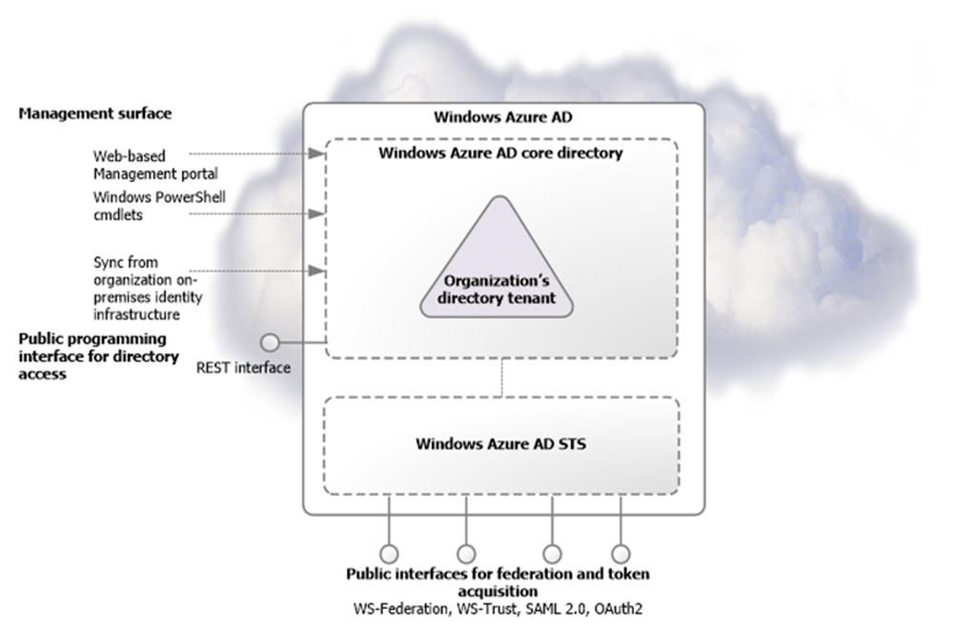
From: Microsoft – Active Directory from on-premises to the cloud

Slide 19
AAD is an ever moving target
Initial samples uses PowerShell
Later samples Tools & wizards
Authentication - currently no charge (other than MFA)

Slide 20
Demo
VS 2012 – AAD Tooling

Slide 21
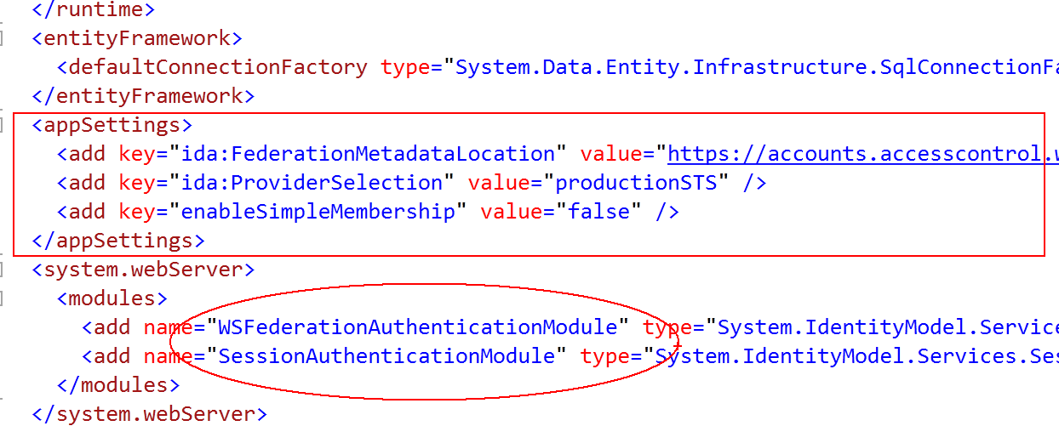

Slide 22
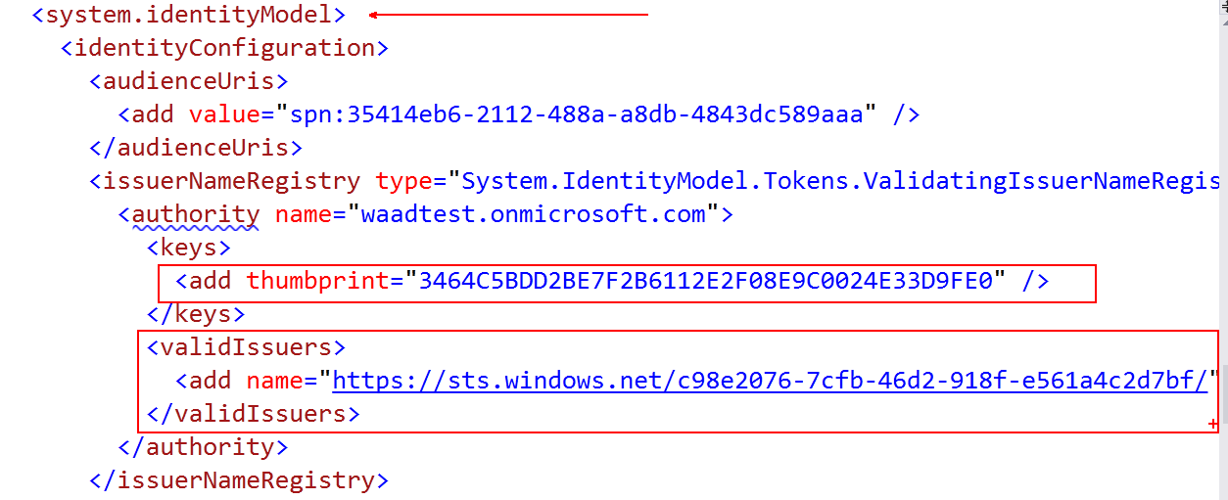

Slide 23
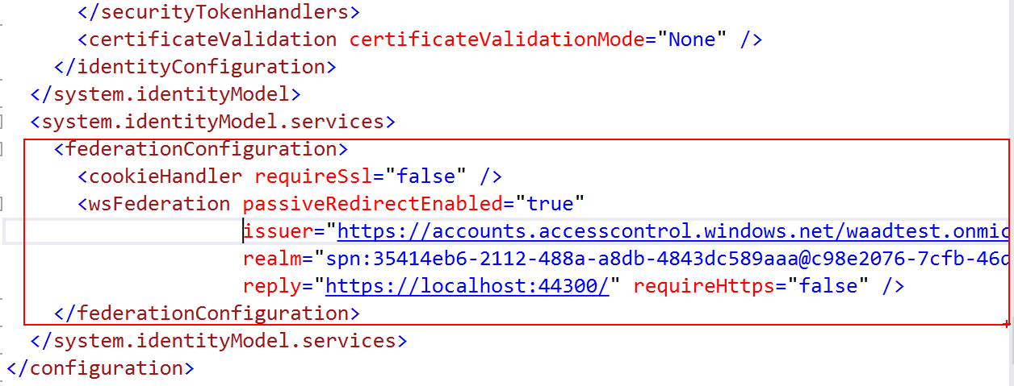

Slide 24
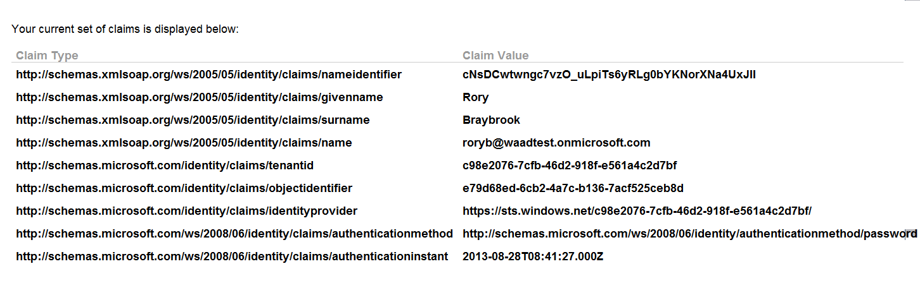

Slide 25
Federate AD and AAD using ADFS
ADFS
Repository (e.g. AD) attributes can be configured in a variety of ways
Claims rules language for manipulating attributes
Allow / deny access
AAD
Fixed set - others can be extracted via the Graph API
No functionality
No functionality

Slide 26
Synchronise or Federate?
Dirsync
A single server is needed
Simple architecture
Same Sign On - users will be prompted for credentials when accessing Office 365
ADFS
Redundant and scaled out ADFS servers
ADFS Proxies, load balancers, certificate management are required
Single Sign On (SSO)

Slide 27
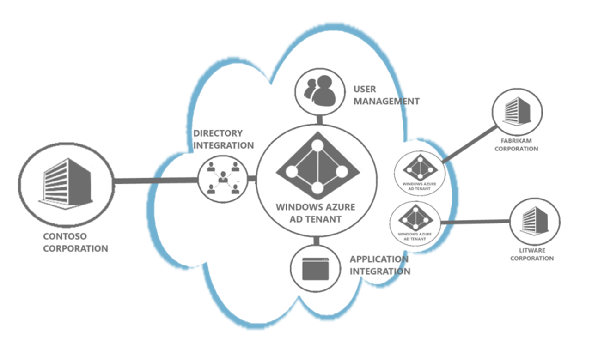
http://technet.microsoft.com/en-us/library/jj573650.aspx

Slide 28
Manipulate AAD using Graph API
Use OAuth endpoint to get token
AAD
Use token in REST call to graph endpoint
Token issued

Slide 29
Graph API REST interface
Create
POST
Read
GET
Update
PATCH
Delete
DELETE

Slide 30
Demo
Graph Explorer

Slide 31
AAL now ADAL
(In cloud)
Tenants
Namespaces
AAL
(In cloud)
Tenants
Namespaces
AAL
ADAL
(On premise)
OAuth2
JWT
ADFS
2012 R2

Slide 32

AAD handles demand
Since
2010
200 Billion
Authentications
processed
50 Million
Active user accounts
for
Average
week
4.7 Billion
Authentication
requests
420,000
Different domains
in
2 minutes
1 Million authentications processed
1 second
Receives 9,000 requests
0.7 second
per authentication

Slide 33
Demo
SSO

Slide 34
AAD allows you to move your I&AM to the cloud and manage access to both cloud and on-premise resources

Slide 35
Resources
Vittorio Bertocci
Cloud Identity blog - http://www.cloudidentity.com/blog/
Azure blog - http://blogs.msdn.com/b/windowsazure/
Azure Active Directory Graph - http://blogs.msdn.com/b/aadgraphteam/
Active Directory Team blog - http://blogs.technet.com/b/ad/
.NET Web Development and Tools blog - http://blogs.msdn.com/b/webdev/

Slide 36

Related content
Other Identity topics
ARC312 The Identity Jigsaw Puzzle
MDC320 The Business Mechanix “Bourne Identity”
OUC204 Overview of Microsoft Office 365 Identity Management
Find Me Later
Around and about TechEd

Slide 37
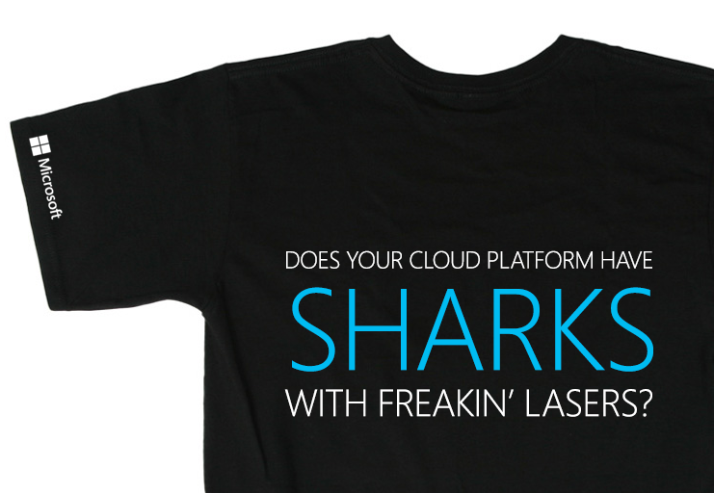
Every Windows Azure session you attend
gives you
a chance
to win this
epic t-shirt.
We’re giving
away one per
Azure session.
Sharks with freakin’
lasers as a Service.
Only on Windows Azure.

Slide 38
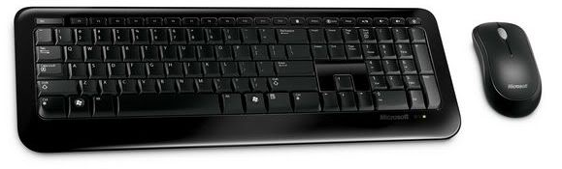
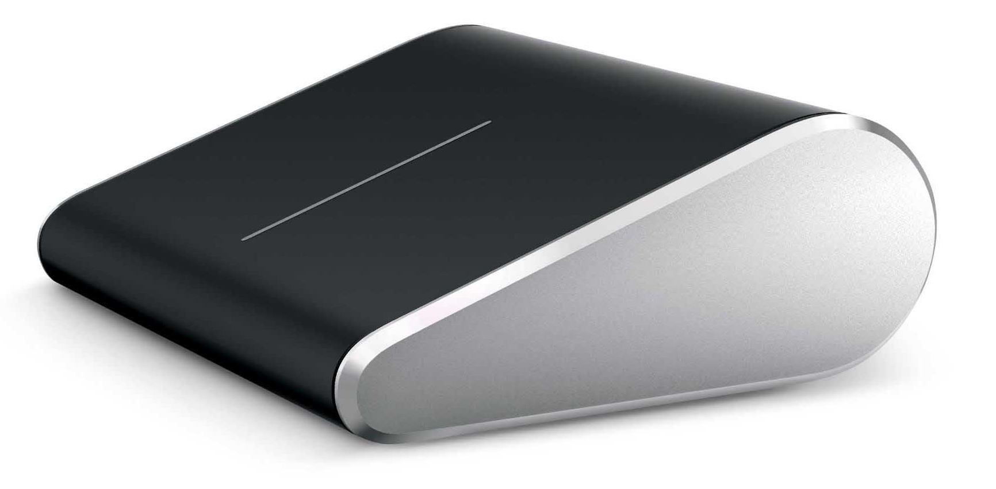
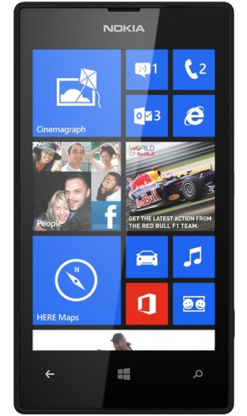
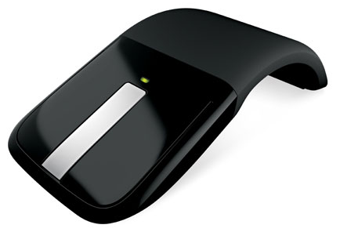
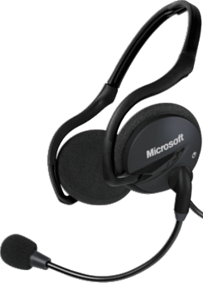
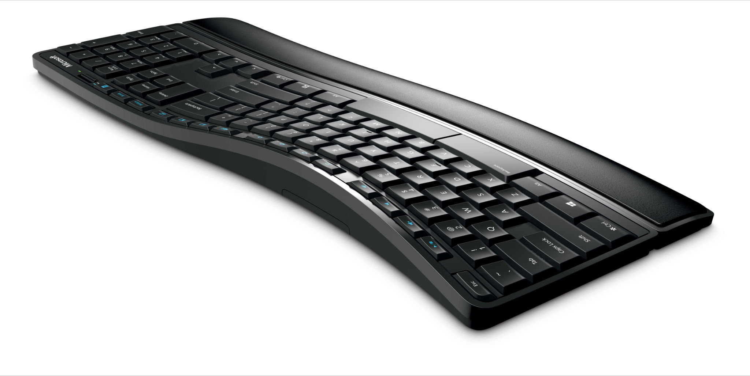
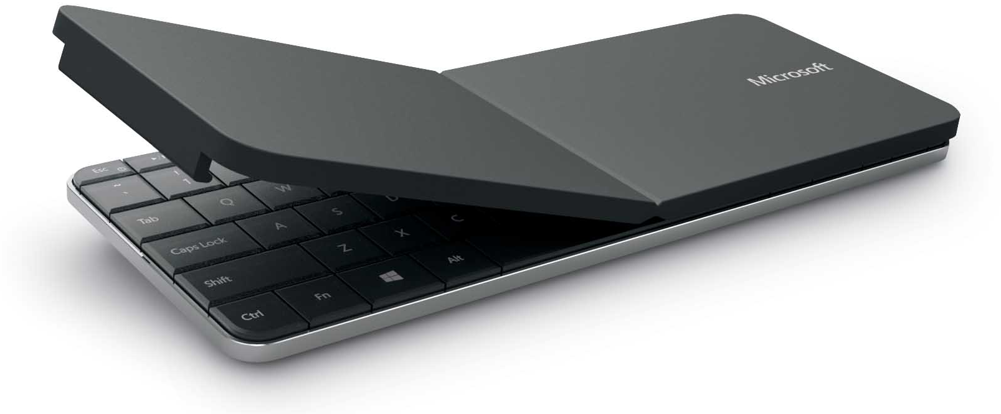
Evaluate this session and you could win instantly!
Head to...
aka.ms/te

Slide 39

© 2013 Microsoft Corporation. All rights reserved.
Microsoft, Windows and other product names are or may be registered trademarks and/or trademarks in the U.S. and/or other countries.
MICROSOFT MAKES NO WARRANTIES, EXPRESS, IMPLIED OR STATUTORY, AS TO THE INFORMATION IN THIS PRESENTATION.

