Slide 1
A lap around Entra External ID Rory Braybrook MVP (Security – Iam)

Slide 2
Note
This session will concentrate on the CIAM solution (B2C)
We are not looking at B2B (guest accounts)
But B2B is now in the EEID space!
Azure AD B2C at end

Slide 3
Why Entra External ID
B2C had to be built outside of Entra because of the large number of customers that had to be supported
This meant that Entra features had to be ported to B2C
Entra External ID is built inside Entra, so it inherits all the Entra goodness ☺ , e.g. groups
New features are being added
Supported features

Slide 4
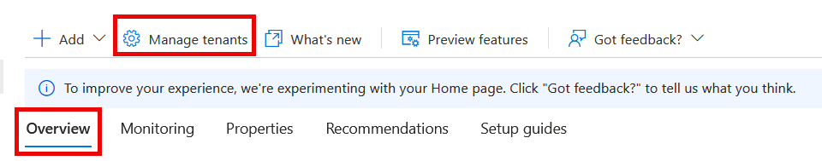
In Entra ID
entra.microsoft.com

Slide 5
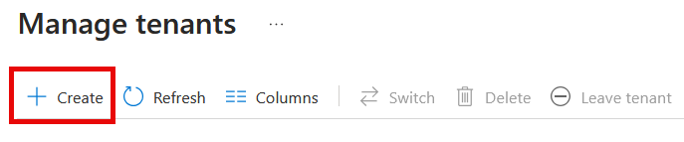
In Entra ID

Slide 6
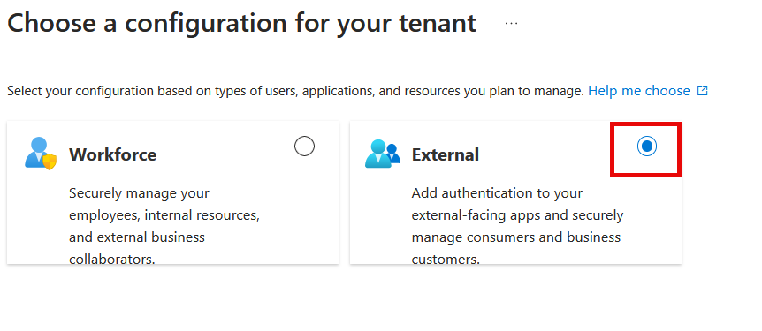
In Entra ID

Slide 7
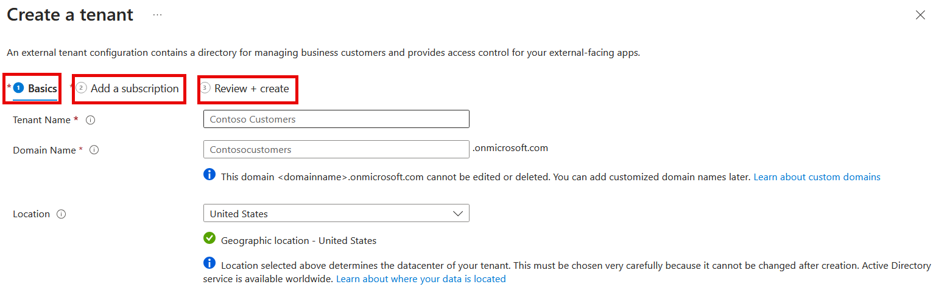
In Entra ID

Slide 8
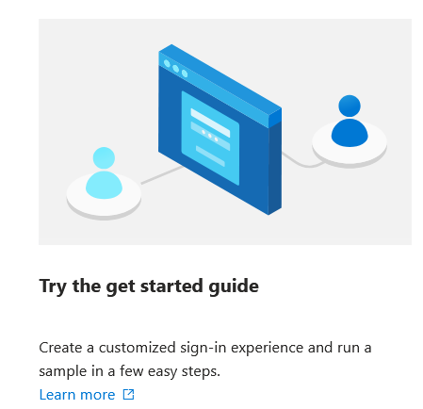
In Entra ID

Slide 9

Users

Slide 10
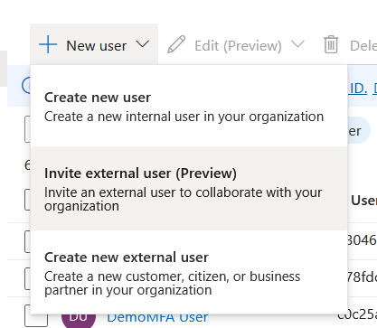
Users

Slide 11
Applications

Slide 12
User flows

Slide 13
Branding

Slide 14
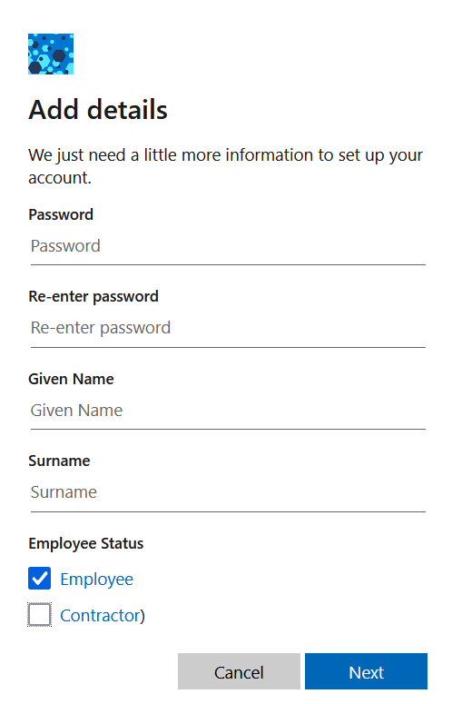
Sign-up

Slide 15
External Identity Providers

Slide 16
Authentication Methods

Slide 17
MFA with Conditional Access

Slide 18
Custom Authentication Extensions

Slide 19
Native Authentication

Slide 20
Pricing

Slide 21
Some points
B2B collaboration external guests in workforce tenants. UserType property is set to Guest
External users. MAU billing applies to all users in an external tenant regardless of their UserType setting
Billing is based on monthly active users (MAU), (the count of unique external users who authenticate within a calendar month). MAUs from all workforce and external tenants that are linked to a subscription are combined
0-50,000 MAUs - Free
Plus MFA (SMS) per verification attempt

Slide 22
Woodgrove Groceries

Slide 23
Samples

Slide 24
Questions?

Slide 25
And finally
B2C questions !!!!

Slide 26
Some points
Cannot create new B2C tenants after 1st May if you have never created one
If you already have one, no worries; you can create more
Support until at least 2030
No custom policies in Entra External ID
Migration plans to EEID be announced
“Hybrid” version

Slide 27
References
Introduction to Microsoft Entra External ID
Native authentication API reference
My blog
Woodgrove EEID demo.
Using Azure AD B2C custom policies with Entra External ID
My presentations

Slide 28
References
Gotchas with configuring EEID
Supported features in workforce and external tenants
Restrictions for Identity Protection
EEID pricing
Samples

Slide 29

Thank you
Rory Braybrook
rbrayb@gmail.com
https://rbrayb.github.io/Presentations/

