Slide 1
CIAM
Now in public preview
Microsoft Entra External ID, our next generation of a customer identity and access management (CIAM) solution that evolves Azure AD External Identities to help developers efficiently build secure and compliant applications for customers
One-stop shop - Identity Platform Developer Centre
Combines existing B2B and current B2C
A single, unified Microsoft Authentication Library (MSAL) where the same application code will work for workforce and customer scenarios

Slide 2
CIAM
Fully integrated into Azure AD so the richness of Azure is now available
Two tenant types – workforce and customer
Currently built-in policies only
New workflow to replace custom policies to be announced later

Slide 3
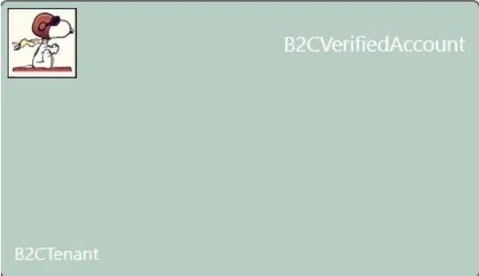
Verifiable credentials
Integrate industry-leading Microsoft Entra Verified ID capabilities into Microsoft Entra External ID natively
Soon can include them in your user journeys
You can integrate the upcoming release of the Verified ID Wallet Library (iOS, Android) into your mobile apps to store and share digital Verified ID cards

Slide 4
References
Microsoft Entra External ID
Entra CIAM developer centre
Microsoft Entra External ID for customer’s documentation
Microsoft Entra External ID​ public preview: Developer-centric platform
Empowering developers in the Dev. centre

