Slide 1
Global Azure Bootcamp Auckland 2018 Azure Active Directory
Rory Braybrook
@rbrayb

Slide 2
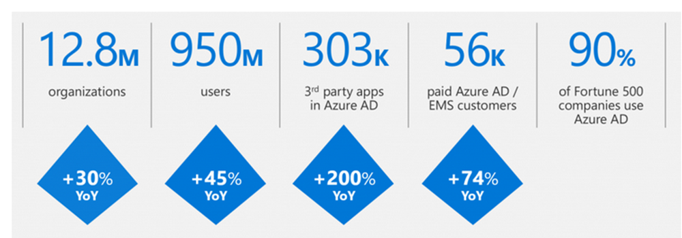
The reach

Slide 3
The Editions

Slide 4
Azure Active Directory Editions
Free
Basic – RBAM, SSPR, Branding
Premium P1 – MFA, Conditional Access, Connect Health
Premium P2 – Identity Protection, PIM
O365 Applications - ~Basic + P1
https://azure.microsoft.com/en-us/pricing/details/active-directory/

Slide 5
Azure Active Directory Premium
Self-Service password reset with on-premises write-back
Self-Service group management
Microsoft Identity Manager (MIM) user licenses
Multi-Factor authentication
Customized company branding
Rich security monitoring, analytics, alerts and reporting
Cloud App Discovery and AAD Connect Health

Slide 6
The Protocols

Slide 7
Protocols
WS Federation
SAML-P 2.0
OAuth2
OpenID Connect

Slide 8
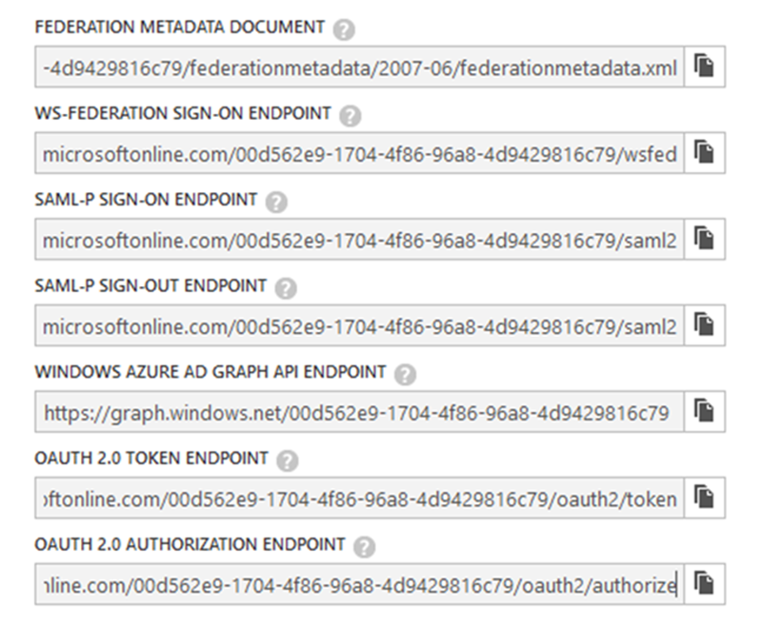

Slide 11
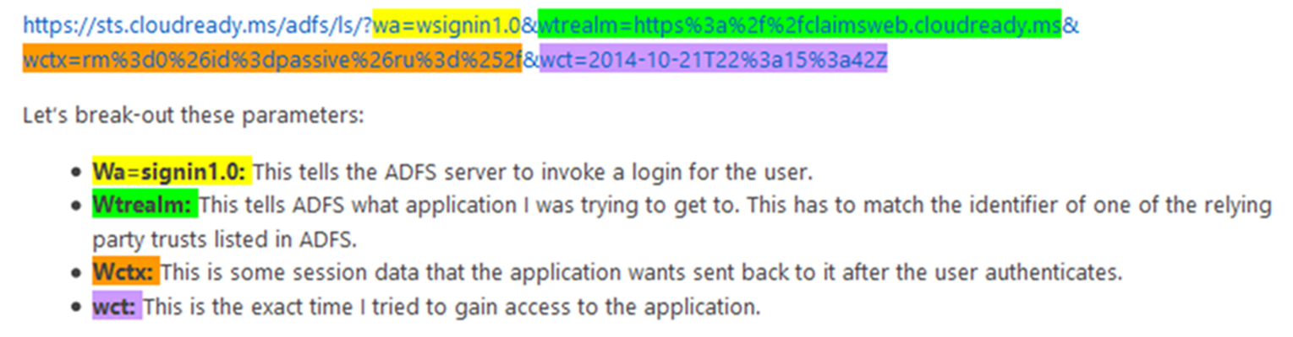
WS Federation
http://blogs.technet.com/b/askpfeplat/

Slide 12
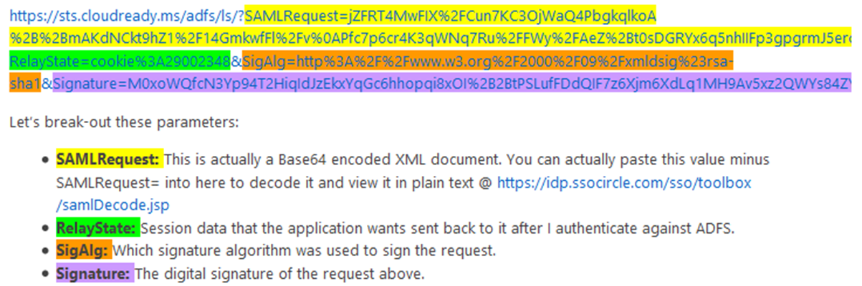
SAML-P
http://blogs.technet.com/b/askpfeplat/

Slide 13
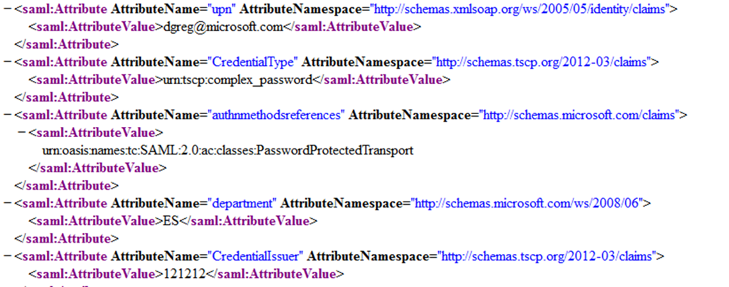
SAML token attributes

Slide 14
SAML token attributes

Slide 15
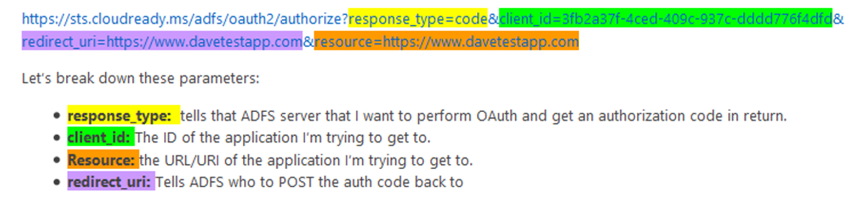
OAuth2
http://blogs.technet.com/b/askpfeplat/

Slide 16
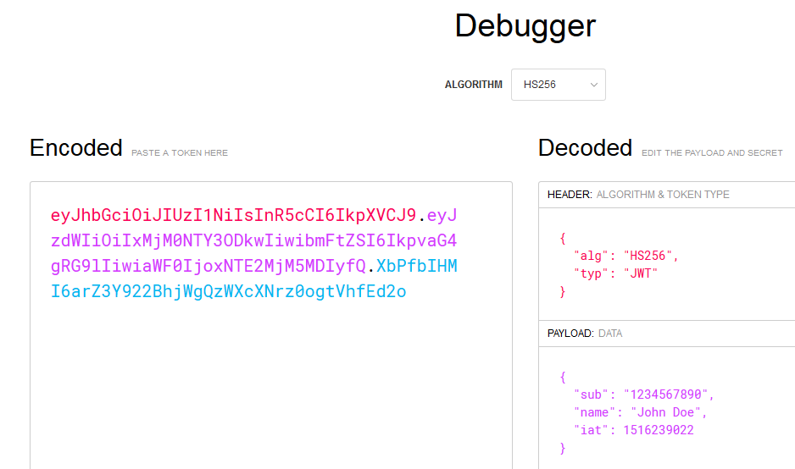
OAuth2 JWT

Slide 17




Manipulate AAD using API
Use OAuth endpoint to get token
AAD
Use token in REST call to endpoint
Token issued
Notes:
RB

Slide 18
OAuth2 token
Access token
ID token (OpenID Connect)
Refresh token
http://blogs.technet.com/b/askpfeplat/

Slide 19
Debug the tokens
jwt.io
jwt.ms
samltool.io
https://adfshelp.microsoft.com/

Slide 20
Use cases

Slide 21



Authentication scenarios
Browser
Web application
Web API
js
Native app
Web API
Web API
Server app
Clients using wide variety of devices/languages/platforms
Server applications using wide variety of platforms/languages
video.ch9.ms/teched/2012/na/SIA209.pptx

Slide 22
Authentication scenarios
WS-Fed, SAML 2.0, OpenID Connect
Web application
OAuth 2.0
Web API
Browser
js
Native app
OAuth 2.0
OAuth 2.0
Web API
Web API
Server app
OAuth 2.0
OAuth 2.0
Standard-based, http-based protocols for maximum platform reach
video.ch9.ms/teched/2012/na/SIA209.pptx

Slide 23
Graph Explorer
https://developer.microsoft.com/en-us/graph/graph-explorer#

Slide 24
The Access Panel
https://myapps.microsoft.com/

Slide 25
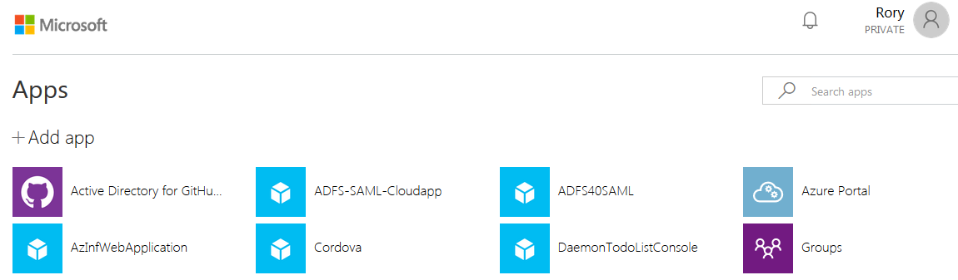
myapps
https://myapps.microsoft.com/

Slide 26
Conditional Access

Slide 27
How users access your cloud applications
Users and groups
Cloud applications
Sign-in risk
Device platforms
Locations
Client applications
What-If

Slide 28
The market place
https://azuremarketplace.microsoft.com/en-us/marketplace/

Slide 29
The wrappers

Slide 30
Wrappers around the protocols
OWIN
(All)
WIF
(WS Federation)
ADAL / MSAL
(OpenID Connect / OAuth)

Slide 31
Active Directory Authentication Library (ADAL)

Slide 32
ADAL Mission statement
The Active Directory Authentication Library (ADAL) is a library meant to help developers to take advantage of Azure Active Directory for enabling client applications to access protected resources

Slide 33
SDK available on multiple platforms
.NET, iOS, JavaScript, Android, Node.JS, Java, Windows Store, Windows Phone etc.
Caching and automatic refresh token
Asynchronous support
Basis of Graph API and Azure Management Library
Open source

Slide 34
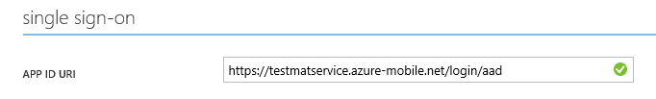
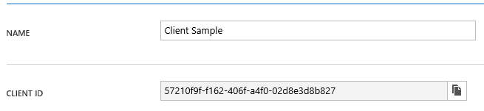

Active Directory Authentication Library
string clientId = "[Enter client ID as obtained from Azure Portal]";
string authority = "https://login.windows.net/[your tenant name]";
string myURI = "[Enter App ID URI of your service]";
AuthenticationContext authContext = new AuthenticationContext(authority);
AuthenticationResult result = await authContext.AcquireTokenAsync(myURI, clientId);

Slide 35
Azure AD as an IDP

Slide 36
Can federate with 3rd party application in Gallery e.g. SalesForce
AAD as an IDP
Can federate with e.g. ADFS via metadata
Can use user name and password via the Access Panel e.g. Twitter
Can federate with 3rd party application not in Gallery via the Access Panel / Custom / SAML-P

Slide 37
VS “Change Authentication”

Slide 38
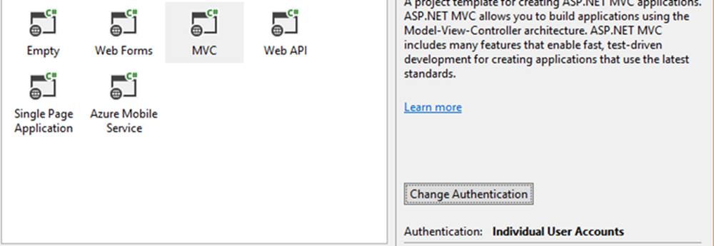
Change authentication

Slide 39
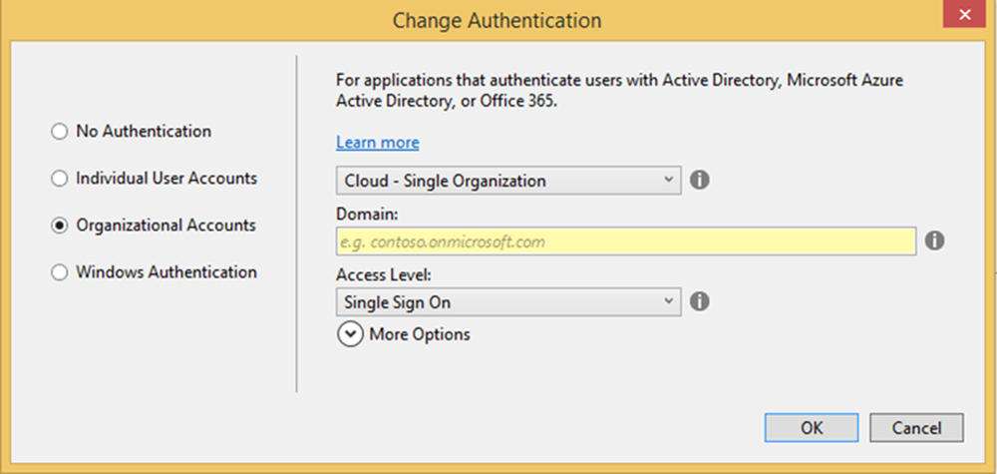
Change authentication

Slide 40
A lap around Azure AD

Slide 41
Resources
Azure AD blog - https://cloudblogs.microsoft.com/enterprisemobility/?filter=0
Ask Premier Field Engineering - http://blogs.technet.com/b/askpfeplat/
Azure AD Documentation – https://docs.microsoft.com/en-us/azure/active-directory/
Azure AD Samples - https://docs.microsoft.com/en-us/azure/active-directory/develop/active-directory-code-samples
Cloud Identity Infographic - http://azure.microsoft.com/en-us/documentation/infographics/cloud-identity-and-access/

