Slide 1


Don’t be a know-it-all Be a learn-it-all
Satya Nadella

Slide 2
Azure AD B2C to Entra External ID Migration Kit
Rory Braybrook – Microsoft MVP (Security – IAM)

Slide 3
Migrate what?
Users ☑️
Passwords (JIT) ☑️
Email login ☑️
Username login ☑️
App. registrations ☑️
User flows ☑️ ✖️
Custom policies ✖️

Slide 4
Migrate what?
Custom attributes ☑️
Social federation ☑️
OIDC federation ☑️
SAML federation ☑️
SUSI ☑️
Password reset ☑️
Profile edit ✖️
MSAL JSON configuration ☑️

Slide 5
Migration options
Graph API and reset password
Graph API and passwordless via email / OTP
Use Azure function – custom policy to EEID
Hybrid – B2C and EEID share tenant
JIT migration
Migration tool

Slide 6
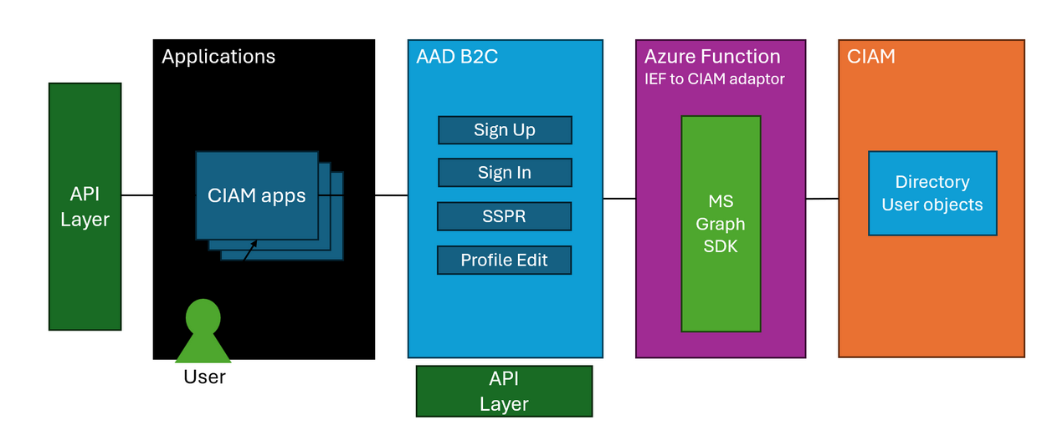
Custom policy to EEID

Slide 7
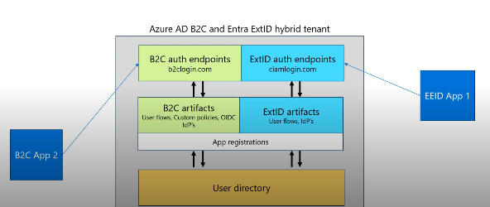
Hybrid approach

Slide 8
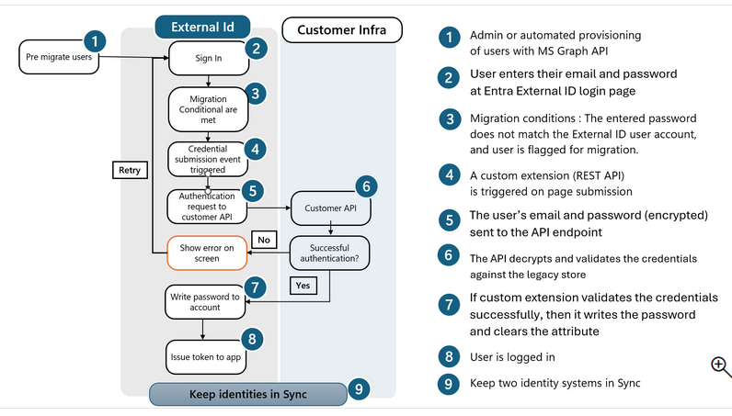
JIT password migration

Slide 9
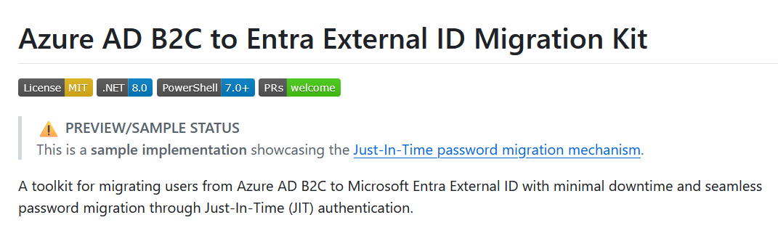
Migration tool

Slide 10
Key Components
B2CMigrationKit.Console
CLI tool with 5 bulk migration commands (export, import, harvest, worker-migrate, phone-registration)
B2CMigrationKit.Function
Azure Function for JIT password migration
B2CMigrationKit.Core
Shared business logic and services

Slide 11
Three parts (simple mode)
(Primarily users and passwords)
Export B2C users to blob storage
Import EEID users from blob storage
JIT password migration

Slide 12
Three parts (advanced mode)
Harvest - B2C user IDs, enqueues batches to migrate queue
WorkerMigrate - Dequeues IDs, fetches from B2C, creates in EEID, enqueues phone tasks
PhoneRegistration - Fetches MFA phone from B2C, registers in EEID (throttled)

Slide 13
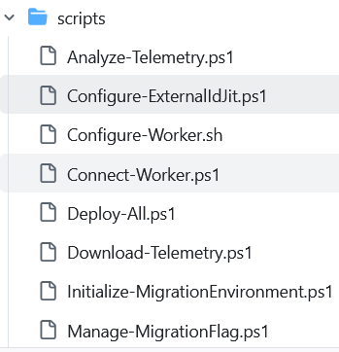
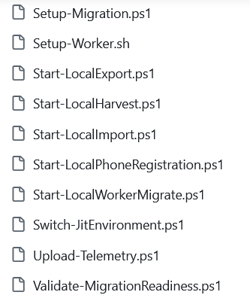
Scripts

Slide 14
Appsettings - Export
"Export":
{ "SelectFields": "id,
userPrincipalName,
displayName,
givenName,
surname,
mail,
mobilePhone,
identities,
extension_abc123_CustomerId"}

Slide 15
Appsettings - Import
"Import": {
"AttributeMappings": {
"extension_b2c_LegacyId": "extension_extid_CustomerId" },
"ExcludeFields": ["createdDateTime"],
"MigrationAttributes":
{ "StoreB2CObjectId": true,
"B2CObjectIdTarget": "extension_xyz_OriginalB2CId",
"SetRequireMigration": true,
"RequireMigrationTarget": "extension_xyz_RequiresMigration" }}

Slide 16
Configure-ExternalIdJit
https://medium.com/the-new-control-plane/azure-ad-b2c-to-entra-external-id-eeid-migration-kit-configure-externalidjit-217f14471f75

Slide 17
Start-LocalExport
https://medium.com/the-new-control-plane/azure-ad-b2c-to-entra-external-id-eeid-migration-kitstart-start-localexport-ef565b075114

Slide 18
Start-LocalImport
https://medium.com/the-new-control-plane/azure-ad-b2c-to-entra-external-id-eeid-migration-kit-start-localimport-a3e0760ed577

Slide 19
Test / Production
Test with Azure function running locally, local keys, Ngrok and Azure blob storage emulator
Production with Azure function running in the cloud, Azure key vault, and Azure blob storage

Slide 20
References
JIT password migration
B2C custom policy to EEID
Migration tool
Azure AD B2C / Entra External ID hybrid policies
B2C to EEID JIT migration
Presentations

