Slide 1
The new control plane
Rory Braybrook
@rbrayb

Slide 2
The new control plane
Goodbye ADFS?

Slide 3
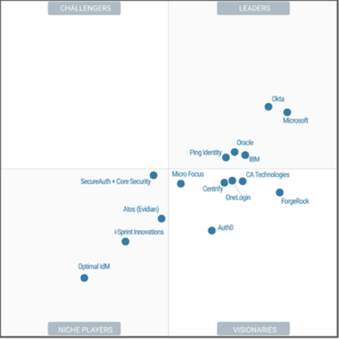

Slide 4
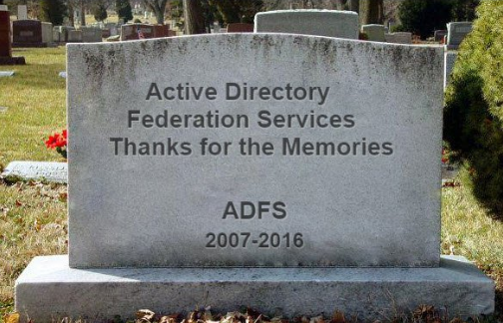

Slide 5
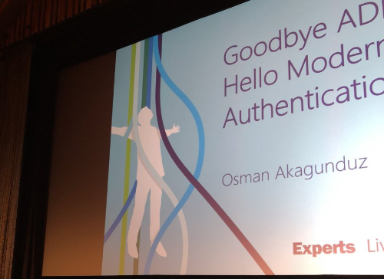

Slide 6
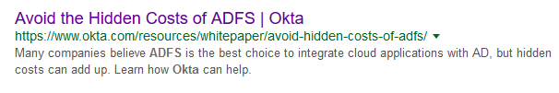
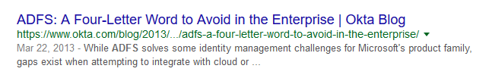

Slide 7
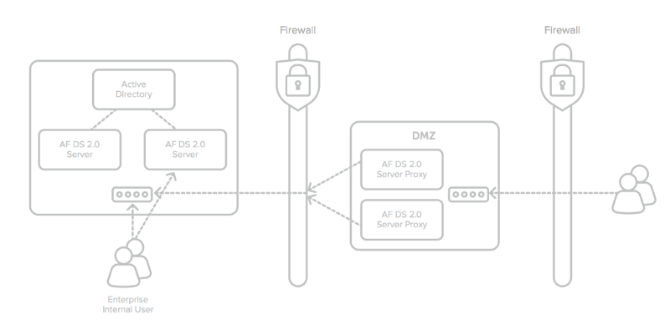

Slide 8
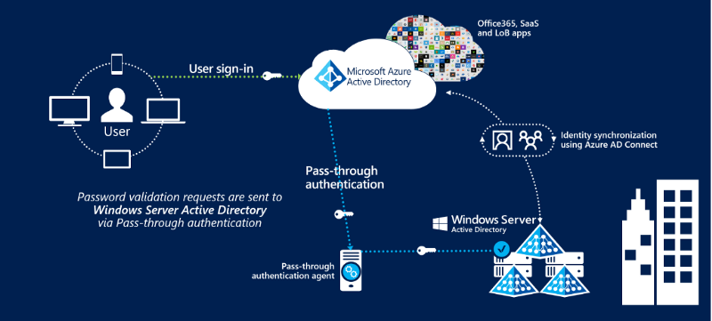
Pass-through authentication
AAD Pass-through Authentication allows your users to sign in to both on-premises and cloud-based applications using the same passwords. It allows your users to sign in to both on-premises and cloud-based applications using the same passwords.

Slide 9
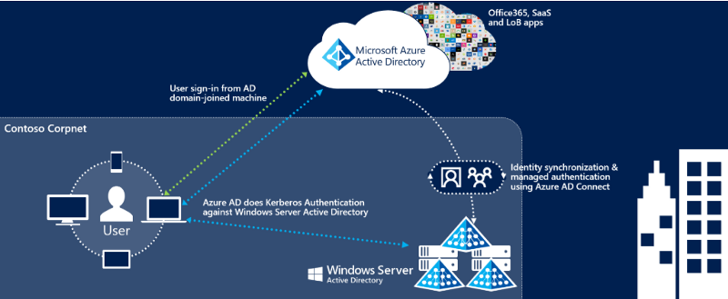
Seamless SSO
AAD Seamless SSO automatically signs users in when they are on their corporate devices connected to your corporate network.
N/A for ADFS.

Slide 10
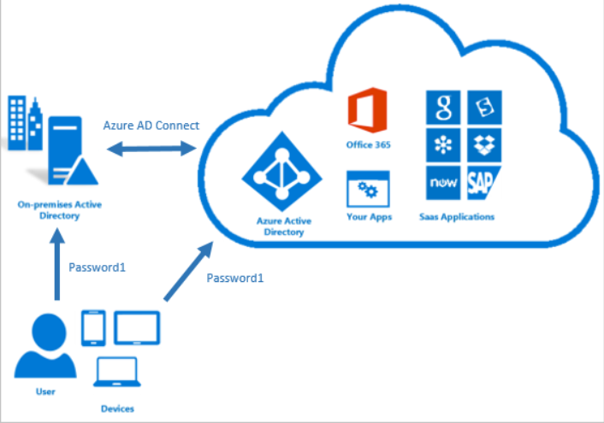
Password hash synchronization
Used to synchronize user passwords from an on-premises AD instance
to a cloud-based AAD instance.

Slide 11
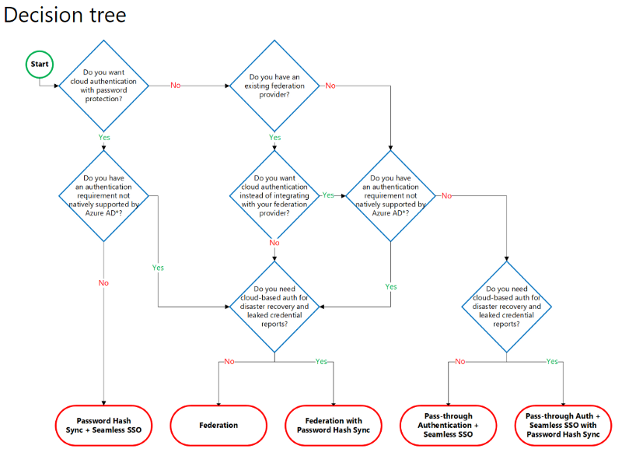

Slide 12
You need ADFS when:
Sign-on using smartcards or certificates
Sign-on using on-premises MFA server
Multi-site on-premises authentication solution
Advanced claim transformations such as transformation of attributes, regular expressions, or claim extractions from LDAP, SQL Server, or custom attribute stores
Token customisations such as SHA256 signatures, specific NameID policies, etc.
Support for SAML 1.1 tokens for WS-Federation applications

Slide 13
You need ADFS when:
Custom triggering of multi-factor authentication rules that are not supported by conditional access.
Custom authorization logic that can’t be modelled as a security group or conditional access policies.
Use of 3rd Party MFA providers such as RSA SecurID, Vasco, YubiKey, etc.
Support for auto-registration of Windows 7 and 8.1 domain joined devices for device-based conditional access.
If you want the authentication to take place on-premises.
If you want to create a trust between SharePoint on-premises and Azure AD and you don’t have Azure AD Premium.

Slide 14
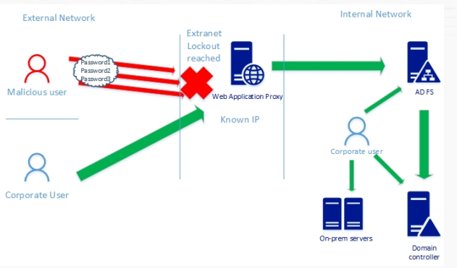
Extranet / smart lockout
https://samilamppu.wordpress.com/2018/07/09/w2016-adfs-smart-lockout/

Slide 15
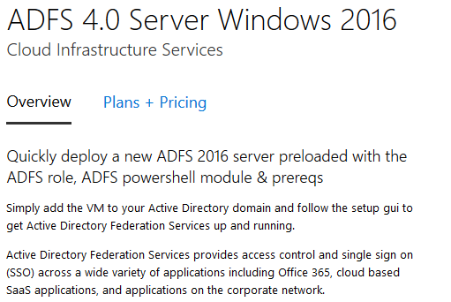
ADFS 4.0 in marketplace
https://azuremarketplace.microsoft.com/en-us/marketplace/apps/cloud-infrastructure-services.adfs-server-2016

Slide 16
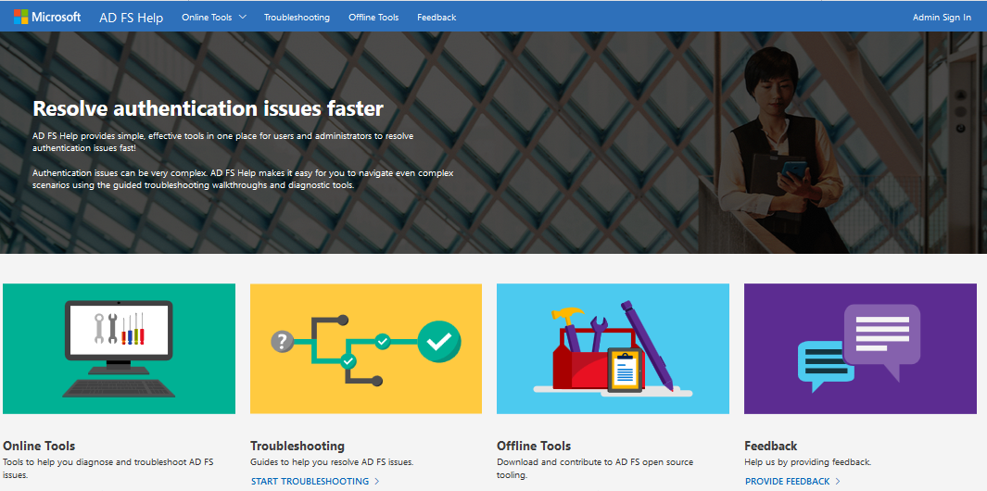
https://adfshelp.microsoft.com/

Slide 17
The new control plane
Thanks for watching

