Slide 1

NHL winning team analysis
Presenter Names: Ravina Kolsawala
Ron Brennan
Joel Demontigny
Date: June 5, 2023
(The NHL and the NHL Shield are registered trademarks of the National Hockey League. NHL and NHL team marks are the property of the NHL and its teams. © NHL 2023. All Rights Reserved.)

Slide 2
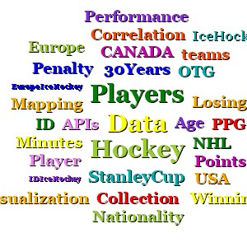
Agenda
Introduction
Objectives
Analysis
Conclusion

Slide 3
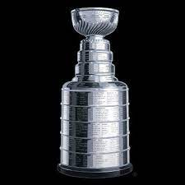
Introduction
The data used for this analysis was collected from the Nation Hockey Leagues free Application Programing Interface (API) which included official National Hockey League(NHL) records and statistics for each season, team and player for the past 30 years (1991-2022). We leveraged the following datapoints: Age, Nationality Penalty Infraction Minutes(PIM), Power Play Goals(PPG), Points(Pts), Plus/Minus(+/-), Overtime Goal(OTG).

Slide 4
Questions to be answered
Does the team with the best plus/minus equate to a Stanley Cup winner?
Over the last 3 decades, is there a trend related to geographic locations/hockey programs?
What statistics have a material difference for the Stanley Cup winning team?
What is the ideal team makeup to create a Stanley Cup winning team?

Slide 5
Analysis
Data

Slide 6
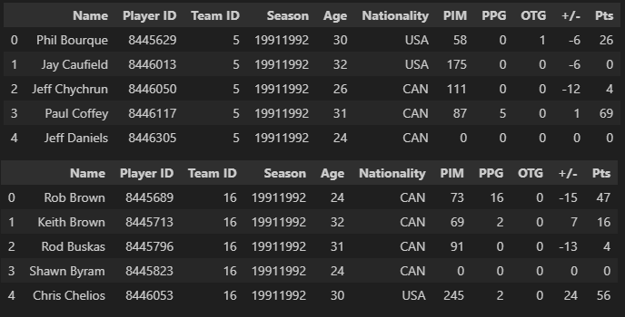
Dataframe snapshot of the Stanley Cup winning and losing team players (1991-2022)
Winning:
Losing:
https://en.wikipedia.org/wiki/List_of_Stanley_Cup_champions
https://statsapi.web.nhl.com/api/v1/teams
https://statsapi.web.nhl.com/api/v1/team/<ID>?expand=team.roster&season=<seasom>
https://statsapi.web.nhl.com/api/v1/people/<ID>

Slide 7
Analysis
Nationality

Slide 8
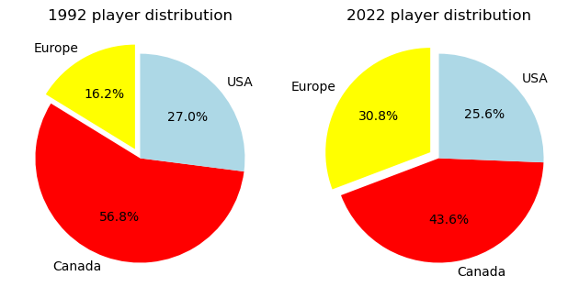
Over the last 3 decades, is there a trend related to geographic locations/hockey programs?
There is a noticeable increase in European players when comparing the most recent winning team's roster vs that of 1991-1992. Canadian representation has had a significant reduction, and the U.S. remains constant, but most recently had the lowest representation.
*charts are reflective of the winning team only

Slide 9
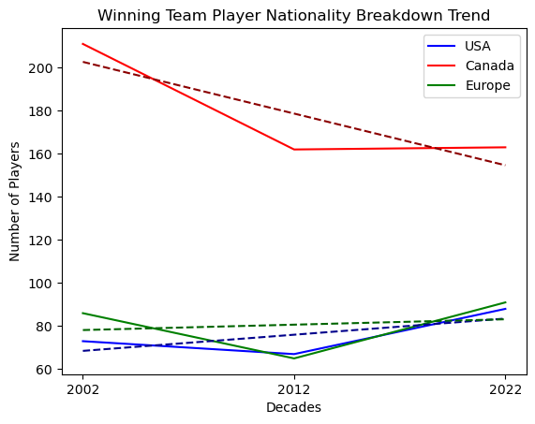
Over the last 3 decades, is there a trend related to geographic locations/hockey programs?
The Canadian player reduction in representation was most significantly impacted in the decade of 2003-2012 and has remained consistent since.

Slide 10
Analysis
PPG vs Pts

Slide 11
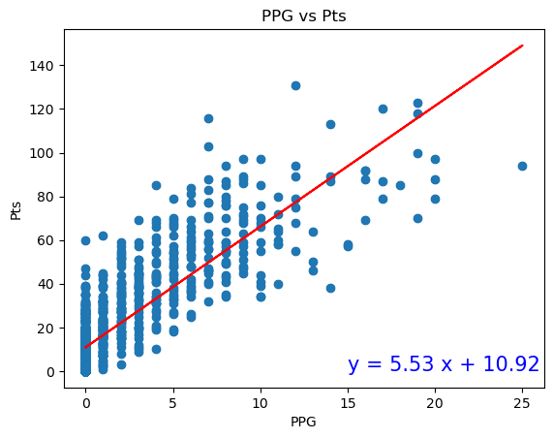
What statistics have a material difference for the Stanley Cup winning team?
The correlation between PPG vs Pts is 0.83. This graph clearly depicts the correlation between scoring PPG and resulting in an overall increase in points.

Slide 12
Analysis
PIM and +/-

Slide 13
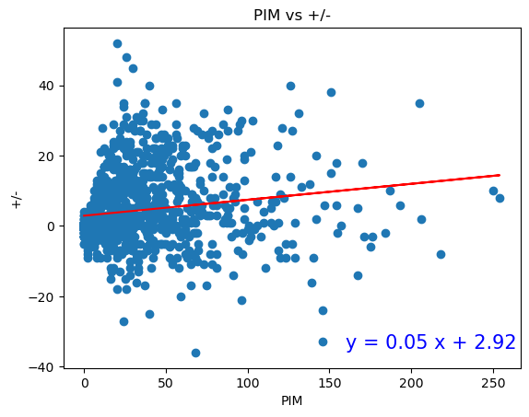
Does the team with the best plus/minus equate to a Stanley Cup winner?
The correlation between PIM and +/- is 0.16. Except for outliers, the lower a player's PIM, the more likely of a more positive +/- result.

Slide 14
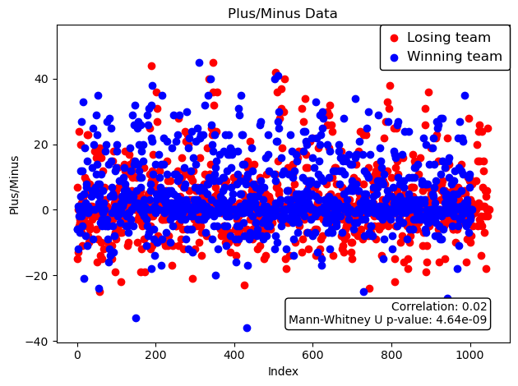
Does the team with the best plus/minus equate to a Stanley Cup winner?
Of the 2000+ entries, +2 to -2 is very dense. The winning team (blue) has a slightly above 0 stronger representation with an average +/- of slightly above 4 and the losing team at 2. When comparing the two sets of values, the p-value supports that there is a very strong correlation between a more positive +/- and winning.

Slide 15
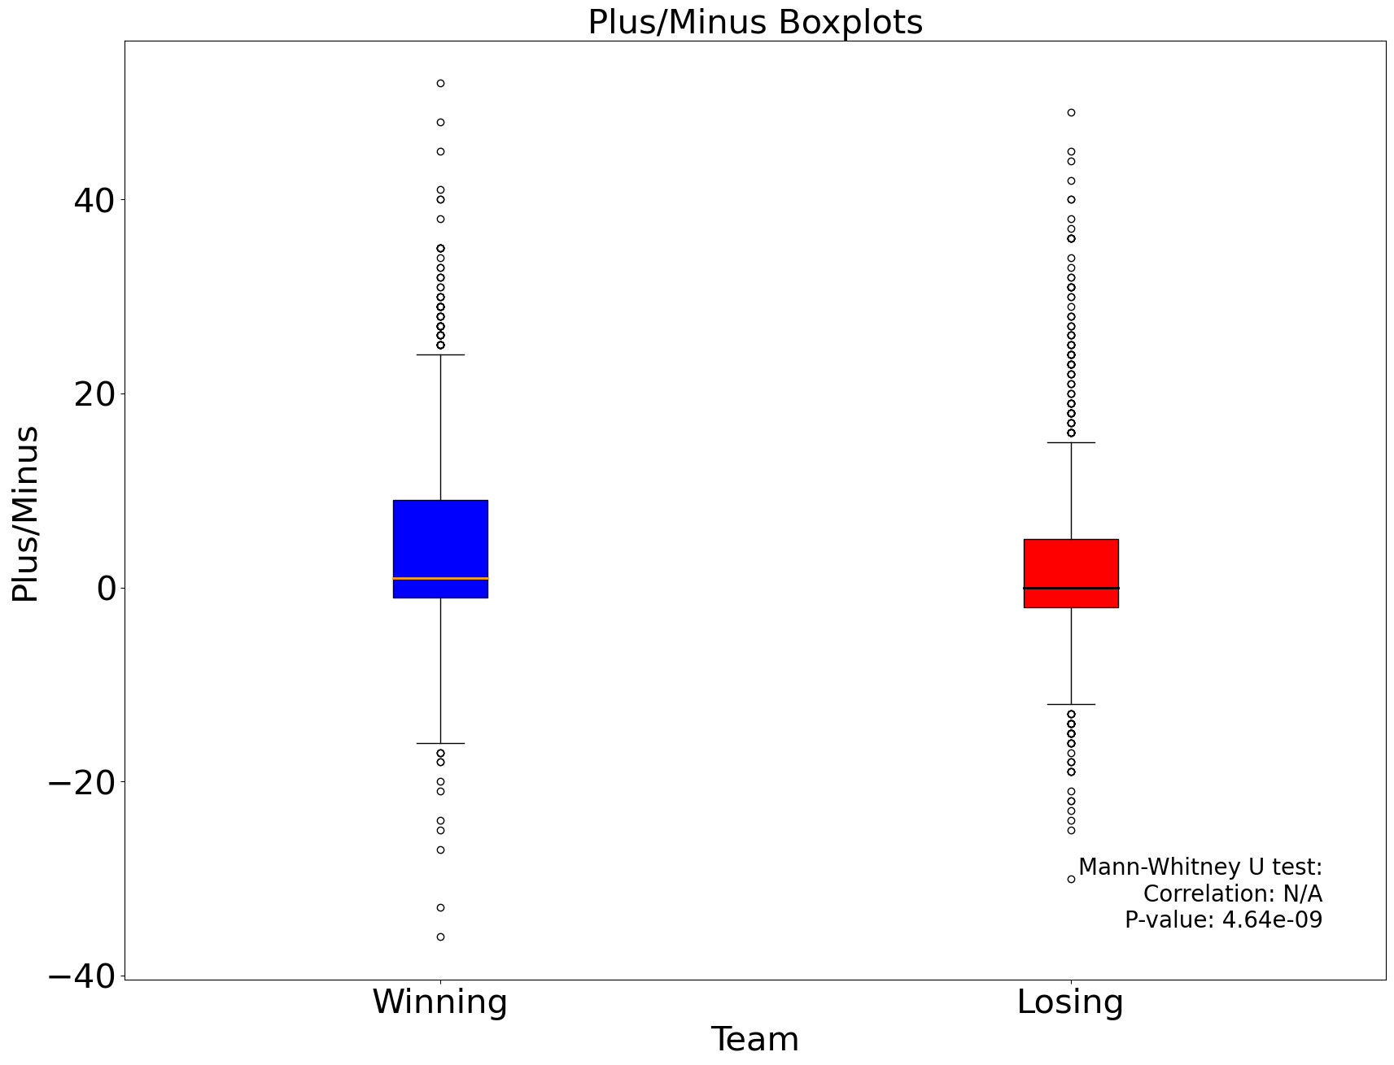
Does the team with the best plus/minus equate to a Stanley Cup winner?
The results of the box plots depicts how the winning team has far more consistency amongst its players. This is also supported by having less outliers than the losing team at each extremity.

Slide 16
Analysis
Key statistical comparison

Slide 17
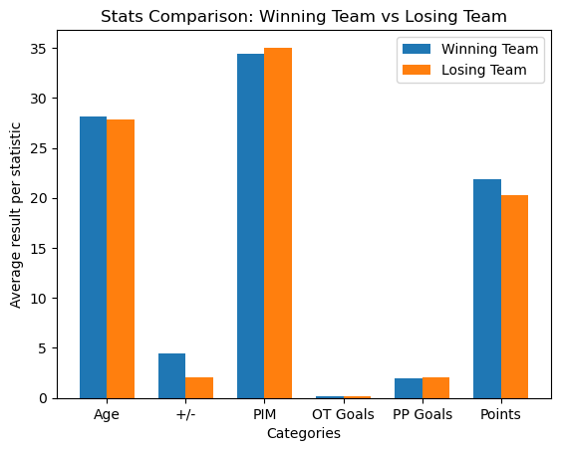
Team comparison
When comparing the identified key stats for all seasons between the winning and losing team, it is apparent that the one statistic with the most material difference and impact is the '+/-'.

Slide 18
Conclusion

Slide 19
Conclusion
Stanley Cup winning team makeup:
Based on our overall analysis and supporting data, there is no material difference regarding age groups and winning. Years of experience requires additional analysis.
There should be a heightened focus on recruiting European players. Their hockey programs have significantly evolved, and the number of European players playing in the NHL is showing a steady increase, while the Canadian player representation is reducing.
More PPG equates to a higher overall point value and not a substitute for regular goals.
It is favorable and improves the likelihood of winning to have more consistency amongst contributing players vs having one or two superstars on the team. The box plot comparing the +/- supports this theory as the winning team has less outliers and more consistency when compared to the losing team. The +/- statistic is also the only key statistic analyzed that has a material difference (100% increase) in results when comparing the winning and losing team.
Future analysis reviewing Stanley Cup Finals’ data only, can provide greater variability in data points and provide additional trending, influencing additional recommendations.

Slide 20


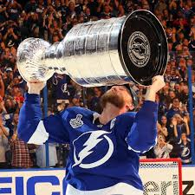


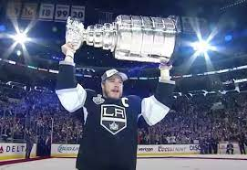
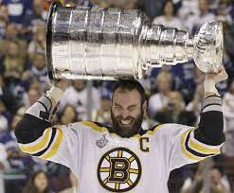

Will your team be the next to hoist the cup?

Slide 21

Team
Ravina Kolsawala
Data Analyst Student
Ron Brennan Data Analyst Student
Joel Demontigny Data Analyst Student

Slide 22
Appendix A:
Glossary:
PIM – Penalty Infraction Minutes – It is the cumulative total of time that a player has spent in the penalty box due to on ice infractions
PPG – Power play goals – Number of goals the player has scored while his team was on the power play.
PTS – Points – Scoring points, calculated as the sum of goals and assists.
+/- – Plus/minus – The number of team even strength or shorthanded goals for minus the number of team even strength or shorthanded goals against while the player is on the ice.
PPG – Power play goals – Number of goals the player has scored while his team was on the power play.
OTG - Overtime Goal

Slide 23
Appendix B:
Reference content:
https://statsapi.web.nhl.com/api/v1/teams
https://statsapi.web.nhl.com/api/v1/team/<ID>?expand=team.roster&season=<seasom>
https://statsapi.web.nhl.com/api/v1/people/<ID>
"copyright" : "NHL and the NHL Shield are registered trademarks of the National Hockey League. NHL and NHL team marks are the property of the NHL and its teams. © NHL 2023. All Rights Reserved.“
https://en.wikipedia.org/wiki/Ice_hockey_statistics#:~:text=Team%20statistics%20STK%20-%20winning%20or%20losing%20streak,tie%20%28Note%3A%20The%20NHL%20no%20longer%20uses%20ties.
https://en.wikipedia.org/wiki/List_of_Stanley_Cup_champions

