Slide 1

NHL winning team analysis
Presenter Names: Ravina Kolsawala
Ron Brennan
Joel Demontigny
Date: June 5, 2023

Slide 2
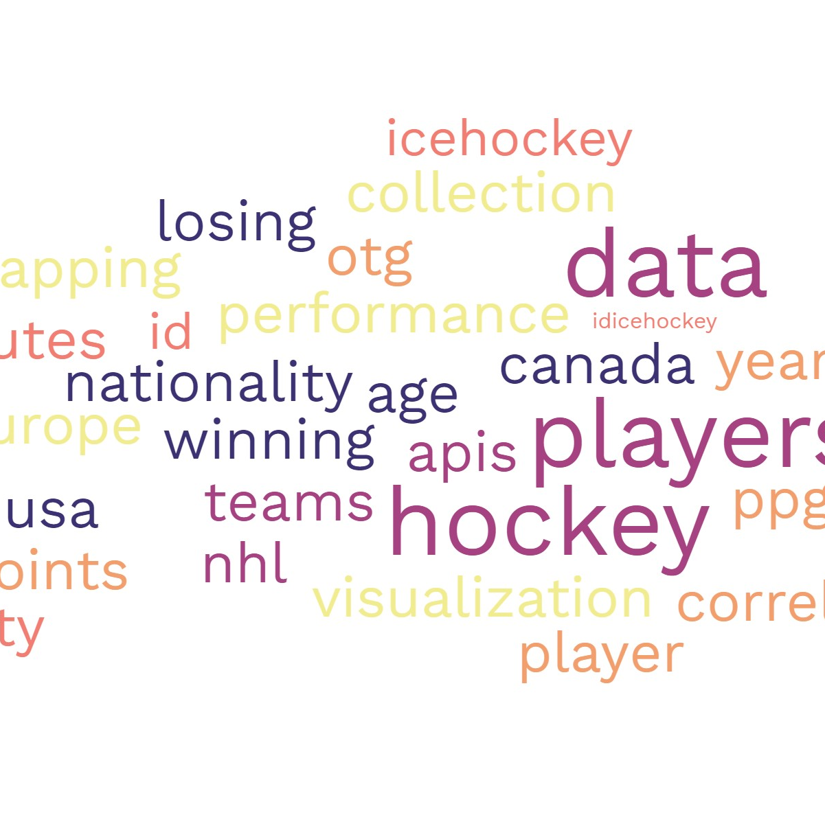
Agenda
Introduction
Objectives
Data review
Analysis
Conclusion

Slide 3
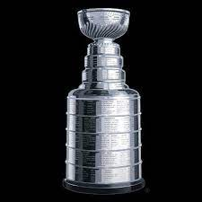
Introduction
The Stanley Cup is the hardest ttophy to win in all professional sports, awarded annually to the team that emerges victorious in the National Hockey League (NHL) playoffs. The winning team must win 16 games in order to win "The Cup". Understanding the composition of winning and losing teams can provide valuable insights into the dynamics and strategies that contribute to success on the ice.
The data used for this analysis was collected from the Nation Hockey Leagues free Application Programing Interface (API) which included official NHL records and statistics for each season, team and player. It includes information such as player names, ages, nationalities, and team affiliations for each season. As well as all the statistical informtion for each player. In order to harvest the information needed, the first task was to get a list of all Stanley Cup winners and losers for the past 30 years (1991-2022).

Slide 4
objectives

Slide 5
Hypothesis
1a) Null Hypothesis:
The plus/minus statistic has no impact on whether a team will win the Stanley Cup or not.
1b) Alternative Hypothesis:
The team with the greatest positive plus/minus result will equate to being the team that wins the Stanley Cup.

Slide 6
Questions to be answered
Does the team with the best plus/minus equate as the Stanley Cup winner?
Over the last 3 decades, is there a trend related to geographic locations/hockey programs?
What statistics have a material difference for the Stanley Cup winning team?
What is the ideal team makeup to create a Stanley Cup winning team?

Slide 7
Analysis

Slide 8
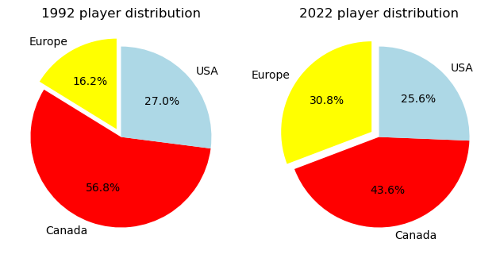
Winning team’s player nationality: then and now
There is a noticeable increase in European players when comparing the most recent winning team's roster vs that of 1991-1992. Canadian representation has had a significant reduction, and the U.S. remains constant, but most recently had the lowest representation.

Slide 9
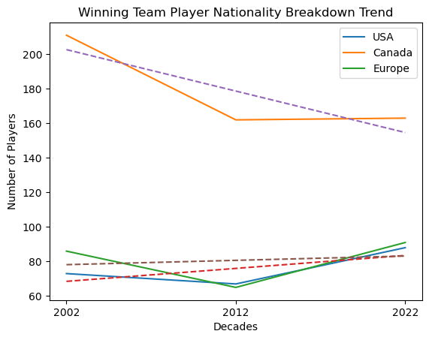
Winning team player nationality trends
The Canadian player reduction in representation was most significant impacted in the decade of 2003-2012 and has remained consistent since.

Slide 10
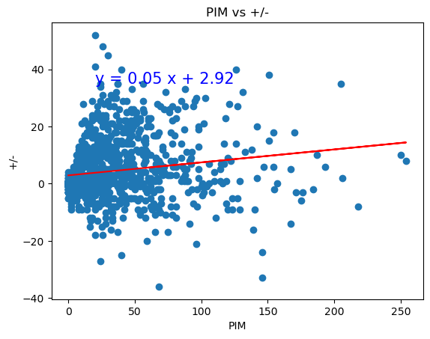
The correlation between PIM and +/- is 0.16. Except for outliers, the lower a player's PIM, the more likely of a more positive +/- result.

Slide 11
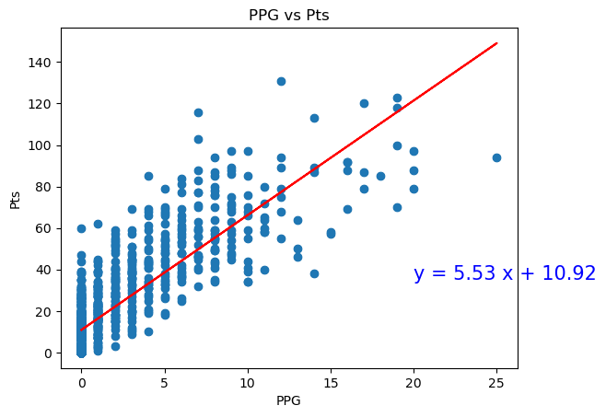
Winning teams’ data
The correlation between PPG vs Pts is 0.83. This graph clearly depicts the correlation between scoring PPG and resulting in an overall increase in points.

Slide 12
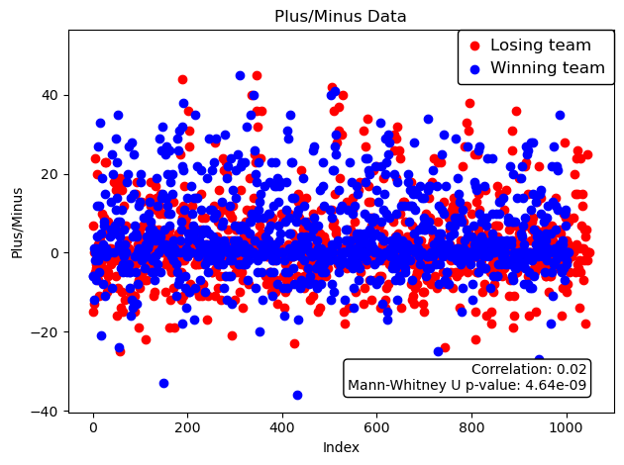
Winning team and Losing team +/- comparison
Of the 2000+ entries, +2 to -2 is very dense. The winning team (blue) has a slightly above 0 stonger representation with an average +/- of slightly above 4 and the losing team at 2. When compare the two sets of values, the p-value supports that there is a very strong correlation between a more positive +/- and winning.

Slide 13
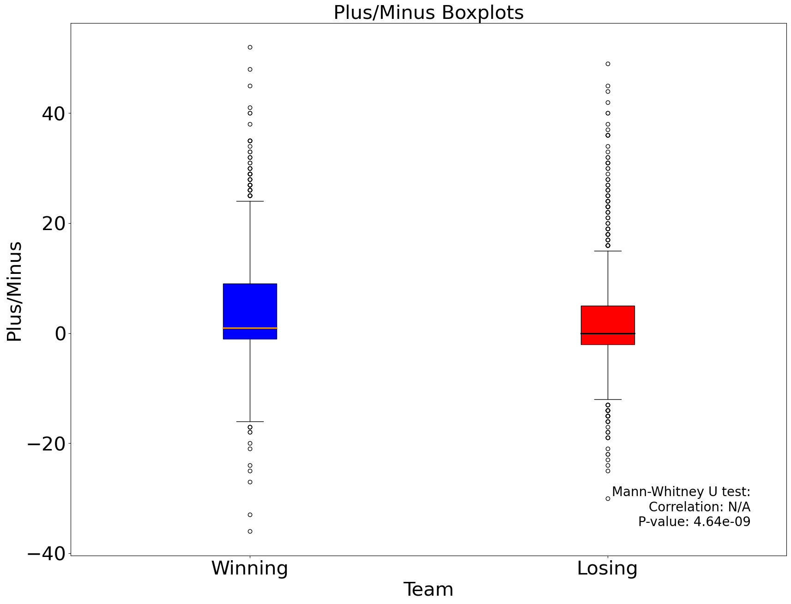
Plus/Minus Comparison
The results of the box plots depicts how the winning team has far more consistency amongst its players. This is also supported by having less outliers than the losing team at each extremity.

Slide 14
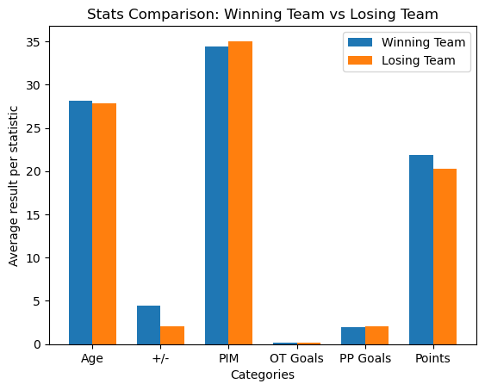
Team comparison
When comparing the identified key stats for the season between the winning and losing team, it is apparent that the one stat with the most material difference and impact is the '+/-'.

Slide 15
Conclusion

Slide 16
Conclusion
Stanley Cup winning team makeup: Based on our overall analysis and supporting data, there is no material difference regarding age groups and winning. There should be a heightened focus of recruiting European players. It is favorable and improves the likelihood of winning to have more consistent contributing players vs having one or two superstars on the team. The +/- statistic

Slide 17


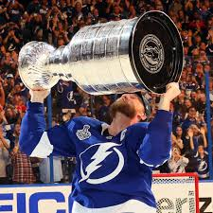


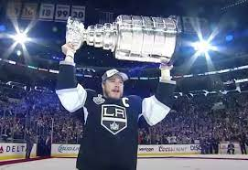
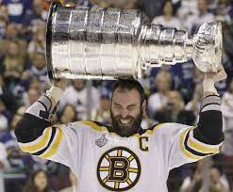

Will your team be the next to hoist the cup?

Slide 18

Team
Ravina Kolsawala
Title
Ron Brennan Title
Joel Demontigny Future Data Analyst

Slide 19
Appendix A:
Reference content:
https://statsapi.web.nhl.com/api/v1/teams
https://statsapi.web.nhl.com/api/v1/teams/1?expand=team.roster&season=20142015
"copyright" : "NHL and the NHL Shield are registered trademarks of the National Hockey League. NHL and NHL team marks are the property of the NHL and its teams. © NHL 2023. All Rights Reserved.“
https://en.wikipedia.org/wiki/Ice_hockey_statistics#:~:text=Team%20statistics%20STK%20-%20winning%20or%20losing%20streak,tie%20%28Note%3A%20The%20NHL%20no%20longer%20uses%20ties.

Slide 20
Appendix B:
Glossary:
PIM – Penalty Infraction Minutes – It is the cumulative total of time that a player has spent in the penalty box due to on ice infractions
PPG – Power play goals – Number of goals the player has scored while his team was on the power play.
PTS – Points – Scoring points, calculated as the sum of goals and assists.
P/M – Plus/minus – The number of team even strength or shorthanded goals for minus the number of team even strength or shorthanded goals against while the player is on the ice.
PPG – Power play goals – Number of goals the player has scored while his team was on the power play.
OTG - Overtime Goal

