Slide 1


Replace: Name of your test
GreatProduct - Search
2020-xx-xx
Replace: Key Visual for your test (replace it on all slides)

Slide 2
GreatProduct - Search
Replace: Name of your test session
Goal
find Issues
find usability problems
…
…
Name your session Goals

Slide 3
GreatProduct - Search
Replace: Name of your test session
The Rules
Everybody test on his own
If you find something - shout ‘Bingo Bongo’
Everyone stops working; the Finder shares his screen and presents the finding
If everyone agrees the Finder has to fill an issue in the bugtracker and gets a point

Slide 4
GreatProduct - Search
Replace: Name of your test session
Replace:
All the details to make sure everybody uses the correct software
We use DEV build 7.5.xx on Server ….
Maybe some installation/update instructiond
and all the other details needed

Slide 5
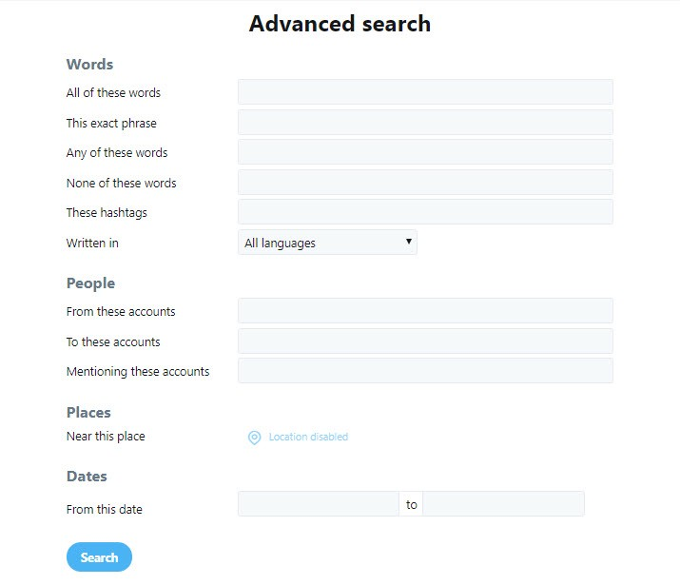
GreatProduct - Search
Replace: Name of your test session
Specification
Demo
Point to the spec
or
Make a short presentation of the feature to test

Slide 6
GreatProduct - Search
Replace: Name of your test session
If there are any
Known Issues
….
Main focus
different ways to search
Input verification
User feedback
Error messages
…..
Replace:
Just to make the goal of the session clear again

Slide 7
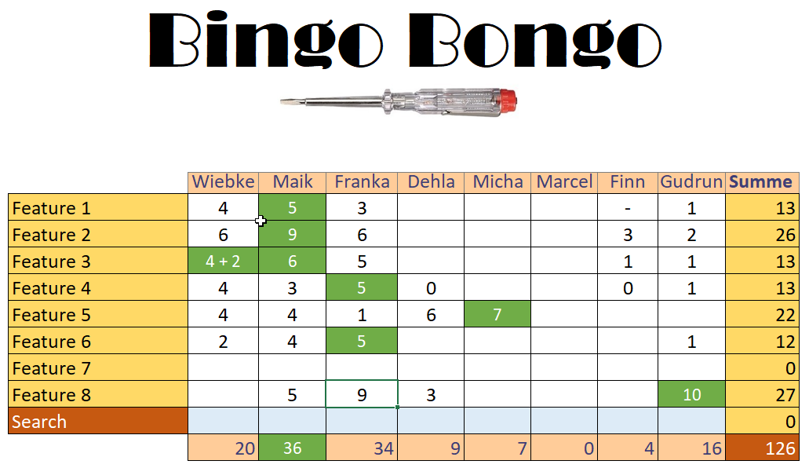
GreatProduct - Search
Replace: Name of your test session
Have some table ready to count the points. Use it for all sessions.

