Slide 1

Childcare Costs
The Rising Cost and What to Do

Slide 2
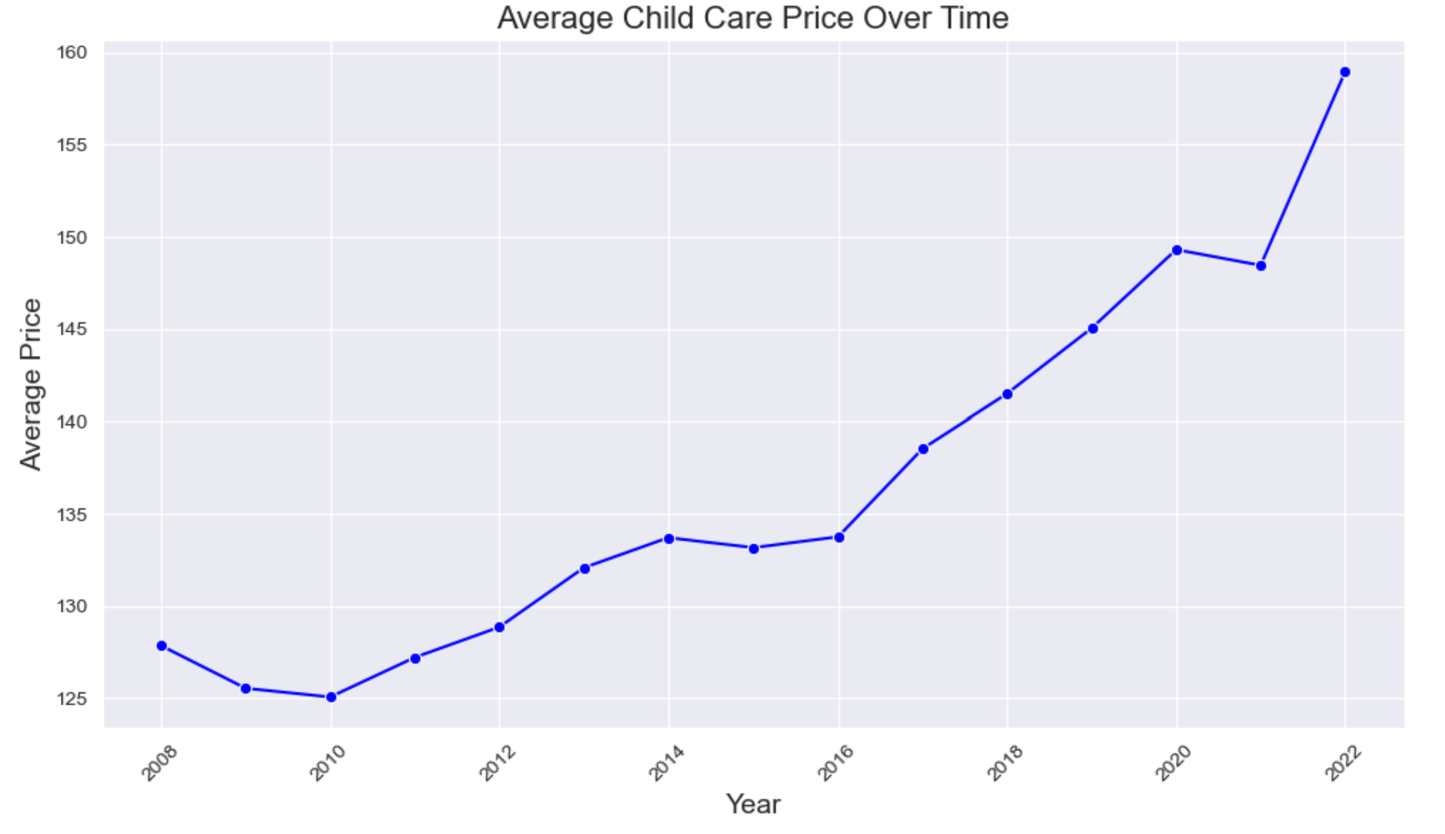
Rising Costs
The cost of childcare has seen a steady rise over the years.
The data points to a clear upward trend from 2010 to 2022 with no indication of a downward trend.

Slide 3
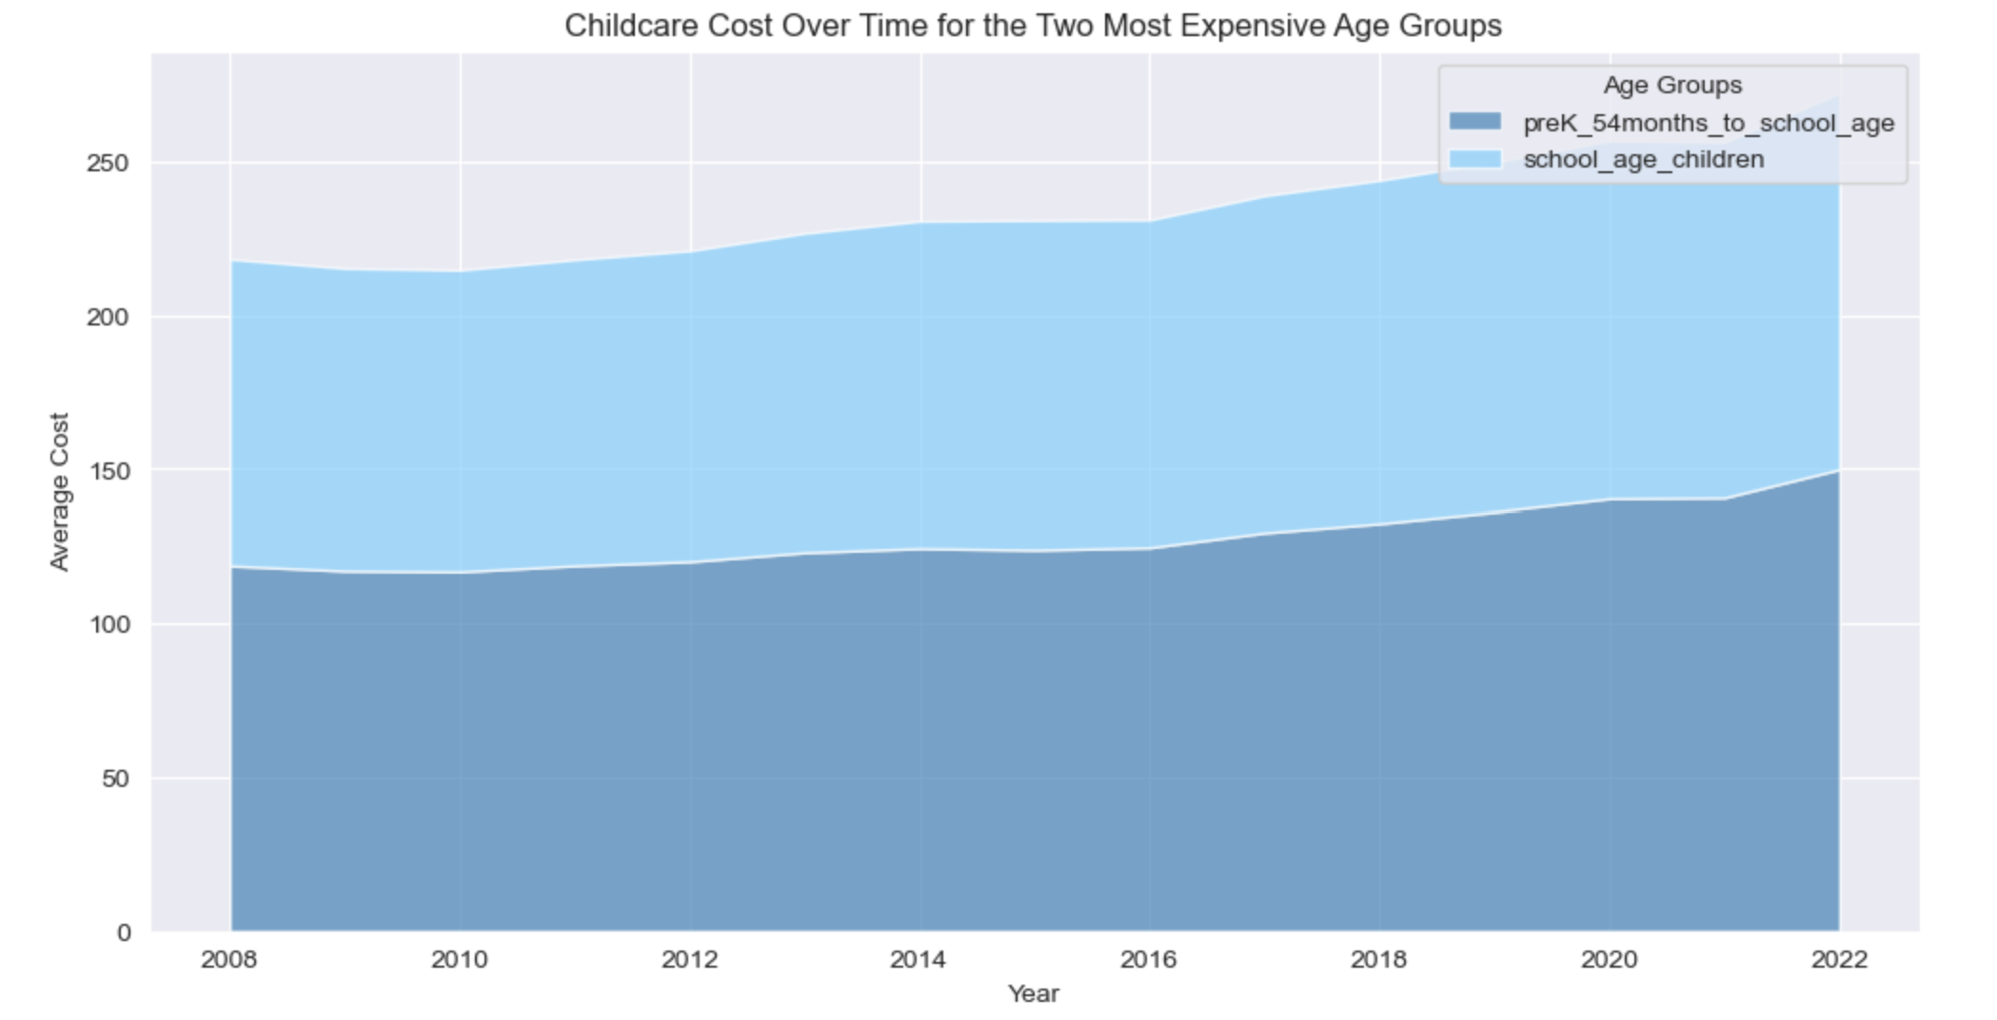
The Most Expensive Groups
The two most expensive age groups for childcare are pre-k to school age.
These are the two most important age groups to help with since they create the most financial burden on working families.

Slide 4
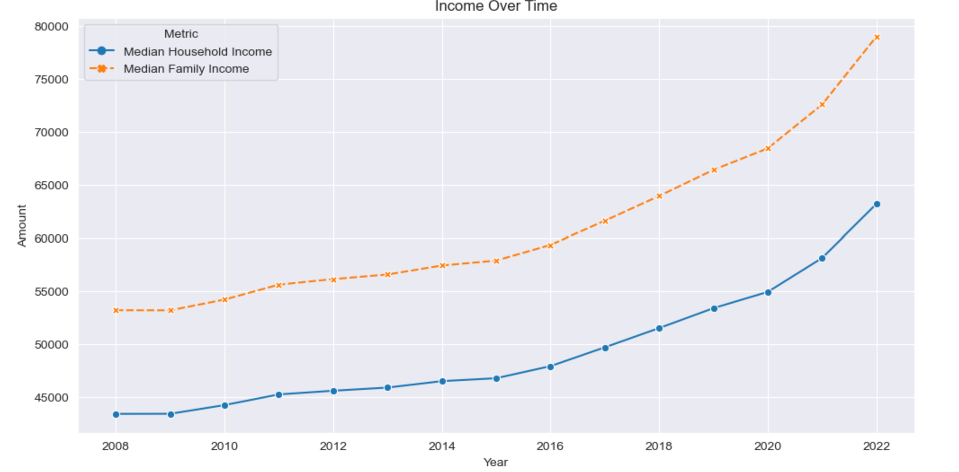
Income
We can see an overall rise in the median household income over the years, spanning from 2008 to 2022.
Although household income has increased, the average cost of childcare also continues to increase.

Slide 5
A Call to Action
Lowering the cost of childcare is crucial to ensuring that working families have access to affordable, high-quality early education and care. Rising childcare expenses often outpace income growth, placing a heavy financial burden on parents and limiting opportunities for children. By advocating for policies that address these costs—whether through subsidies, tax incentives, or increased funding for childcare programs—we can support families and strengthen our communities. Placing this issue on the ballot allows voters to have a direct say in shaping policies that make childcare more accessible and affordable for all.

