Slide 1

CyberXML
An XML Enabled
Vulnerability Management
Workflow
01 April 2015
Ronald Broberg
ronald.broberg@lmco.com
ronald.broberg@mdnt.com

Slide 2
Presenter Ronald Broberg
Experience / Education
18 years with LM
BS Physics (Spring 1994)
MSc Mathematics (Fall 2015)
Programs
C2BMC
BAEC2 – Al Diriyah
TBMCS
SPADOC
Skills
Information Assurance (CISSP 2008)
Programming (Python, R, Julia, Java, MATLAB, FORTRAN, SQL, XQuery, XPath)
Data Science (Coursera / Johns Hopkins University / Data Science Certification 2015)
Notes:
Bona Fides

Slide 3

Vulnerability Management: Overview
Security Advisories
Software
Catalog
Automated Applicability Determination
Dashboards
Reports
Software
Tickets
Software
Patches

Slide 4
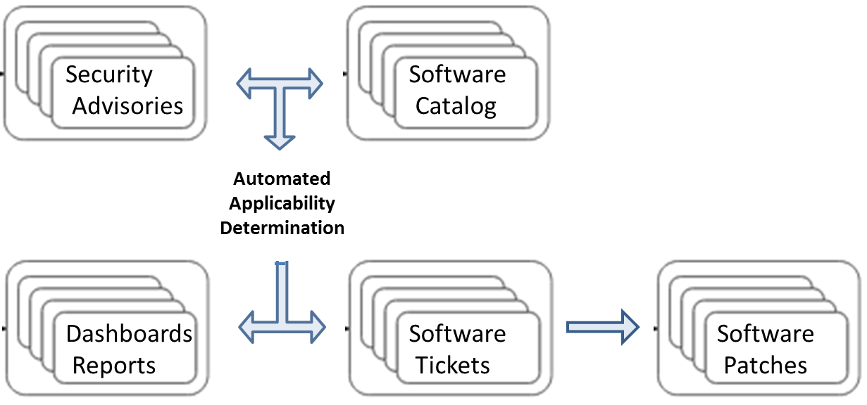
Vulnerability Management: Common Problem Areas
Approximately 250 IAVMs per year
IAVMs use loose naming conventions
in identifying vulnerable products;
Sometimes caused by
inconsistent vendor naming
Program Software Catalogs
may not include detail sufficient
for vulnerability management
Program SMEs relied on to
provide best guesses
IAVM alerts require response in 7 days
Manual cut&paste from IAVMs
to software tickets slows creation
Notes:
IAVM: Information Assurance Vulnerability Management – Issued weekly by DISA for USCYBERCOM

Slide 5
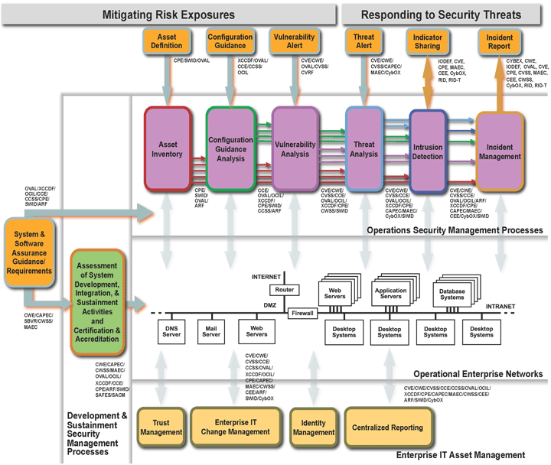
MITRE: Making Security Measureable Vulnerability Management Framework
CyberXML
CPE, AI
Asset Definition
Asset Inventory
CVE, CVRF
Vulnerability Alert
Vulnerability Analysis
http://msm.mitre.org/
Notes:
CPE: Common Platform Enumeration – A dictionary of hardware, software, and operating systems
AI: Asset Identification - Inventories network equipment, network services, workstations, servers and software
CVE: Common Vulnerabilities and Exposures – Includes OVAL definition of applicable software and platforms
CVRF: Common Vulnerability Reporting Framework – Commercial vulnerability report similar to CVE

Slide 6
CVRF: Common Vulnerability Reporting Framework
ICASI: Industry Consortium for Advancement of Security on the Internet
Members:
CISCO*
Intel
IBM
Juniper
Microsoft*
Amazon
BlackBerry
Oracle*
Red Hat* (non-member)
“The ICASI Common Vulnerability Reporting Framework (CVRF) is an XML-based language that enables different stakeholders across different organizations to share critical security-related information in a single format, speeding up information exchange and digestion. CVRF is a common and consistent framework for exchanging not just vulnerability information, but any security-related documentation. CVRF Version 1.0 was released in May 2011; the current version is CVRF 1.1, released in May 2012.”
* Regularly Publish Publicly Available CVRF
http://www.icasi.org/cvrf

Slide 7
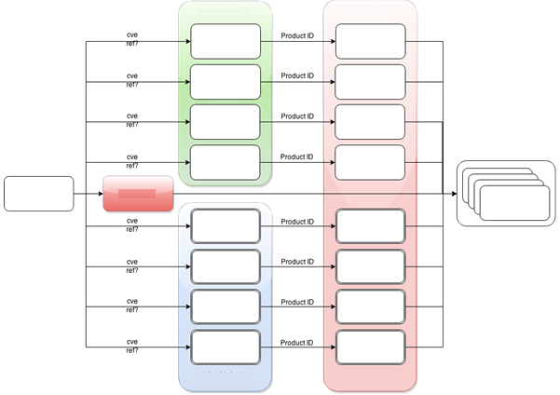
CyberXML: An XML enabled workflow IAVM XML - Vendor CVRF - SCAP CVE,CPE, AI
Vendor CVRF
Vuln Software
Microsoft
MS CPE
Red Hat
RHEL CPE
Vulnerable CPEs
Identified by CVEs
Published in IAVM
Program
Software Catalog
Enumerated by CPE
CISCO
CISCO CPE
Oracle
Oracle CPE
IAVM
NIST CVE
CPE
CPE
Adobe
Adobe CPE
IBM
IBM CPE
Automated Applicability Determination
Juniper
Juniper CPE
True Positive
False Positive
VMware
VMware CPE
Derived CVRF
(HTML -> XML)
False Negative
True Negative
Accuracy = (TP+TN) / Total = How many are correctly classified
Sensitivity = TP / (TP+FN) = How many Applicable are classified as Positive
Specificity = TN / (TN+FP) = How many Not Applicable are classified as Negative
CyberXML System Boundary: IAVM-to-CPE and Applicability Analysis
Notes:
IAVMs published in three forms: HTML, XML and DISA report of IAVM-to-CVE (which comes a few days later).
IAVM information not always consistent between three formats.
Red Hat CVRF not suitable for processing; discussed below
Juniper HTML to sparse to easily process; discussed below

Slide 8
CyberXML Standalone Opportunities
Applicability Analysis Accuracy:
96.6% Accuracy on current 2014-2015 IAVMs for one program
Time Savings: From IAVM import to Software Ticket Creation
Previous Manual Efforts Estimated at ~ 60 minutes per applicable IAVM
Previous Automation Efforts Estimated at ~ 10 minutes per IAVM
IAVM Dashboard generation 100% automated
Cost Savings:
[50 min / IAVM] x [200 IAVM / year] x [1 hr / 60 min] x [200 dollars / hr]
$33,000 per year per program
Notes:
Current 2014-2015 IAVMs through 21 Mar 2015 and excludes superseded SMR

Slide 9
CyberXML Enterprise Opportunities
Enterprise IAVM-to-CPE analysis
Run Once; Use Everywhere
Enterprise Program Software Catalog Registry
Register Program Software Catalog in Enterprise Server
Enterprise IAVM Applicability Analysis Report
Enterprise Server sends weekly IAVM Dashboard back to Program
Enterprise Server sends weekly pre-formatted Software Ticket inputs
Enterprise Server sends weekly software patch package

Slide 10
Known CyberXML Issues:
Not all IAVMs included CVE information
IAVM 2015-A-0061 Microsoft Windows Fraudulent Digital Certificate Vulnerability
Example of Broad –v- Narrow IAVM target products
IAVM 2014-A-0166 for generic OpenSSL CVE-2014-3568
IAVM 2015-B-0014 for VMware ESXi 5.5 OpenSSL CVE-2014-3568 (VMSA-2014-0001)
Identifying intended IAVM target product
Too Many Products
Mapping from CVE-to-Product is One-to-Many
Vendor Security Advisories
NIST CVEs
Mapping from IAVM-to-CVE is One-to-Many
Mapping from Vendor_Advisory-to-CVE is One-to-Many
Product Filtering
Use IAVM “References”
Use IAVM “Title”
Time Gaps
Vendors Vulnerability Reports Can Be Delayed by Days or Weeks
IAVMS subject to Revisions

Slide 11
CyberXML 3rd Party Issues:
DISA IAVM XML
Not 100% match with IAVM HTML
Work with DISA FSO Help Desk
Vendor CVRF / NIST CVE Errors
Microsoft fixed ~100 errors in their XML when notified
Red Hat corrected field delimiter issues in RHSAMAPCPE
Red Hat working towards a new CVRF tool
NIST CVE correcting errors on case-by-case
Vendor CVRF Inconsistencies
Microsoft: One TechNote bulletin per CVRF. Release Monthly
Oracle: Dozens of products and CVES per CVRF. Released Quarterly
Red Hat: Products Identified only by OS Release. Released ASAP
Red Hat CVRF
CVRF Product IDs tied to OS release, not SW component
Workaround: Use RHSAMAPCPE file
Juniper HTML-to-XML
HTML both sparse and evolving -> breaking parsers
Workaround: NIST provides redundancy
Potential issue for any HTML-to-XML module

Slide 12
Acronyms:
AI: Asset Identification (SCAP)
http://scap.nist.gov/specifications/ai/
CPE: Common Platform Enumeration (SCAP)
https://cve.mitre.org/ | https://nvd.nist.gov/cpe.cfm
CVE: Common Vulnerability and Exposures (SCAP)
https://cve.mitre.org/ | https://web.nvd.nist.gov/view/vuln/search
CVRF: Common Vulnerability Reporting Framework (Commercial)
http://www.icasi.org/cvrf
IAVM: Information Assurance Vulnerability Management (DISA, USCYBERCOM)
http://www.prim.osd.mil/cap/iavm_req.html?p=1.1.1.1.3
SCAP: Security Content Automation Protocol (NIST, MITRE)
http://scap.nist.gov/

Slide 13
CyberXML
IAVM Applicability Analysis Tool

Slide 14
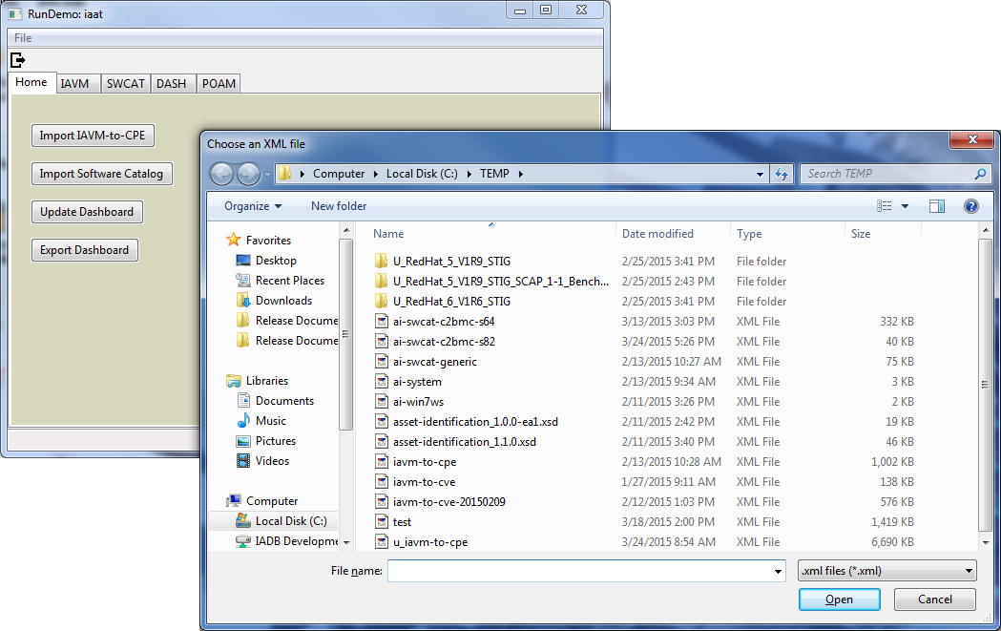
CyberXML: IAAT IAVM Applicability Analysis Tool – Control Panel

Slide 15
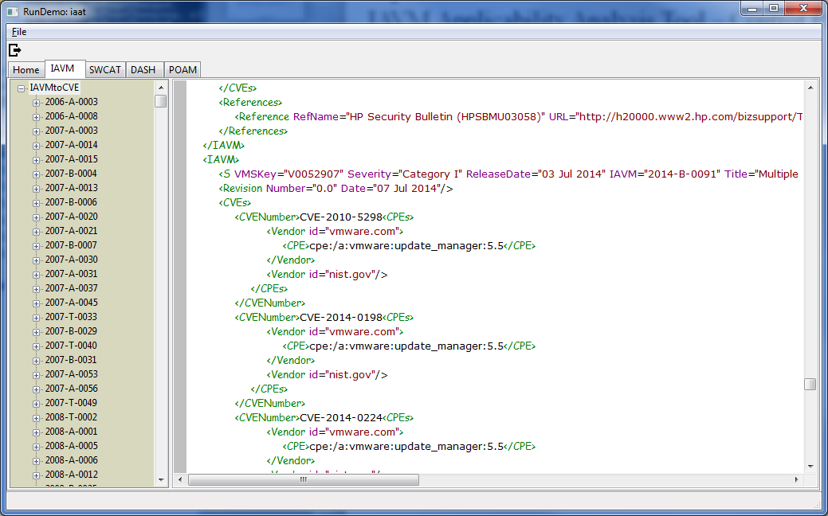
CyberXML: IAAT IAVM Applicability Analysis Tool – IAVM to CPE

Slide 16
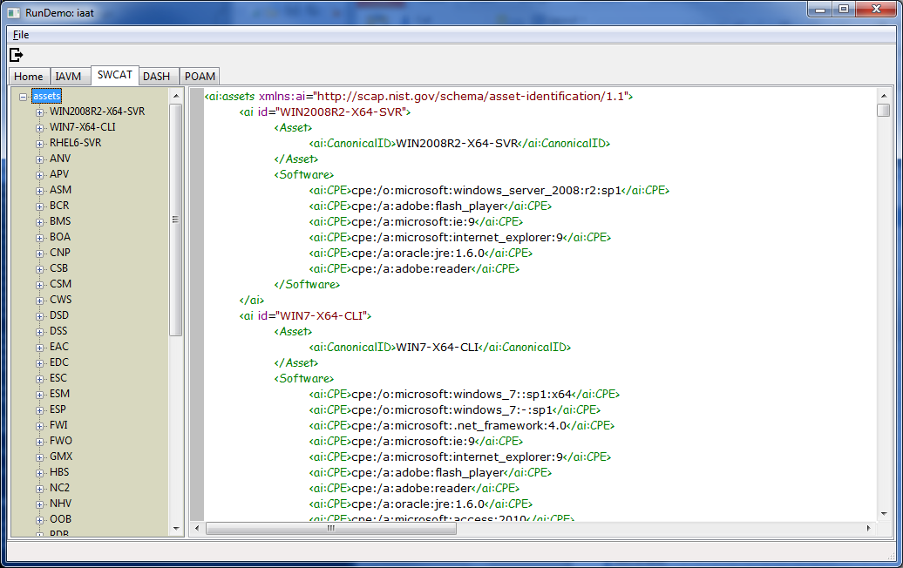
CyberXML: IAAT IAVM Applicability Analysis Tool – Software Catalog

Slide 17
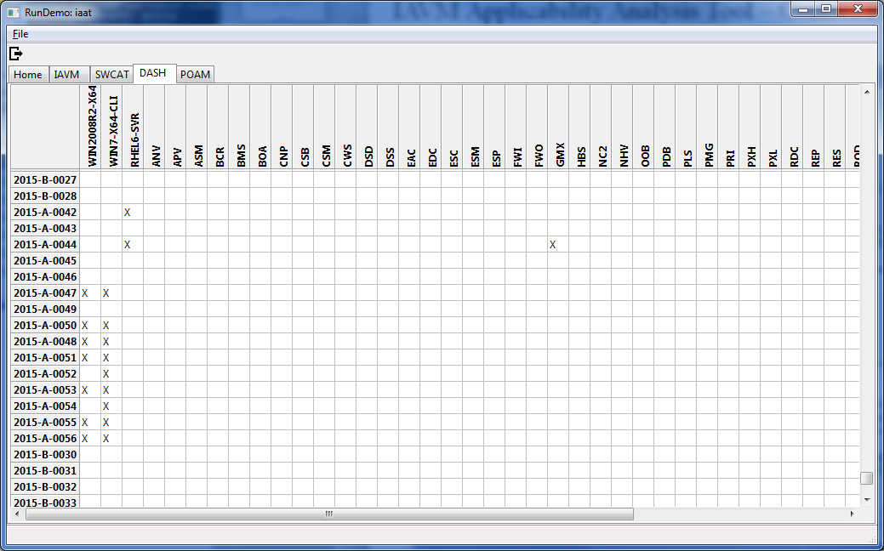
CyberXML: IAAT IAVM Applicability Analysis Tool – Dashboard

Slide 18
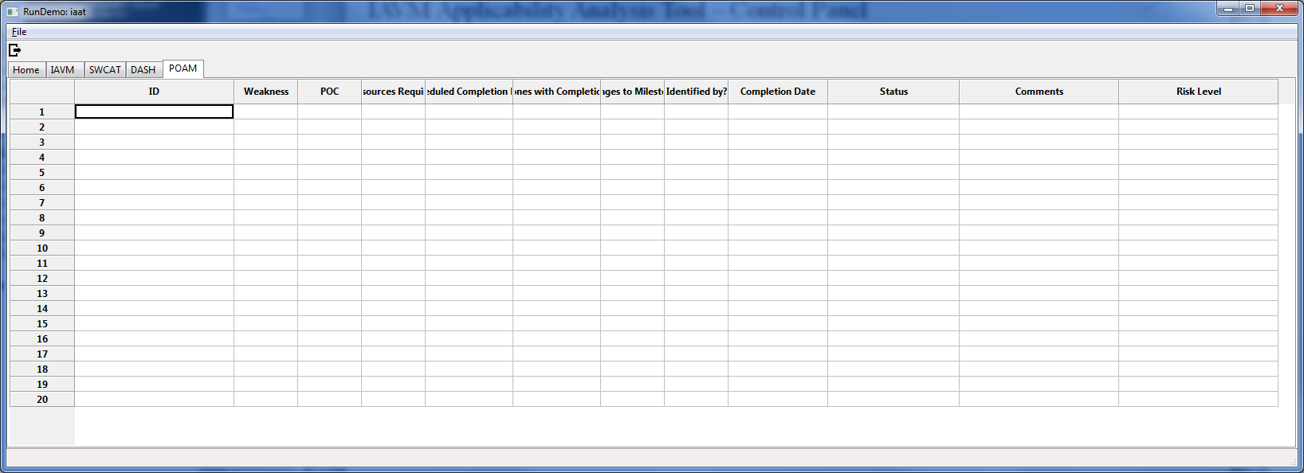
CyberXML: IAAT IAVM Applicability Analysis Tool – POA&M

