Slide 1
Detection of Malicious Web Traffic by Anomalous Behavior
Ronald Broberg
May 6, 2015

Slide 2
Overview: CVE-2014-0226
Race condition in the mod_status module in the Apache HTTP Server before 2.4.10 allows remote attackers to cause a denial of service (heap-based buffer overflow), or possibly obtain sensitive credential information or execute arbitrary code, via a crafted request that triggers improper scoreboard handling within the status_handler function in modules/generators/mod_status.c and the lua_ap_scoreboard_worker function in modules/lua/lua_request.c.

Slide 3
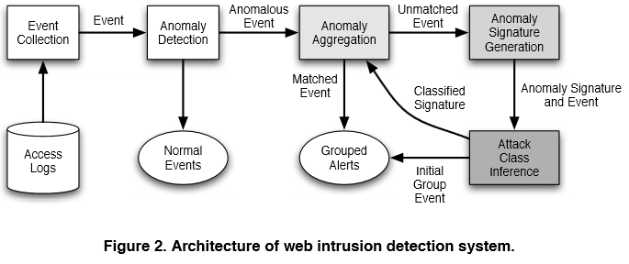
Overview: Anomoly Detection
Robertson et al (2006)

Slide 4
Data Processing: Log File
Sample Apache Access Log
Simple Stats
3,461,612 lines
137,979 unique sources
31,059 unique pages requested

Slide 5
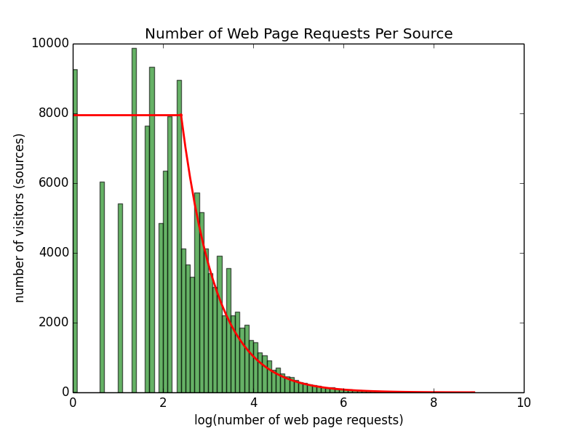
Data Exploration: Visitor Preferences number of web pages requested by each visitor
A few web pages attract a large number of visitors
Many web pages attract a small number of visitors
Half the visitors visit 10 or few web pages
Minimum = 1
Median = 10
Mean = 25
Maximum = 21988

Slide 6
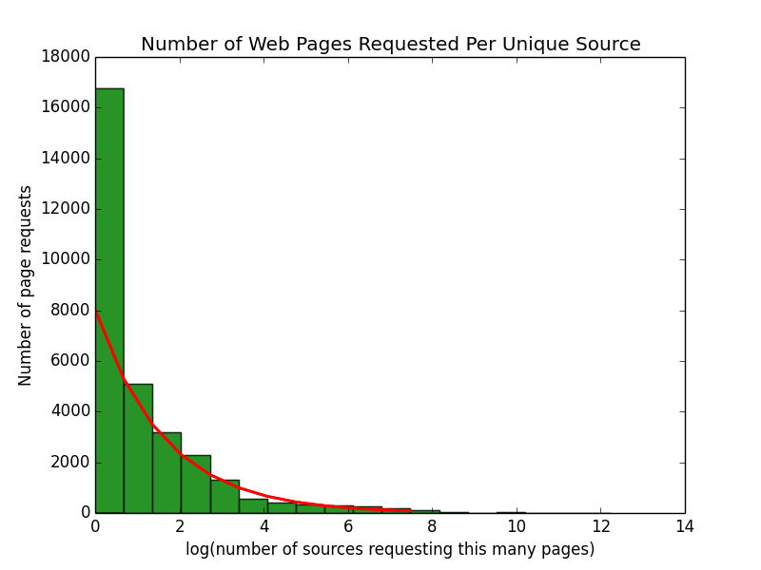
Data Exploration: Web Page Popularity number of visits to each web page
A few web pages are visited by a large number of sources
Many web pages are visited by a small number of sources
Over half the web pages are visited by only one source
Minimum = 1
Median = 1
Mean = 112
Maximum = 208353

Slide 7
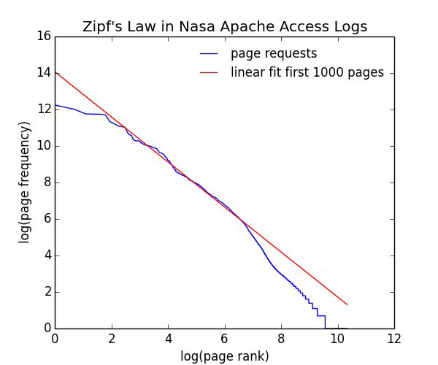
Data Exploration: Zipf’s Law
Zipf’s Law:
log(freq) ~ [log(rank)]⁻¹

Slide 8
Data Model: Web Browsing Behavior
A
B
C
1
2
1
3
Normal Flow:
Page A -> Image 1 -> Image 2 -> Page B
Page B -> Image 1 -> Image 3 -> Page A
-> Page B -> Image 3 -> Page C
-> Page B -> Image 3 -> Page A
Abnormal Flow:
Page C -> Image 3 -> Image 2 -> Page C

Slide 9
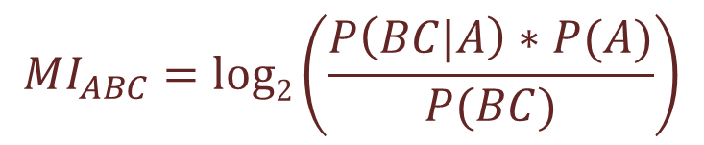
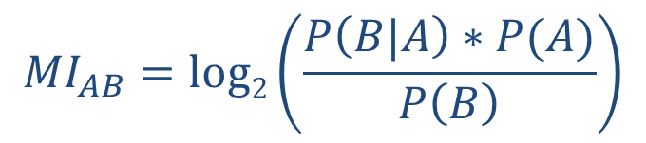
Data Model: n-Gram Mutual Information
$$MI_{AB}=log2\left(\frac{P\left(B|A\right)∗P(A)}{P\left(B\right)}\right)$$
$$MI_{ABC}=log2\left(\frac{P\left(BC|A\right)∗P(A)}{P(BC)}\right)$$
Common n-Grams produce large values
Uncommon n-Grams produce small values

Slide 10
Results: Anomaly Detection
Unique Bigrams
47185
Unique Bigrams
4593 = 9.7%
9000
Solo hits
Unique Bigrams
42592 = 90.3%
345348
requests
Robertson et al (2006)

Slide 11
Results: Confusion Matrix

Slide 12
Priors
Juvonen and Hamalainen (2014) | Reduced Dimension Matrix Method
Zolotukhin et al (2014) | Training on normal behavior only
Robertson, Vigna, Kruegel, Kemmerer (2006) | Automated Clustering and Attack Inference
Kruegel, Vigna, Robertson (2005) | Multi-model approach
Wang, Zhou, Yu, Cai (2005) | Data Mining HTTP Requests
Kruegel and Vigna (2003) | Anomaly Detection of Web-based Attacks

Slide 13
Backup
Chodorow, Martin, and Claudia Leacock. "An unsupervised method for detecting grammatical errors." Proceedings of the 1st North American chapter of the Association for Computational Linguistics conference. Association for Computational Linguistics, 2000.

Slide 14
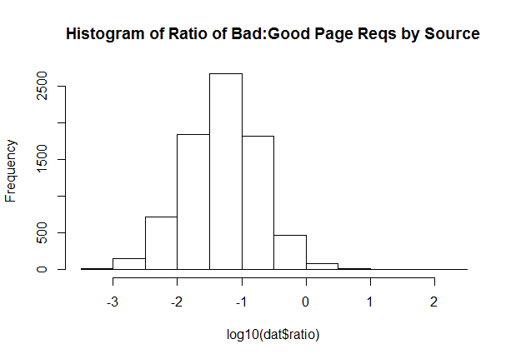
Data Exploration: Histogram Bad v Good
206 sources with ratio > 1

Slide 15
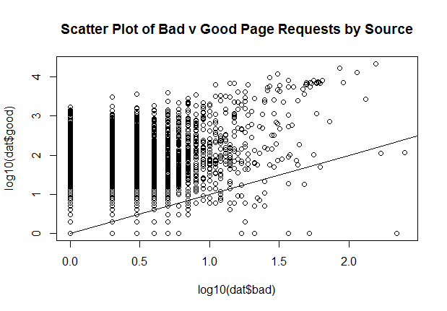
Data Exploration: Scatterplot Bad v Good
Potential Area
of Interest

