Slide 1
Detection of CVE-2014-0226 Web Traffic by Anomalous Behavior: Milestone Report
Ronald Broberg
Department of Mathematics. University of Colorado at Colorado Springs

Slide 2
Overview: CVE-2014-0226
Race condition in the mod_status module in the Apache HTTP Server before 2.4.10 allows remote attackers to cause a denial of service (heap-based buffer overflow), or possibly obtain sensitive credential information or execute arbitrary code, via a crafted request that triggers improper scoreboard handling within the status_handler function in modules/generators/mod_status.c and the lua_ap_scoreboard_worker function in modules/lua/lua_request.c.

Slide 3
Problem: Detect CVE-2014-0226
Intrusion Detection
Misuse detection systems (known signatures)
Anomaly detection systems (probabilistic profiles)

Slide 4
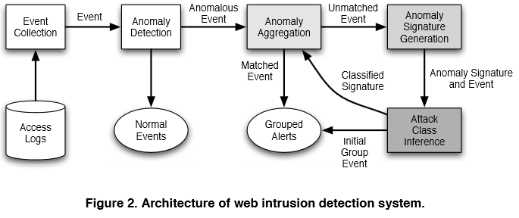
IDS: Generic Model
Robertson et al (2006)

Slide 5
Data Processing: Log File
Sample Apache Access Log
Simple Stats
3,461,612 lines
137,979 unique sources
31,059 unique pages requested

Slide 6
Data Processing: HTTP Server Codes
HTTP Server Codes
cat all.access.log | cut -d'"' -f3 | cut -d' ' -f2 | sort | uniq -c

Slide 7
Data Processing: Good –v- Bad HTTP Requests
Requesting Source
130,057 sources with only ‘good’ page requests
7,786 sources with ‘mixed’ page requests
Bad Actors Features on “Mixed” Requests?
Average ratio of bad requests to good = 0.17
Foreign –v- Domestic
IP Address –v- Resolved Names

Slide 8
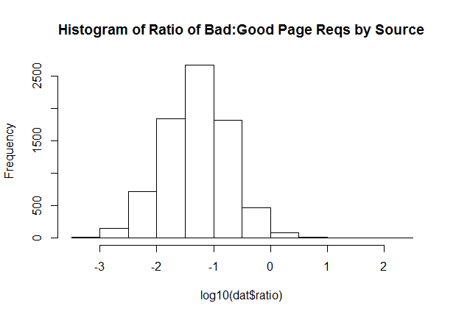
Data Exploration: Histogram Bad v Good
206 sources with ratio > 1

Slide 9
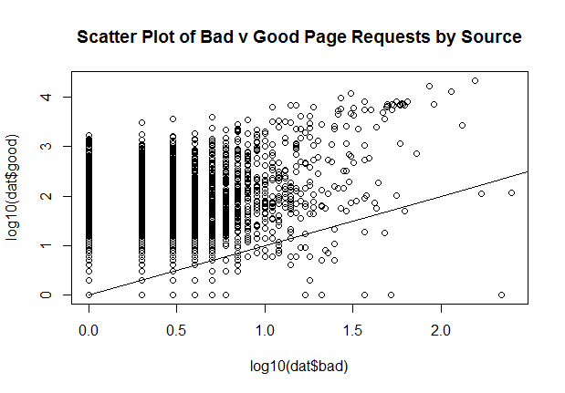
Data Exploration: Scatterplot Bad v Good
Potential Area
of Interest

Slide 10
Data Exploration: Directory Tree Frequency
Profiling visitor by “frequently visited sites”
By scoring a visitor by the averaging the popularity of pages visited,
Identify the visitor looking at common pages
And the visitor looking in uncommon locations

Slide 11
Priors
Juvonen and Hamalainen (2014) | Reduced Dimension Matrix Method
Zolotukhin et al (2014) | Training on normal behavior only
Robertson, Vigna, Kruegel, Kemmerer (2006) | Automated Clustering and Attack Inference
Kruegel, Vigna, Robertson (2005) | Multi-model approach
Wang, Zhou, Yu, Cai (2005) | Data Mining HTTP Requests
Kruegel and Vigna (2003) | Anomaly Detection of Web-based Attacks

