Slide 1
Detection of CVE-2014-0226 Web Traffic by Anomalous Behavior
Ronald Broberg
Department of Mathematics. University of Colorado at Colorado Springs

Slide 2
Overview: CVE-2014-0226
Race condition in the mod_status module in the Apache HTTP Server before 2.4.10 allows remote attackers to cause a denial of service (heap-based buffer overflow), or possibly obtain sensitive credential information or execute arbitrary code, via a crafted request that triggers improper scoreboard handling within the status_handler function in modules/generators/mod_status.c and the lua_ap_scoreboard_worker function in modules/lua/lua_request.c.

Slide 3
Problem: Detect CVE-2014-0226
Intrusion Detection
Misuse detection systems (known signatures)
Anomaly detection systems (probabilistic profiles)

Slide 4
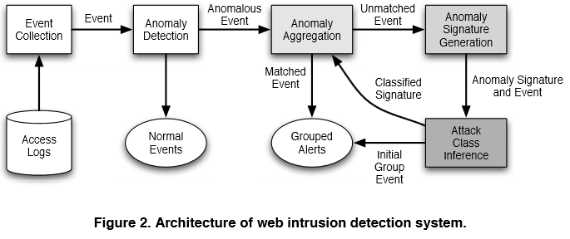
Generic Model
Robertson et al (2006)

Slide 5
Datasets
Create Synthetic Dataset by Merging …
Known Apache Server Logs
Apache Logs Under Attack
For Attack Logs
Set up VM
Run Attack Bot
Massage and Merge into larger, known log

Slide 6
Model Tools
Attack Bot
http://downloads.securityfocus.com/vulnerabilities/exploits/68678.py
SCAPY
Python Library for Packet Manipulation
SciPy
Numerous Clustering and Classification Packages

Slide 7
Priors
Juvonen and Hamalainen (2014) | Reduced Dimension Matrix Method
Zolotukhin et al (2014) | Training on normal behavior only
Robertson, Vigna, Kruegel, Kemmerer (2006) | Automated Clustering and Attack Inference
Kruegel, Vigna, Robertson (2005) | Multi-model approach
Wang, Zhou, Yu, Cai (2005) | Data Mining HTTP Requests
Kruegel and Vigna (2003) | Anomaly Detection of Web-based Attacks

Slide 8
Results
Clustering
Does this log include a cluster of entries that can be tagged as CVE-2014-0226?
Results measured by gap statistics
Classification
Does this session include a CVE-2014-0226 attack?
Results measured by sensitivity and specificity

