Slide 1



Machine Learning-Based Classification of Patterns of EEG Synchronization for Seizure Prediction
Piotr Mirowski,
Deepak Madhavan MD,
Yann LeCun PhD,
Ruben Kuzniecky MD
Courant Institute of
Mathematical Sciences

Slide 2
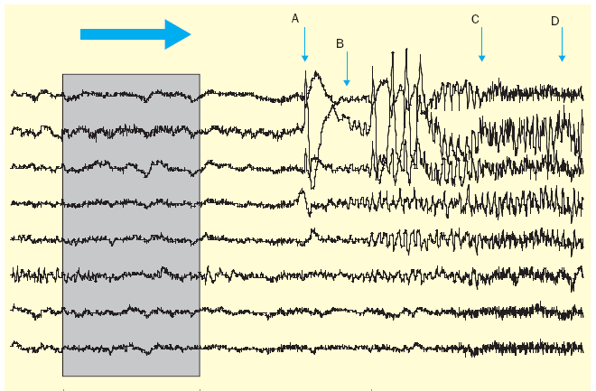
The seizure prediction problem
Review of literature:
  most methods implement
  1D decision boundary
  machine learning used
  only for feature selection
Trade-off between:
  sensitivity
  (being able to
  predict seizures)
  specificity
  (avoiding false positives)
Benchmark data:
21-patient Freiburg EEG dataset;
current best results are:
  42 % sensitivity
  3 false positives per day
  (0.25 fp/hour)
Observation
window
Seizure onset
Extraction of features
from EEG,
pattern recognition
+
classification
intracranial
EEG
interictal
phase
preictal
phase
ictal
phase
[Litt and Echauz, 2002; Schulze-Bonhage et al, 2006]

Slide 3
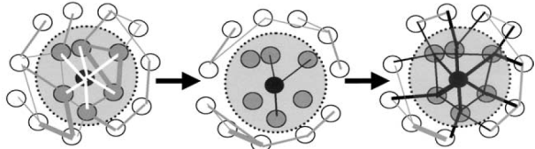
Hypotheses
patterns of brainwave synchronization:
  could differentiate preictal from interictal stages
  would be unique for each epileptic patient
definition of a “pattern” of brainwave synchronization:
  collection of bivariate “features” derived from EEG,
  on all pairs of EEG channels (focal and extrafocal)
  taken at consecutive time-points
  capture transient changes
a bivariate “feature”:
  captures a relationship:
  over a short time window
goal: patient-specific automatic learning to differentiate preictal and interictal patterns of brainwave synchronization features
interictal
preictal
ictal
[Le Van Quyen et al, 2003; Mirowski et al, 2009]

Slide 4
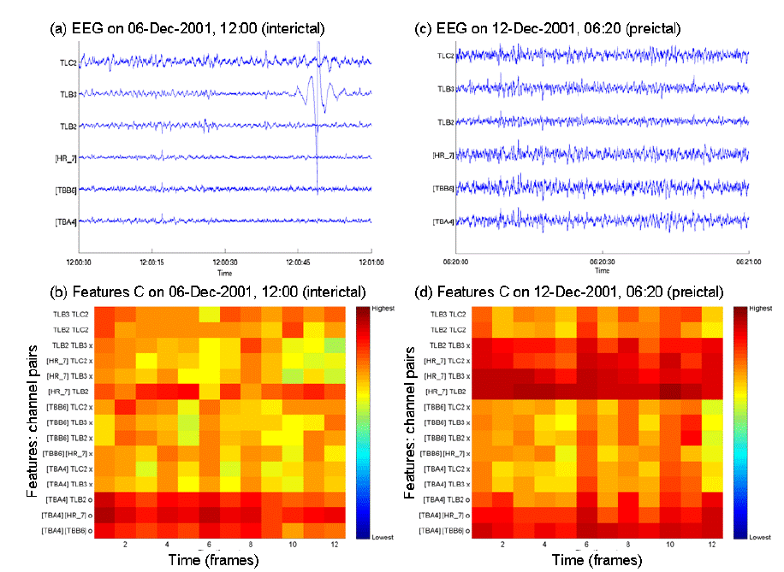
Patterns of bivariate features
Varying synchronization
of EEG channels
1min of interictal EEG
1min of preictal EEG
Non-frequential features:
  Max cross-correlation [Mormann et al, 2005]
  Nonlinear
  interdependence
  [Arhnold et al, 1999]
  Dynamical entrainment [Iasemidis et al, 2005]
Frequency-specific features:
[Le Van Quyen et al, 2005]
  Phase locking synchrony
  Entropy of phase difference
  Wavelet coherence
1min interictal pattern
1min preictal pattern
Examples of patterns of cross-correlation
[Le Van Quyen et al, 2003; Mirowski et al, 2009]
Notes:
We investigated 6 types of bivariate features from epilepsy prediction literature. Bivariate features encode the relationship between pairs of EEG channels: very recent research indeed suggests that epilepsy is a dynamical disease, and that the development of a seizure corresponds to varying synchronization between EEG channels, specifically between the epileptic focus and non-epileptogenic areas. The features we investigated are: maximal cross-correlation, difference of short-term estimates of maximal Lyapunov exponent (i.e. the similarity of chaotic behavior between two EEG channels), nonlinear interdependence (i.e. the similarity of the trajectory, in state-space, described by EEG channels), and three measures of wavelet-analysis-based synchrony. Synchrony measures are statistics of the phase difference between two EEG channels at a specific frequency. Once we compute bivariate features, we aggregate them into spatio-temporal patterns (spatial: across channel pairs, temporal: over a window of 5min).

Slide 5
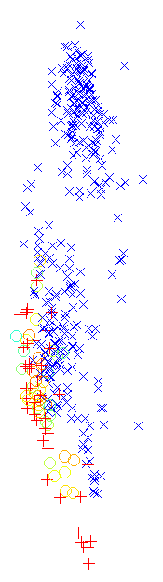
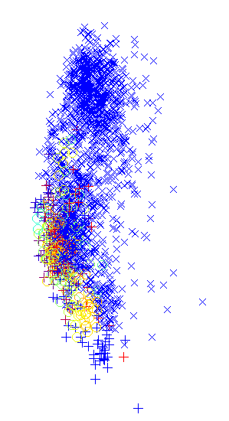
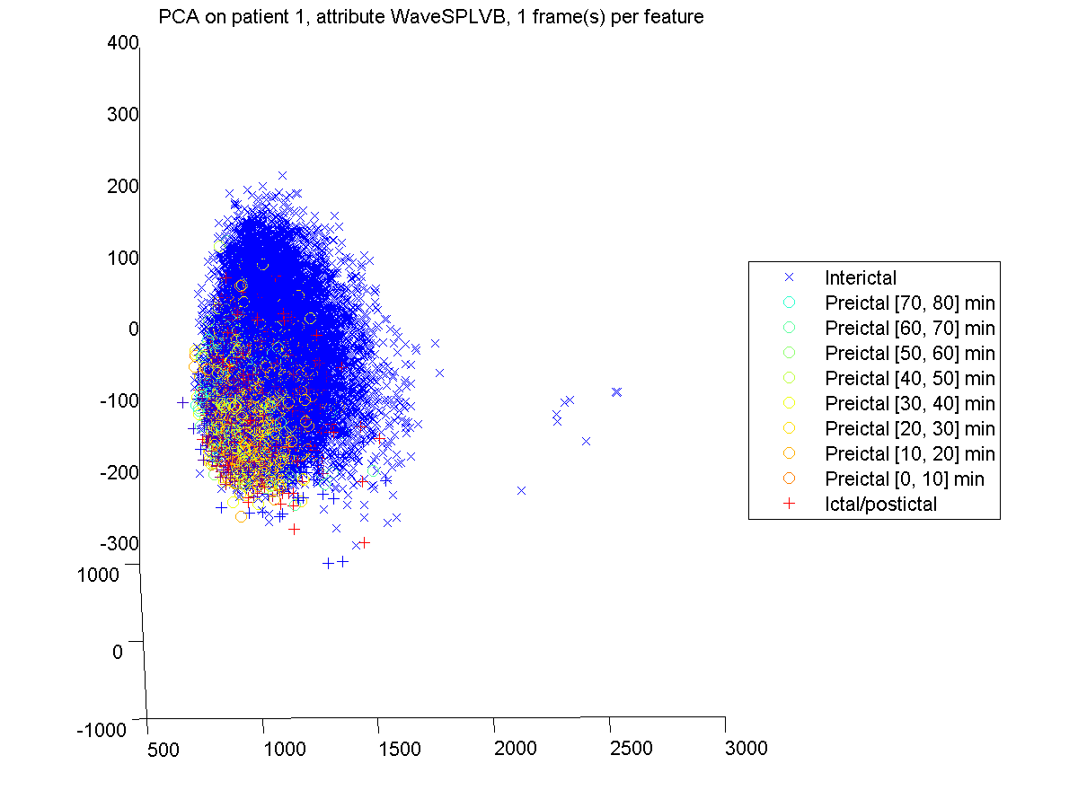
Separating patterns of features
a) 1-frame
patterns (5s)
b) 12-frame
patterns (1min)
c) 60-frame
patterns (5min)
d) Legend
2D projections (PCA) of wavelet synchrony SPLV features, patient 1
[Mirowski et al, 2009]

Slide 6
Patterns of bivariate features
Features computed on 5s windows (N=1280 samples)
6x5/2=15 bivariate features on 6 EEG channels
(Freiburg dataset)
Wavelet analysis-based synchrony values grouped in
7 electrophysiological frequency bands:
δ [0.5Hz-4Hz], θ [4Hz-7Hz], α [7Hz-13Hz], low β [13Hz-15Hz], high β [15Hz-30Hz], low γ [30Hz-45Hz], high γ [55Hz-120Hz]
Features are aggregated
into temporal patterns y_{t}:
12 frames (1min)
or 60 frames (5min)
# feat
C, S, DSTL
SPLV, H, Coh
1min
12×15=180
12×15×7=1260
5min
60×15=900
12×15×7=6300
[Mirowski et al, 2009]

Slide 7
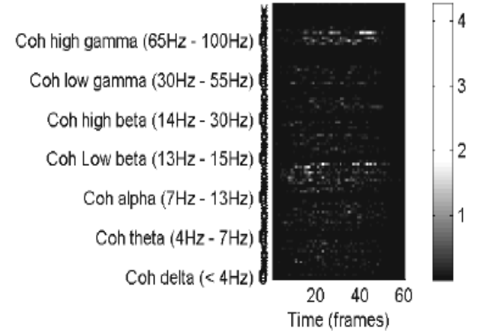
Machine Learning Classifiers
Input pattern of features:
px60
Layer 1
5@px48
Layer 2
5@px24
Layer 3
5@1x16
Layer 4
5@1x8
Layer 5
3
preictal
interictal
1x2
sub-
sampling
1x8
convolution
(across time)
1x13
convolution
(across time)
px9
convolution
(across time
and space/freq)
1x2
subsampling
L₁-regularized convolutional networks (LeNet5, above)
L₁-regularized logistic regression
Support vector machines
(Gaussian kernels)
L1-regularization highlights pairs of channels and frequency bands discriminative for seizure prediction
Input sensitivity
[LeCun et al, 1998; Mirowski et al, AAAI 2007, 2009]
Notes:
We compared L1-regularized logistic regression, L1-regularized convolutional networks (based on LeNet5 architecture), and support vector machines. By enforcing sparse parameters through L1 regularization, and by observing the logistic regression weights or the convolutional networks input sensitivity, we see that only a subset of feature inputs is necessary, and that high frequency inputs are necessary for good classification. As an example, this image shows the average input sensitivity to a pattern of bivariate features (wavelet coherence). Frequencies and pairs of channels are sorted vertically, time frames horizontally. Input elements discriminative for the seizure prediction task appear in white, only at a subset of pairs of channels and specific frequency bands.

Slide 8
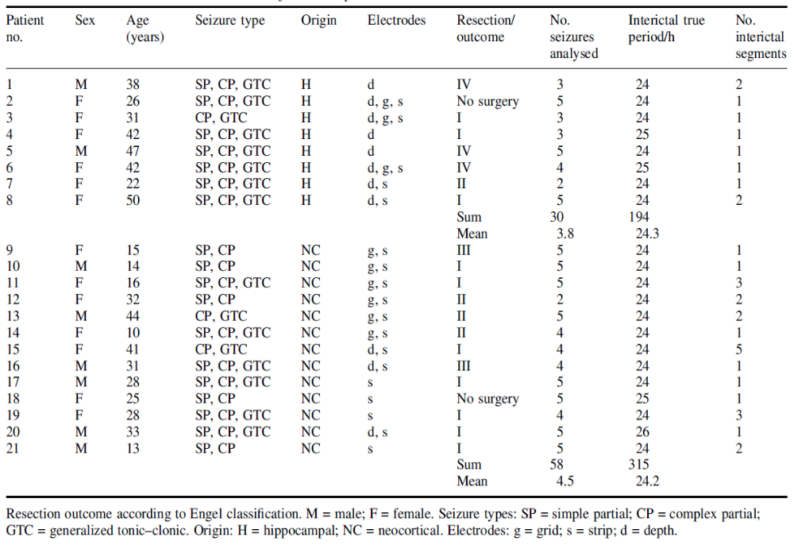
21-patient Freiburg EEG dataset
medically
intractable
> 24h interictal
2 to 6 seizures
Train + x-val on
66% data
(57 earlier seizures)
PATIENT SPECIFIC
Test on 33% data
(31 later seizures)
Previous
best results:
42% sensitivity,
0.25 fpr/h
[Aschenbrenner-Scheibe et al, 2003; Schelter et al, 2006a, 2006b; Maiwald, 2004; Winterhalder et al, 2003]

Slide 9
Results on 21 patients (Freiburg)
For each patient, at least 1 method predicts 100% of seizures,
on average 60 minutes before the onset, with no false alarm.
But not always the same method…
16 combinations (feature, classifier): how to choose a good one?
  Classifiers:
  Features:
Wavelet coherence + conv-net: 15/21 patients (0 fp/hour)
Wavelet SPLV + conv-net: 13/21 patients (0 fp/hour)
Wavelet coherence + SVM: 14/21 patients (<0.25 fp/hour)
Nonlinear interdependence + SVM: 13/21 patients (<0.25 fp/hour)
<0.25 fp/hour, | log-reg | conv-net (LeNet5) | SVM
100% sensitivity | 15/21 | 20/21 | 17/21
 |  |  |  | wavelet-based
< 0.25 fp/hour, | cross-correlation | nonlinear interdep. | diff. Lyapunov | phase locking | phase entropy | coherence
100% sensitivity | 12/21 | 17/21 | 2/21 | 16/21 | 14/21 | 18/21
[Mirowski et al, 2009]
Notes:
Results are reported on the standard Freiburg EEG dataset which contains data from 21 patients suffering from medically intractable focal epilepsy. Each patient had at least 24 hours of interictal recording, and between 2 and 6 seizures and corresponding preictal recordings. We trained and cross-validated on 2/3 of the data (earlier seizures), tested on remaining 1/3 (later seizures). We are showing here, for each patient (1 through 21), false alarms per hour (zero is good) and time before seizure when the first alarm sounds obtained on the test data. For each patient, at least one method predicts 100% of the seizures on average 60 minutes before the onset, with no false alarm. However, no single combination of feature and classifier works for all patients. Convolutional networks achieve zero false positive and 100% sensititivity (i.e. all test seizures predicted) on 20 patients out of 21, logistic regression on 15 and SVM on 11. The best features are nonlinear interdependence and wavelet coherence. We believe that these very encouraging results (the best so far reported on any EEG dataset) would enable, in the long run, neuroprosthetic applications such as implantable devices capable of warning the patient of an upcoming seizure or local drug-delivery .

Slide 10
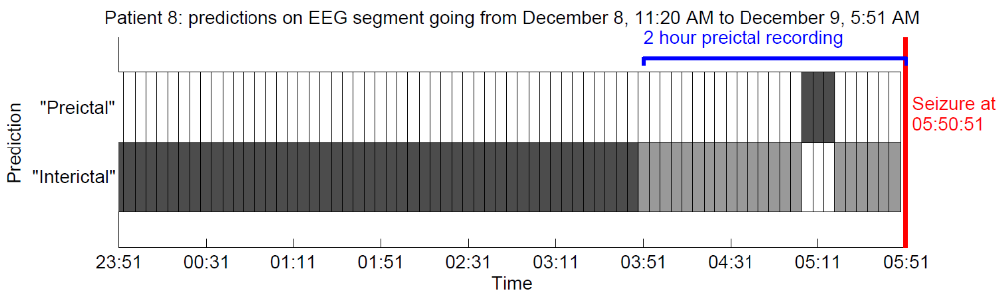
Example of seizure prediction
True
positives
True negatives
False
negatives
False
negatives
Wavelet coherence + convolutional network, patient 8
[Mirowski et al, 2009]

Slide 11
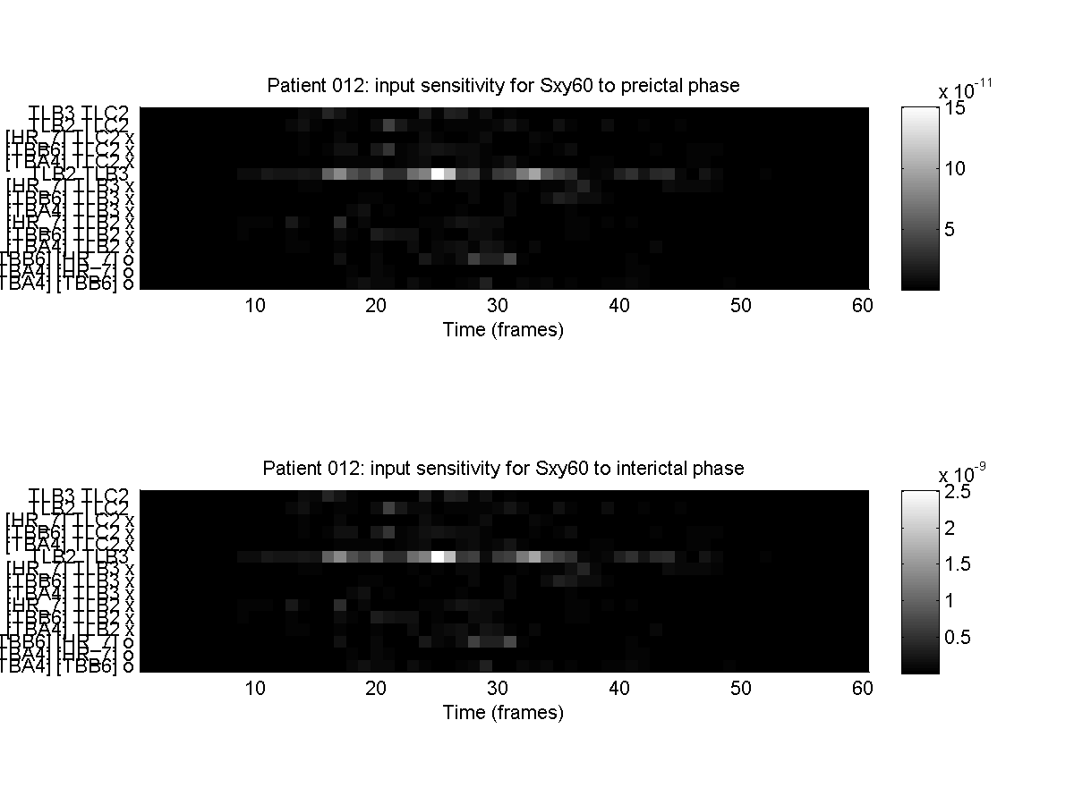
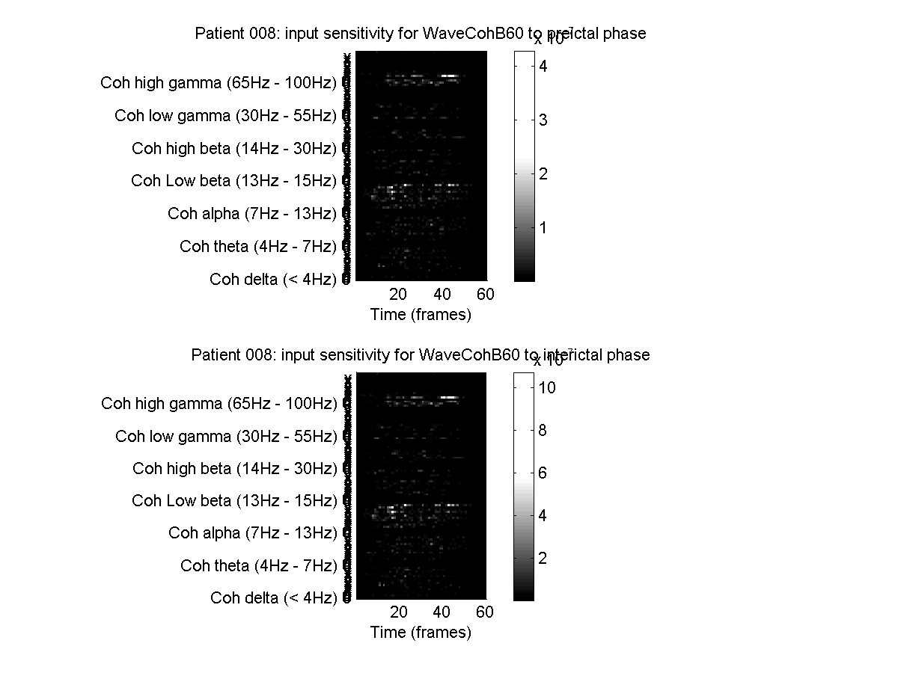
Feature sensitivity (and selection)
L₁ regularization
→ sparse weights
Patient 12, nonlinear interdependence
extrafocal
TLB3 TLC2
TLB2 TLC2
[HR_7] TLC2
[TBB6] TLC2
[TBA4] TLC2
TLB2 TLB3
[HR_7] TLB3
[TBB6] TLB3
[TBA4] TLB3
[HR_7] TLB2
[TBB6] TLB2
[TBA4] TLB2
[TBB6] [HR_7]
[TBA4] [HR_7]
[TBA4] [TBB6]
15
focal-
extrafocal
Analysis of
input sensitivity:
Logistic regression:
look at weights
Conv nets:
gradient on inputs
extrafocal
10
focal-
extrafocal
5
intrafocal
0
10
20
30
40
50
60
0
Time (frames)
Patient 8, wavelet coherence
High γ (55-100Hz)
4
High γ frequencies
could be discriminative
for seizure prediction
classification?
Low γ (31-45Hz)
3
High β (14Hz – 30Hz)
Low β (13Hz – 15Hz)
2
α (7Hz – 13Hz)
θ (4Hz – 7Hz)
1
δ (< 4Hz)
0
0
10
20
30
40
50
60
Time (frames)
[Mirowski et al, 2009]

Slide 12

Thank You
Litt B., Echauz J., Prediction of epileptic seizures, The Lancet Neurology 2002
EEG Database at the Epilepsy Center of the University Hospital of Freiburg, Germany, available: https://epilepsy.uni-freiburg.de/freiburg-seizure-prediction-project/eeg-database/
Le Van Quyen M., Soss J., Navarro V., et al, Preictal state identification by synchronization changes in long-term intracranial recordings, Clinical Neurophysiology 2005
Mormann F., Kreuz T., Rieke C., et al, On the predictability of epileptic seizures, Clinical Neurophysiology 2005
Mormann F., Elger C.E., Lehnertz K., Seizure anticipation: from algorithms to clinical practice, Current Opinion in Neurology 2006
Iasemidis L.D., Shiau D.S., Pardalos P.M., et al, Long-term prospective online real-time seizure prediction, Clinical Neurophysiology 2005
B. Schelter, M. Winterhalder, T. Maiwald, et al, Do False Predictions of Seizures Depend on the State of Vigilance? A Report from Two Seizure-Prediction Methods and Proposed Remedies, Epilepsia, 2006
B. Schelter, M. Winterhalder, T. Maiwald, et al, Testing statistical significance of multivariate time series analysis techniques for epileptic seizure prediction”, Chaos, 2006
T. Maiwald, M. Winterhalder, R. Aschenbrenner-Scheibe, et al, Comparison of three nonlinear seizure prediction methods by means of the seizure prediction characteristic, Physica D, 2004
R. Aschenbrenner-Scheibe, T. Maiwald, M. Winterhalder, et al, How well can epileptic seizures be predicted? An evaluation of a nonlinear method, Brain, 2003
M. Winterhalder, T. Maiwald, H. U. Voss, et al, The seizure prediction characteristic: a general framework to assess and compare seizure prediction methods, Epilepsy Behavior, 2003
J. Arnhold, P. Grassberger, K. Lehnertz, C. E. Elger, A robust method for detecting interdependence: applications to intracranially recorded EEG, Physica D, 1999
LeCun Y., Bottou L., et al, Gradient-Based Learning Applied to Document Recognition, Proc IEEE, 86(11), 1998
Mirowski P., Madhavan D., et al, TDNN and ICA for EEG-Based Prediction of Epileptic Seizures Propagation, 22nd AAAI Conference 2007
Mirowski P., et al, Classification of Patterns of EEG Synchronization for Seizure Prediction, Clinical Neurophysiology, under revision
Mirowski P., et al, System and Method for Ictal Classification, US Patent Application, 2009

Slide 14
Appendix

Slide 15
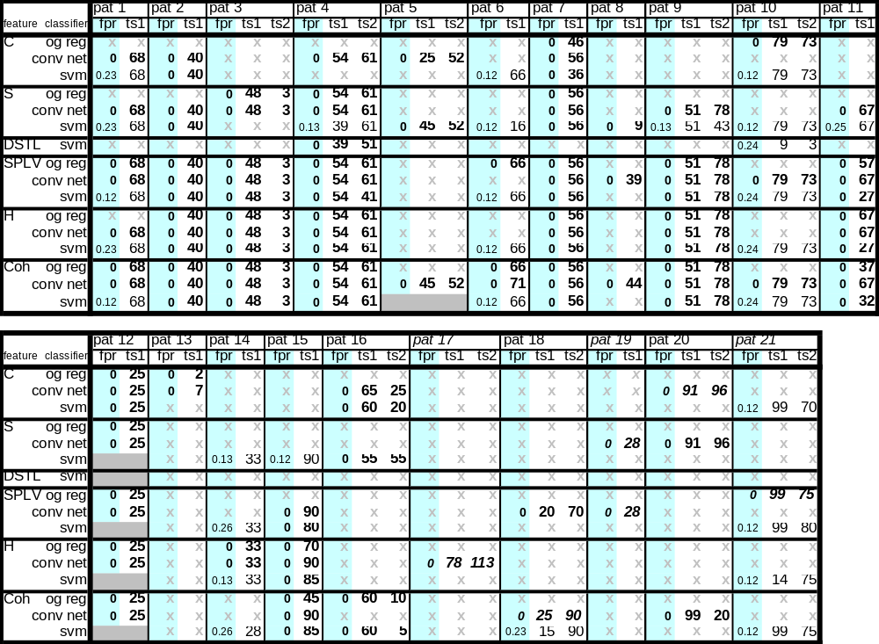
Detailed results

Slide 16
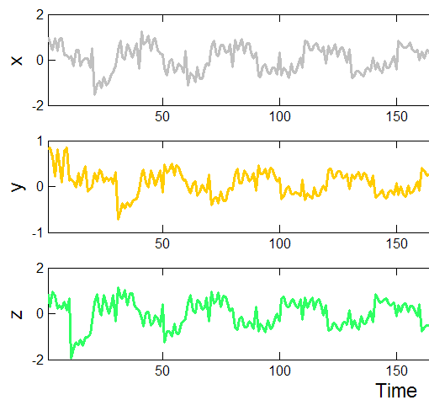
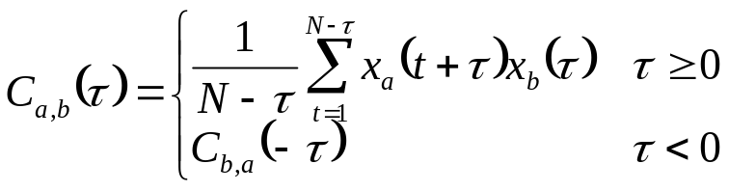
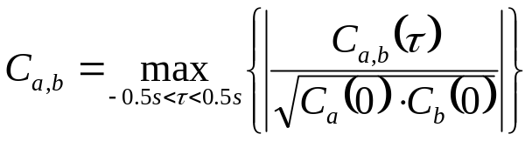
Maximum cross-correlation
Cross-correlation between EEG channels x_{a} and x_{b}:
Maximum cross-correlation
for delays |τ|<0.5s:
Cross-correlation between channels
For each channel, choice of delay
giving best cross-correlation
[Mormann et al, 2005]

Slide 17
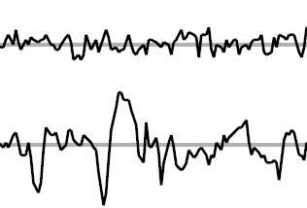
Time-delay embedding
x_{a}(t) and x_{b}(t) are time-delay
embeddings of d EEG samples
from channels x_{a} and x_{b}
around time t.
Elec b
Elec a
1 second
[Iasemidis et al, 2005], [Mormann et al, 2005]

Slide 18

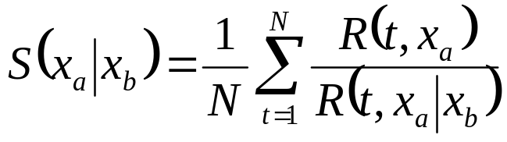
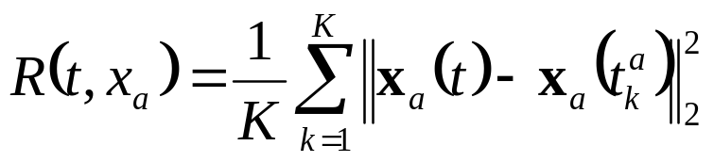

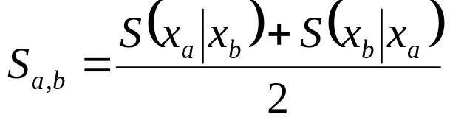
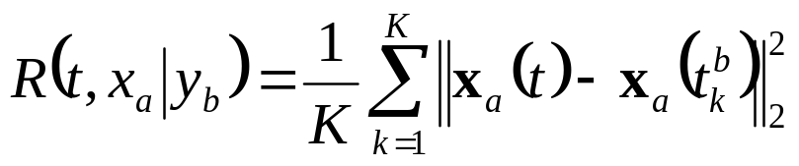
Nonlinear interdependence
Measure Euclidian distances,
in state-space, between
trajectories of x_{a}(t) and x_{b}(t).
Similarity of trajectory of x_{a}(t)
to the trajectory of x_{b}(t):
K nearest neighbors of x_{a}(t):
Distance of neighbors of x_{a}(t) to x_{a}(t):
Symmetric measure of
similarity of trajectories:
K nearest neighbors of x_{b}(t):
Distance of neighbors of x_{b}(t) to x_{a}(t):
[Arnhold et al, 1999] [Mormann et al, 2005]

Slide 19
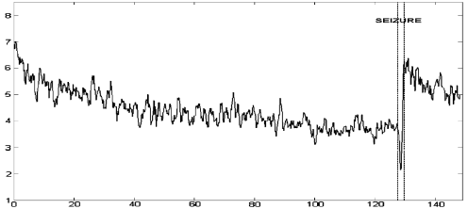
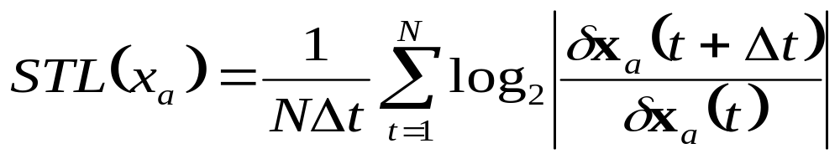
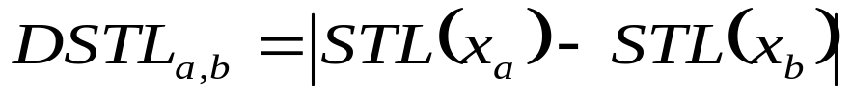
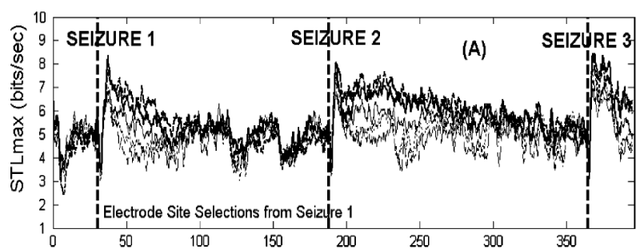
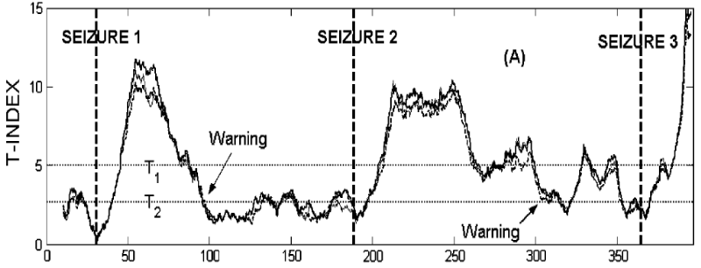
Difference of Lyapunov exponents
Estimate of the largest Lyapunov exponent of x_{a}(t),
i.e. exponential rate of growth of a perturbation in x_{a}(t):
STL b
Short-term Lyapunov exponent (computed over 10sec)
decreases (i.e. stability of EEG trajectory increases)
before seizure
STL a
Measure of convergence of chaotic behavior
of EEG channels x_{a} and x_{b}:
1 hour
disentrainment
entrainment
[Iasemidis et al, 2005]

Slide 20
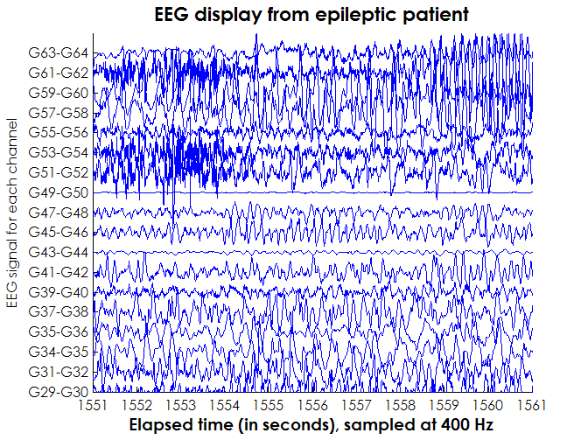
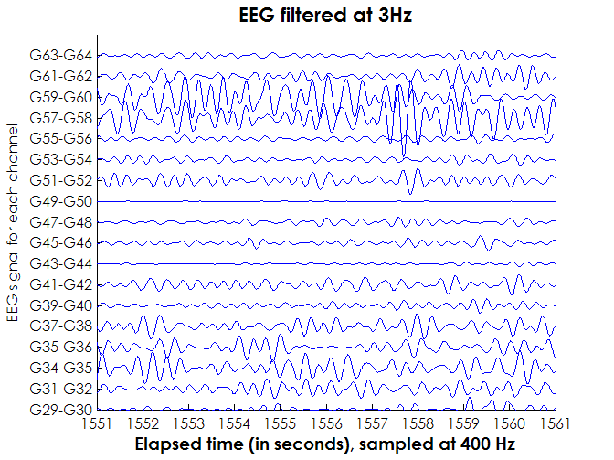
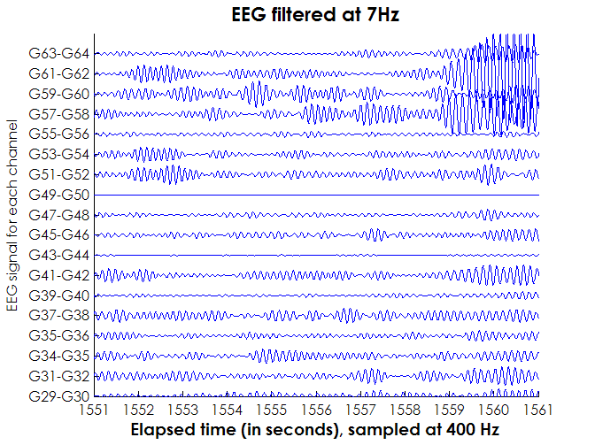
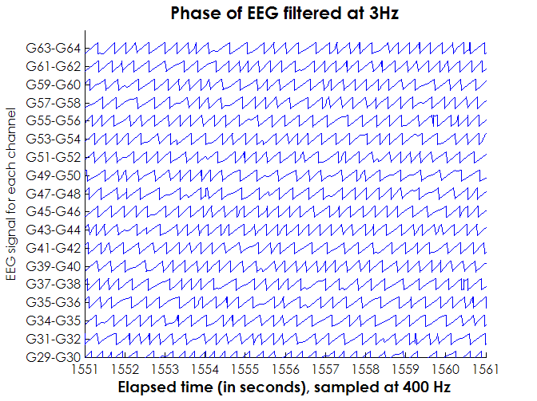
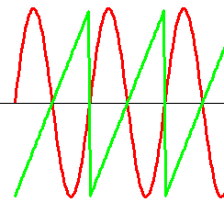
Phase locking, synchrony
Phase locking
= phase synchrony
(Wavelet or Hilbert transforms)
phase
[Le Van Quyen et al, 2005], [Mormann et al, 2005]

Slide 21
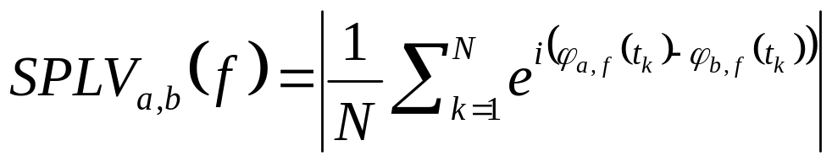
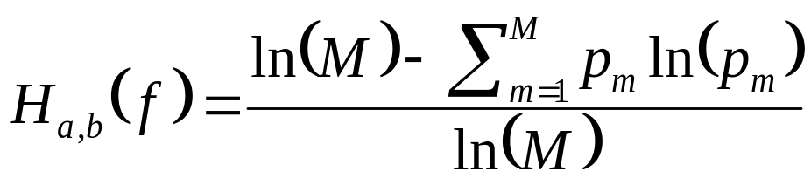
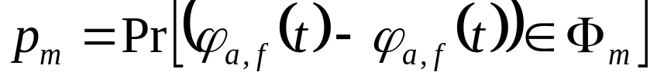
Phase locking statistics
φ_{a,f}(t) and φ_{b,f}(t) are phases of Morlett wavelet coefficients from EEG channels x_{a} and x_{b}, at frequency f, time t
Phase-locking value at frequency f:
Related measure: wavelet coherence Coh_{a,b}(f)
Shannon entropy of phase difference at frequency f using M bins Φ_{m}:
[Le Van Quyen et al, 2005], [Mormann et al, 2005]

