Slide 1
Multistep Synthesis Tool for Organic Chemistry Education
Raelyn Brooks
College of Wooster
Notes:
Welcome, my name is Ray Brooks, and this is my Junior Independent Study project—a computational tool designed to help students explore multistep organic synthesis

Slide 2


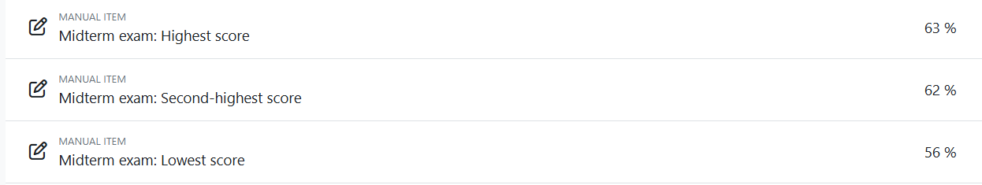

Motivation
Why build a Multistep Synthesis Tool?
  I almost failed O-Chem and I’m a problem solver
  Students often struggle to visualize multistep pathways
  Existing tools are expensive and not beginner-friendly

Slide 3
Goal of the Project
Generate possible multistep synthesis pathways but…
In a useful, interactive, and educational way.
Multistep Synthesis and CS both loves….
Graphs so graph-based system to explore connections between reactions
Ultimately it is all about…
Helping struggling students

Slide 4
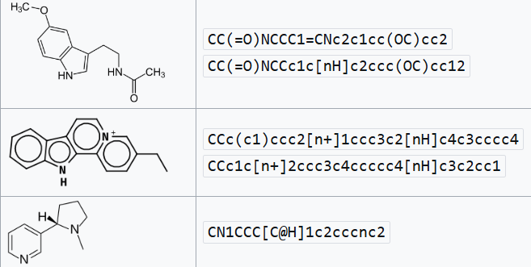
High Level Overview
How the System Works
  Reactions are encoded as reaction SMILES (Simplified Molecular Input Line Entry System)
  Molecules and reactions form a directed graph (aka not random)
  A search algorithm explores possible pathways from starting materials to a target
  Outputs the shortest or alternative synthesis routes
Figure 1: Examples of SMILES and their structures.

Slide 5

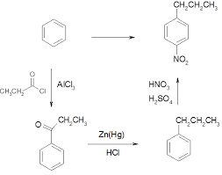
High Level Overview
Nodes are compounds
Edges are reactions (reagents, conditions)
You see it now…
Directed Graph In A Nutshell
Figure 2: Example of a Multistep Synthesis Pathway

Slide 6
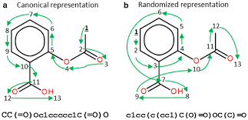
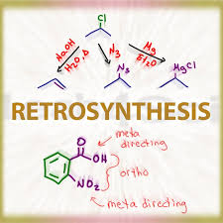
High Level Overview
Components:
  Dataset Parser
    Reads and standardizes reaction SMILES from large dataset
  Canonicalizer
    Converts SMILES to canonical (ordered) form
  Reaction graph builder
    Connects reactions by matching: product → reactant
  Pathway searcher
    BFS / DFS / modified search
Figure 3: Canonical vs Non-canonical

Slide 7
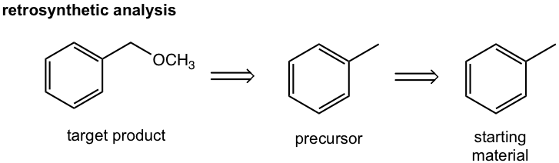

Slide 8
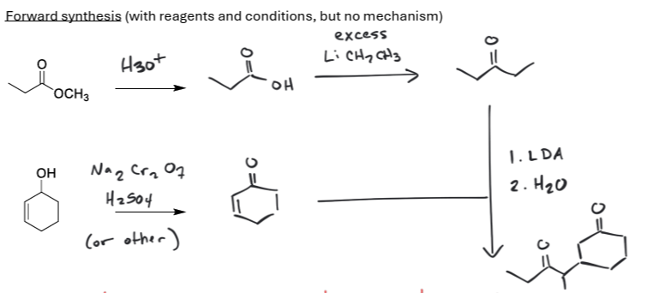
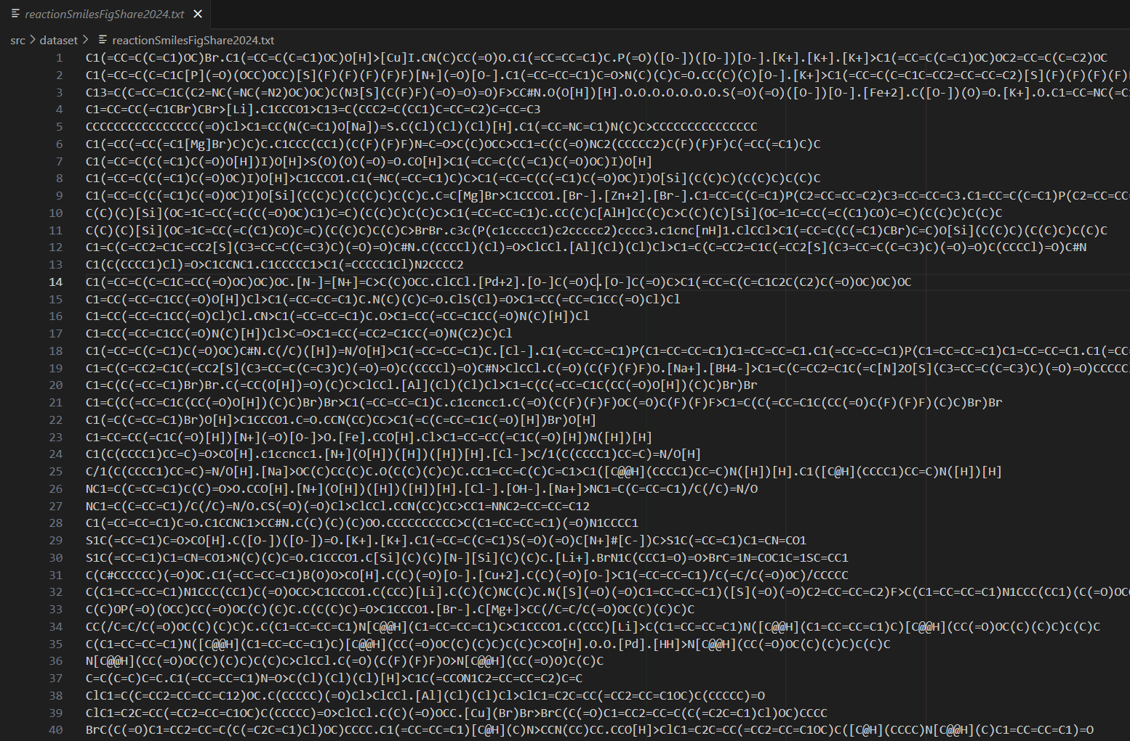
Datasets
Two Datasets
  Small
    Textbook reactions (intro-level organic chemistry)
    Came from pass O-Chem questions from my old exams (shout out Dr. Bonvallet)
  Large
    1.37 million real-world reaction entries from Rik van der Lingen
    Reaction data span from 1976 – 2024
    Both datasets are formatted in SMILES/SMIRKS notation
Figure 4: Example of Textbook Problem
Figure 5: Part of the 1.37 million SMILES

Slide 9


Implementation
Pathway Generation Code
  Python + RDKit
  Smiles canonicalization ensures consistent node matching
  ReactionGraph class stores edges and nodes
  BFS used for shortest pathway search
Example Pathway Search
  Input: Target molecule
  Tool traverses reaction graph
  Outputs all viable synthetic routes up to N steps
  Returns pathways with structures + SMILES

Slide 10
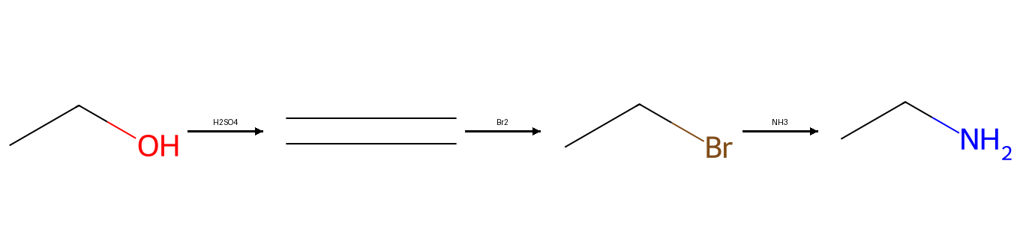
Results
Successful Syntheses Generated
  Generated multistep pathways for both common textbook molecules and complex real-world reactions
  Correctly identified multiple alternate pathways
  Robust to varied SMILES inputs after canonicalization
Figure 6: Actual generated image from my project

Slide 11
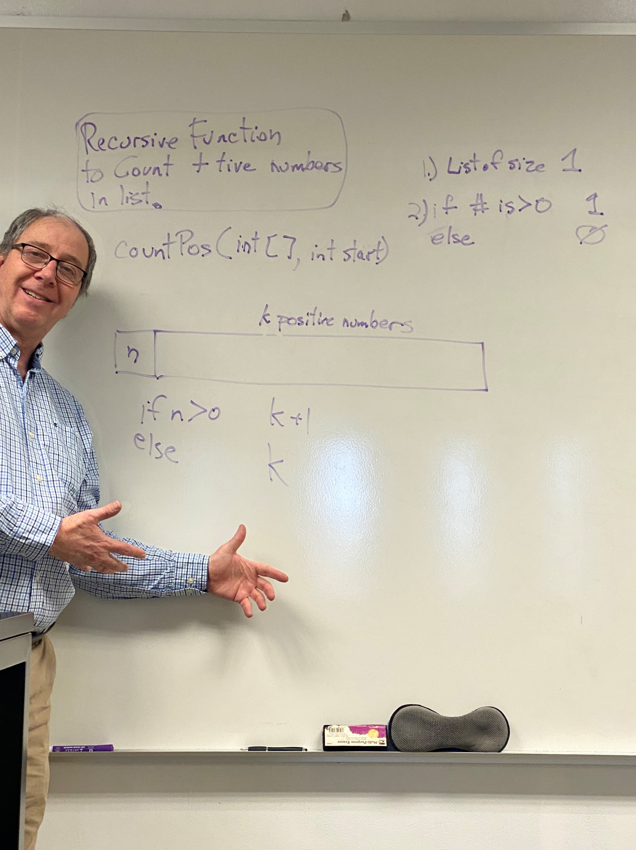
Demo Time

Slide 12
Future Works
Integrate UI for interactive student use
Add reaction condition filtering (temperature, reagents)
Implement scoring: cost, yield, difficulty
Lessons Learned
Canonical SMILES is critical for accuracy
Organic chemistry datasets are inconsistent and require heavy cleaning
If I were to do this project again to block on large chunks of time for it
The importance of algorithms and their usages

Slide 13
Questions?

Slide 14
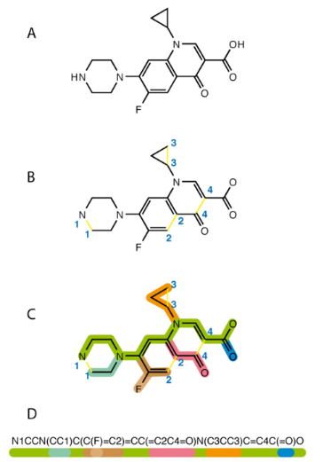
Background: Reaction SMILES
Encode reactions as reactants >> products
Why they’re useful in cheminformatics

Slide 15
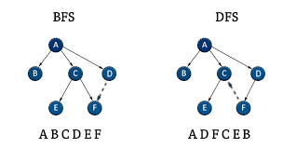
Graph Theory Refresher
Why graphs fit synthesis planning
BFS vs DFS for chemical pathway searching

Slide 16
RDKit Overview
Molecule objects
Canonicalization
Reaction handling tools
  MolFromSmiles() - Converts a SMILES string into an RDKit molecule object.
  MolFromSmarts() - Parses SMARTS patterns for substructure searching.
  Draw.MolToImage() - Creates 2D images of molecules for slides or demos.

Slide 17
Limitations of the System
Dataset size
No stereochemistry
No reaction energetics
Graph search can generate unrealistic paths

Slide 18
Architecture
How scripts interact:
  reactionGraph.py
  generatePathways.py
  combined123.py
  dataset/
  data/

