Slide 1

Centralized Disaster Response System
Team: Cloudbusters
Members:
Gaurav Jain
Ramshakti Singh
Suprit Todwal
Rajesh Tanwar

Slide 2
Centeralised Disaster Response System
Problem Statement:
The lack of a proper system to identify/inspect disaster occurrence and also lacking the mechanism to measure the related destruction/damage. This results in inadequate and delayed help. And of course casualty/damage is comparatively high.
Solution:
Build an effective centeralised disaster tracking system to gather and analyse the disaster data being collected through the affected or nearby people. Need/Help can be raised immediately through various communication means and by anyone from the disaster place. On the basis of nature of data, disaster management team can quickly model down their help mechanism and straight away direct the disaster action teams accordingly. It will be linked with maps API to report the affected location.

Slide 3
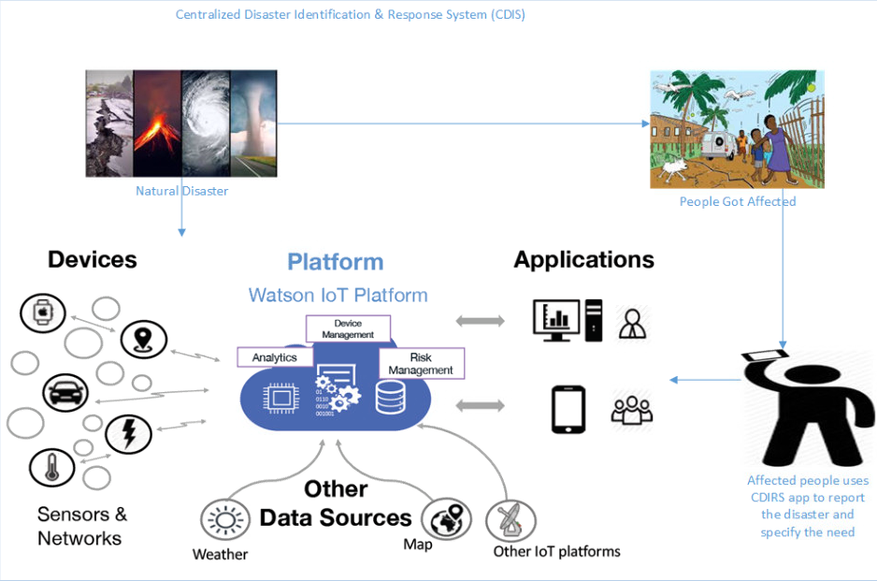

Slide 4
Technology Stack:
IBM Bluemix Console
IBM Watson Assistant
Slack
Internet of Things
IBM Visual Recognition Technology
Node Red
AI enabled Serverless Functions
Weather API
Cloudant(No SQL)

Slide 5
Benefits:
Effective centralized disaster tracking system. Immediate and need based help granted to the affected population. Effective resource utilization and co-ordination.

