Slide 1

Jerome Application TEXT-TO-SPEECH TRANSLATOR AND CONVERTER
Domain: AI and Machine Learning using AWS services
Application URl
Team: 405found

Slide 2









New Post
SNS
3
4
POST
4
5
6
WEB APP – EBS hosted
API Gateway
Dynamo DB
1
2
7
9
Text Translate
Audio Convertor
Store in S3
Update Dynamo DB
8
Blue/Green
11
GET
10
Amazon S3
New
Get
13
12
Fetch mp3
Text to Speech Convertor & Translator using Serverless Architecture

Slide 3
Application workflow
User inputs text in the textbox , select language from drop-down and Click on “Process” using the WebApp hosted on Elastic Bean Stalk
The information is submit to RESTful web service using POST protocol exposed by Amazon API Gateway
Amazon API Gateway sets off a dedicated Lambda function, “New Post,” which is responsible for initializing the process of generating MP3 files
At trigger of lambda, following actions are taken:
Lambda function inserts Information about the post into a DynamoDB table, where information about all posts is stored
To run the whole process asynchronously, we use Amazon SNS to decouple the process of receiving information about new posts and starting their conversion
Another Lambda function, “Convert to Speech,” is subscribed to our SNS topic whenever a new message appears (which means that a new post should be converted into an audio file). This is the trigger.
The “Convert to Speech” Lambda function uses Amazon Translator to translate the text into the language specified in the WebApp
The “Convert to Speech” Lambda function uses Amazon Polly to convert the text into an audio file in the specified
The new MP3 file is saved in a dedicated S3 bucket
Information about the post is updated in the DynamoDB table. Then, the reference (URL) to the S3 bucket is saved with the previously stored data
The RESTful web service is deployed using Amazon API Gateway, internally triggers Lambda function “GET Post” to retrieves information about posts
The Lambda function Amazon API Gateway exposes the method for retrieving information about posts. These methods contain the text of the post and the link to the S3 bucket where the MP3 file is stored. In our scenario, this web service is invoked by a static webpage hosted on EBS
Amazon API Gateway invokes the “Get Post” Lambda function, which deploys the logic for retrieving the post data
The “Get Post” Lambda function retrieves information about the post (including the reference to Amazon S3) from the DynamoDB table and show the mp3 file stored in S3 Bucket
We also used State of Art technologies based on Blue/Green model resuting Zero Downtime while deployment of new version of Application

Slide 4
Jerome capabilities
One click text-to-speech conversion to multiple global accents
SSML (Speech Synthesize Markup Language) used in premium products like Amazon Alexa, Google Home
Provides run-time translation service to multiple languages before converting to speech
“Hello” in English (en) -> “Hola” in Spanish (es)
Built on serverless architecture! (No worries of maintaining costly infrastructure)
Utilize power of cloud computing
Cost efficient (only charged for the actual execution time of lambda which is in millisec, generally)
Can be easily adapted to take any language in input before translation
No need to install desktop/mobile applications
Additionally, supports of Blue/Green implementation (using Elastic Bean Stalk( for maintaining of web application (zero downtime deployments))

Slide 5
Services and TechStack
Amazon Polly: Standard Text-to-speech service generating audio files for input text
Amazon Translate: Translator service for language text translation
SSML: Speech Synthesize Markup Language (life like speech with better clarity and usage of punctuation marks than “plain text” type)
Amazon Lambda: Technology that supports FaaS (Function as a Service) and serverless architecture
Amazon DynamoDB: NoSQL Database
Amazon S3: Simple Storage Service providing support of storing data and hosting static web content
Amazon SNS: Simple Notification Service supporting trigger of lambda functions and other notifications
Amazon API Gateway: API gateway service interacting with RESTful APIs/Microservices.
Language used in Lambda: Python (open source scripting language build to support AI/ML)
Programming language for web-app: HTML5, JavaScript, Ajax, jQuery
Amazon EBS (Elastic Bean Stalk): Provides run-time environment to host front-end of applications

Slide 6
Team Formation
Abhishek Sharma
Bharat Bhushan
Mohit Bansal
Sourav Anand
Sunil Aggarwal

Slide 7
Important links
Jerome Application URl
GitHub URl
Demo URl

Slide 8

Thank You

Slide 9
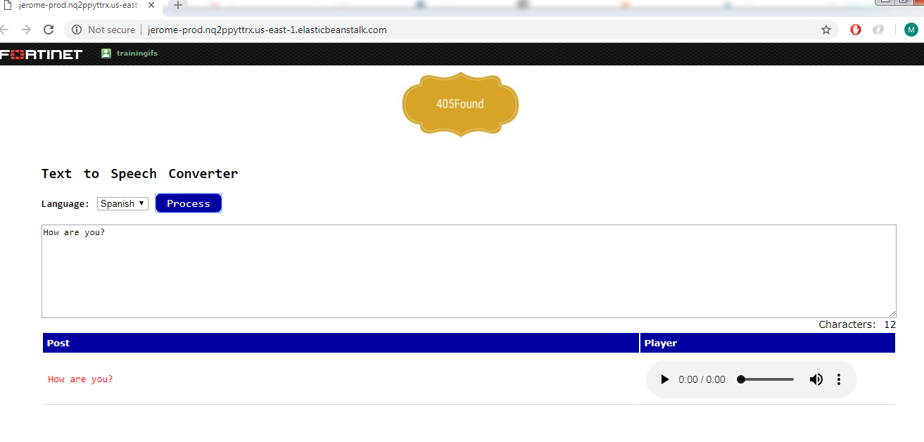
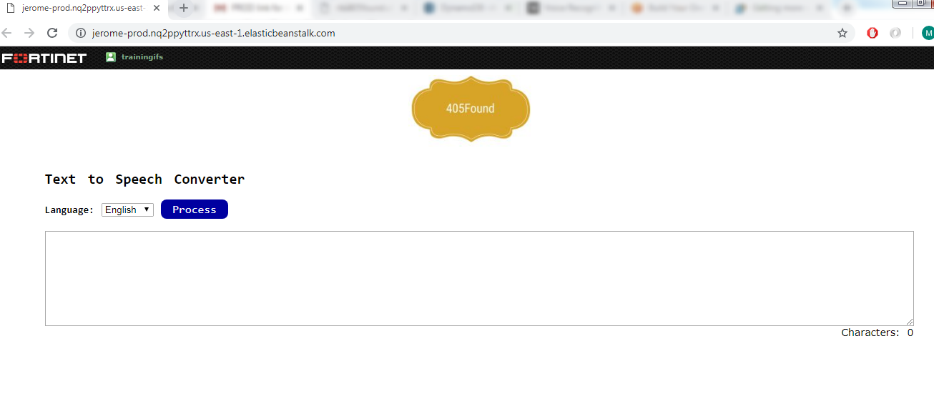
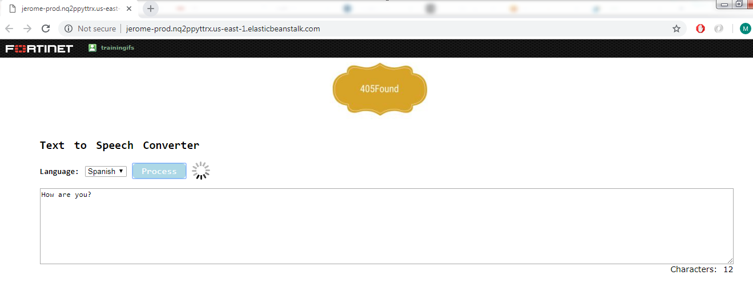

Snapshots

