Slide 1
Conceptualization and Measurement
Network Analysis Reading Group
February 2017

Slide 2
Why do we care about networks?

Slide 3
Levels of Analysis
Actor level: centrality, prestige and roles such as isolates, liaisons, bridges, etc.
Example: Who is the most influential opinion-maker on Twitter?
Wasserman, S. and K. Faust, 1994, Social Network Analysis. Cambridge: Cambridge University Press.

Slide 4
Levels of Analysis Ctd.
Dyadic level: distance and reachability, structural and other notions of equivalence, and tendencies toward reciprocity.
Triadic level: balance and transitivity
Example: Do people change their preferences to match their network of friends?

Slide 5
Levels of Analysis, Ctd.
Subset level: cliques, cohesive subgroups, components
Network level: connectedness, diameter, centralization, density, prestige, etc.
Example: Are Democratic or Republican activists more connected to each other?

Slide 6
Sampling
Traditional sampling
Sampling a network:
Okay to sample cases. Not okay to sample edges.
Loss of information roughly equal to (100 – k)% (Burt 1983)

Slide 7
Sampling Solutions
Focus on networks where all relations are known
Focus on ego-centered networks
Work qualitatively
Snowball sampling

Slide 8
Example Analysis
Koger, Masket and Noel (2009)
Level of analysis: network
Single-mode directed network
Node = 1 organization
Edge = 1 shared email solicitation
Snowball sample
Initial sample of 50 organizations, 2nd/3rd waves of 110 and 170
433 edges out of a 81,510 possible edges

Slide 9
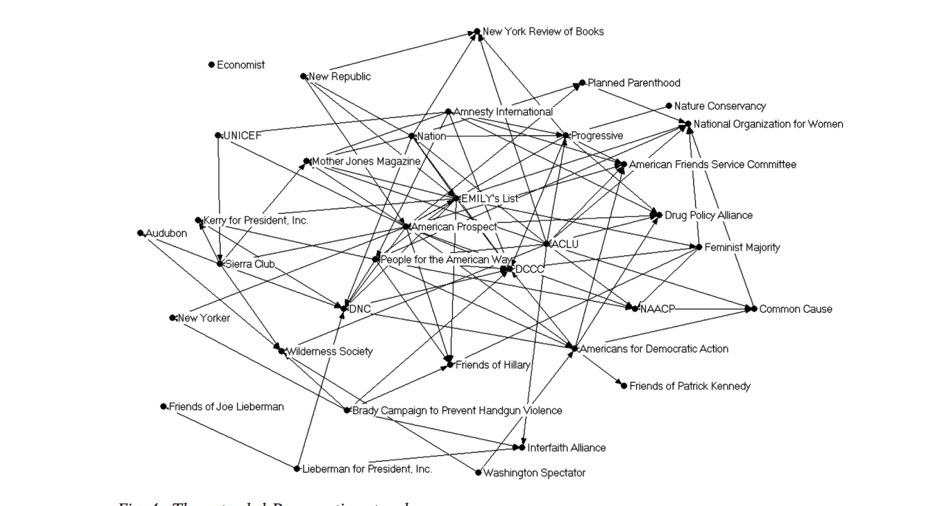

Slide 10
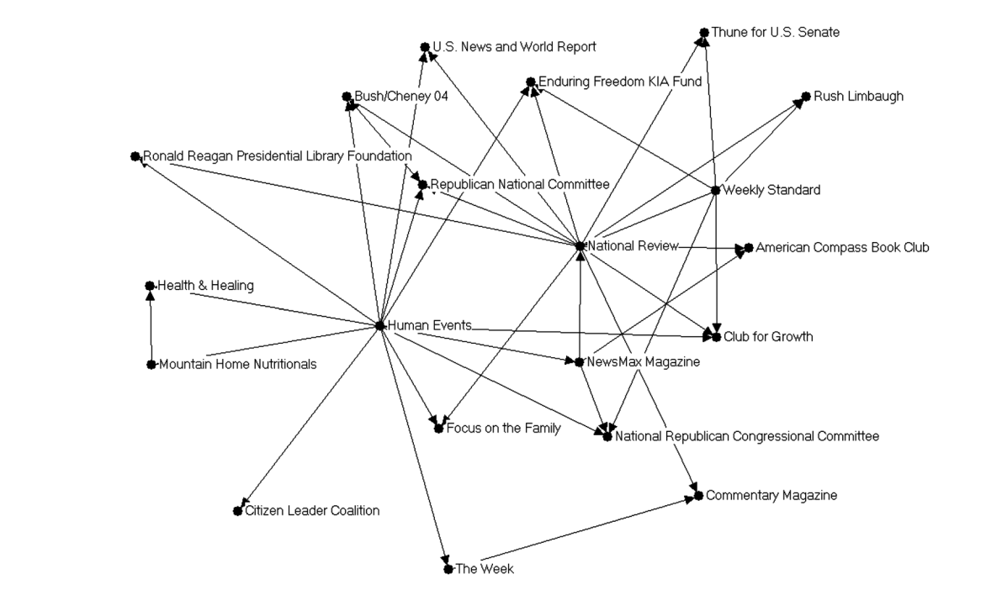

Slide 11
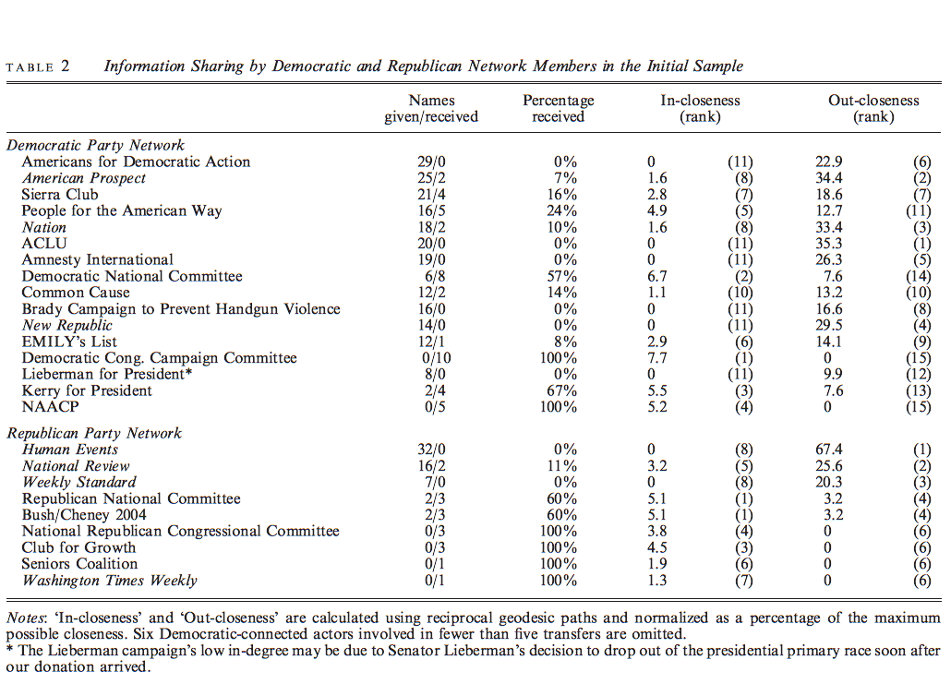

Slide 12
Practicum: Terrorism Network

Slide 13
