Slide 1
Community Detection & Local Structures (i.e. triad analysis)
Ross Buchanan
NARG
March 9, 2017

Slide 2
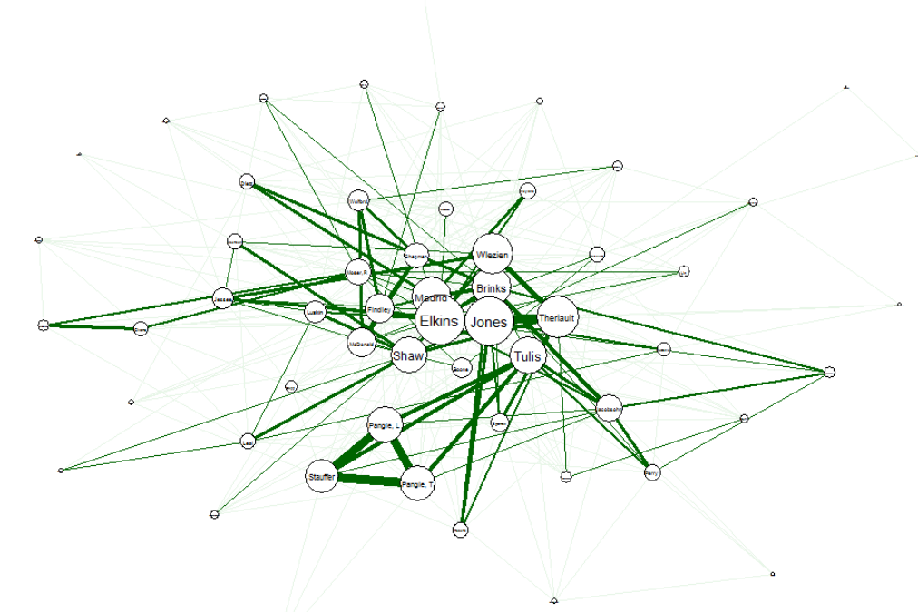
How to find local structures

Slide 3
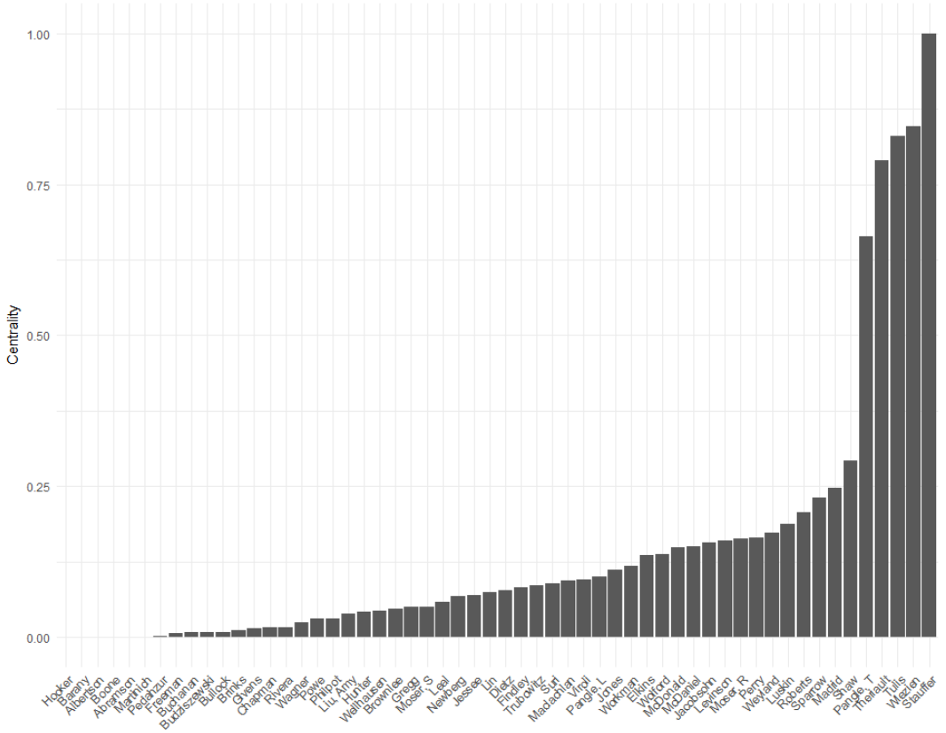
Multiple high centrality scores suggest clustering, but…

Slide 4
Looking for local structures
Test for modularity:
# of edges in a group - # of edges expected from random placement
Positive: suggests cluster
Negative: suggests division between clusters
How do you know the # of edges expected from random placement?

Slide 5
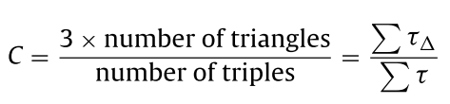
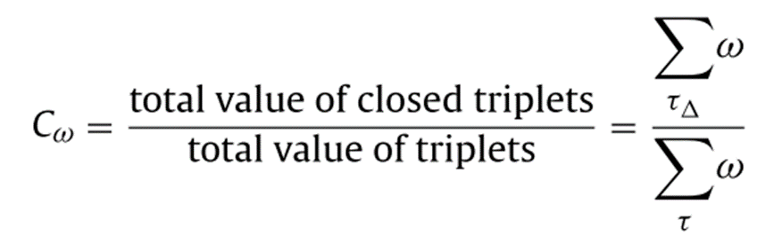
Clustering Coefficient
Unweighted
Weighted

Slide 6
Characteristics of Both Clustering Coefficients
Possible C values: [0, 1]
C=0 means no closed triangles, and 1 means all nodes are in closed triangles.
C -> 0 as the size of a network increases, if the edges are generated at random.

Slide 7
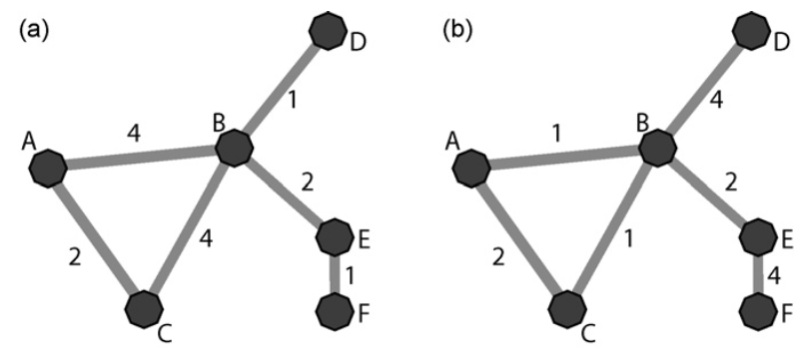
Example
(a) has a higher weighted cluster coefficient than (b).

Slide 8
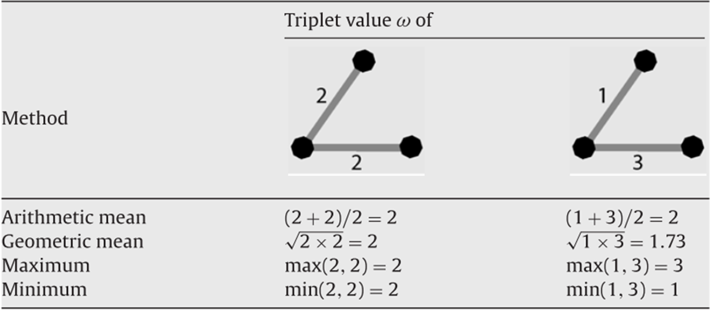
Calculating Triplet Values

Slide 9
Mathematical Procedures
How to preform these tests in practice?
Procedures are mathematically complex (see Fortunato and Newman readings for details.

Slide 10
Citations
Newman, M. E. J. 2006. “Modularity and Community Structure in Networks.” Proceedings of the National Academy of Sciences of the United States of America 103(23): 8577–82.
Opsahl, Tore, and Pietro Panzarasa. 2009. “Clustering in Weighted Networks.” Social Networks 31(2): 155–63.
Fortunato, Santo. 2010. “Community Detection in Graphs.” Physics Reports 486(3–5): 75–174. http://dx.doi.org/10.1016/j.physrep.2009.11.002.

