Slide 1
Exec. Summary of Enfys InAs vs InGaAs Sensor Simulations & Evaluation
Enfys reflectance sampling has been simulated to understand the difference in mineral discriminatory ability between an InAs (long-range, high-noise) and modified InGaAs (short-range, low-noise) Mid-Wave Infrared (MWIR) sensor.
Simulations
Reflectance sampling has been performed following these common steps:
Sampling high resolution lab. mineral reflectance spectra with instrument response (taking norm’d integral product).
Adding Gaussian noise according to the spectral Signal-to-Noise Ratio (SNR).
Instrument response is simulated with a Cauchy distribution, with latest FWHM measurements of Enfys optics (Aber. Uni.).
Spectral Signal-to-Noise Ratio data is taken from latest modelling results (Aber. Uni.).

Slide 2
Exec. Summary of Enfys InAs vs InGaAs Sensor Simulations & Evaluation
Evaluation
The discriminatory ability for a given mineral is evaluated using the Spectral Angle, between a noisy spectrum of the mineral and the clean spectrum of each mineral of the MICA files set.
The uncertainty on the Spectral Angle is computed by repeatedly drawing 128 independent noisy samples of the mineral spectrum, to give the standard deviation on the mean Spectral Angle (of the given mineral against each mineral of the MICA files).
The ability of the instrument spectral range and noise conditions to discriminate the given mineral is evaluated as the Fisher Ratio – the ratio of the difference between the 2 lowest spectral angles and the total variance of these spectral angles.
Fisher Ratio: Spectral Angle Separation
Evaluation
We obtain a Fisher Ratio score for each mineral, and each instrument simulation. This provides evaluation of each sensor mineral discriminatory ability.
Second smallest Spectral Angle,
next best match
Smallest Spectral Angle,
best match
Difference >> Variance, high confidence id
Summarised by high Fisher Ratio
Spectral Angle
Vector Angle between 2 n-dim. spectra, for n spectral channels

Slide 3
InAs vs InGaAs Sensor Simulation Differences:
Signal-to-Noise Ratio
The only change between sensor simulations is the spectral Signal-to-Noise Ratio, used to define the amount of noise added to a resampled Enfys spectrum, and the spectral range.
All simulations use the same SWIR (0.9 - 1.65 µm) InAs sensor.
- Simulation 1 uses the InAs MWIR (1.65 – 3.1 µm) sensor.
- Simulation 2 also uses this sensor, with SNR degraded by a factor of 10, to approximate additional error introduced by uncharacterised thermal behaviour.
- Simulation 3 uses the modified InGaAs MWIR (1.65 – 2.5 µm) sensor.
Source: Enfys Science Traceability Matrix, V.2., M. Gunn, C. Cousins, P. Grindrod. EXM-EN-MTX-ABU-0001
Signal-to-Noise Ratio calculated (M. Gunn) for a 30% albedo Lambertian reflector, under Solar illumination at Mars aphelion, with 0.1 OD of atmospheric dust.

Slide 4
Spectral Resampling:
Sampling Hi-Res Spectra to Enfys Spectral Channels
We spectrally resample the input high resolution spectral library to the Enfys spectral channels by computing the transmission-normalized integral product between the given 𝜆_{cwl} transmission profile and the given hi-res spectrum, approximating:
High-Resolution Input Spectrum
Enfys Channel Profiles
Enfys Sampled Spectrum

Slide 5
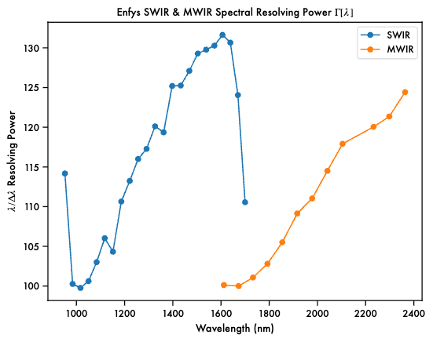
Spectral Resampling:
Setting the Enfys Spectral Channels
Measured LVF Spectral Resolving Power (Aber. Uni.)
We assume that Enfys channel centre wavelengths (CWLs, 𝜆_{cwl}) can be set with arbitrary precision.
We set channel wavelength intervals (𝛿𝜆) relative to Full-Width-at-Half-Maximum (FWHM, ∆𝜆) at the given 𝜆_{cwl.}
∆𝜆 is defined from the Spectral Resolving Power (𝜆/∆𝜆) of the Linear Variable Filters (LVFs), measured by Aber. Uni. We interpolate and extrapolate the data.
Starting at the initial 𝜆_{cwl} of 𝜆₀=0.900 µm, we iteratively generate the 𝜆_{cwl} list with Nyquist sampling, i.e. 𝛿𝜆 = ∆𝜆/2, such that:
that we repeat up to the longest 𝜆_{cwl}.
Interpolate and extrapolate ∆𝜆
Generate Nyquist-spaced 𝜆_{cwl}

Slide 6
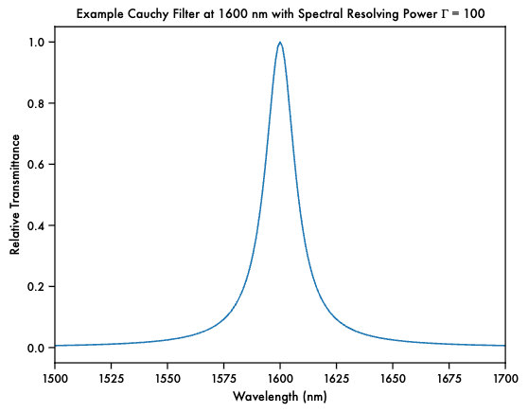
Spectral Resampling:
Setting the Enfys Spectral Channel Transmission Profiles
We model the transmission with a Cauchy distribution profile (M. Gunn):
where 𝛾 is the HWHM:
where ∆𝜆 (FWHM) is a function of 𝜆_{cwl} (see previous slide).
We assume there is no out-of-band leakage.

Slide 7
‘Clean’ Enfys spectrum
Spectral Resampling:
Adding Noise
We add Gaussian noise to the sampled spectrum.
We take the std. dev. of the noise distribution for each channel from the channel observed reflectance and the spectral SNR
Single-draw Noisy Spectrum
Enfys SNR
Std. Dev. of noise
Additive noise, drawn from Gaussian
Noisy reflectance

Slide 8
Spectral Angle
Spectral Angle Uncertainty
We summarise the ability of a noisy spectrum to be identified by computing the Spectral Angle between the ‘noisy’ spectrum of unknown material ‘i’ and the ‘clean’ spectrum (Enfys sampled, pre-noise) of known material j.:
When i=j, the Spectral Angle will be near 0, but it will be perturbed by the noise of the noisy spectrum
This is just the familiar vector dot product, where our reflectance spectra are treated as n-dimensional vectors, where n is the number of Enfys spectral channels:
The noise propagates to the Spectral Angle.
We can Monte Carlo approximate the Spectral Angle uncertainty by repeatedly drawing noisy spectra from the same clean spectrum, and evaluating the Spectral Angle mean and std. dev.
After computing 𝜃(i,j) for each mineral j in the MICA set,
i is identified as the mineral j for which 𝜃(i,j) has the lowest value.

Slide 9
Uncertainty on Mineral ID by Spectral Angle & Fisher Ratio
For a noisy reflectance spectrum to be uniquely identifiable, it must have a Spectral Angle that is not only small, but observably smaller than the next nearest match.
To evaluate this, we need to consider:
distance between smallest (rank 1) and next smallest (rank 2) values of 𝜃(i,j):
∆𝜃₁₂= 𝜃₁-𝜃₂
- and the uncertainty on 𝜃₁ & 𝜃₂:
𝜎_{𝜃1}, 𝜎_{𝜃2}
We summarise this with the Fisher Ratio:
Good separation,
good identification
Good separation
Poor separation,
poor identification
Poor separation

Slide 10
Fisher Ratio Instrument Performance Summary
We can summarise the success of the instrument configuration (i.e. MWIR sensor spectral range and SNR) for discriminating the minerals of the MICA Files with a Fisher Ratio barplot.
Fisher Ratio of the Spectral Angle

