Slide 1
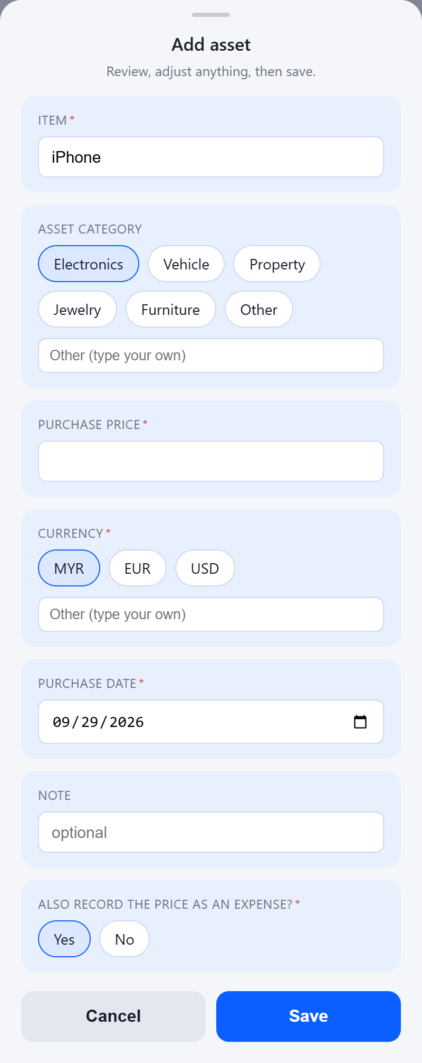
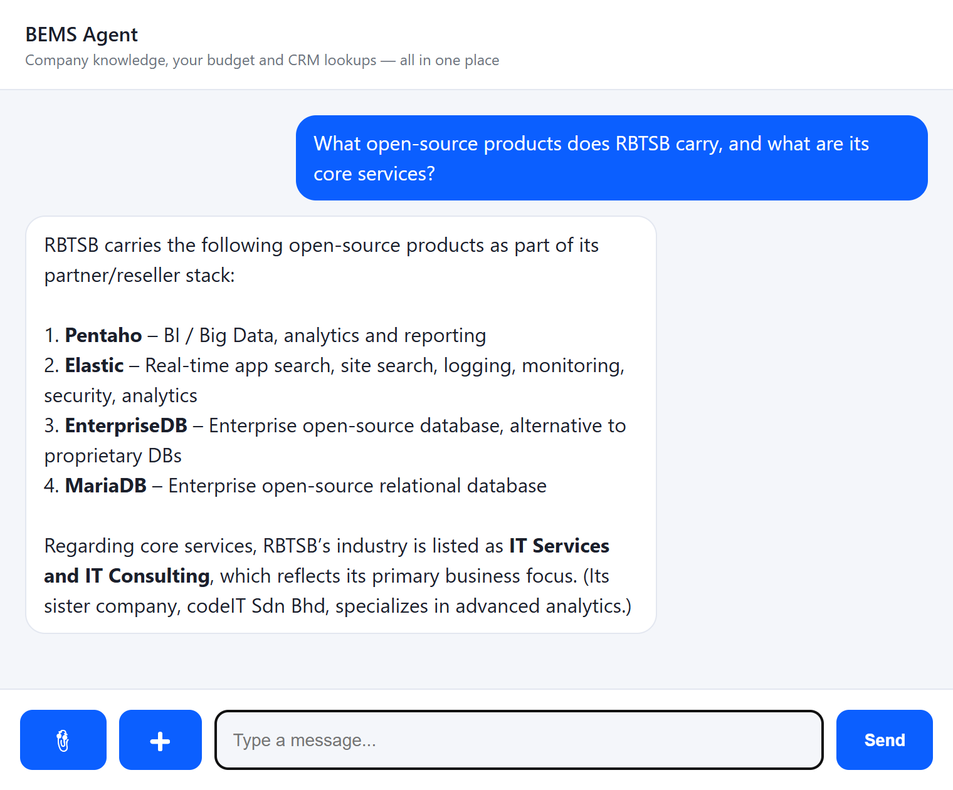
BEMS Agent
One chat for company knowledge, your money and real actions
RAG · Semantic search
Live data tools
Chat-driven forms
Capability overview · all screenshots taken from the running app
Notes:
BEMS Agent is a single conversational entry point. It answers general questions from the company knowledge base (RAG), reads exact live data through tools (balance, transactions, budgets, assets, CRM), and opens structured forms (bottom sheets) that it pre-fills from the chat. Every screenshot in this deck is from the real running application.

Slide 2






What the agent can do
Six capability areas behind one chat box
Semantic search (RAG)
Exact balance
Transactions, budgets & assets
Answers company questions from the knowledge base via vector search
"What's my balance?" is read live from the budget service
Tables of income/expenses, spending limits and owned items
Chat-to-form
CRM database
Ask your documents
"I bought a phone" opens a pre-filled form for you to finish
Natural-language questions over the CRM, writes need approval
Upload a PDF, Word, Excel or PowerPoint file and ask about it
Notes:
Blue = knowledge and lookups, mint = exact data from the budget service, amber = structured human-in-the-loop forms.

Slide 3
How it works
The model decides; deterministic code executes. Every write passes through a human-approved sheet.
RAG
Milvus + TEI (multilingual-e5)
LangGraph agent
LLM tool routing, checkpointed thread state, interrupt / resume, bounded loops
Web / mobile UI
Chat + bottom sheets rendered from JSON
Flask API
/send · /resume · /entry · /upload
Budget API
Spring Boot + PostgreSQL
BEMS DB
PostgreSQL (read / approved write)
One interrupt protocol, any client. The agent never emits HTML. It sends a JSON description of the fields it needs (choice, date, text, number, confirm) with defaults and errors; web, mobile or CLI render it and send one shared answer shape back.
Notes:
Separation of reasoning and execution: the LLM only chooses a tool and proposes arguments. Python code validates the arguments, performs the call, and all write paths pause on a LangGraph interrupt until the user confirms in the UI.

Slide 4




General knowledge with semantic search
Ask in your own words; the answer is grounded in the company knowledge base
1. Embed the question
multilingual-e5-small via the TEI service; works across languages
2. Vector search
Top-3 closest chunks from Milvus, not keyword matching
3. Grounded answer
The excerpts are injected as context, so the model answers from sources
Graceful degradation
If Milvus or TEI is down the chat still works, just without RAG
Notes:
Question shown: 'What open-source products does RBTSB carry, and what are its core services?' The answer lists Pentaho, Elastic, EnterpriseDB and MariaDB — all taken from knowledge_base.md chunks retrieved from Milvus.

Slide 5
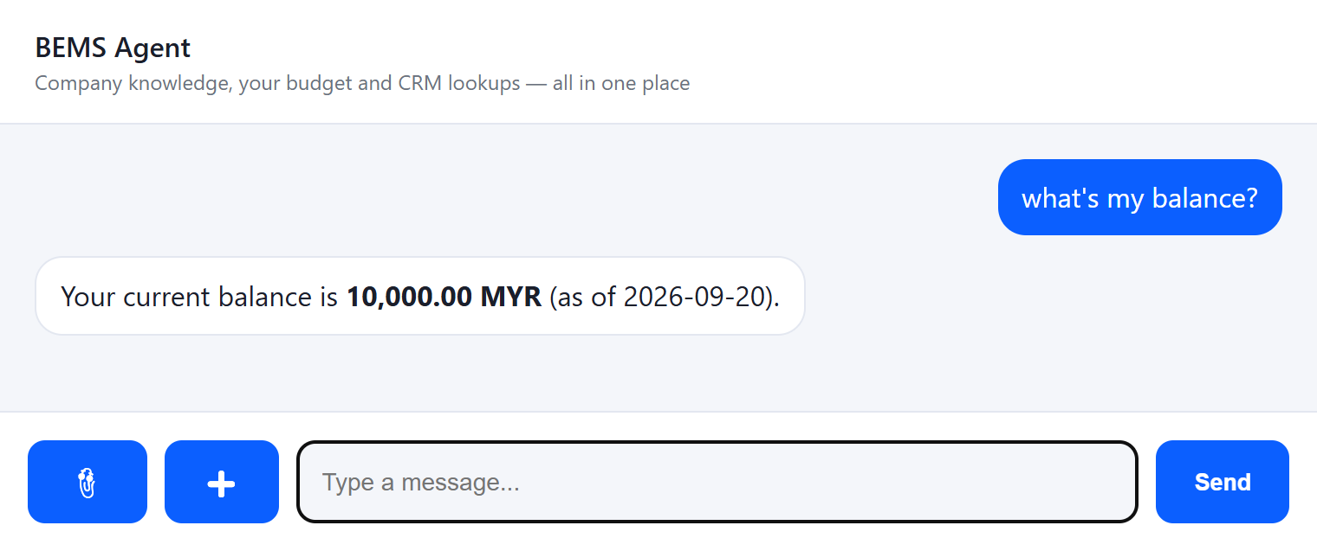
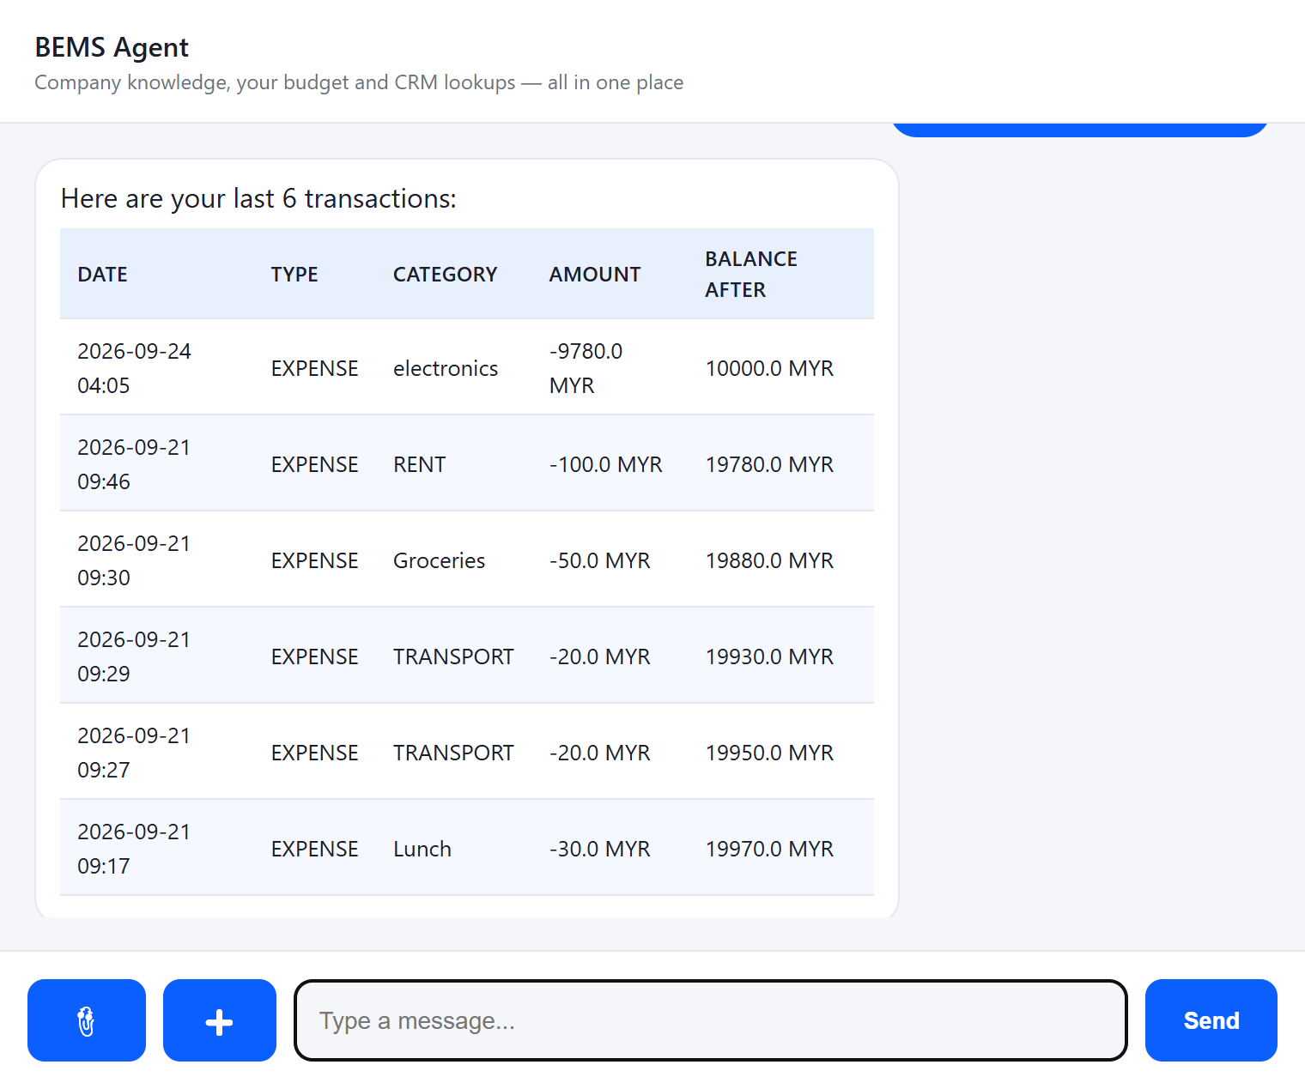
Exact data, not guesses
Precise questions call live tools and get back real numbers from the database
10,000.00 MYR
returned by get_balance, read directly from PostgreSQL through the Budget API
Tables are formatted by code, not by the model, so rows and amounts are never re-typed or invented.
Notes:
'what's my balance?' → get_balance. 'show my last 6 transactions' → list_transactions. The Markdown table is built server-side and the model is instructed to relay it verbatim.

Slide 6
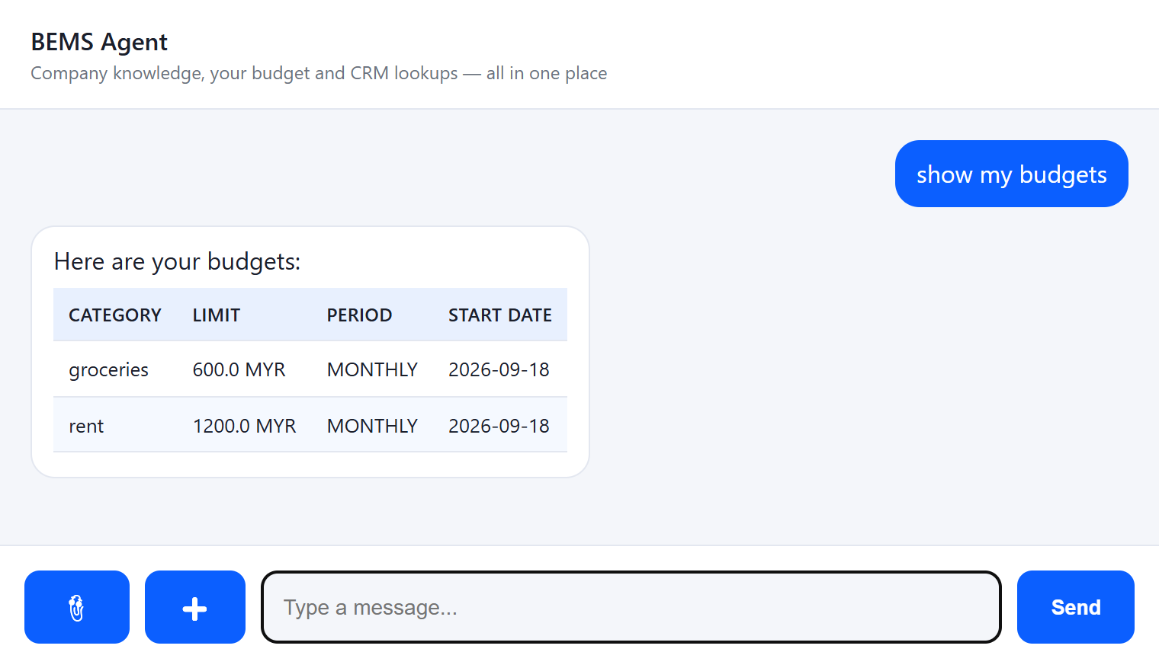
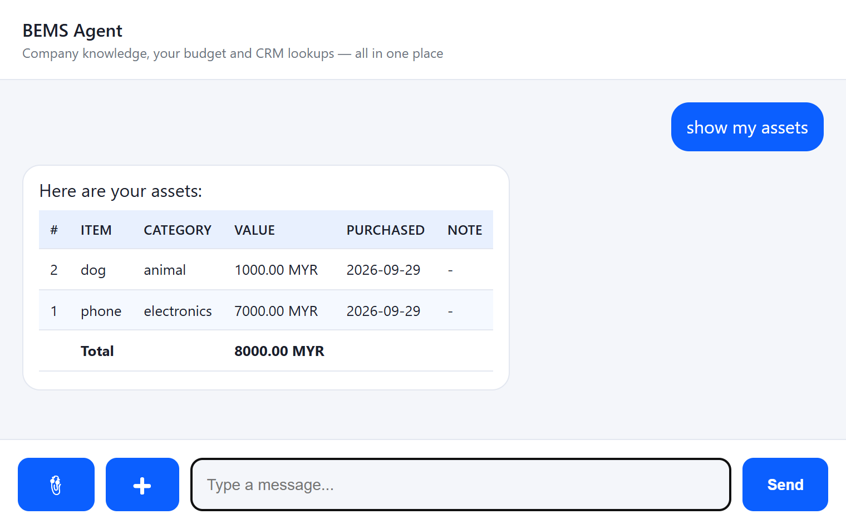
Budgets and assets at a glance
"show my budgets" · "show my assets": same pattern, different data
Category limits per week / month / year
Owned items with purchase value and totals
Notes:
Both tables come from the Budget API (PostgreSQL). Assets were added in this iteration: new asset table, POST/GET endpoints, idempotent creation.

Slide 7
Say it, and the right form opens
The agent fills in what it understood; you complete the rest and press Save
“today I bought a new iPhone, add it to my assets”
Filled by the agent
Item = iPhone · Category = Electronics · Date = today · Currency = MYR
Left for you
Purchase price (never invented by the model) · optional note
One more choice
“Also record the price as an expense?” keeps the balance in sync
Notes:
The model calls open_entry_form(entry_type=ASSET, prefill={...}). Prefill values are whitelisted and coerced; unknown keys are dropped. Nothing is saved until the user presses Save, and the server validates every field again.

Slide 8
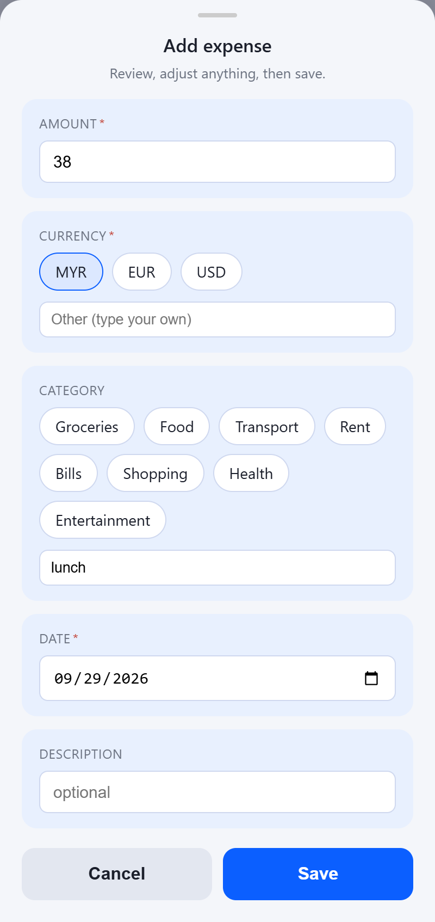
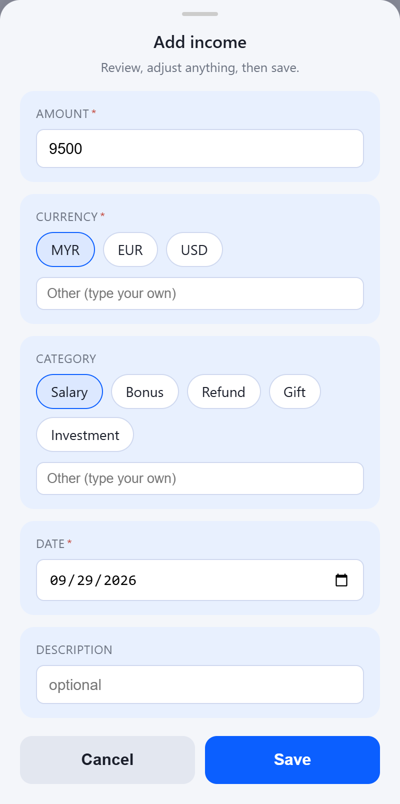
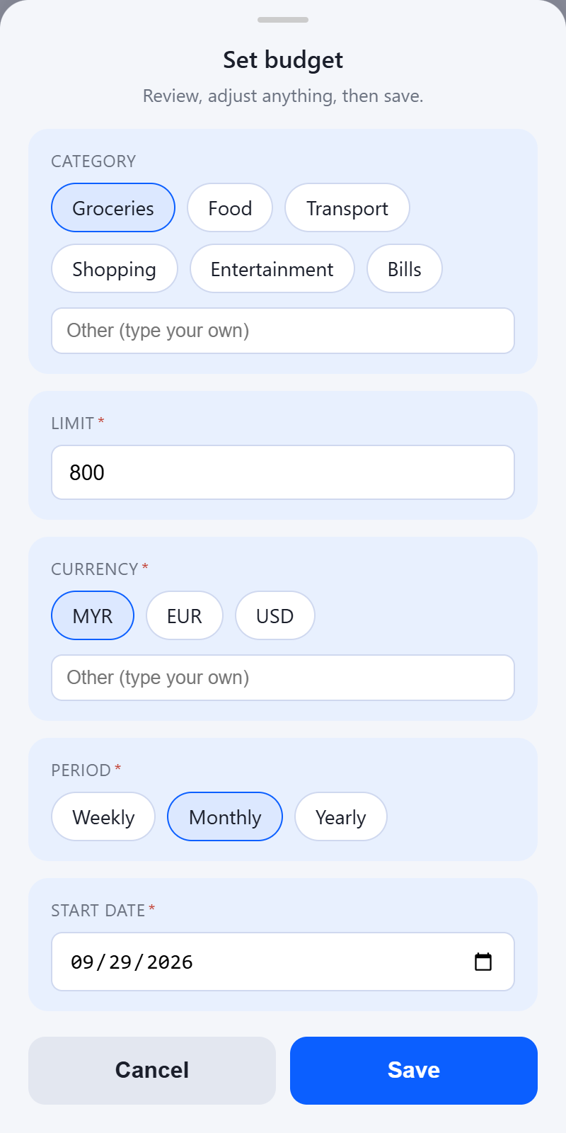
Every financial entry, from one sentence
The same bottom-sheet engine renders expense, income and budget forms
“I paid 38 RM for lunch today”
“I got my salary of 9500 RM today”
“set a monthly budget of 800 RM for groceries”
Amount, category and date pre-filled
Income form, salary category
Limit, period and category
Notes:
All three are the same entry_form node with a different field set. Currency and category chips plus free-text 'Other' for anything not on the list.

Slide 9
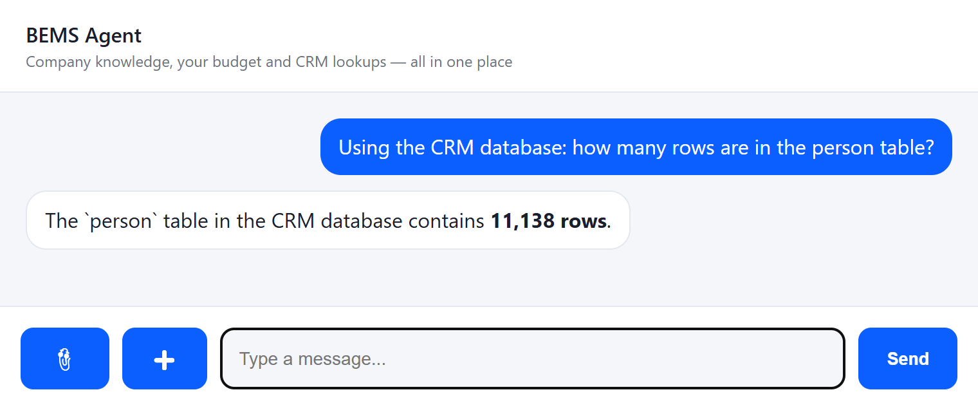
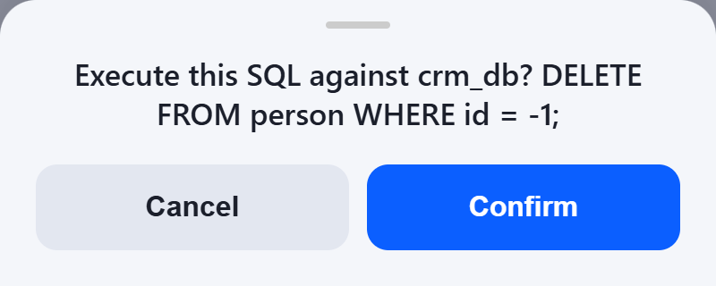



Direct database access: approval is not enough
Writes wait for Confirm, but reads run instantly, and a read can already expose confidential data
The risk behind “how many people are in the CRM?”
The same free-form SQL path that counted 11,138 persons can just as easily return their names, addresses, phone numbers, contracts or salaries. A curious question, a mistaken query or a prompt injected into a document is enough. Nothing stops the model from reading any table it can reach.
Writes need a click, not a typed “yes”
INSERT / UPDATE / DELETE show the exact SQL in a Confirm / Cancel sheet
Reads have no such gate
A SELECT runs immediately, so the result is in the model's context before anyone reviews it
Notes:
Point to make: the confirm sheet protects against destructive writes, but confidentiality is lost at read time. That is why the budget features use dedicated API tools instead of SQL (next slide). The raw SQL tool is only acceptable against a local dev database.

Slide 10


Safer by design: tool / API calling instead of database access
The agent calls a small set of purpose-built APIs; it never sees the database behind them
Agent with database access
query_crm_database: the model writes any SQL
Agent with API tools
get_balance, list_transactions, list_assets, open_entry_form …
Can read every table and column it can reach
Fixed operations; each returns only the fields it needs
Personal and financial data enters the model context
personId comes from trusted config, not from the model
Prompt injection can turn into data exfiltration
The service validates, authorizes and enforces limits
Hard to audit: every query is different
Every call is a named, loggable, auditable action
Least privilege is impossible to express
Writes are idempotent and confirmed by the user
Result: the model can only see what an API deliberately returns. Confidential records outside those APIs never reach it, so they cannot leak through a prompt.
Notes:
Recommendation: replace query_crm_database with purpose-built CRM tools (e.g. count_customers_by_segment, get_customer_summary) that expose only aggregated or explicitly allowed fields, scoped per tenant and per user. Honest caveat: API tools don't make leakage impossible. Whatever an API returns can still be shown to the user, so each API's response must be designed with least privilege. But the exposure becomes bounded, reviewable and auditable instead of 'the whole database'.

Slide 11
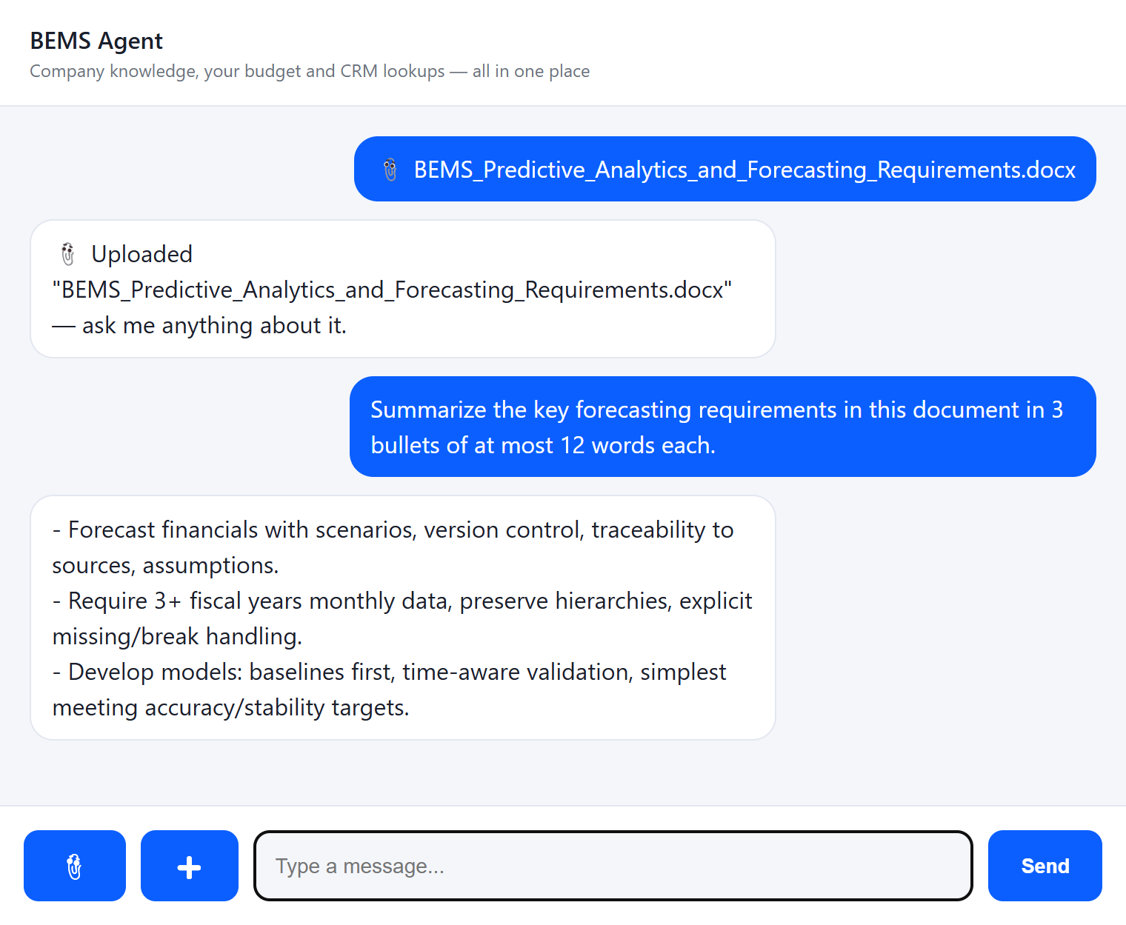
Ask questions about your own documents
Attach a file and the agent reads it, summarises it and answers follow-up questions
Supported formats
PDF
DOCX
XLSX
PPTX
CSV
TXT / MD
PNG / JPG (OCR)
Text is extracted (scanned PDFs are OCR'd) and added to the conversation, so every later question can use it. Up to 10 MB per file.
Notes:
Shown: BEMS_Predictive_Analytics_and_Forecasting_Requirements.docx uploaded, then 'Summarize the key forecasting requirements in this document in 4 short bullets.'

Slide 12
BEMS Agent in numbers
6
4
5
0
tools behind one chat
entry forms: expense, income, budget, asset
interrupt field types, one protocol
writes without your Confirm
Next steps
Native mobile client rendering the same interrupt protocol
Multi-user auth and per-tenant person mapping (instead of a fixed person)
Budget alerts when spending approaches a limit
Receipt photo → pre-filled expense form (OCR is already in place)
Notes:
Tools: query_crm_database, get_balance, list_transactions, list_budgets, list_assets, open_entry_form (6), plus RAG retrieval on every turn. Field types: choice, date, text, number, confirm.

