Slide 1
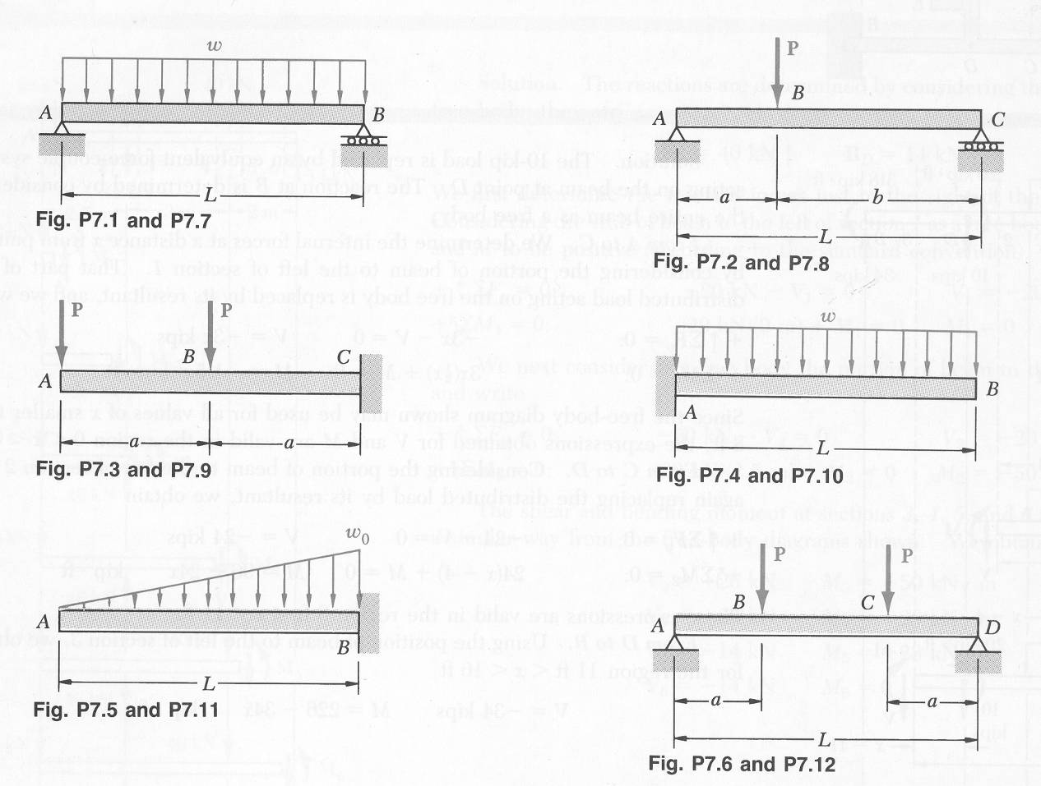
Draw the V, M, θ, and u Diagrams

