Slide 1
The Finite Element Method
Overview of Technique
Sample Element Library
Errors Associated with the technique
1D Truss Element
Direct Stiffness Method

Slide 2
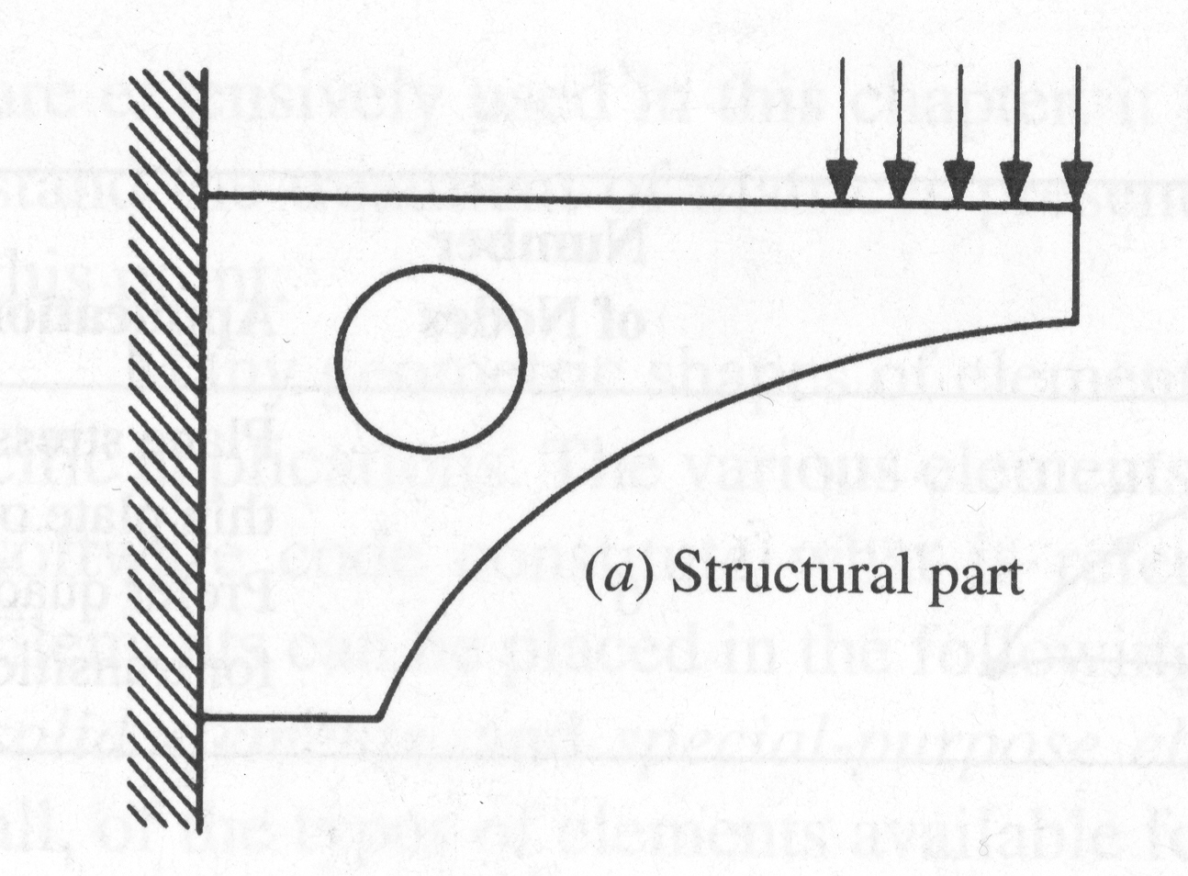
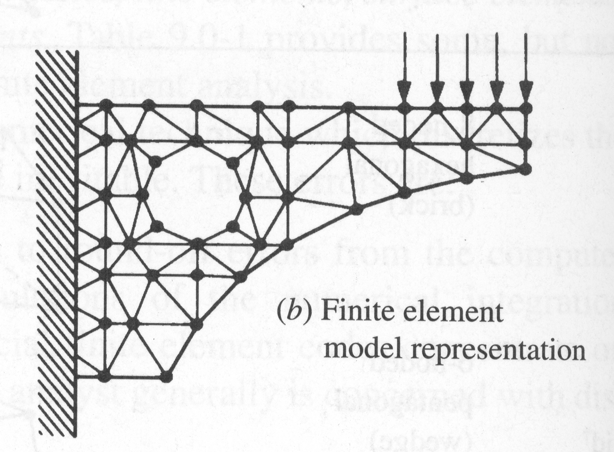
Overview of Method
Numerical Technique
Continuous elastic structure
continuum
Divided into small but finite well-defined substructures (elements)
discretized

Slide 3
Continuous Elastic Behavior Characterized
Element’s material and geometric properties
Distribution of loading
static
dynamic
thermal
Loads and displacements at the nodes

Slide 4
One Dimensional (Line) Elements
Pin-ended bar in
tension or
compression
Truss
2 Nodes
Beam
2 Nodes
Bending
Axial, torsional,
bending. With or
without load
Stiffening.
Frame
2 Nodes

Slide 5
Two Dimensional (Surface) Elements
Plane stress or strain,
axisymmetry, shear
panel, thin flat plate
in bending
4-node
quadrilateral
4 Nodes
Plane stress or strain,
thin plate in bending
8-node
quadrilateral
8 Nodes
Plane stress or strain,
axisymmetry, shear
panel, thin flat plate
in bending. Prefer quad where possible. Used for transitions of quads.
3-node
triangular
3 Nodes
Plane stress or strain,
axisymmetry, thin flat plate
or shell in bending. Prefer quad where possible.
6-node
triangular
6 Nodes

Slide 6
Three Dimensinal (Solid) Elements
Hexagonal
(Brick)
Solid, thick plate
(using midside nodes)
8-nodes
Pentagonal
(Wedge)
Solid, thick plate
(using midside nodes
Used for transitions
6-nodes
Solid, thick plate
(using midside nodes
Used for transitions
Tetrahedron
(Tet)
4-nodes

Slide 7
Sample Special Purpose Elements
Gap
Free displacement for
prescribed compressive gap
2-Nodes
Hook
2-Nodes
Free displacement for
prescribed extension gap
Rigid
Variable
Rigid constraints
between nodes

Slide 8
Errors Associated with Elements
Computational
round-off errors
numerical integration error
Discretization
geometric
displacement

Slide 9
Development of Method
Direct Stiffness Method
easy to understand physically
more difficult to apply to complex element
Rayleigh-Ritz Method
based on energy methods

Slide 10
One-Dimensional Truss Element
y
f_{xi}
f_{xj}
u_{i}
u_{j}
x
i
j
x_{i}
L_{e}
x_{j}

Slide 11
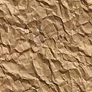
Sample Problem
y
1
(1)
F
x
2
(2)
3
L₁
L₂

Slide 12
Discretization
F₁
F₂
F₃
1
(1)
2
(2)
3
L₁
L₂
(f_{x1})₁
(f_{x2})₁
1
(1)
2
(f_{x2})₂
(f_{x3})₂
2
(2)
3

Slide 13
Lab Problem
F=20kN
A₁=100mm²
A₂=75mm²
A₃=50mm²
E=50GPa
1. Using Closed form solution find the load in each section
2. Using the finite element method find the solution
3. Plot the stress and displacements for both.
y
(1)
(2)
(3)
1
x
F
2
3
4
200mm
150mm
125mm
1.0mm

