Slide 1
MER311: Advanced Strength of Materials
LECTURE OUTLINE
State of Stress
Stress Tensor
Equilibrium

Slide 2









Example Continuation
z
Given that the cross-section of this structure is circular with a radius of 0.1m, find the maximum normal and shearing stresses.
A
3m
x
B
y
C
3m
2m
D

Slide 3
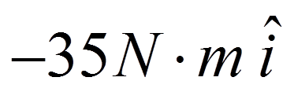
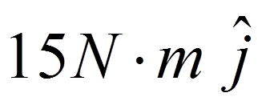
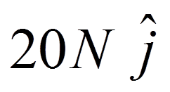
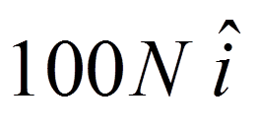
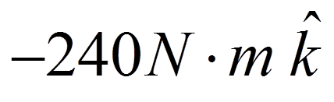
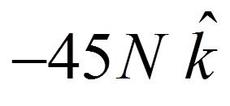
At the Wall
z
A
y
x

Slide 4
Calculating the State of Stress Using Strength of Materials

Slide 5
Body and Surface Loads Result In An Internal Force Distribution
s1
n
s2

Slide 6
Body and Surface Loads Over An Area Define Stress On A Surface
y
τ_{xy}
τ_{xz}
σ_{x}
x
z

Slide 7
Stress at a Point Shown in the Tensile (+) Direction
y
y
σ_{y}
τ_{yz}
τ_{yx}
τ_{zy}
τ_{xy}
σ_{x}
τ_{xz}
τ_{zx}
σ_{z}
σ_{z}
τ_{yx}
τ_{xz}
σ_{x}
τ_{xy}
τ_{zy}
z
x
z
τ_{yx}
τ_{yz}
x
σ_{y}
Surfaces with a Positive
Directed Area Normal
Surfaces with a Negative
Directed Area Normal

Slide 8
Stress Tensor Can Be Expressed In Multiple Ways

Slide 9
Dilatational and Distortional Stress Tensors
Dilatational Tensor
Distortional Tensor

Slide 10
EXAMPLE: Stress Tensor
At a specified point in a body, the state of stress with respect to a Cartesian coordinate system is,
Determine the Dilatation and Distortion stress tensors

Slide 11
Moment Equilibrium in an Element with Finite Dimensions (about x)
y
σ_{x}
τ_{xz}
τ_{zx}
σ_{z}
Δy
τ_{xy}
τ_{zy}
x
z
τ_{yx}
τ_{yz}
Δx
σ_{y}
Δz

Slide 12
Relationship of Shear Stress on Perpendicular Surfaces

Slide 13
Force Equilibrium in an Element with Finite Dimensions (in x)
y
σ_{x}
τ_{xz}
τ_{zx}
σ_{z}
Δy
τ_{xy}
τ_{zy}
x
z
τ_{yx}
τ_{yz}
Δx
σ_{y}
Δz

Slide 14
Elastic Equations of Equilibrium

Slide 15
The Stress Tensor Rewritten Accounting for Symmetry

Slide 16
EXAMPLE: 3D Equilibrium
The stress field within an elastic structural member is expressed as follows:
σ_{x}=-x³+y², τ_{xy}=5z+2y², τ_{xz}=xz³+x²y
σ_{y}=2x³+.5y², τ_{yz}=0, σ_{z}=4y²-z³
Determine the body force distribution required for equilibrium.

Slide 17
EXAMPLE: Equilibrium Equations
Determine whether the following two dimensional stress field is possible within an elastic structural member. Assume that the body forces are negligible

