Slide 1
MER311: Advanced Strength of Materials
LECTURE OUTLINE
Strain – Displacement Relations

Slide 2
Strain-Displacement Relationships
C’
B’
D’
Q’
B
C
Q
D

Slide 3
Normal Strain - Displacements

Slide 4
Shear Strain - Displacements

Slide 5
Curvature - Displacements

Slide 6
Strain-Displacement Relations Cylindrical System

Slide 7
Compatibility

Slide 8
Compatibility Continued

Slide 9
Example
The following displacement field is applied to a certain body where k=10^{-4.}
u=k(2x+y²), v=k(x² -3y²), w=0
(a) Show the distorted configuration of a two-dimensional element with sides dx and dy and its lower left corner (point A) initially at the point (2,1,0), i.e., determine the new length and angular position of each side.

Slide 10
Strain Tensor

Slide 11
Strain Transformations

Slide 12
Two Dimensional/Plane Strain Transformations
General Transformation Equations
Principal Strains

Slide 13

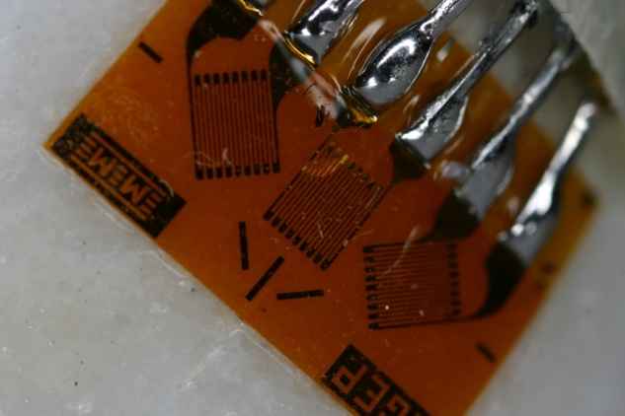
Typical Strain Gage Rosettes
45°
c
45°
b
a

Slide 14
Typical Strain Gage Rosettes
axial
hoop
a
45°
c
b
45°
|ε_{a*}|= ε_{a} = 1237(10⁻⁶) in/in = 1237με (12)
|ε_{b*}|= ε_{b} = 1270(10⁻⁶) in/in = 1270με (13)
|ε_{c*}|= ε_{c} = 402(10⁻⁶) in/in = 402με (14)

Slide 15
Transverse Sensitivity
(1)
(2)
(3)

Slide 16
Mohr’s Circle for Strain
ε_{c2}
ε_{a1}
45°
ε_{b2}
ε_{p2}
ε_{p1}
a
45°
b
ε_{b1}
ε_{c1}
ε_{a2}
ε_{c}
c
|ε_{a}-ε_{c}|
ε_{a}
ε_{b}
|ε_{a*}|= ε_{a} = 1237(10⁻⁶) in/in = 1237με
|ε_{b*}|= ε_{b} = 1270(10⁻⁶) in/in = 1270με
|ε_{c*}|= ε_{c} = 402(10⁻⁶) in/in = 402με

Slide 17
Mohr’s Circle for Strain
2|ε_{ave}-ε_{b}|=|ε_{a}+ε_{c}-2ε_{b}|
ε_{ave}=½(ε_{a}+ε_{c})
|ε_{ave}-ε_{b}|
ε_{c2}
ε_{a1}
45°
ε*
ε_{b2}
2⋅φ
ε_{p2}
ε_{p1}
h₂
h₁
a
45°
b
2⋅φ
ε_{b1}
ε_{c1}
ε_{a2}
ε_{c}
c
|ε_{a}-ε_{c}|
ε_{a}
ε_{b}
|ε_{a*}|= ε_{a} = 1237(10⁻⁶) in/in = 1237με
|ε_{b*}|= ε_{b} = 1270(10⁻⁶) in/in = 1270με
|ε_{c*}|= ε_{c} = 402(10⁻⁶) in/in = 402με

