Slide 1
MER311: Advanced Strength of Materials
LECTURE OUTLINE
Stress-Strain Relations

Slide 2
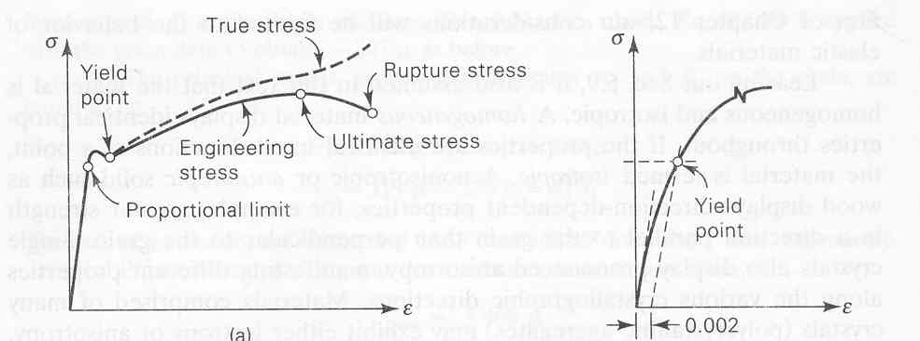
Stress-Strain Curve True Stress-Strain versus Engineering Stress-Strain

Slide 3
Relationship Between Stress and Strain
y
σ_{y}
y
y
σ_{x}
σ_{z}
z
x
σ_{x}
σ_{z}
z
x
x
σ_{y}
z

Slide 4
Stress-Strain Relations

Slide 5
Matrix Form of Stress-Strain Relations

Slide 6
Matrix Form of Stress-Strain Relations

Slide 7
Strain-Stress Relations

Slide 8

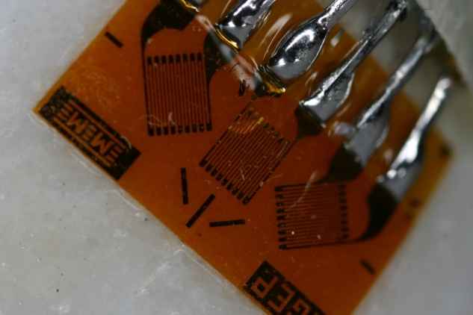
Typical Strain Gage Rosettes
c
45°
b
45°
loop
|ε_{a*}|= ε_{a} = 1237(10⁻⁶) in/in = 1237με (12)
|ε_{b*}|= ε_{b} = 1270(10⁻⁶) in/in = 1270με (13)
|ε_{c*}|= ε_{c} = 402(10⁻⁶) in/in = 402με (14)
a

Slide 9
Anisotropic Materials
ISOTROPIC - material properties are the same in all directions
ANISOTROPIC - material properties change with direction
HOMOGENEOUS - material of uniform composition throughout and whose properties are constant at every point
HETEROGENEOUS - material uniformity within a body consisting of dissimilar constituents separately identifiable

Slide 10
Stress-Strain Relations
Stiffness
Compliance

Slide 11
Symmetry of the Stiffness Matrix
Elastic Potential/Strain Energy Density
Incremental work per unit volune
dW=σ_{i}dε_{i}
Using the Stress-Strain Relations
dW=C_{ij}ε_{j}dε_{j}
Work per Unit Volume
W=1/2 C_{ij}ε_{i}ε_{j}
dW/dε_{i}=C_{ij}ε_{j} or dW²/dε_{i} dε_{j} =C_{ij} thus C_{ij}= C_{ji}

Slide 12
Stiffness and Compliance down from 36 to 21 Constants
Stiffness
Compliance

Slide 13
One Plane of Elastic Symmetry
Monoclinic
13 Independent Constants

Slide 14
Three Planes of Elastic Symmetry
Orthotropic Body
9 Independent Constants

Slide 15
Relationship Between S and C

Slide 16
One Plane in which the Mechanical Properties are Equal
Transversely Isotropic
6 Independent Constants

Slide 17
Material Properties Equal in all Directions
Isotropic
2 Independent Constants

Slide 18
Matrix Form of Stress-Strain Relations

Slide 19
Matrix Form of Stress-Strain Relations

Slide 20
Example 1
Given the following state of stress, determine the state of strain. E=200Gpa, υ=0.3

Slide 21
Example 2
Given the following state of strain, determine the state of stress. E=200GPa, υ=0.3

