Slide 1
MER 311: Chapter 5
Torsion in Thin-Walled Hollow Shafts
Thin-Walled Hollow Shafts
Multiple Cell Sections in Torsion
MER311: Advanced Mechanics

Slide 2
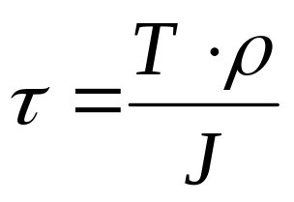
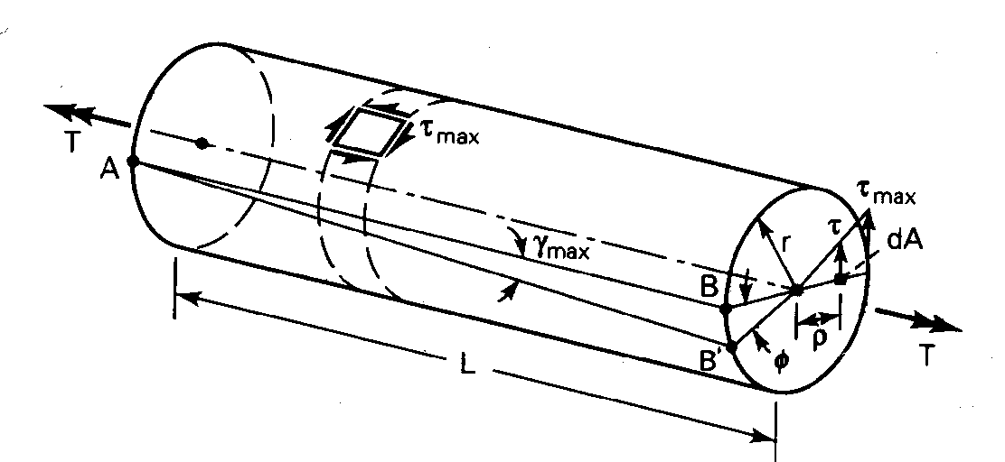
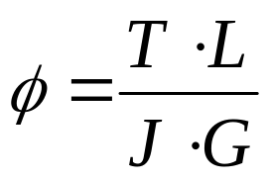
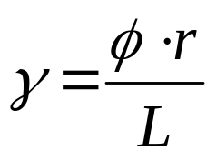
Review of Torsion
From Strength of Materials
Torque on a Cross-Section
Angle of Twist
Shear Strain
MER311: Advanced Mechanics

Slide 3
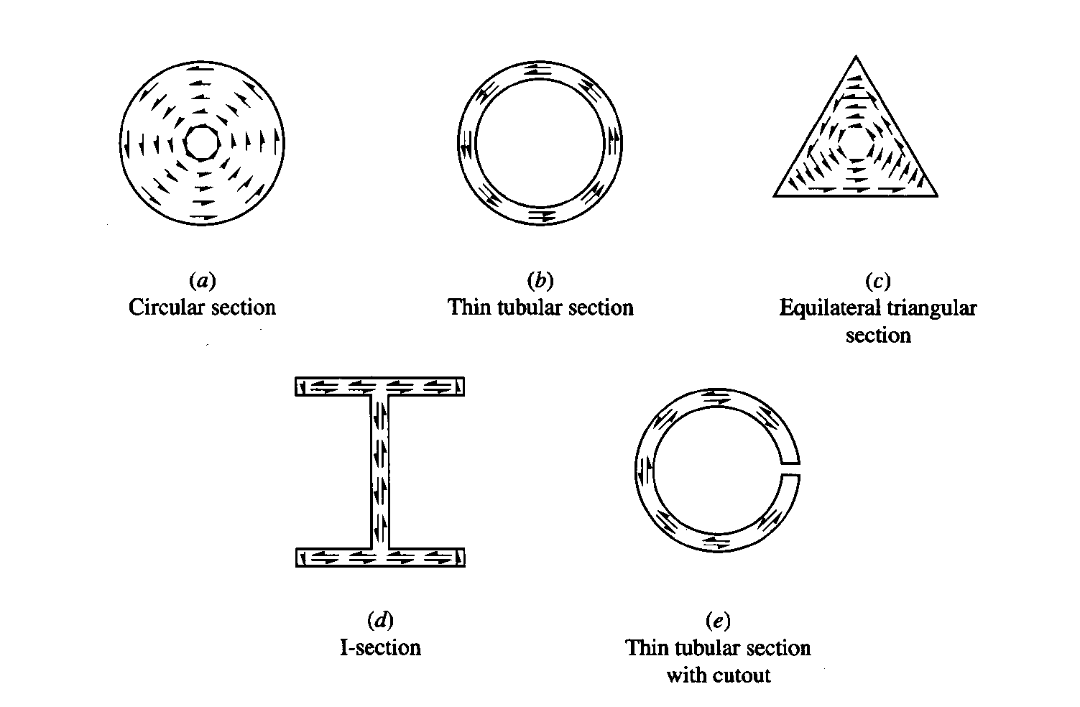
Shear Flow Due to Torsion
MER311: Advanced Mechanics

Slide 4
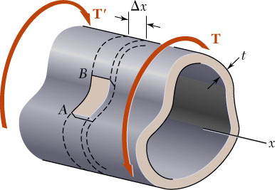
Thin Walled Tubes
Closed Cross Sections
The member is cylindrical
  The cross section does not vary along the length of the member
The cross section is closed
The wall thickness is small compared with the cross-sectional dimensions of the member
The member is subjected to end torques only
The ends are not restrained from warping
MER311: Advanced Mechanics

Slide 5
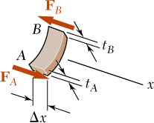
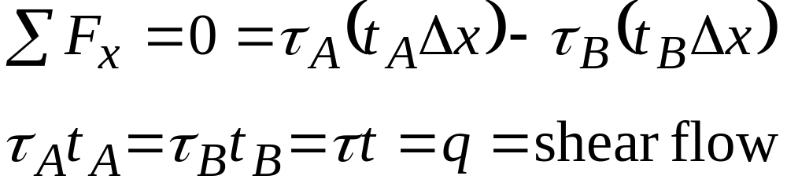
Thin Walled Tubes
Closed Cross Sections
MER311: Advanced Mechanics

Slide 6
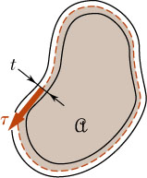
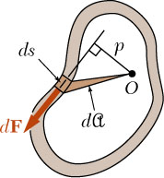
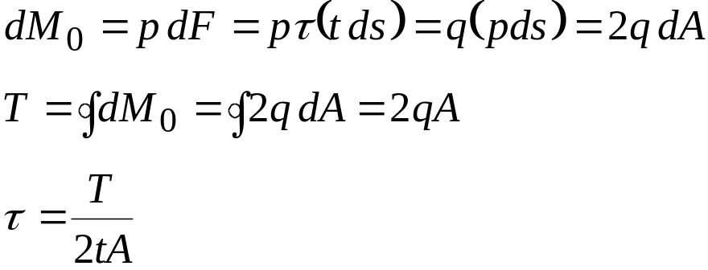
Average Shear Stress
MER311: Advanced Mechanics

Slide 7
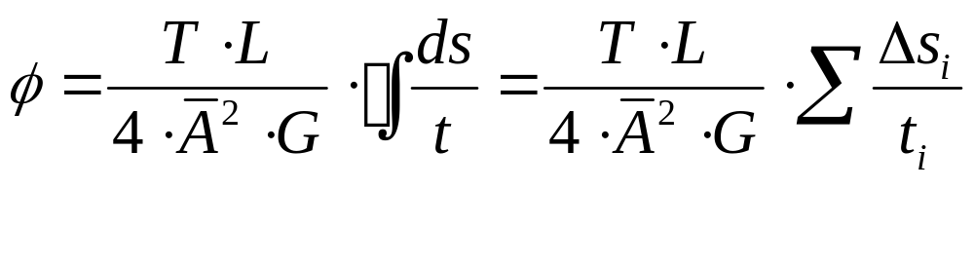
Angle of Twist
Expanding using Strength of Materials Principles
MER311: Advanced Mechanics

Slide 8
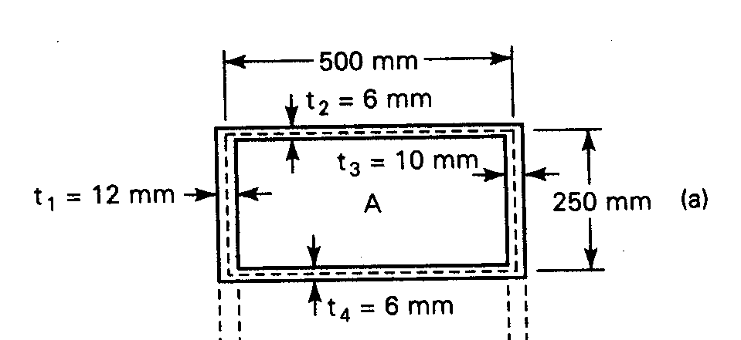
Example
A hollow aluminum tube of rectangular cross section is subjected to a torque of 56.5 kN-m along its longitudinal axis. Determine the shearing stresses and the angle of twist. Assume G=28 GPa.
MER311: Advanced Mechanics

Slide 9
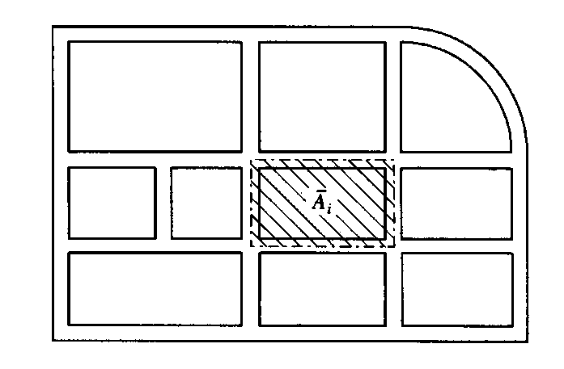
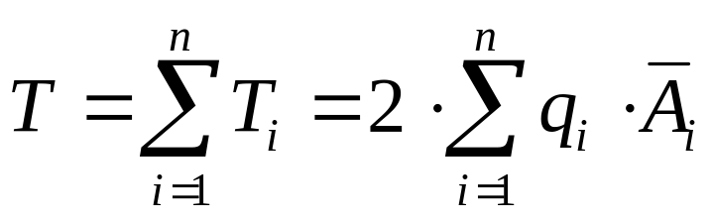
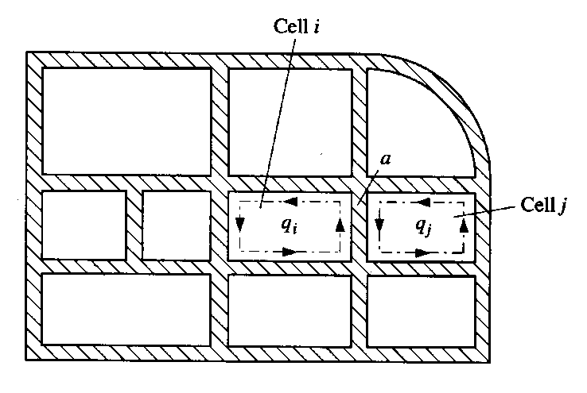
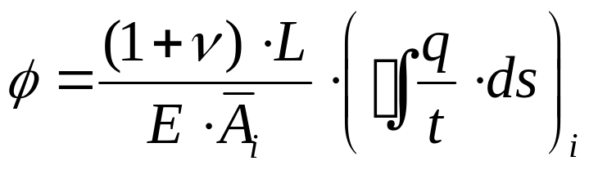
Multiple Cell Sections in Torsion
Angle of twist Ф of each cell is the same.
MER311: Advanced Mechanics

Slide 10
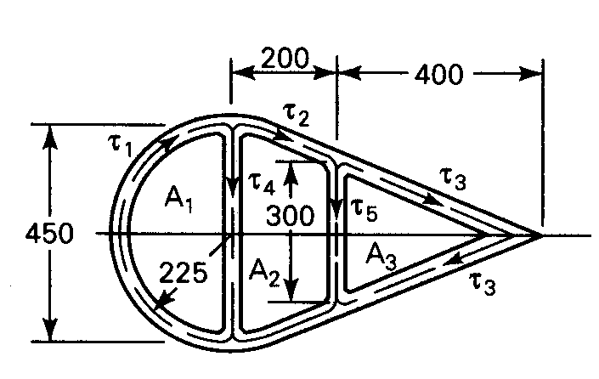
Example
A multiply connected hollow steel tube resists a torque of 12 kN-m . The wall thicknesses are t₁= t₂= t₃=6mm and t₄= t₅=3mm. Determine the maximum shearing stresses and the angle of twist per unit length. Let G=80GPa. Dimensions are given in millimeters.
MER311: Advanced Mechanics

