Slide 1
MER311: Advanced Strength of Materials
LECTURE OUTLINE
Thermal Expansion
Moisture Expansion

Slide 2
Relationship Between Stress and Strain
y
σ_{y}
y
y
σ_{x}
σ_{z}
z
x
σ_{x}
σ_{z}
z
x
x
σ_{y}
z

Slide 3
Free Thermal Strains
Material Expands and Contracts when Heated and Cooled
Rate of Expansion Different in the 3 Principal Material Directions
Graphite fibers contract along their length when heated
Polymers, aluminum, boron, ceramics and most other matrix materials expand when heated

Slide 4
Free Thermal Strain
Directly Related to Change in Length

Slide 5
Thermal Expansion Coefficient
Thermal Expansion is Linear with Temp

Slide 6
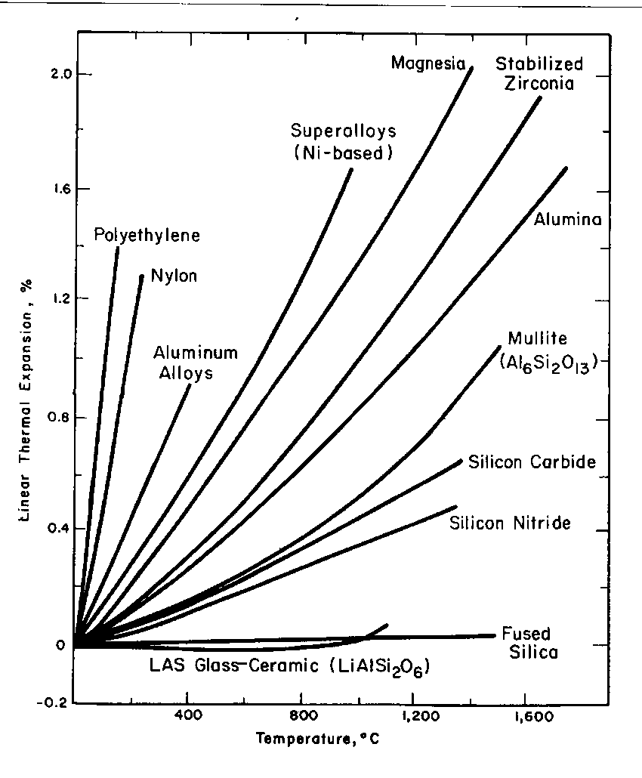
Linear CTE for Various Engineering Materials

Slide 7
Notes on Linear Thermal Expansion Coefficients
α₁, α₂, and α₃, are referred to as the LINEAR coefficients of thermal expansion
If expansion effects are not linearly proportional to temperature, α’s have no meaning
Free thermal strains do not involve any shearing deformations
For an element of material isolated in space, the thermal strains do not result in stresses

Slide 8
Matrix Form of Stress-Strain Relations

Slide 9
σ-ε Relations Including Thermal Strains (Compliance)

Slide 10
σ-ε Relations Including Linear Thermal Strains (Compliance)

Slide 11
σ-ε Relations Including Linear Thermal Strains (Stiffness)

Slide 12
Hygroscopic Strains
Polymers exposed to liquids will
absorb moisture
expand, typically linearly with %Moisture
Free Moisture Strains

Slide 13
Thermal/Mechanical Properties-Compliance

Slide 14
Thermal/Mechanical Properties-Stiffness

