Slide 1
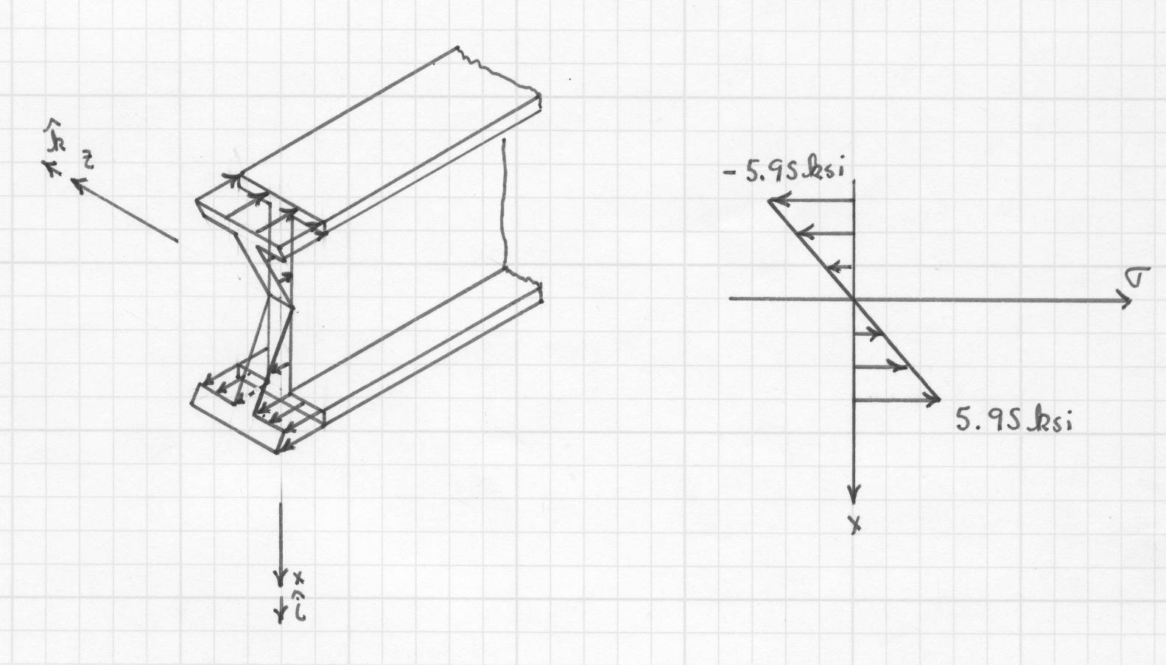
Stress Distribution

Slide 2

Composite Beam

Slide 3
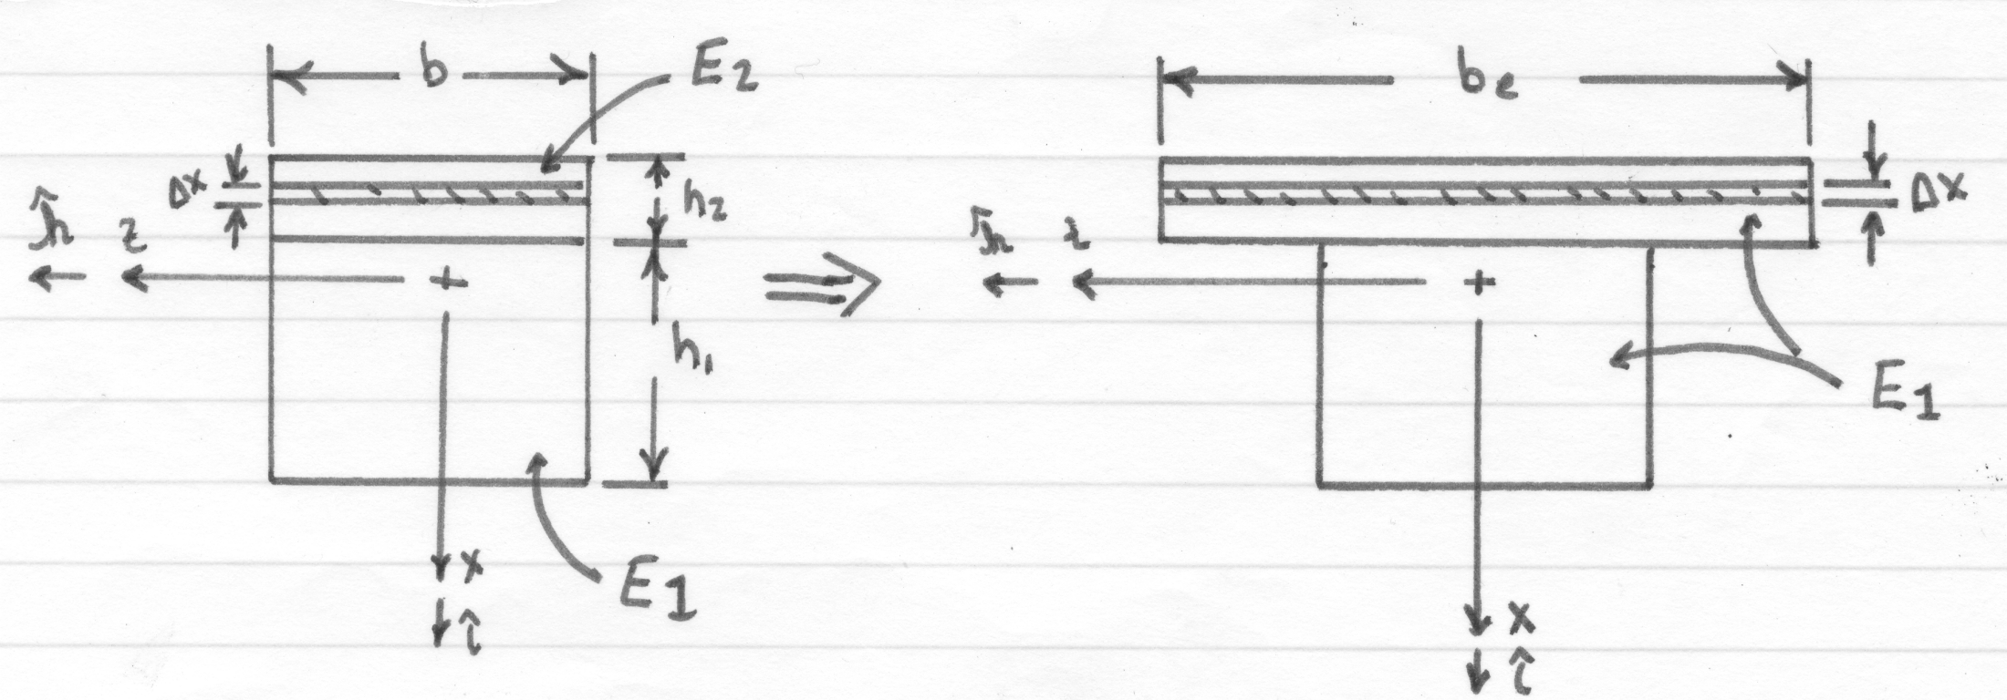
Redefining Cross-Section

