Slide 1
Chapter 5: Pure Bending
Asymmetrical Loading

Slide 2
Eccentric Axial Loading

Slide 3
Super-Impose Stress Distribution

Slide 4
Example 2
The eccentric axial force acts a distance 30mm below the top surface of the steel bar. Determine the stress distribution at the designated cross-section and draw the distribution.

Slide 5
Solution

Slide 6
Unsymmetrical bending
z
z
z
x
x
x
z
z
x
x

Slide 7
Rectangular Cross-Section
Neutral
Axis

Slide 8
Rectangular Cross-Section

Slide 9
Example
2 in
Determine the angle between the resultant moment and the z axis, the neutral axis, the value and location of the maximum compressive stress normal to the surface and the value and location of the maximum tensile stress normal to the surface.
4 in

Slide 10
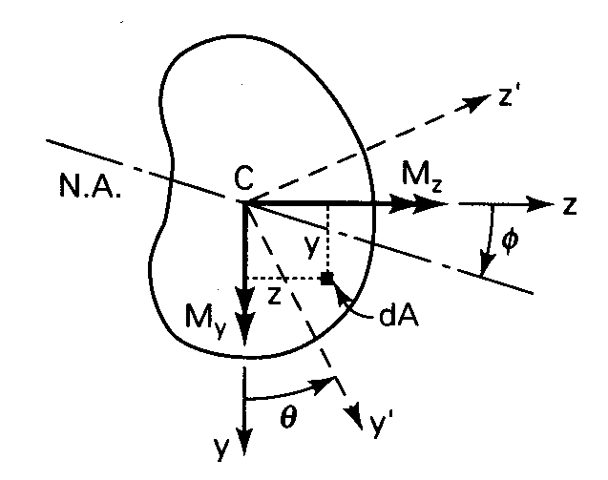
Pure Bending of Beams of Asymmetrical Cross Sections

Slide 11
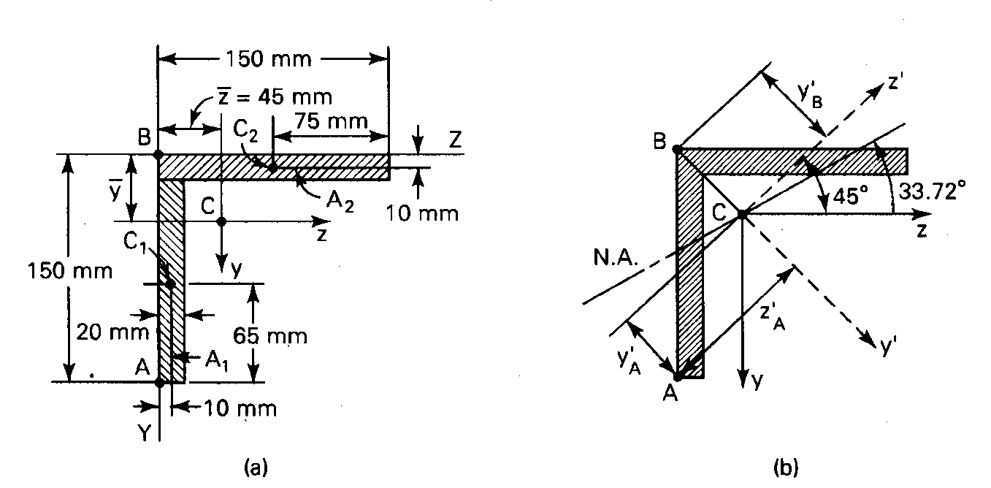
Example
A 150 by 150-mm slender angle of 20-mm thickness is subjected to oppositely directed end couples M_{z}=11kN-M, at the centroid of the cross section. What bending stresses exist at points A and B on a section away from the ends. Determine the orientation of the neutral axis.

