Slide 1
MER043: Advanced Strength of Materials
Fracture Mechanics

Slide 2
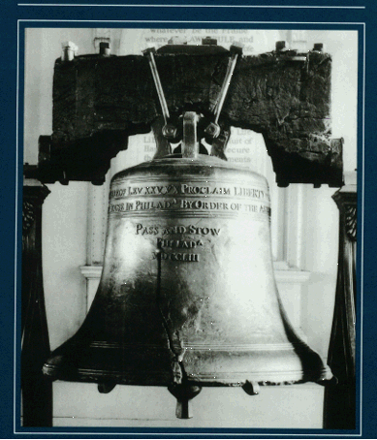
Examples of Fracture
Leonardo DiVinci experiments to determine the strength of Iron wires (15th century)
Liberty Bell
World War Two Liberty Ships
De Havilland Comet Aircraft (Britain 1950’s)
Aloha Airlines 737 (1987)

Slide 3
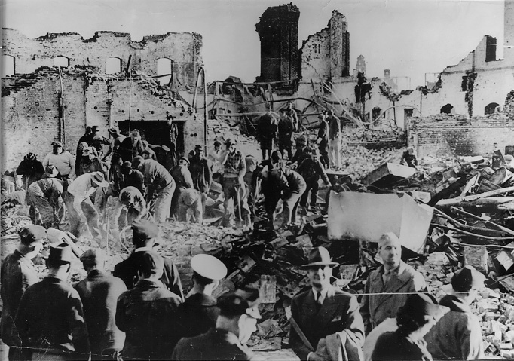
1944 Cleveland, OH Gas Storage Tank

Slide 4
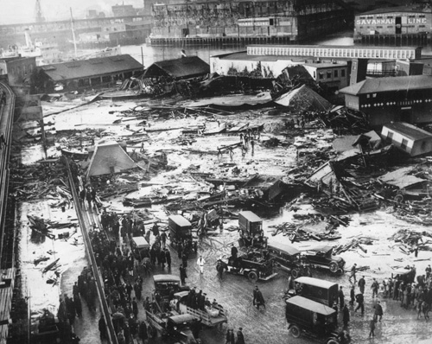
1919 Boston, MA Molasses Tank Failure (2x10⁶ gal)

Slide 5
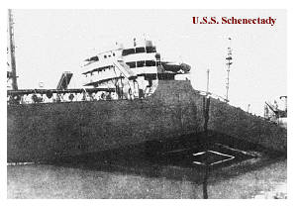
USS Schenectady WWII Liberty Ship

Slide 6
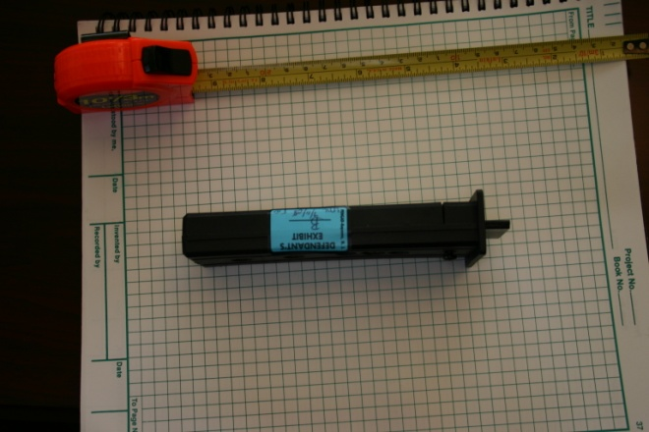
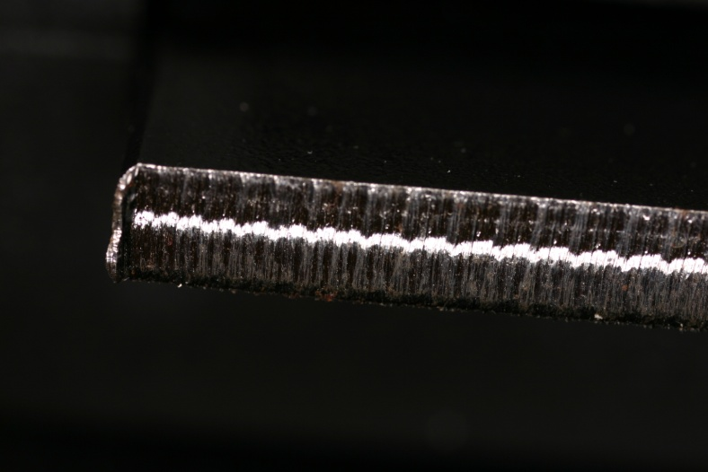
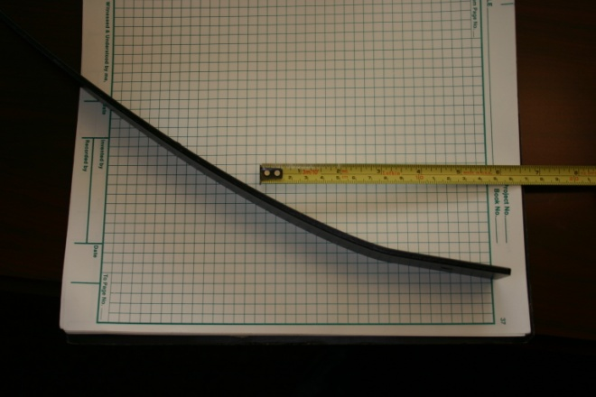
Forensic Investigations

Slide 7
When to Use Fracture Mechanics
Toughness
Linear
Elastic
Fracture
Mechanics
Behavior
Elastic-
Plastic
Fracture
Mechanics
Regime
Flaw
Size
Fracture
Mechanics
Stress
Engineering
Design
Regime
Strength
Of Materials
Behavior

Slide 8
How Fracture Relates to Fatigue
Crack Propagation
Period
Crack Initiation
Period
Stress Amplitude (log scale)
S_{e}=Fatigue Limit
Fatigue Life (log scale)

Slide 9
The Mechanics of Fracture
Plate with an elliptical hole
Inglis, 1913
σ_{max}- maximums stress – major axis
σ_{a} – stress applied normal to major axis
a – half major axis
b – half minor axis
2a
2b

Slide 10
Stress Concentration Factor
Radius of Curvature of Ellipse
Stress
a>>ρ

Slide 11
Griffith Crack Theory (1920)
B
Load-Deflection
prior to crack
extension
A
P_{C}
E
Applied Load
Load-Deflection
with crack
Extension da
D
C
Deflection of Applied Load

Slide 12
Griffith Crack Theory (1920)
Surface Energy = Crack Surface Energy
x Specific Surface Energy
= (2a)(2t)γ_{s} = area x energy density
2a
2b
Crack Surface Energy for
Elliptical Crack - Inglis
t
W

Slide 13
Griffith Calculation of Surface Energy
U - potential energy of body with crack
U₀- potential energy of body without crack
σ - applied stress
a - one half crack length
t - thickness
E - Modulus of elasticity
γ_{s} - Specific surface energy

Slide 14
Equilibrium Condition of Crack
U₀ does not vary with a

Slide 15
Stability of Equilibrium
Equilibrium is unstable, crack will always grow

Slide 16
Griffith
Plane Strain
Plane Stress

Slide 17
Irwin – 1949 – Plastic Deformation

Slide 18
Crack Growth
Unstable
Growth or
Gross Plastic
Deformation
Unstable
Growth
Unstable
Growth
Time
Dependent
K_{Ic}
Stable
K_{Ic}
No
Growth
No
Growth
K_{iscc} or
Δ K_{th}
No
Growth
Linear-Elastic
Elastic-Plastic
Subcritical

Slide 19
Very Large Body subjected to a Tensile stress
Centrally located crack of length 2a
Remote tension σ normal to crack
Edge crack of length a normal to free edge
Remote tension σ normal to crack

Slide 20
Strip of Width 2W Subjected to a Tensile Stress
Centrally Located Crack of Length 2a
Remote Tension σ normal to crack

Slide 21
Vessel Having Diameter D and Wall Thickness h
Through-wall axial crack of length 2a
Internal pressure p
Through-wall circumferential crack of length 2a
Internal pressure p

Slide 22
Very Large Body with Circular Hole of Radius R
Two symmetrical cracks at edge of hole of length a
Remote tension σ normal to the cracks

Slide 23
Fracture Modes
Mode I
(Opening)
Mode II
(Sliding)
Mode III
(Tearing)

