Slide 1
The Finite Element Method
2D Truss Element
  Direct Stiffness

Slide 2
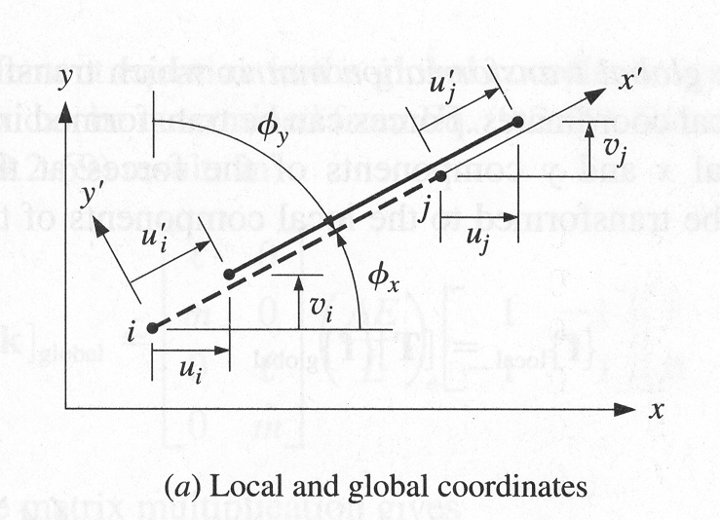
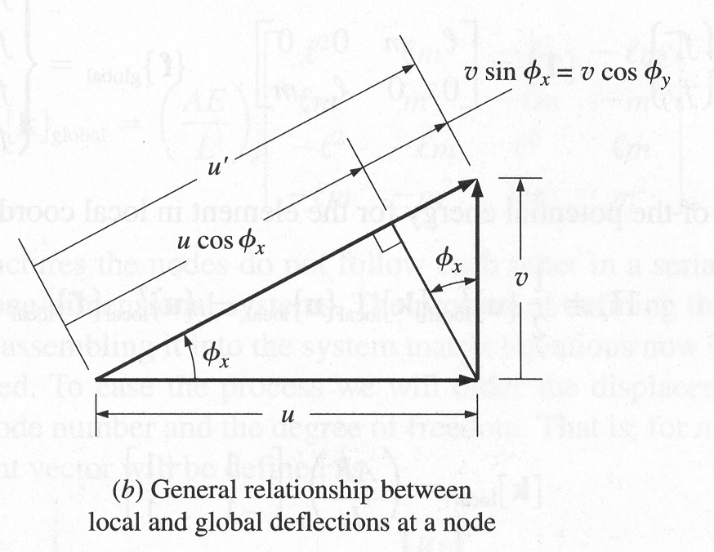
Lab Problem

Slide 3
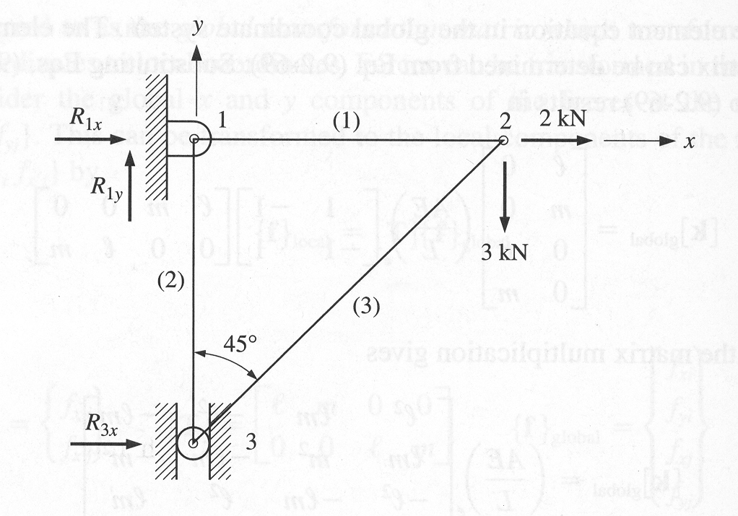
Lab Problem
Determine the nodal deflections, nodal forces, and stress in each of the elements.
L₁=L₂=2m
A=80mm²
E=200GPa
Ignor Buckling

