Slide 1
The Finite Element Method
2D Truss Element
Direct Stiffness

Slide 2
Lab Problem
y
v⋅sinφ_{x}
=v⋅cosφ_{y}
u’_{j}
x’
φ_{y}
v_{j}
u’_{i}
y’
j
φ_{x}
u’_{i}
u⋅cosφ_{x}
v
φ_{x}
u_{j}
v_{i}
φ_{x}
i
u_{i}
u
x

Slide 3
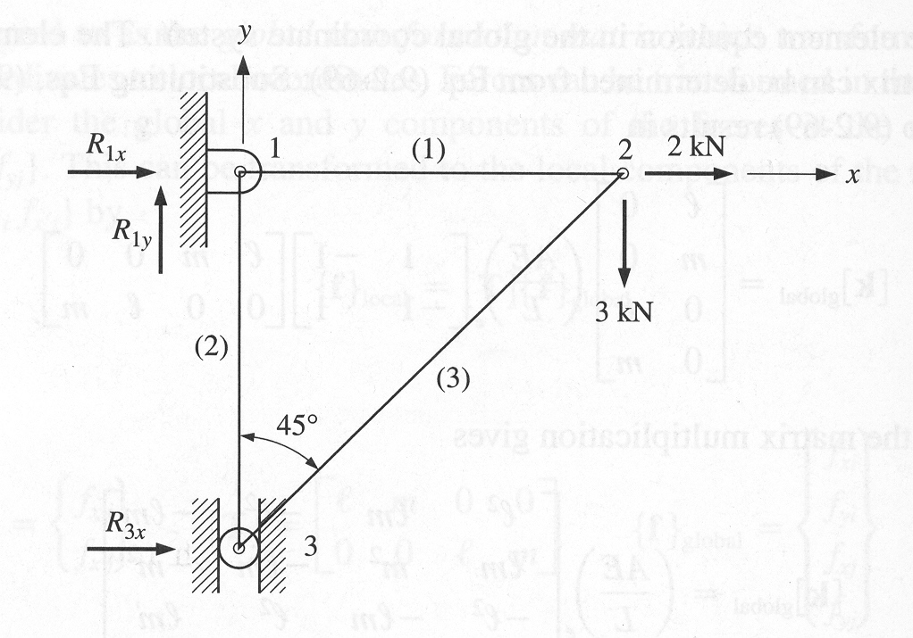
Lab Problem: Excel
Determine the nodal deflections, nodal forces, and stress in each of the elements.
L₁=L₂=2m
A=80mm²
E=200GPa
Ignor Buckling

Slide 4
Lab Problem: SolidWorks
10 ft
1200 lb
8 ft
10 ft
10 ft
1000 lb
Cross Section Diameter: 2.5in
Material: Steel
Determine:
Load in each member
Stress in each member
Deformed shape

