Slide 1
The Finite Element Method
3D Truss Element
Direct Stiffness

Slide 2
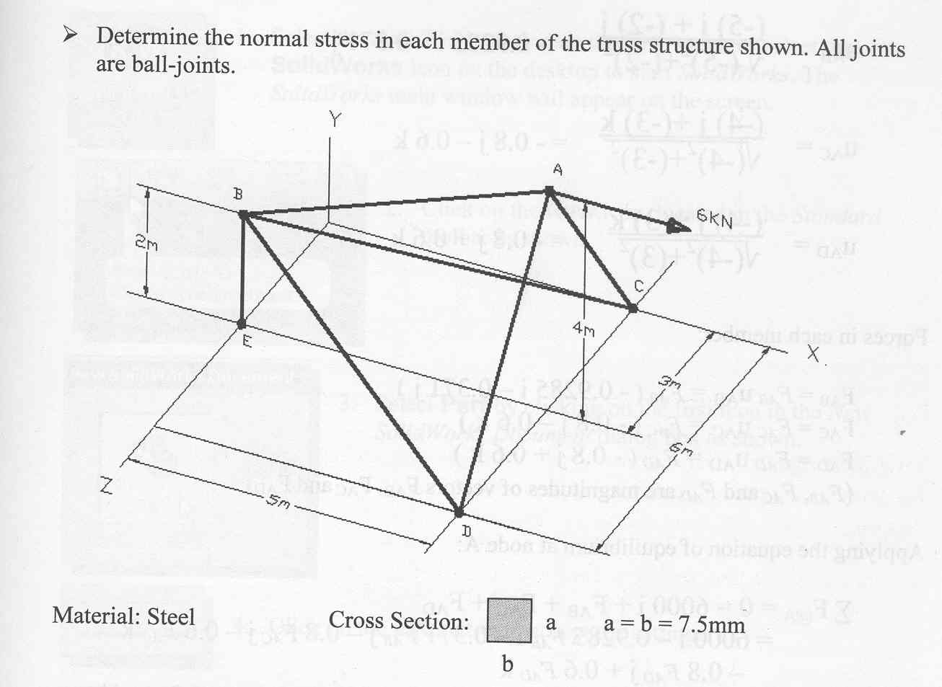
Instructor Problem

Slide 3
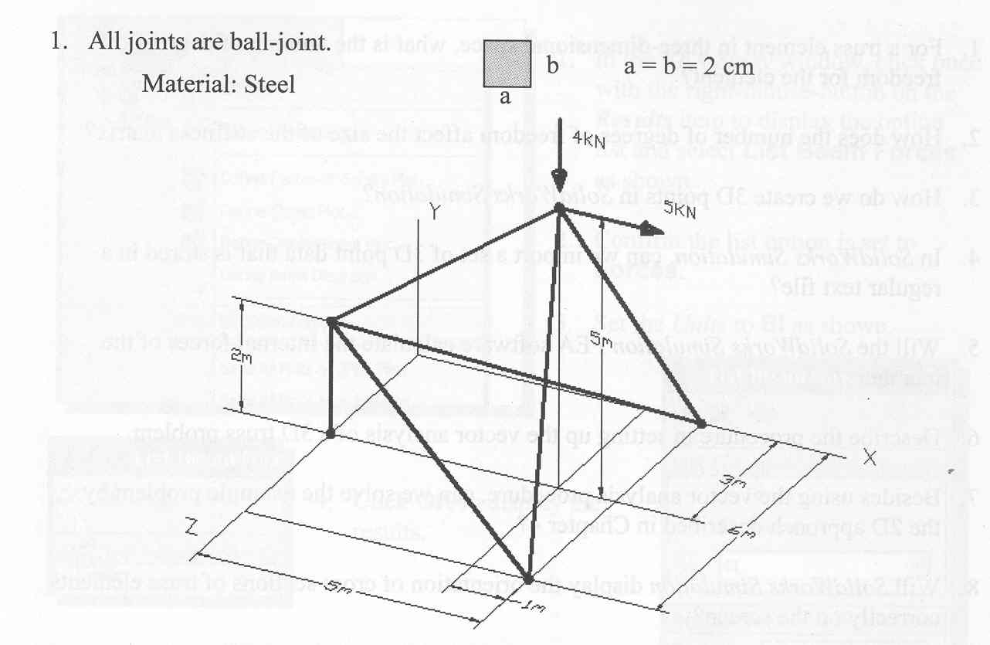
Lab Problem:

