Slide 1
GIT STARTED
AN INTRODUCTION TO GIT

Slide 2




Present Situation

Slide 3
Technical Comparison
Wrote up objective technical criteria for evaluating SCM systems, thirteen specific test cases from trivial and mundane to complex cases involving refactoring code.
Results are below…
 | 1 | 2 | 3 | 4 | 5 | 6 | 7 | 8 | 9 | 10 | 11 | 12 | 13 | LF | SCORE
SVN | Y | Y | Y | Y | Y | Y | Y | N | Y | N | N | N | N | Y | 9
GIT | Y | Y | Y | Y | Y | Y | Y | Y | Y | Y | Y | Y | Y | Y | 14
HG | Y | Y | Y | Y | Y | Y | N | Y | N | Y | Y | N | N | N | 9

Slide 4
Agenda
Introductory Topics
Essential Concepts
Demo
Initial Git Setup
Essential Commands
Occasionally Used Commands
Advanced Topics
Branch Naming
Branch Management
Branching Models
Workflow
Other Topics

Slide 5
ESSENTIAL CONCEPTS
GIT STARTED

Slide 6
Git Conceptually
Work independently.
Productive anytime, anywhere; plane, train, home or office; with full command and confidence.
Work collaboratively.
Code sharing with your web of trust, exchanging code without going through a centralized authority.

Slide 7
Git Conceptually
What does it mean to work independently?
Access complete information instantaneously.
Innovate freely with no loss of service or performance.
Compare and contrast what-if scenarios using local branches.
Merge between branches without centralized authorities.
Stage a linear sequence of changes as a single atomic change.

Slide 8
Git Conceptually
What does it mean to work collaboratively?
Leverage the works of others, and avoid duplication.
Share ideas earlier to refine solutions that have staying power.
Perform sanity checks to avoid making the wrong choice.
Try out others changes locally.

Slide 9
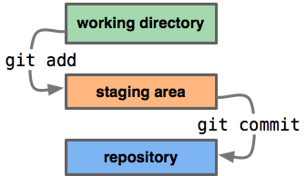
The Three States for Files
Modified means you've changed the file but have not committed it to the repository yet.
Staged means that you have marked a modified file in its current version to go into your next commit snapshot.
Committed means the data is safely stored in your local repository.

Slide 10
The Git Working Copy
Complete working copies of all files and also a copy of the database.
Database containing all information needed to retain and manage the revisions and history of a project.
Contains two data-structures: the object store and the index.

Slide 11
The Git Index
The index holds a snapshot of the content of the working tree.
The index contains the contents of the next commit.
The index serves as the connection point between a working tree and the object database.
Thus after making any changes to the working directory, and before running the commit command, you must use the add command to add any new or modified files to the index.

Slide 12
The Git Object Store
The object store contains blobs, trees, commits, and tags:
Blobs are identified by their calculated SHA1 hash, so a tree with two identical files only store it once.
Trees represent one directory level of information: pathnames, metadata, blob identifiers, and sub-trees.
Commits hold meta data about a commit.
Tags assign a human-readable name to a specific object, usually a commit.

Slide 13
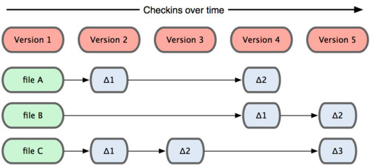
Snapshots, Not Differences
Other systems, set of files plus changes over time.

Slide 14
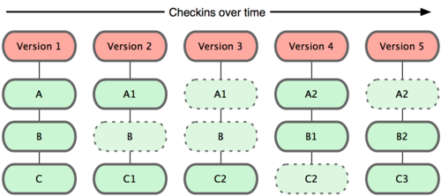
Snapshots, Not Differences
Git stores each revision of a file as a unique blob object.
Benefits `git search`, relevance and context.

Slide 15
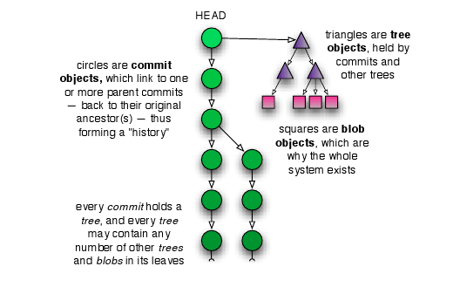
Git Trees
Commits point to roots of trees.
Trees point to blobs.

Slide 16
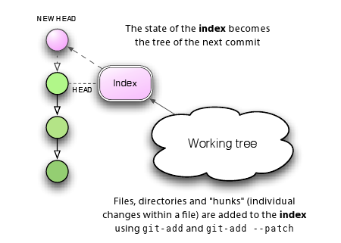
Git Commits : Tree's and Index
State of index becomes the tree of the next commit.
Remember, git uses blob-references in the tree, so a branch is very lightweight in practice!

Slide 17
Git Commits
Commit internals explained…
Each git object is stored with a unique SHA1 name.
Git tracks content.
The object store is indexed by SHA1 values.
If two files have the same content only one copy is stored as a blob in the object store.
Git stores changesets (an object) as a snapshot of the index and stores the snapshot in the object store.
Snapshots are chained together, with each new snapshot pointing to its predecessor forming a series of commits over time.

Slide 18
Git Branches
Big topic, so first the basics…
A branch is simply a named reference to a particular commit.
Branches allow multiple copies of a file-set to vary independently from each other.
Branches have lifetimes and can be created and destroyed.
In Git parlance, "trunk" is named master.

Slide 19
Code Sharing
Code is shared using public repositories.
Public repositories are repositories that are addressable.
Public repositories are generally bare, with only an index and an object store.
Code is cloned locally to be viewed or modified.
Local (working) repositories are related to those they clone through logical connections called remotes.

Slide 20
Code Sharing and Remotes
By default, each new clone maintains a link back to its parent repository via a remote called origin.
Remotes are named handles to other repositories.
Simplified names for complicated URI.
Basis for push and pull operations between local and remote repositories.
See .git/config file for the list of remotes.

Slide 21
Nearly Every Operation is Local
You can browse and search all history locally.
You can browse and search all versions of all files locally.
Given a local copy of a remote branch you can perform all merging and commits locally.
You can locally checkout a working copy of any branch instantaneously, easily switch between them.

Slide 22
DEMOS
GIT STARTED

Slide 23
Git Demo
What is demonstrated:
Clone
Commit
Diff
Merge
Push

Slide 24
INITIAL GIT SETUP
GIT STARTED

Slide 25
First Day
Read Welcome Pack Files:
WELCOME
https://github.com/rbuck/git-started
For Windows users:
install/git-core/windows/README
For Unix users:
$ install/git-core/unix/install.sh

Slide 26
First Day
Set Up Username and Email
Before you do any work you will want to set up your email address and password so that Git will be able to identify you.
$ git config --global user.name \
"First Last"
$ git config --global user.email \
email@yourcompany.com

Slide 27
First Day
Set Up Coloring
To visually assist in distinguishing states of files in a console, set up coloring.
$ git config --global color.diff auto
$ git config --global color.status auto
$ git config --global color.branch auto

Slide 28
First Day
Set Up Replay and Rebase
Minimize merge replay work (tells Git to remember how you resolved a hunk conflict, useful for long-lived branches), and keep histories linear.
$ git config --global rerere.enabled true
$ git config --global branch.autosetuprebase always

Slide 29
Welcomed Extras
There are a number of other scripts to assist in setting up:
Visual Diff or Merge Tools
Araxis Merge, WinMerge, Meld, Beyond Compare, etc
Common Git Ignore Settings
Swap files, lock files, out files, Mac files (.DS_Store)
Maven, IntelliJ, Java, Eclipse, Visual Studio
Send Mail for Automated Code Reviews via Email

Slide 30
ESSENTIAL COMMANDS
GIT STARTED

Slide 31
Essential Commands
Most common commands used:
clone
pull
status
add
diff
commit
merge
push

Slide 32
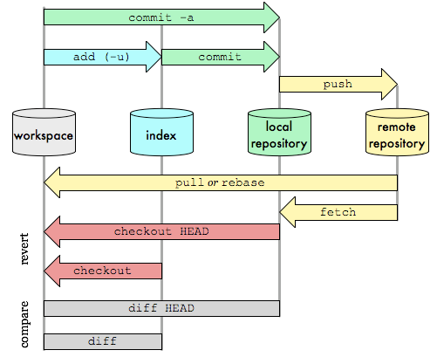
Git Commands
Bear this diagram in mind when learning about the commands described hereafter…

Slide 33
Git Commands : clone
Cloning Repositories
Clone a repository into a local working directory, set it up so that it tracks the remote repository, and set the default branch to the currently active branch in the remote repository.
$ git clone git@github.com:youname/hello-git.git \
hello-git.git

Slide 34
Git Commands : pull
Fetch from and merge with another repository.
Is simply a 'fetch' then a 'merge' rolled into one.
Supports --squash
Supports --rebase to replay your changes on top of newer history from central repository
Resolve conflicts should they exist as cited previously.
$ git pull --rebase origin master

Slide 35
Git Commands : status
Show Working Tree Status
Displays paths that:
are in the working tree but are not tracked
have differences between working tree and the index file
have differences between index file and current HEAD commit,
$ git status # display changes and untracked
$ git status -u # display untracked files

Slide 36
Git Commands : add
Add Files
Add file to update the index that holds the snapshot of working files.
If no file-pattern is given, default to “.”
$ git add [file-pattern]
$ git add . # add all files (new or updated)
$ git add --all # add all files (new or updated)
$ git add --update # add only updated files

Slide 37
Git Commands : diff
Using <path> limits diff output.
Display the changes that remain in your working directory and are not staged.
$ git diff [<path>...]
Display changes that are staged and will therefore contribute to your next commit.
$ git diff --cached [<path>...]

Slide 38
Git Commands : diff
Display changes since your last commit.
$ git diff HEAD
Display changes between two branch tips.
$ git diff topic..master
Display changes on master since branch-point.
$ git diff topic...master

Slide 39
Git Commands : commit
Commits files to the local repository.
Record a snapshot of the index in the object store.
Git stores the differences in the index, not the entire index.
If no file-pattern is given, default to "."
$ git commit (options) [<file-pattern>...] (-m|--message "commit message")
(-a|--all) # inline `add --all` (-F|--file <file>) # file contains commit message (-s|--signoff) # adds signoff by committer to end

Slide 40
Git Commands : merge
Unites two or more branch development histories.
All branches being merged must be present in the local repository.
You will merge and commit to *-next or to master branches yourselves.
Merge handles refactoring cases automatically, correctly!
Perform a "checkout" of the branch you want to merge to, the target, then merge in the source.
Merge is used by a "pull" to incorporate changes from another repository.
Check in changes locally, then "push".

Slide 41
Git Commands : merge
Merge a private contributors branch onto the topic branch. Contributor task is:
...
$ git fetch
$ git checkout feature/famous-widget
$ git merge contributors-branch
# note if any merge conflicts...
$ git status
# if any merge conflicts...
$ git mergetool
$ git commit -m "added famous widget"
$ git push feature/famous-widget
...

Slide 42
Git Commands : push
Update remote refs and associated objects with local state.
Push to current branch's remote, or origin if none specified.
$ git push
Push matching branches to origin.
$ git push origin :

Slide 43
Git Commands : push
Interesting point: you can push hooks too!
Push a ref that matches master and update the same ref in origin repository.
$ git push origin master
Find a ref that matches experimental in the origin repository and delete it.
$ git push origin :experimental

Slide 44
OCCASIONALLY USED COMMANDS
GIT STARTED

Slide 45
Commands Occasionally Used
Other commands occasionally used:
branch
checkout
reset
fetch
init

Slide 46
Git Commands : branch listing
List branches.
List existing branches and highlight ("*") the current branch.
$ git branch

Slide 47
Git Commands : checkout
Set the current branch in your workspace.
$ git checkout <branchname>
N.B. Branch creation and checkout can be performed in a single step.
$ git checkout -b <branchname>
Checkout a previously checked in version of a file.
$ git checkout <filename>

Slide 48
Git Commands : reset
Remove a file from the index before a commit:
$ git reset -- <filename>

Slide 49
Git Commands : fetch
Keep up to date with top of tree.
Assumes a remote ref is defined.
May require a merge.
Update the remote tracking branches:
$ git fetch origin

Slide 50
Git Commands : init
Initialize Repositories
What if… I want source control for purely experimental works?
Create a new repository by creating a ".git" directory with its subdirectory contents.
Reinitialize non-destructively an existing repository to pick up newly added templates.
$ git init [directory]
$ git init .
$ git init foo.git/ && cd foo.git

Slide 51
ADVANCED TOPICS
GIT STARTED

Slide 52
ADVANCED TOPICS: BRANCH NAMING
GIT STARTED

Slide 53
Git Commands : branch naming
Branch names can be hierarchical akin to Unix path-syntax.
Proposed reserved prefixes to include 'bug', 'maint', and 'next', and ‘feature’.
*-feature/famous-widget
*-bug/12345
*-next/2.0
This is a huge win for automation because branch names can be wild-carded.
$ git show-branch 'bug/*' # what bugs are fixed?

Slide 54
ADVANCED TOPICS: BRANCH MANAGEMENT
GIT STARTED

Slide 55
Git Commands : branch creation
Create a branch.
The default start-point for a new branch is at the point where you’re working right now.
$ git branch <unique-branchname> [<startpoint>]
$ git branch story/epic-failure next/2.0
$ git branch user/myname story/epic-failure
$ git branch bug/13452 maint/1.0

Slide 56
Push a Branch with Remote Tracking
For branches that are successfully pushed, add an upstream reference so that argument-less pull and other commands. Also affects subsequent argument-less push commands.
Tell git-fetch and git-merge which branch to merge.
$ git push –u origin HEAD
$ git push –u origin <unique-branchname>

Slide 57
Git Commands : branch delete
You cannot delete a branch you are currently on!
Delete an existing branch, safely.
$ git branch -d <branchname>
Force (unsafe) deletion of a branch.
$ git branch -D <branchname>

Slide 58
Git Commands : push branch deleted
To delete a branch on the remote repository you need to push the deletion.
$ git push origin :[branchname]

Slide 59
Git Commands : branch renaming
Rename a branch.
$ git branch (-m|-M) [<branchname>] \ <unique-branchname>
If unspecified <branchname> defaults to current branch.
Will return with an error message if <unique-branchname> exists.
$ fatal: A branch named 'two' already exists.
Can force a (destructive) rename to an existing branchname.
$ git -M <existing-branchname>

Slide 60
ADVANCED TOPICS: BRANCHING MODELS
GIT STARTED

Slide 61
Web of Trust (No Branches)
Web of Trust
Small clusters of trusted friends, networks of trust.
Delegation and security.
Stable master.
Repository per release, or candidates.
Tags in upstream repositories propagate to release repositories.
Lieutenants for Trusted Repositories merge in pull requests.
GitHub makes this VERY easy with Pull Request automation.

Slide 62
Hybrid, Occasionally Branch
Generally Stable Master
Test-driven rigor required.
Release candidate tagged from master.
Developers generally work off master.
Strictly requires --rebase to avoid non-linear histories.
[ t₀ t₁ t₅ t₂ t₃ t₄ t₆ t₇ … )
Branch Only When Necessary
When supporting release patching.
Collaborative efforts for larger stories on feature branches.
Speculative development on feature branches.
Pre master commit visibility limited to branches, patch files, w/o GitHub
GitHub makes branching irrelevant; simply fork and go.
Few active release branches, if any (SaaS); not for longer-lived shrink wrap.

Slide 63
Stable Master, Generally Branch
Stable Master
In theory stable, but in practice not.
Isolation via branching a reaction to a lack of test-driven rigor.
Test-driven makes stable-master irrelevant.
Branch to Share
To share changes amongst a set of developers:
Patch files for smaller change sets.
Branches for larger change sets.

Slide 64
ADVANCED TOPICS: WORKFLOW
GIT STARTED

Slide 65
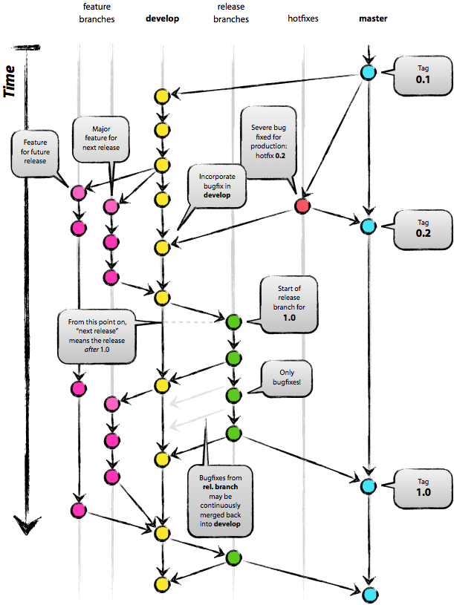
Branching Model
Variation of the diagram to the right…
…except we will try to avoid hot fixes as much as possible.
…feature branches will be named ”feature/*"
…release branches will be named “maint/*"
…bug fixes will be on their own branches named “bug/*"
…development branches, the next line of development, will be named “next/*"
Notes:
Alternates, since these are only in public repositories containing all bedrock stuff, drop the bedrock prefixes.

Slide 66
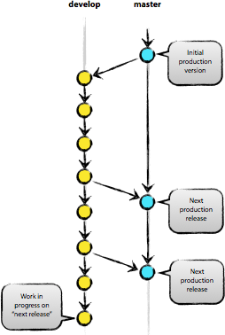
Reintegration with Master
The *-next lines of development only are integrated with master when the line of development is ready to be released to production.
The *-next lines may be recreated at the end of release cycles.
Could have multiple *-next lines of development going on concurrently.

Slide 67
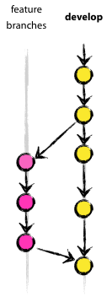
Integration with Next
The *-story lines of development only are integrated with *-next when the story is completed.
The *-story lines may be destroyed at the end of release cycles.
Will have multiple *-story lines of development going on concurrently.
Use rebase and squash!
But we'd lose all those bug numbers in the commit messages?

Slide 68
ADVANCED TOPICS: OTHER TOPICS
GIT STARTED

Slide 69
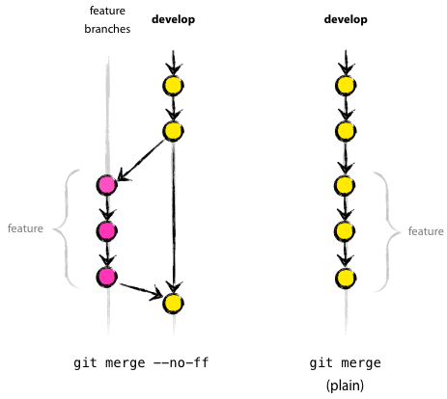
Git Commands : merge --no-ff
When merging, consider using the no-fast-forward option. It record that a merge took place where otherwise in some situations no history of it otherwise would have been recorded (optimizations in git).
$ git merge --no-ff ...

Slide 70
Git Commands : merge --squash
Merge a feature branch onto the *-next branch, but squash all the interim merge history so it does not appear in the upstream branch. Maintainer task is:
...
$ git fetch
$ git checkout turtles-next
$ git merge --squash feature/famous-widget
# note if any merge conflicts...
$ git status
# if any merge conflicts bring up mergetool...
$ git mergetool
$ git commit -m "add famous widget feature to turtles"
$ git push turtles-next
...

Slide 71
Fini!

Slide 72
Useful Links
General Manuals
http://book.git-scm.com/
http://progit.org/book/

