Slide 1
Git
Illustrated
INFORMATION MANAGEMENT
Robert Buck
Bedrock Engineering Team

Slide 2




Present Situation

Slide 3
Technical Comparison
Wrote up objective technical criteria for evaluating SCM systems, thirteen specific test cases from trivial and mundane to complex cases involving refactoring code.
Results are below…
 | 1 | 2 | 3 | 4 | 5 | 6 | 7 | 8 | 9 | 10 | 11 | 12 | 13 | LF | SCORE
SVN | Y | Y | Y | Y | Y | Y | Y | N | Y | N | N | N | N | Y | 9
GIT | Y | Y | Y | Y | Y | Y | Y | Y | Y | Y | Y | Y | Y | Y | 14
HG | Y | Y | Y | Y | Y | Y | N | Y | N | Y | Y | N | N | N | 9

Slide 4
Agenda
  Git Conceptually
  Git In Depth
  Git Demo
  Why Git ?
  Git Daily Use
  Git Workflows

Slide 5
Git Conceptually

Slide 6
Git Conceptually
Work independently.
    Productive anytime, anywhere; plane, train, home or office; with full command and confidence.
Work collaboratively.
    Code sharing with your web of trust, exchanging code without going through a centralized authority.

Slide 7
Git Conceptually
What does it mean to work independently?
  Access complete information instantaneously.
  Innovate freely with no loss of service or performance.
  Compare and contrast what-if scenarios using local branches.
  Merge between branches without centralized authorities.
  Stage a linear sequence of changes as a single atomic change.

Slide 8
Git Conceptually
What does it mean to work collaboratively?
  Leverage the works of others, and avoid duplication.
  Share ideas earlier to refine solutions that have staying power.
  Perform sanity checks to avoid making the wrong choice.
  Try out others changes locally.

Slide 9
Git in Depth

Slide 10

The Three States for Files
  Modified means you've changed the file but have not committed it to the repository yet.
  Staged means that you have marked a modified file in its current version to go into your next commit snapshot.
  Committed means the data is safely stored in your local repository.

Slide 11
The Git Working Copy
  Complete working copies of all files and also a copy of the database.
  Database containing all information needed to retain and manage the revisions and history of a project.
  Contains two data-structures: the object store and the index.

Slide 12
The Git Index
  The index holds a snapshot of the content of the working tree.
  The index contains the contents of the next commit.
  The index serves as the connection point between a working tree and the object database.
  Thus after making any changes to the working directory, and before running the commit command, you must use the add command to add any new or modified files to the index.

Slide 13
The Git Object Store
  The object store contains blobs, trees, commits, and tags:
    Blobs are identified by their calculated SHA1 hash, so a tree with two identical files only store it once.
    Trees represent one directory level of information: pathnames, metadata, blob identifiers, and sub-trees.
    Commits hold meta data about a commit.
    Tags assign a human-readable name to a specific object, usually a commit.

Slide 14
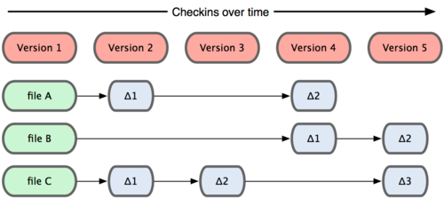
Snapshots, Not Differences
  Other systems, set of files plus changes over time.

Slide 15
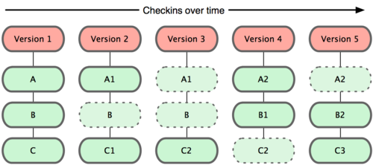
Snapshots, Not Differences
  Git stores each revision of a file as a unique blob object.
  Benefits `git search`, relevance and context.

Slide 16
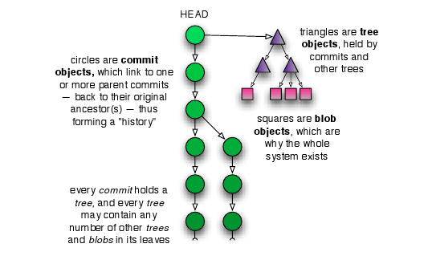
Git Trees
  Commits point to roots of trees.
  Trees point to blobs.

Slide 17
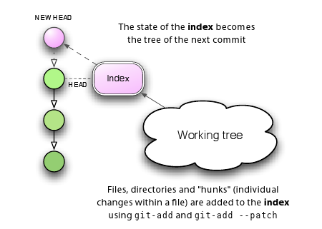
Git Commits : Tree's and Index
  State of index becomes the tree of the next commit.
  Remember, git uses blob-references in the tree, so a branch is very lightweight in practice!

Slide 18
Git Commits
Commit internals explained…
  Each git object is stored with a unique SHA1 name.
  Git tracks content.
    The object store is indexed by SHA1 values.
    If two files have the same content only one copy is stored as a blob in the object store.
  Git stores changesets (an object) as a snapshot of the index and stores the snapshot in the object store.
  Snapshots are chained together, with each new snapshot pointing to its predecessor forming a series of commits over time.

Slide 19
Git Branches
Big topic, so first the basics…
    A branch is simply a named reference to a particular commit.
    Branches allow multiple copies of a file-set to vary independently from each other.
    Branches have lifetimes and can be created and destroyed.
    In Git parlance, "trunk" is named master.

Slide 20
Code Sharing
  Code is shared using public repositories.
    Public repositories are repositories that are addressable.
    Public repositories are generally bare, with only an index and an object store.
  Code is cloned locally to be viewed or modified.
  Local (working) repositories are related to those they clone through logical connections called remotes.

Slide 21
Code Sharing and Remotes
  By default, each new clone maintains a link back to its parent repository via a remote called origin.
  Remotes are named handles to other repositories.
      Simplified names for complicated URI.
      Basis for push and pull operations between local and remote repositories.
      See .git/config file for the list of remotes.

Slide 22
Nearly Every Operation is Local
  You can browse and search all history locally.
  You can browse and search all versions of all files locally.
  Given a local copy of a remote branch you can perform all merging and commits locally.
  You can locally checkout a working copy of any branch instantaneously, easily switch between them.

Slide 23
Git Demo

Slide 24
Git Demo
What is demonstrated:
    Clone
    Commit
    Diff
    Merge
    Push

Slide 25
Why Git

Slide 26

The goal to achieve nirvana, it is…
… and stop chasing the krusty's.

Slide 27
So Really, Why Git?
Cheap local branching.
Everything is local.
Git is Fast
Git is Small.
Staging Areas
Distributed, Safe
Flexible Workflow
Fun, Simply Fun

Slide 28
Git Illustrated - Part 2
Break time…

Slide 29
Git Daily Use

Slide 30
First Day
Read Welcome Pack Files:
    WELCOME
    For Windows users:
      install/git-core/windows/README
    For Unix users:
      $ install/git-core/unix/install.sh

Slide 31
First Day
Set Up Username and Email
Before you do any work you will want to set up your email address and password so that Git will be able to identify you.
$ git config --global user.name \
"First Last"
$ git config --global user.email \
email@yourcompany.com

Slide 32
Git Commands
Typical daily commands:
    clone
    init
    status
    add
    reset
    commit
    branch
    checkout
    diff
    fetch
    merge
    pull
    push

Slide 33
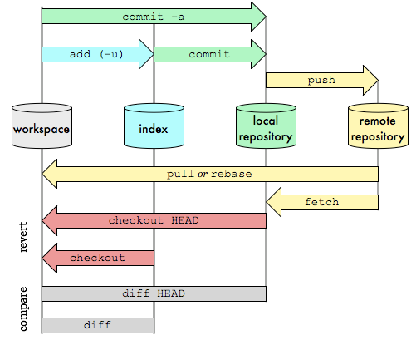
Git Commands
Bear this diagram in mind when learning about the commands described hereafter…

Slide 34
Git Commands : clone
Cloning Repositories
  Clone a repository into a local working directory, set it up so that it tracks the remote repository, and set the default branch to the currently active branch in the remote repository.
$ git clone git@github.com:youname/hello-git.git \
hello-git.git

Slide 35
Git Commands : init
Initialize Repositories
What if… I want source control for purely experimental works?
  Create a new repository by creating a ".git" directory with its subdirectory contents.
  Reinitialize non-destructively an existing repository to pick up newly added templates.
$ git init [directory]
$ git init .
$ git init foo.git/ && cd foo.git

Slide 36
Git Commands : status
Show Working Tree Status
  Displays paths that:
    are in the working tree but are not tracked
    have differences between working tree and the index file
    have differences between index file and current HEAD commit,
$ git status # display changes and untracked
$ git status -u # display untracked files

Slide 37
Git Commands : add
Add Files
  Add file to update the index that holds the snapshot of working files.
  If no file-pattern is given, default to “.”
$ git add [file-pattern]
$ git add . # add all files (new or updated)
$ git add --all # add all files (new or updated)
$ git add --update # add only updated files

Slide 38
Git Commands : reset
Remove a file from the index before a commit:
$ git reset -- <filename>

Slide 39
Git Commands : commit
Commits files to the local repository.
  Record a snapshot of the index in the object store.
    Git stores the differences in the index, not the entire index.
  If no file-pattern is given, default to "."
$ git commit (options) [<file-pattern>...]
(-m|--message "commit message")
(-a|--all) # inline `add --all`
(-F|--file <file>) # file contains commit message
(-s|--signoff) # adds signoff by committer to end

Slide 40
Git Commands : branch naming
Branch names can be hierarchical akin to Unix path-syntax.
Proposed reserved prefixes to include 'bug', 'maint', and 'next', and ‘feature/cool’.
      *-feature/famous-widget
      *-bug/12345
      *-next/2.0
    This is a huge win for automation because branch names can be wild-carded.
    $ git show-branch 'bug/*' # what bugs are fixed?

Slide 41
Git Commands : branch listing
List branches.
  List existing branches and highlight ("*") the current branch.
    $ git branch

Slide 42
Git Commands : branch creation
Create a branch.
The default start-point for a new branch is at the point where you’re working right now.
    $ git branch <unique-branchname> [<startpoint>]
    $ git branch story/epic-failure next/2.0
    $ git branch user/myname story/epic-failure
    $ git branch bug/13452 maint/1.0

Slide 43
Git Commands : branch renaming
Rename a branch.
    $ git branch (-m|-M) [<branchname>] \
    <unique-branchname>
  If unspecified <branchname> defaults to current branch.
  Will return with an error message if <unique-branchname> exists.
    $ fatal: A branch named 'two' already exists.
    Can force a (destructive) rename to an existing branchname.
    $ git -M <existing-branchname>

Slide 44
Git Commands : branch delete
You cannot delete a branch you are currently on!
Delete an existing branch, safely.
    $ git branch -d <branchname>
Force (unsafe) deletion of a branch.
    $ git branch -D <branchname>

Slide 45
Git Commands : checkout
Set the current branch in your workspace.
    $ git checkout <branchname>
N.B. Branch creation and checkout can be performed in a single step.
    $ git checkout -b <branchname>

Slide 46
Git Commands : diff
Using <path> limits diff output.
Display the changes that remain in your working directory and are not staged.
    $ git diff [<path>...]
Display changes that are staged and will therefore contribute to your next commit.
    $ git diff --cached [<path>...]

Slide 47
Git Commands : diff
Display changes since your last commit.
    $ git diff HEAD
Display changes between two branch tips.
    $ git diff topic..master
Display changes on master since branch-point.
    $ git diff topic...master

Slide 48
Git Commands : fetch
Keep up to date with top of tree.
Assumes a remote ref is defined.
May require a merge.
Update the remote tracking branches:
    $ git fetch origin

Slide 49
Git Commands : merge
Unites two or more branch development histories.
  All branches being merged must be present in the local repository.
    You will merge and commit to *-next or to master branches yourselves.
  Merge handles refactoring cases automatically, correctly!
  Perform a "checkout" of the branch you want to merge to, the target, then merge in the source.
  Merge is used by a "pull" to incorporate changes from another repository.
  Check in changes locally, then "push".

Slide 50
Git Commands : merge
  Merge a private contributors branch onto the topic branch. Contributor task is:
    ...
    $ git fetch
    $ git checkout feature/famous-widget
    $ git merge contributors-branch
    # note if any merge conflicts...
    $ git status
    # if any merge conflicts...
    $ git mergetool
    $ git commit -m "added famous widget"
    $ git push feature/famous-widget
    ...

Slide 51
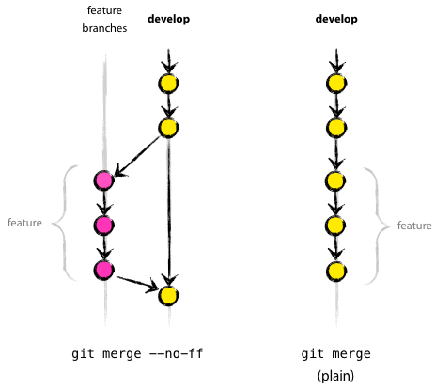
Git Commands : merge --no-ff
When merging, consider using the no-fast-forward option. It record that a merge took place where otherwise in some situations no history of it otherwise would have been recorded (optimizations in git).
    $ git merge --no-ff ...

Slide 52
Git Commands : merge --squash
  Merge a feature branch onto the *-next branch, but squash all the interim merge history so it does not appear in the upstream branch. Maintainer task is:
    ...
    $ git fetch
    $ git checkout turtles-next
    $ git merge --squash feature/famous-widget
    # note if any merge conflicts...
    $ git status
    # if any merge conflicts bring up mergetool...
    $ git mergetool
    $ git commit -m "add famous widget feature to turtles"
    $ git push turtles-next
    ...

Slide 53
Git Commands : pull
Fetch from and merge with another repository.
    Is simply a 'fetch' then a 'merge' rolled into one.
    Supports --squash
    Resolve conflicts should they exist as cited previously.

Slide 54
Git Commands : push
Update remote refs and associated objects with local state.
  Push to current branch's remote, or origin if none specified.
    $ git push
  Push matching branches to origin.
    $ git push origin :

Slide 55
Git Commands : push
Interesting point: you can push hooks too!
  Push a ref that matches master and update the same ref in origin repository.
    $ git push origin master
  Find a ref that matches experimental in the origin repository and delete it.
    $ git push origin :experimental

Slide 56
Git Workflows

Slide 57
Workflow
Web of Trust
    Small clusters of trusted friends, networks of trust.
    Delegation and security.

Slide 58

Branching Model
Variation of the diagram to the right…
    …except we will try to avoid hot fixes as much as possible.
    …feature branches will be named "widget-story/*"
…release branches will be named "widget-maint/*"
    …bug fixes will be on their own branches named "widget-bug/*"
    …development branches, the next line of development, will be named "widget-next/*"
Notes:
Alternates, since these are only in public repositories containing all bedrock stuff, drop the bedrock prefixes.

Slide 59
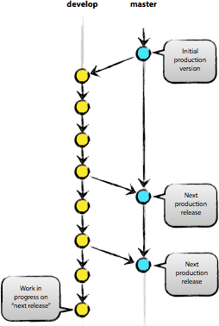
Reintegration with Master
The *-next lines of development only are integrated with master when the line of development is ready to be released to production.
The *-next lines may be recreated at the end of release cycles.
Could have multiple *-next lines of development going on concurrently.

Slide 60
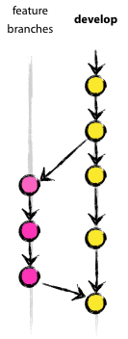
Integration with Next
The *-story lines of development only are integrated with *-next when the story is completed.
The *-story lines may be destroyed at the end of release cycles.
Will have multiple *-story lines of development going on concurrently.
Use rebase and squash!
    But we'd lose all those bug numbers in the commit messages?

Slide 61
Fini!

Slide 62
Useful Links
General Manuals
Flow and Branches
http://nvie.com/git-model
http://www.kernel.org/pub/software/scm/git/docs/gitworkflows.html
http://book.git-scm.com/3_distributed_workflows.html

Slide 63
Objectives
Distribution Model
  Distributed
    Work Disconnected
  Centralized
    Authoritative Repositories
Whole Repository Tracking
  Single Repository Object Store
    No partial checkouts!
    No hidden directories sprinkled throughout!

Slide 64
Considerations
Structure big projects wisely.
    Flatten, not hierarchical!

