Slide 1
Hypermedia Design
By: Becca Buechle

Slide 2

Business Use Case
Actors – Client, user or a computer that interacts with the API.
The Goal – To have a working API for Doggos.com that will give the user a list of all emojis they are allowed to use on the site.
Pre-Conditions – We must fully understand what the API needs to do. Once that happens, we will then begin to create and test the API.
Post Conditions – The API will be shared with the client to make sure that it is as they intended and has everything, they were needing from it.
Main Flow – The user connects to the API and uses it in some way. A user can use the GET method to get a list of all Emoji’s offered on the site.
Expectations – One thing that could go wrong in doing this is that it pulls too much information from the sever and crashes.
Alternate Flows – One alternative use for the API would be that a user connects and uses the GET method to also pull up a picture of the emoji they are thinking about using. Once the emoji is selected the API would pull up a picture of said icon. They may want to use the emoji on their site.
Source – (Webmaster, I.)

Slide 3
Return on Investment (ROI)
Costs will be soft as it may require more of less time, but I estimate that it will take our team about three weeks to complete once we have received all necessary information. Once finished you (client) will have a working API.
Cost Estimate - At $80/h x 8h a day x 5 days a week x 3 weeks, You (client) is looking at an estimated total of $9,600. This price does not cover any database hosting that might be needed which if needed would be a separate fee of 10$ a month.
Estimate of Return – By implementing this API solution, we hope to be able to grow your customer base and revenue in the next several months by brining more people to your company because of the great new API.

Slide 4

The following slides will layout the 7 steps of the design procedure for building/designing an API.

Slide 5
Step 1 - List the Semantic Descriptors Doggos.com API
Figure out what your client might want to get out of the API you are creating and then create a list with that information. This list will become your semantic. After You create your list them in hierarchy order.
What the API needs - listed in hierarchy order
Home page for emoji’s
About
List of Emojis
Emoji ID
Picture of emoji
Sort Emojis - Type
Source – (Richardson, Leonard.)

Slide 6
Step 2 – Draw a State Diagram
In this step you will want to draw a state diagram for the API that is being created.
Each box represents one kind of representation.
You group use the list you created in step 1 to group together the items.
Once you have items in a boxes that you think go together use arrows to connect representations in ways that you think your client will find natural.
The arrows are your state transitions.
The state transitions are triggered by HTTP requests
Source – (Richardson, Leonard.)

Slide 7
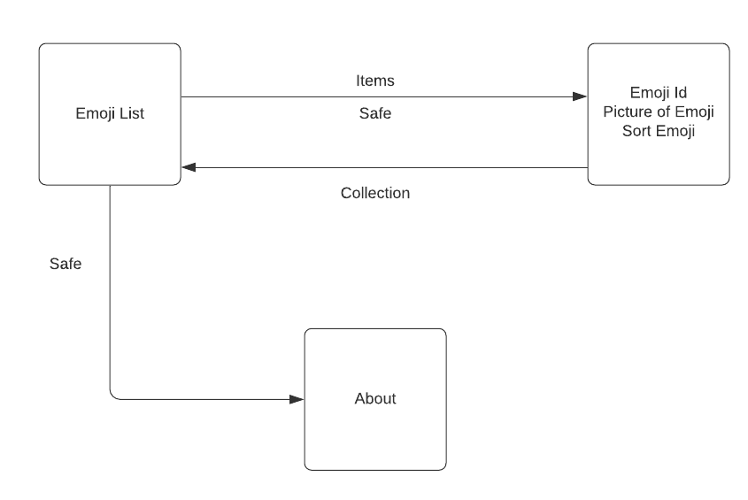
Doggo’s.com API State Diagram

Slide 8
Step 3 – Reconcile Names
You could skip this step because a computer doesn’t understand what a name is.
Even though you can skip this step you should still do it.
Names also matter quite a bit to humans.
You can make up your own names for everything if you choose to.
Don’t autogenerate the names of the semantic descriptors from the fields in the database scheme or object model.
Don’t come up with link relations that duplicate the functionality of IANA-registered link relations. That just adds extra work.
Source – (Richardson, Leonard.)

Slide 9
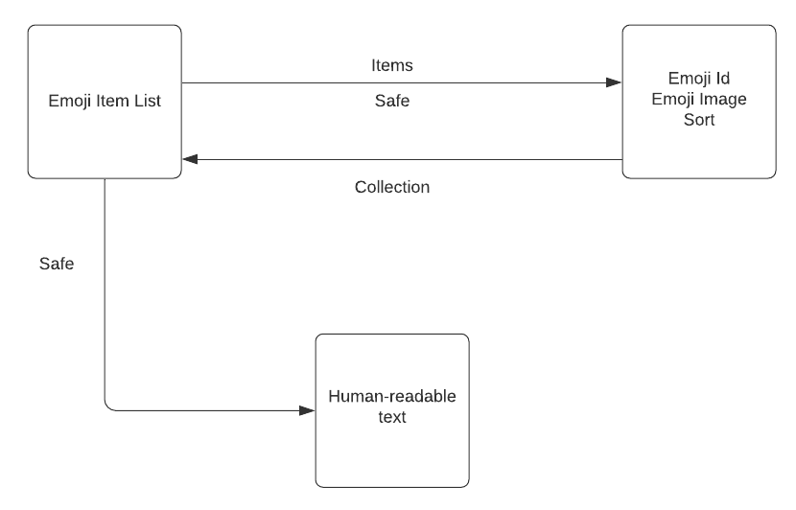
IANA corrections

Slide 10
Step 4 – Choose a Media Type
Now its time to choose a hypermedia format.
You can create one though you shouldn’t need to.
Or you can use one that is already in existence.
Depending on how your semantics look will help to determine which media type you should use.
There are several different ones to choose from.
Collection+JSON, AtomPub, Odata and many others
Or you might need to choose a generic hypermedia language such as HTML, HAL or Siren.
For our API we will use Collection+JSON
Source – (Richardson, Leonard.)

Slide 11
Step 5 – Write a Profile
Writing a profile. When our server sends a representation it will include many things such as a Content-Type header. This tells the client how to parse the representation.
You’ll also include a link to at least one or more profile in which you explain the applications semantics.
The profile can be an ALPS document, a JSON-LD context or even a webpage that uses XMDP microformat.
It should be machine-readable however, if you have trouble coming up with something it could also be a human-readable profile.
Machine-readable is something a computer can read.
A human-readable profile looks like a traditional API documentation.
Source – (Richardson, Leonard.)

Slide 12
Step 6 - Implementation
This is the step you will likely spend most of your time getting everything setup, tested, and ready to go.
Now let’s write that code!
Picking a framework to use or creating your own.
Looking at the state diagram and using it and making any changes if necessary.
You’ll also be creating an HTTP server to implement that state diagram.
You’ll also be using the media type you choose in Step 4 and using that link you created in Step 5.
Source – (Richardson, Leonard.)

Slide 13
Step 7 - Publication
Great job we made it to the last step! As long as we have everything done from all the other steps this should be pretty easy for us.
We will be publishing our URL.
The URL will be what clients and users need to use the API
We can also create many thing here to make it easier for our clients and users to understand how to use the API.
You can write a human readable profile.
Or even tutorials which will help everyone know how to use the API.
Source – (Richardson, Leonard.)

Slide 14
Bibliography
Richardson, Leonard. RESTful Web APIs: Services for a Changing World . O'Reilly Media.
Webmaster, I. (2017, February 02). Blog: 7 Steps to Writing Business Use Cases. Retrieved August 10, 2020, from https://www.iag.biz/7-steps-to-writing-business-use-cases/

