Slide 1
OAuth API
By: Becca Buechle

Slide 2
What is oauth?
OAuth can be thought of as either a framework or an open standard authorization tool that anyone can use and implement. (Raible, M.)
Applications can use this as a way to secure authorized access (Raible, M.)
OAuth will not share password data but gives users a token instead. (Sobers, R. )
This token is used to prove the user's identity between the consumer and service. (Sobers, R. )
OAuth is a authentication protocol
It allows the you to approve one interaction with an application with another application without giving out personal information such as your password. (Sobers, R. )

Slide 3
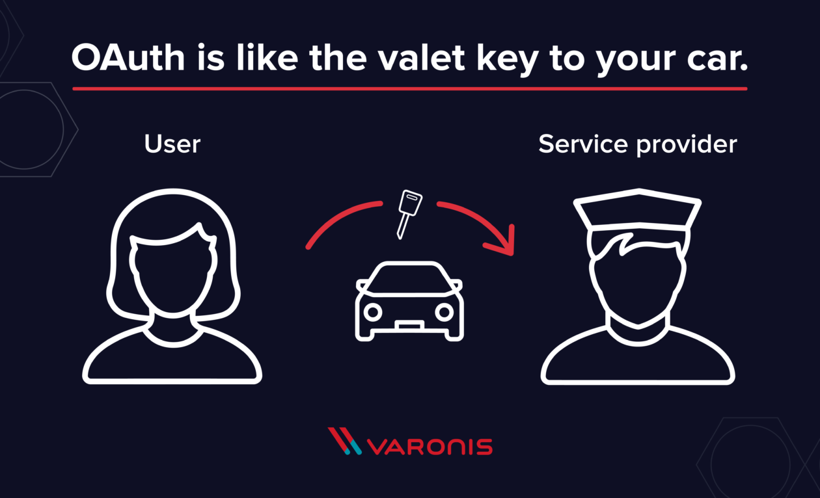
Source: (Sobers, R.)

Slide 4

How does Oauth work?
The user show intent on getting/using something – User wants to post something on social media so asks for permission from the consumer.
The consumer will then get the permission by asking for an access token. The service provider will then decide if its okay or not and then provide a token and a secret.
The user is then redirected to the service provider (social media site) with the token. Then the social media site then checks for the authorization and for any other information.
The user then will give the permission for such and such to happen in this case for the post to be made on the users account. The service then says its okay and has permission to use that request token.
The consumer will then obtain the access token – there is an exchange done for the request token for an access token and secret.
The consumer then will access the protected resource. The token is given to the service and then all is complete.
Source: (Sobers, R. )

Slide 5
History of Oauth version 1.0 vs 2.0
December 2007 1.0 OAuth started with a framework using digital signatures
It was both strong and secure.
Big companies began to use it. Google started support in 2008 and Twitter started making all third-party applications use 1.0.
OAuth 2.0 came out in October of 2012.
It is said that OAuth 2.0 is much easier to implement
With the support for non web browsers it is said that 2.0 is a better choice for most things.
Source: (Synopsys.)

Slide 6
version 1.0 vs 2.0
Version 1
Only handles web workflows
Security is not delegated to HTTPS/TLS
Digital signatures are used to prove authenticity of a message.
Version 2
Handles web workflows and non-web clients
Some of the security is delegated to HTTPS/TLS.
Uses tokens
Source: (Synopsys.)

Slide 7
Why is oauth so popular?
OAuth is popular for many reasons one being that its secure than sharing any type of credentials. (Swoop.)
It lets its users use the service across several different platforms. (Swoop.)
It’s a great security feature
Don’t have to have to give out passwords to third party apps
Login tokens
Limited credentials issued to each client and user.
Source: (Richer, J.)

Slide 8
End to end data flow of oauth api
The application will request the authorization so that it can access service resources from the user
If the user made the request, then the app will get the authorization grant
The app then requests a token from the authorization server by giving it the authentication of its identity and the grant from previous step
If the apps identity is then authenticated and authorized grant are both valid then the authorization service will issue a access token to the app and the authorization is finished
The app will then request the resource from the server and give the access token that came from the authentication
If the access token is valid the resource server will then server, the resource to the app.
Keep in mind this can change
Source: (Anicas, M.)

Slide 9
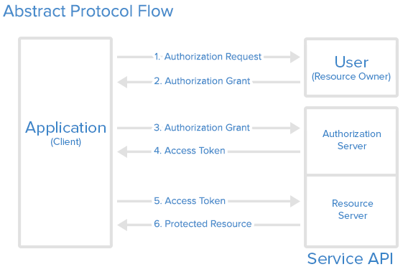
Source: (Anicas, M. )

Slide 10
Pro’s of 2.0 OAuth
OAuth 2.0 is very flexible protocol
Uses SSL (Secure Sockets Layers) helps keep data between the web server and browsers private
Saves a user access token
Makes sure that cryptography protocols are being used to keep data safe
Limits access to the user's data when a authorization token expires
Can share the user's data without giving out personal information
Strong authentication
Source: (Tutorialspoint.)

Slide 11
Con’s of 2.0 Oauth
If you add more extensions later on in the specification it will run into a a lot of non-interoperable implantations. (Tutorialspoint.)
You will have to write separate code for separate apps
If a bunce of sites are connected via a central hub and it is hacked, it will have serious consciences across several of your sites instead of just one. (Tutorialspoint.)
Even though a lot of sites use OAuth its still limited support on a lot of other sites. (Fronczak, T.)
Phishing
Data being misused and sold off (Facebook being one of those) (Fronczak, T.)

Slide 12
Bibliography
Anicas, M. (2014, July 21). An Introduction to OAuth 2. Retrieved September 02, 2020, from https://www.digitalocean.com/community/tutorials/an-introduction-to-oauth-2
Fronczak, T. (2011, February 10). OAuth: Pros and Cons of OAuth. Retrieved September 02, 2020, from http://www.socialtechnologyreview.com/articles/oauth-pros-and-cons-oauth
Raible, M. (2017, June 21). What the Heck is OAuth? Retrieved September 01, 2020, from https://developer.okta.com/blog/2017/06/21/what-the-heck-is-oauth
Richer, J. (2015, September 25). OAuth 2: Why You Should Care - DZone Web Dev. Retrieved September 02, 2020, from https://dzone.com/articles/what-is-oauth-2-and-why-should-you-care
Sobers, R. (2018, August 31). What is OAuth? Definition and How it Works. Retrieved September 01, 2020, from https://www.varonis.com/blog/what-is-oauth/
Swoop. (2020, August 04). What is OAuth?: Open Authorization FAQs & Best Practices. Retrieved September 01, 2020, from https://swoopnow.com/what-is-oauth/
Synopsys. (2019, January 17). What's the difference between OAuth 2.0 and OAuth 1.0?: Synopsys. Retrieved September 01, 2020, from https://www.synopsys.com/blogs/software-security/oauth-2-0-vs-oauth-1-0/
Tutorialspoint. (2020). OAuth 2.0 - Overview. Retrieved September 02, 2020, from https://www.tutorialspoint.com/oauth2.0/oauth2.0_overview.htm

