Slide 1
Pager Rotation Duties – DevOps Model
By: Becca Buechle

Slide 2
What is Pager Rotation?
Pager Rotation is for after hours issues that come up.
The whole team is available to be called at any hour when something disrupts how the program is intended to be running.
They found that when their teams are called in the middle of the night the issue gets solved much quicker.
Even when a release goes smoothly that doesn’t mean it won’t still run into issue later on.
Everyone in the Value Stream will also share the Down Streams responsibilities when it comes to handling operational issues.
This will make sure that each team gets primitive feedback on any architectural coding decisions that are made.
Doing this makes it so that Operations don’t struggle alone with code issues instead all the teams are helping fix and solve issues.
Source: (Kim, G.)

Slide 3
Duties of Pager Duty
Staying up until the program is working as it was intended
No just slapping on a Band-Aid for a temp fix
Make sure teams are getting the feedback they need
By giving feedback teams don’t end up feeling alone when they are trying to fix something or figure out a way to do something
The issue is considered done and fixed when it is preforming as it was designed in the production stage
Everyone is responsible the infrastructure
Source: (Kim, G.)

Slide 4

On-Call Rotation Schedule
Having a schedule lets teams see who's available at any given time and what skill sets they have
It also let you see how the escalation policy will affect different team members
When creating such a schedule you should use a software that allows for you to setup escalation policies as well as setting up the hierarchy for the escalation
These rotating schedules make it so that everyone gets enough sleep by making sure the same people aren’t on call each night
It also make sure that the workload is shared when it comes to weekends and holidays and such
When something happens having this all-in place already will speed up the process to get the problem solved
Source: (AlertOps.)

Slide 5
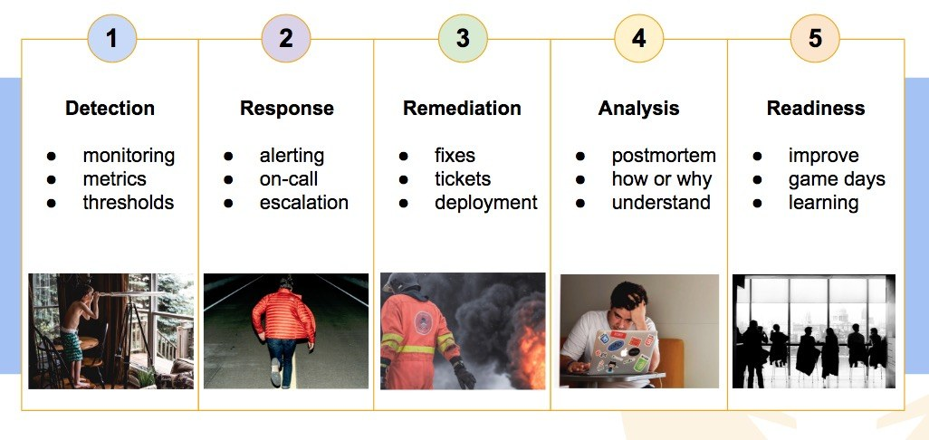
Steps to Solve a Reported Issue

Slide 6

Detection of Issue
Have some type of monitoring in place that will catch the issues quickly as they come up
Metrics, logs and traces should all be things that should be used to monitor things in production
Synthetic monitoring – Monitors applications and services by creating artificial users and simulating what their behavior might be (Holloran, D.)
Real-user monitoring – Web monitoring that tracks every transaction and action taken by the end user working on the application or service. (Holloran, D.)
Once an alert comes up the incident's information is there and relayed to the on-call person / team
If there are any gaps in detection its important for them to be noticed and more detection software added
Souce: (Holloran, D.)

Slide 7
Incident Response and Incident Solution
Getting the right people working on the issue right away is important.
Without information about what the issue is it’s hard to make sure the correct people are called. Refer to issue detection to make sure this is done correctly
Knowing which systems are involved is also just as important
Make sure that when someone is called in that they have the needed permissions to fix said issue otherwise the fix could take that much longer
Knowing which systems are involved as well as the known issue plays a big part in how quick something can be fixed
When the issue is sent the correct team the fix normally comes pretty quickly
Source: (Loughman, K.)

Slide 8
Incident Analysis
Teams should always look back after an issue occurs so that they might be able to fix it before it happens in the future
Learn from what happened
Ask questions such as -
Was there a better team that could have solved the issue quicker?
Where their issues with the detection software?
Where enough tests ran before the product was pushed out to the public?
Was there enough information for the teams that were called in
Source: (Loughman, K)

Slide 9

Ask for Help
Many times than not people are afraid to ask for help. This can cause issues in code if the person isn’t quite sure how to do something and later on cause the app to break in one way or another.
In DevOps the whole project is the whole team’s responsibility.
More time than not when a company is using the DevOps method, they will have SREs (site reliability engineers) and they are all about helping
Software architects are normally the best first contact because if they don’t know the answer to something, they will normally be able to point you in the right direction
Remember there are no dumb questions when asking for help
By asking for help it can save a lot of time and money for the project because someone might be able to tell you how to do something the correct way first
Source: (Riggins, J.)

Slide 10
Bibliography
AlertOps. (2019, July 12). Best Practices for Managing On-Call Rotation (in 2020). Retrieved October 14, 2020, from https://alertops.com/on-call-rotation/
Holloran, D. (2018, November 30). Leveraging Synthetic and Real-User Monitoring for SRE. Retrieved October 14, 2020, from https://victorops.com/blog/synthetic-monitoring-and-real-user-monitoring-for-sre
Kim, G., Humble, J., Debois, P., & Willis, J. (2016). DevOps Handbook. Portland, OR: IT Revolution Press.
Loughman, K. (2019, June 03). The DevOps and IT Incident Response Plan. Retrieved October 14, 2020, from https://victorops.com/blog/the-devops-and-it-incident-response-plan
Riggins, J. (2018, November 20). The Art of DevOps Communication, at Scale and On-Call. Retrieved October 14, 2020, from https://thenewstack.io/the-art-of-devops-communication-at-scale-and-on-call/

