Slide 1
The Dangers of Change Approval Processes
By: Becca Buechle

Slide 2
What is Change Management?
Change management is a process that helps ensure minimum risk to the infrastructure and operations when implementing new items into development.
Change management includes things such as –
Pre-release such as roll-outs
Backout Planning – Having a plan if the roll-out causes issues
Scheduling of changes – A plan for how the changes will roll-out live
It also does quality control to make sure that release activities are as planned
Source: (FreshService.)

Slide 3

Treat Different Changes Differently
Standard Change – This would be a low-risk change that everyone knows, and it is following a strict procedure. These have very low risks when it comes to having large errors and such.
Normal Change – You don’t know how risky these changes types of changes might be. These changes could be ones that have never been done before or they can be ones that people are afraid to do. These changes are normally ones that have gone through a change advisory board so that it can be analyzed before it’s pushed live. IT Ops like to avoided these types of changes.
Emergency Change – These are changes that need attention and action right away. These will not have time to go trough an approval process.
You can see from above that there are several different types of changes and that they need to be handled differently.
Changes should go through an approval process when possible before the change is pushed out.
Starting out you will have more Normal changes rather than Standard ones, but you should work towards more Standard ones.
Source: (Melendez, C.)

Slide 4

What is the Change Approval Process?
When a change is ready it will be submitted to a CAB team to be reviewed before it can be pushed out.
An RFC template is used to record the information on the submitted change. This will explain the reason for the change and any risks and benefits it might have.
The RFC will also address things such as the impact, cost and how it will be implemented.
If approved the change assessment and planning stage. In this stage you will determine the type of change being done and then prioritize the requests then schedule a start and end date for the roll-out followed by planning how the roll-out will be done. Lastly, if anything unexpected happens have a plan for that as well.
The change will then be pushed out to the system.
The change will then be reviewed to make sure that everything is working as intended.
Source: (FreshService.)

Slide 5
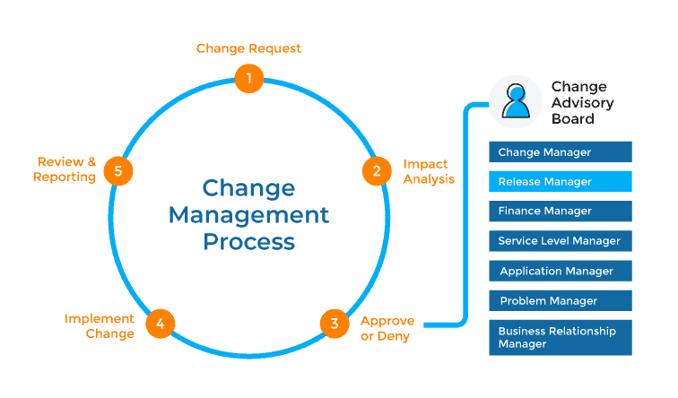
The CAB Process
Source: (Plutora.)

Slide 6
Implementing a Change Approval Process
There are several goals when it comes to implementing the change approve process below are a few.
Goal One – Decrees the risk when applying new changes
When you decrees the risk it will help make sure that there is less downtime, less errors that could cost the company money and many other things
Goal Two – Satisfy regulatory requirements
One of these regulatory requirements is that segregation of duties. This says that changes must be approved by someone other than the designer so that no one person has all the control.
These goals normally are met through a strenuous process which are typically approved by people outside of the team that created it. It can be a CAB team, or senior manager.
These strenuous process however have been showed to really slow down the delivery process leading to a larger batches and less frequent.
Source: (Google.)

Slide 7
Implementing a Change Approval Process Continued
Teams should use peer review to help them meet the goal of segregation of duties. Reviews, comments and approvals should all be noted in the team's development platform
Use continuous testing as well as continuous integration as these will both help find errors faster and prevent and correct any bad changes
Think of your development platform as a tool that helps the team gets faster feedback on things like security, performance and stability
Your change management process should be a quick process that works for normal and emergencies
CAB should put out notifications between teams
CAB should also help with process improvement so that teams are able to increase their software delivery performance
CAB helping make important choices will require a trade off and sign off at higher levels
Source: (Google.)

Slide 8

Con’s of Using a Change Approval Process
Teams become reliant on a Change Approval Board (CAB) to catch any errors and to approve the project before it can move along.
Treating all changes equal. There are different types of changes and they should be treated differently.
Not pushing towards a continuous improvement. When using a CAB performance metrics such as lead time, change fail rate and several others tend to be forgotten about.
Often times when there are problems more processes will be added. This will drive up lead times and batch sizes.
These only name a few of the cons to using the approval process but there are a lot of others.
Source: (Google.)

Slide 9
Pro’s of using Change Management
Reduces the risk of a bad impact
Helps maintain a current working state
Feedback from teams such as managers or the CAB team
Approval – So random stuff isn’t just being pushed out
Change planning – A schedule of when stuff will happen
Reduced incidents when the change is pushed out
Source: (FreshService.)

Slide 10
Bibliography
FreshService. (2020). Freshservice ITSM System: ITIL-aligned service desk software. Retrieved October 20, 2020, from https://freshservice.com/change-management-software/itil-change-management
Google. (2020). DevOps process: Streamlining change approval | Google Cloud. Retrieved October 20, 2020, from https://cloud.google.com/solutions/devops/devops-process-streamlining-change-approval
Melendez, C. (2020). How Does DevOps Handle Change Management? Retrieved October 20, 2020, from https://www.cprime.com/resources/blog/how-does-devops-handle-change-management/
Plutora. (2019, November 25). Change Advisory Board (CAB) and Release Management: The Connection. Retrieved October 20, 2020, from https://www.plutora.com/blog/cab-and-release-management-whats-the-connection

