Slide 1

Security Controls in Shared Source code repositories
By: Becca Buechle

Slide 2
Repository Code Threats
Code repositories such as GitHub have potential security issues that all users should be aware of.
When posting to these type of sites developers are taking private files and then pushing them to a repository which are then being copied to public repositories which are then searchable.
An attacker knowns exactly how open-source code is used.
An attacker will then watch the repositories and watched for ones that are marked as having problems.
While developers might think individual code repositories are low importance or low value but when combined with active reconnaissance techniques the data can be leveraged in attacks against employees using phishing or by locating potential targets for attacks.
These treats can involve infrastructure attacks, social engineering, credential theft, and even an entire shut down of systems and applications when codes are altered.
This not only happens because of malicious attacks but also due to developer negligence by accidently putting confidential data in the uploaded code.
Source: (Perlmutter, D.)

Slide 3
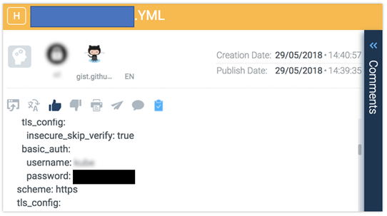
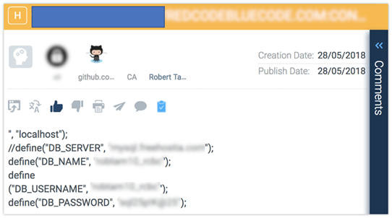
Code that you shouldn’t include in Your repo
Source: (Perlmutter, D.)

Slide 4
Attacks and Exploits against Infrastructure
Sensitive information is valuable to a hacker as it allows them to focus their efforts on finding exposed instances and subsequent vulnerabilities in the companies' high-level technologies.
Technical indicators such as hostnames, IP addresses and service configurations allow hackers to build up a larger picture of the company's infrastructure which can then be used to determine the high-value targets.
A hacker does not need to go through the full code to find the vulnerabilities and to be able to potentially leverage his attack on the deployed code.
An example of this is when Uber had their data breach in 2016 and hackers broke into the source code repository on GitHub and opened up their infrastructure to attacks worldwide.
This left the personal information of 7 million Uber drivers and 50 million customers compromised the damage to the company and for the world of data security was massive.
Source: (Perlmutter, D.)

Slide 5
Best Practices for Implementing security controls
Security Awareness Training – Your development teams should all be briefed on what is and what is not appropriate to share on services such as GitHub.
Explain that they should remove any company-wide confidential and personal data before the code is uploaded.
Development teams should also be careful when sharing any types of screenshots that can be publicly viewed as these often contain confidential information as well.
Audit/Monitoring – A review should be done to make sure that existing code repositories permissions are configured with the correct the type of repository they are for i.e. internal-use only.
With public repositories keep in mind when you mark something as being a possible issue that it should be possibly switched to a private repo.
Intelligence-Led Penetration Testing - Doing an intelligence-led penetration test will help find exposed data during the reconnaissance step that will later be used in a cyber attack. During this reports should be gathered and created so that it can be studied to help prevent it from happening.
A tool that can be used is CyberInt’s threat intelligence and digital monitor service. This gives you a look at realtime incidents and alerts if sensitive data is shared places such as GitHub or the Dark Web.
Source: (Perlmutter, D.)

Slide 6
Clear Security Policies
Security policies should be a huge part of any company now days. These will help a company see possible security issues and help to create strategies. Data theft of all kinds are major issues, and more than 6.5 million records are stolen each day. (Clement, M. )
Any type of data breach can put a company at financial risk and company stock usually stays down for several months after a breach.
Any type of source code should be treated like any other confidential thing in the company. Threats must be identified and addressed.
When using programs such as GitHub make sure people are only downloading them on to secure computers.
Policies should be developed to stop the rick of password sharing.
Have security awareness training for development teams.
Developers should only have access to the code they need to be working with.
Keep any secret credentials and certificate keys sperate from source code.
Source: (Clement, M. )

Slide 7
Have dedicated tools to prevent source code theft
Insider threats to source code can cost a company a lot of money. The average is around $1.8 million and up to $20 million to fix and insider incident.
Making sure that insiders use companies Intellectual Property can be hard but there are many software tools out there to help with this issue.
Data Loss prevention tools help to manage security issues which related to high-level risk.
89% of people that leave tend to still have access to proprietary company data.(Clement, M. )
With the correct tools this can be much less so that the company has a little less to worry about.
Source: (Clement, M. )

Slide 8
Privileged Access
Passwords can be the weakest link to making sure people stay out of places they shouldn’t be.
Developers normally require high levels of privilege when working on source code.
Collection #1 had 773 million data records breached including things like passwords, which makes the use of password for privileged access high risk. (Clement, M. )
Anyone that is working with source code should have high levels of authentication applied.
More than one factor should be in place such as an authenticator and a digital certificate.
Only allow people to work with what they need.
Source: (Clement, M. )

Slide 9
Encryption and Behavioral Monitoring
Having a layered approach when it comes to security is important.
You cannot just have one policy you need several, some that are human-centered and some that are technical.
These can be applied either on a global or departmental basis to help with protection.
Use tools like encryptions and code obfuscation.
By monitoring your developers you can stay on top of issues before they become a problem.
Start at the top of the process and work to the bottom where the info is stored make sure everything is secure.
The US Department of Homeland Security noted that 90% of security breaches happen because of vulnerabilities in the code. (Assembla.)
Source: (Clement, M. )

Slide 10
Bibliography
Assembla. (2020). How to Secure Your Source Code. Retrieved October 31, 2020, from https://www.assembla.com/security/secure-source-code-report
Clement, M. (2019, March 20). Source Code Security Best Practices. Retrieved October 31, 2020, from https://www.stop-source-code-theft.com/source-code-security-best-practices/
Perlmutter, D. (2018, July 22). What You Need to Know About Code Repository Threats. Retrieved October 31, 2020, from https://blog.cyberint.com/what-you-need-to-know-about-code-repository-threats

