Slide 1


The Technology Value Stream
By: Becca Buechle

Slide 2

Defining Lead Time vs. Processing Time
Lead Time is also known as touch time or task time. (Kim, G., Debois, P., Willis, J., Humble, J., & Allspaw, J.)
Lead Time clock starts when a request has been made and then ends once it has been fulfilled. (Kim, G. et al.)
Process Time clock starts when a developer starts work on a customer request. (Kim, G. et al.)
Process Time does not look at the time that the work has been sitting in the queue and waiting to be done. (Kim, G. et al.)
Since Lead time is more what the client experiences more time is focused on that instead. (Kim, G. et al.)
However, Its also important to try to reduce the time that work is sitting in queue. (Kim, G. et al.)

Slide 3
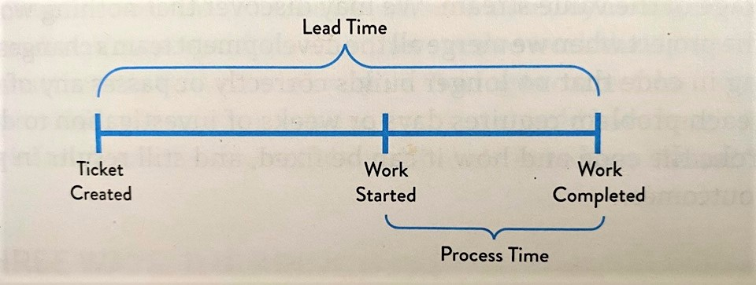
Lead Time vs Process Time Deployment Operation
Source: (Kim, G. et al.)

Slide 4
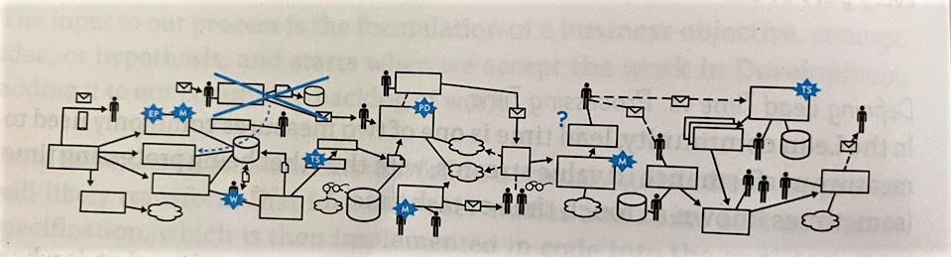
The Common Scenario: Deployment Lead Timers Requiring Months
Big organizations that often work with work with complex applications that are tightly coupled and have minimal test environments can take months to deploy anything. (Kim, G. et al.)
With long deploy times heroics are required at each stage of the value system. (Kim, G. et al.)
Sometimes at the end of a project the team finds that none of their code works once all the tests and everything else have been completed. (Kim, G. et al.)
Sometimes the Fixes can take weeks to figure out which part broke the rest of the project. (Kim, G. et al.)
All this can cause poor client outcomes
Value Stream Example – (Kim, G. et al.)

Slide 5
Our DevOps Ideal: Deployment Lead Times of Minutes
In DevOps Idea developers should get feedback often on the work they do.
This allows for fast and independently implement, integrate, and to validate the code that has been created and to deploy into the production environment. (Kim, G. et al.)
This is achieved by checking small amounts of code changes in the versioning control repository and by doing automated testing against it and then quickly deploying it. (Kim, G. et al.)
This helps give confidence that any change will operate as it should.
It also helps find problems faster rather than waiting until then end and then having to go back and find it in a ton of different code. (Kim, G. et al.)
Teams are able to work without much outside help.

Slide 6
DevOps History
DevOps was first created back in 2008 by Patrick Debois (Rivera, A.)
In 2009 the first DevOpsDay event was held in Belgium (Rivera, A.)
It was created because Patrick and Andrew Clay wanted something that worked a little better than the Agile process. (Rivera, A.)
In 2010 the first United States DevOps conference is held. (Mezak, S.)
In 2018 there are now more than 30 DevOps Days across the US. (Mezak, S.)
DevOps continues to grow and improve since it first started back in 2008.

Slide 7
So What is DevOps Anyways?
DevOps is a group of different concepts to follow while developing.
The DevOps movement has really started to grow in popularity since it came out back in 2008. (Mueller, E.)
It was first known as agile infrastructure or agile operations because it applied the rules from Agile and Lean approaches. (Mueller, E.)
It also is a much-needed understanding of the value of collaboration between development and the operations team throughout all stages of the development lifecycle. (Mueller, E.)
DevOps has the understanding that the app isn’t done until its out there for the client to use and it meets their expectations. (Mueller, E.)
The DevOps process is really just there to help throughout the whole process.

Slide 8
Benefits to DevOps
Collaboration – Talking amount other departments helped to change how the team works as a whole. Which really helps the development process. (Plutora.)
Speed – Automated testing, and intagration help to really speed up the process to get the finished product out faster. (Plutora.)
Innovation – It helped with innovation because it allows teams to learn more things and help understand what the client expects once it is finished. (Plutora.)
Customer Satisfaction – One of the biggest things you should worry about. This can make or break your software and company. (Plutora.)
DevOps allows more flexibility when trying to learn how the customer uses the products. (Plutora.)
Security – This is where DevSecOps comes into play and helps with the security aspect of the program. (Plutora.)

Slide 9
DevOps Practices
Continuous Integration – Code is always being merged into a repository then automated tests and builds are ran. This helps to find any issues and bugs quicker. (Freeman, E.)
Continuous Delivery – Code is always tested and built and then prepared for release as soon as it is done. (Freeman, E.)
Microservices – Each microservice runs its own process and then communicates with the other process services that are all defined in the interface which is normally an HTTP based application. Each service only has one task that it does and completes. (Freeman, E.)
Infrastructure as Code – This is a practice where infrastructure is previsioned then managed using both code and software development techniques. (Freeman, E.)
Monitor and Logging – This logs to see how the application and unfractured preform and how it impacts the clients experience of the product. (Freeman, E.)
Communication – Having more communication is a huge part of DevOps. It helps keep everyone on track and on the same page as well as helping to solve issues quicker.

Slide 10
Bibliography
Freeman, E. (2019). DevOps. Retrieved September 16, 2020, from https://aws.amazon.com/devops/what-is-devops/
Kim, G., Debois, P., Willis, J., Humble, J., & Allspaw, J. (2017). The DevOps handbook: How to create world-class agility, reliability, and security in technology organizations. Portland, OR: IT Revolution Press, LLC.
Mezak, S. (2020, March 02). The Origins of DevOps: What's in a Name? Retrieved September 16, 2020, from https://devops.com/the-origins-of-devops-whats-in-a-name/
Mueller, E. (2019, January 12). What Is DevOps? Retrieved September 16, 2020, from https://theagileadmin.com/what-is-devops/
Plutora. (2019, October 03). 9 Proven DevOps Beneftis (and How to Get Them) - DevOps At Scale. Retrieved September 16, 2020, from https://www.plutora.com/devops-at-scale/benefits
Rivera, A. (2019, September 06). DevOps didn't exist when I started as a developer: How this one principle changed my career. Retrieved September 13, 2020, from https://circleci.com/blog/devops-did-not-exist/

