Slide 1
AI-Driven Marketing Chatbot
Revolutionizing Digital Advertising Through Generative AI

Slide 2
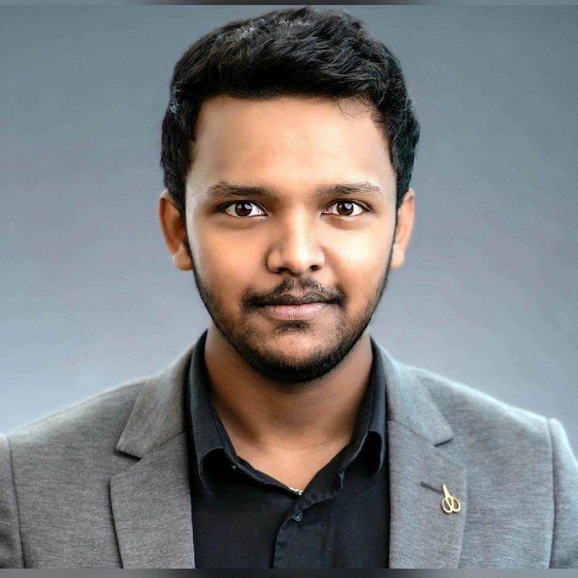

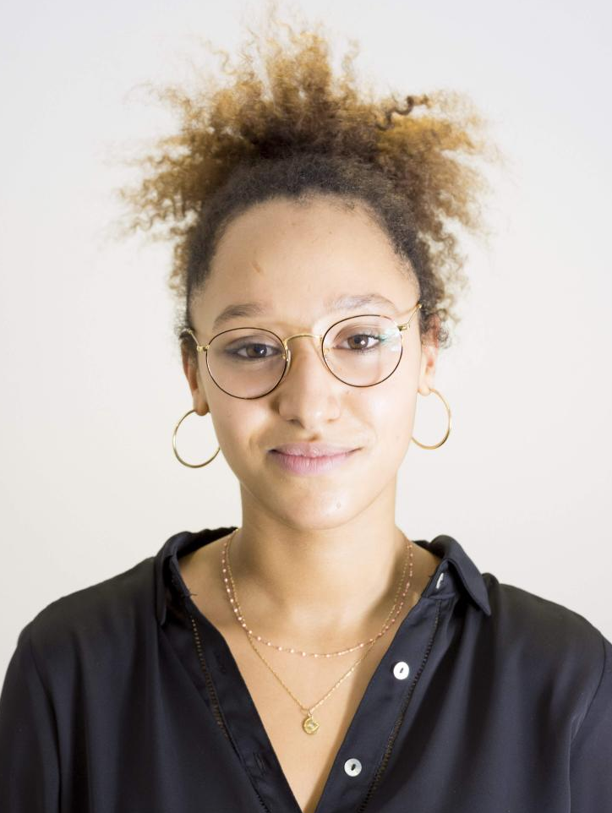
Our team
Jagan Galla
Rukmini Bugga
Julie Pronier
BIA
AAI
BIA

Slide 3
Table of contents
01
02
03
04
Introduction
Data
Motivations Problem Description
The Dataset EDA
Development
Conclusion
Methodology Results
Summary Demonstration

Slide 4
Introduction
In today's fast-moving digital world, our project uses advanced marketing and Generative AI to quickly create ads that grab attention and meet current needs, outperforming slower traditional methods in a competitive market.
Advertising is costly, especially for smaller businesses. Using Generative AI to automate content creation cuts costs and makes effective advertising more accessible, helping more businesses compete online.
Our project uses advanced marketing and Generative AI to quickly create ads that grab attention and meet current needs, outperforming slower traditional methods in a competitive market.

Slide 5
Problem Description
Capturing Attention: Traditional advertising struggles to keep up with the rapid changes in consumer interests and fails to consistently capture their attention.
Personalization Challenges: Manually creating ads that meet the varied preferences of a diverse audience is slow and not scalable, making it tough for especially smaller businesses to compete.
Using Consumer Data: There's a lot of consumer behavior data available, but many businesses don't have the tools to effectively use this data to enhance their advertising strategies.

Slide 6

02
Data
EDA notebook Link

Slide 7
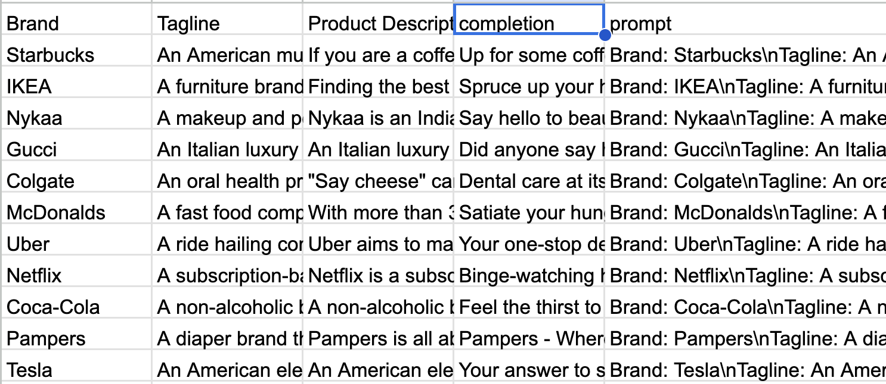
The Dataset
Description
Relevance
Columns
Shape
Brand: Starbucks\nTagline: An American multinational chain of coffeehouses that brews coffee for those who love it.\nProductDescription: If you are a coffee lover you know this beverage is not just a word but an emotion. Starbucks, an American multinational chain of coffee houses…

Slide 8
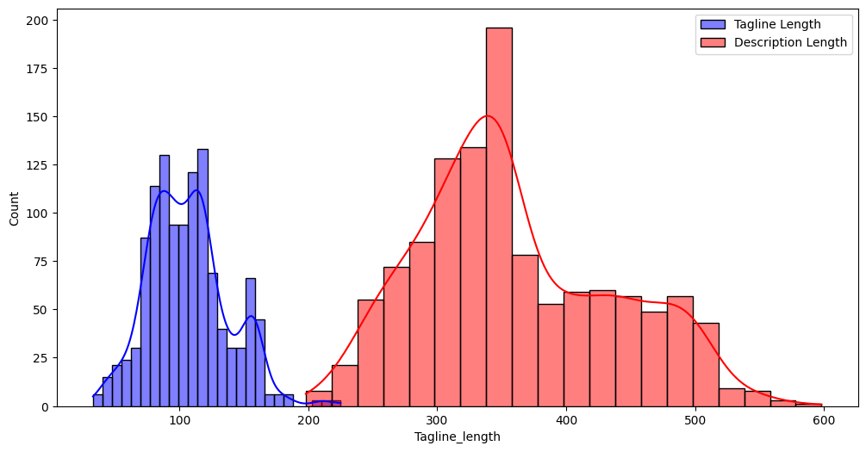
EDA
Text length distribution

Slide 9
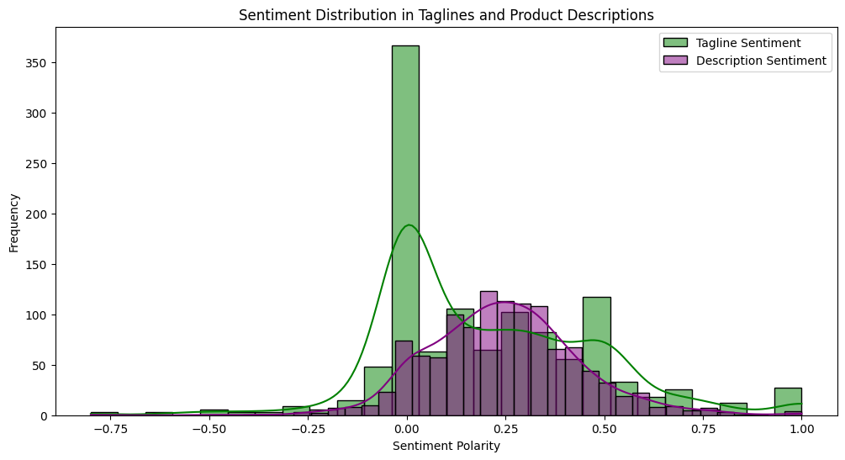
EDA
Sentiment Analysis

Slide 10
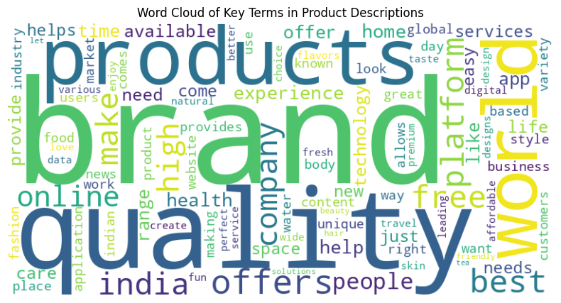
EDA
Keyword Extraction

Slide 11
03
Development
Demonstration

Slide 12
Thanks
Do you have any questions?
rbugga@stevens.edu
jgalla@stevens.edu
jpronier@stevens.edu
Please keep this slide for attribution

